Slide 1
Word Charades by Cosmik
Guess your favorite Hollywood Movies by selecting letters.
This project is a JavaScript-based Web Application. You are provided a fixed life per movie guess.
Features:
*Single Player Classic Feature
*Multiplayer Handoff Feature.
*Ability to choose difficulty level and turn sounds on and off.
Link: sarthi92.github.io/Word-Charades
Developed & Designed by:
SARTHI CHUGH
Team: Cosmik
Email: sarthi.chugh@gmail.com

Slide 2
Technology Stack
A Front End project based on:
HTML 5, CSS, JavaScript.
Custom Styles and Scripts.
Utilized Brackets Editor by Adobe.

Slide 3
Problems Solved
Ported a popular paper-based game to a paperless format.
Puzzle game to sharpen cognitive ability of players.
Implemented entire game as Single Page Application.
Removed AJAX and instead used JSON-like data, aka made the entire game as a downloadable standalone.

Slide 4
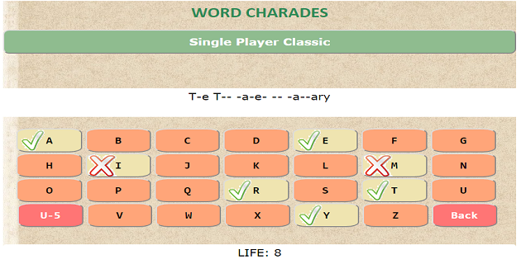
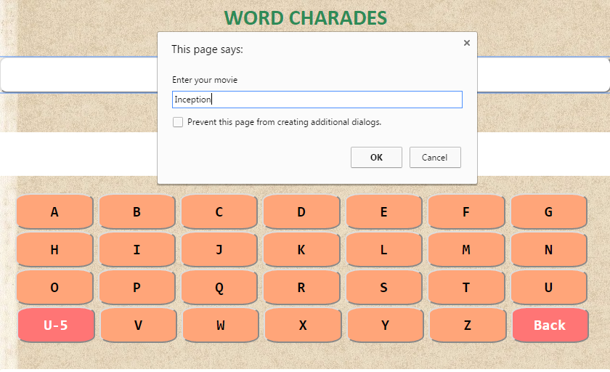
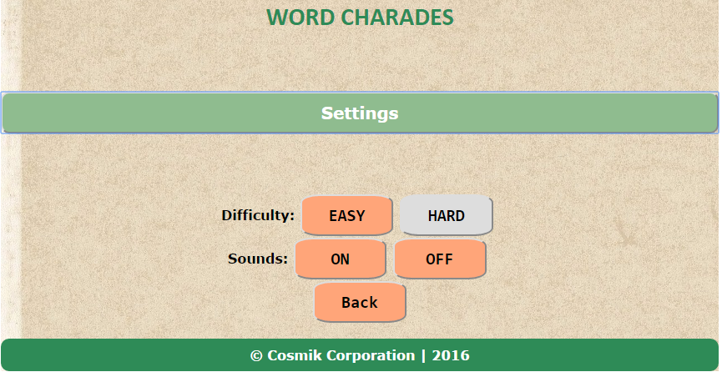
Demo Screenshots

Slide 5
Challenges Faced
Changing properties of multiple elements dynamically and simultaneously on a single page game.
Updating ‘immutable’ string placeholders for movies.
Added skill-factor in game by adding Unlucky-5 Low-life Strike-off Option

Slide 6
Future Scope
Adding skill factor by introducing a Pass option.
Adding Marathon Mode for time-constrained movie guessing.
Converting it into multi-platform game, namely Android, iOS, Windows Phone.

