Slide 1
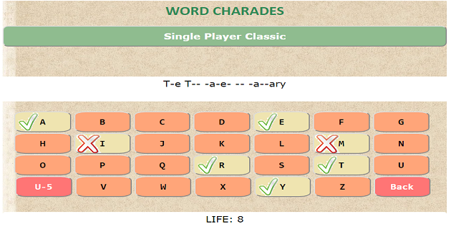
Word Charades
Guess your favorite Hollywood Movies by selecting letters.
This project is a JavaScript-based Web Application. You are provided a fixed life per movie guess.
Features:
*Single Player Classic Feature
*Multiplayer Handoff Feature.
*Ability to choose difficulty level and turn sounds on and off.
Link: sarthi92.github.io/Word-Charades
A Front End project based on:
HTML 5, CSS, JavaScript.
Custom Styles and Scripts.
Utilized Brackets Editor by Adobe.
By Cosmik (Sarthi Chugh)

