Slide 1
Directory Size Calculator – C++ CLI Application
Simulating a Virtual File System Using Object-Oriented Programming
Presented by: Sarthak Jain
Date: June 30, 2025
GitHub: github.com/sarthkjn/directory-size-calculator

Slide 2
Project Overview
This project simulates a simplified file system using object-oriented C++.
Implements real-world file system commands: 'cd', 'ls', 'size'
Uses recursive logic to compute directory sizes, including nested folders
Fully in-memory and self-contained — no reliance on the actual file system
Designed with performance, extensibility, and clean architecture in mind
Employs modern C++ features — including smart pointers ('std::unique_ptr') for memory safety
Demonstrates systems thinking, recursion, and modular software design.

Slide 3
Features
Fully in-memory virtual file system
Recursively calculates folder size
Object-oriented C++17 design
Smart memory management with ‘std::unique_ptr’
Seamless CLI navigation: ‘cd’, ‘cd ..’, ‘ls’, ‘size’, ‘exit’
Clean object-oriented architecture (File, Directory, FileSystem)
Extensible design — easy to add ‘mkdir’, ‘rm’, ‘touch’, etc.
CMake-based build system — portable and IDE-friendly
Includes unit tests for validation of size and navigation logic
Readable, maintainable codebase with clear separation of concerns

Slide 4
Folder Structure
directory-size-calculator/
├── include/ # Header files
│ ├── File.h
│ ├── Directory.h
│ └── FileSystem.h
├── src/ # Source files
│ ├── File.cpp
│ ├── Directory.cpp
│ ├── FileSystem.cpp
│ └── main.cpp
├── test/ # Unit tests
│ └── test_filesystem.cpp
└── README.md # Project documentation
└── CMakeLists.txt # CMake build config
├── /assets/ # Screenshots
│ ├─── cli-demo.png
│ └── test-demo.png

Slide 5
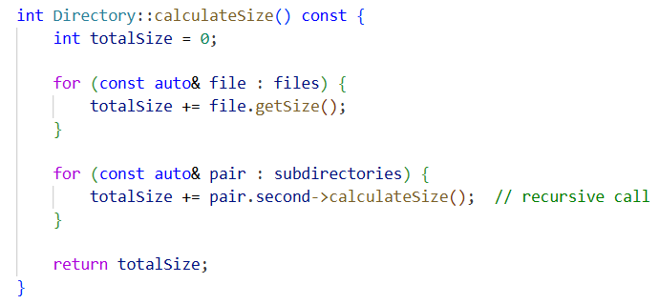
Core Logic – Recursive Size Calculation
Implementation
Why This Logic is Efficient & Elegant
Minimal Code
Time Complexity: O(N) where N = total files + folders
Easy to maintain and self-contained logic
No Redundancy: Each file and folder is visited exactly once
Memory-Safe: Subdirectories use std::unique_ptr – no manual cleanup
Functionality
This method calculates the total size of the current directory by:
Adding sizes of all files in the current directory
Recursively summing the sizes of all subdirectories
Visual Flow
root/
├── file1.txt (100)
└── docs/
└── doc1.pdf (300)
Total = 100 + docs->calculateSize() = 100 + 300 = 400

Slide 6
What Happens When You Run a Command?
User types: size
main.cpp receives command
FileSystem delegates to Directory
Directory recursively calls calculateSize() on its children
Final result bubbles back up and is printed to CLI
This is structured, layered, and testable command delegation.

Slide 7
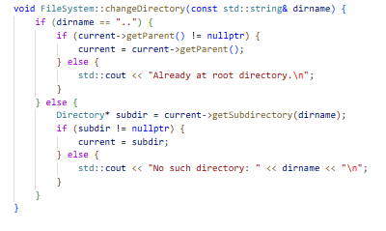
cd – Change Directory
What it does:
Navigate into a subdirectory using: cd <folder>
Navigate back using: cd ..
Maintains a pointer to the current directory ('current')
Handles invalid directories gracefully
Behind the Code:
Uses getParent() for cd ..
Uses getSubdirectory(name) for cd <folder>
Updates the 'current' pointer based on user input
Provides feedback if path is invalid

Slide 8
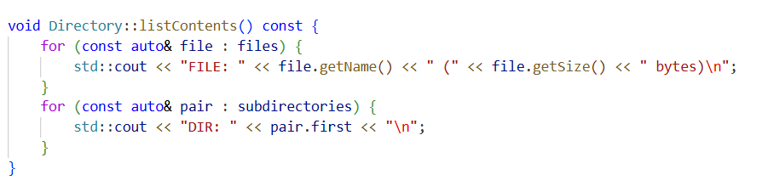
ls – List Directory Contents
What it does:
Displays files and subdirectories inside the current directory
Labels each item clearly: FILE vs DIR
Emulates Unix-like ls output in CLI
Behind the Code:
Iterates through ‘files’ vector → prints name + size
Iterates through ‘subdirectories’ map → prints name
Output is clean and structured for the CLI

Slide 9
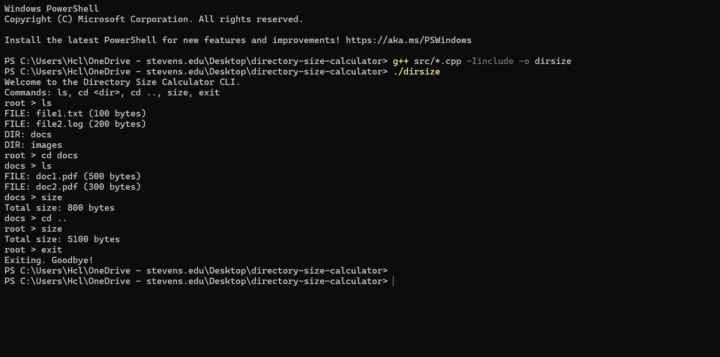
CLI Demo

Slide 10
Testing
Unit tests ensure correctness:
Tested cases:
- Root directory total size
- Subdirectory size (‘docs’)
- Command flow: ‘cd’, ‘cd ..’, ‘ls’, ‘size’
Written in: ‘test_filesystem.cpp’
Built separately via CMake or g++

Slide 11
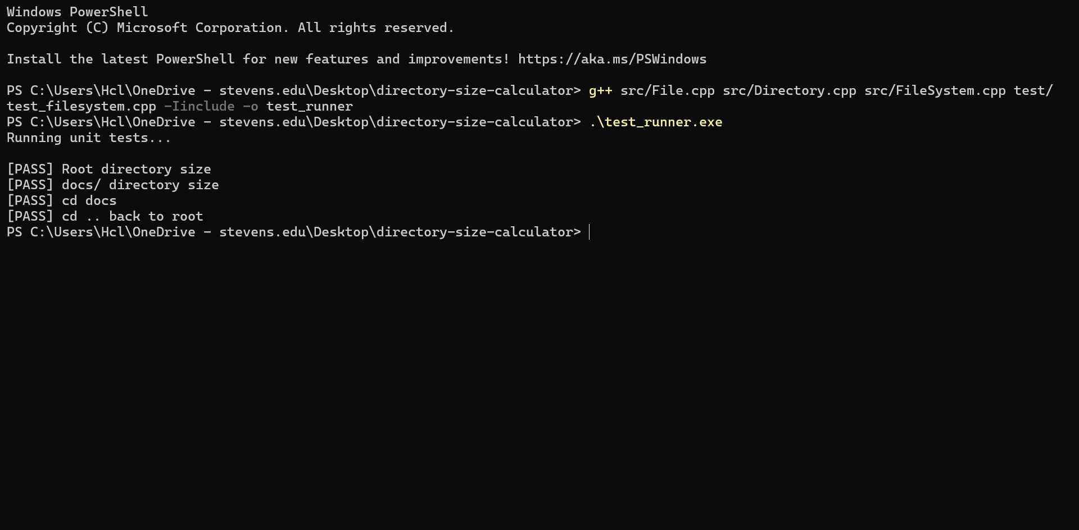
Testing

Slide 12
Design Decisions & Why They Matter
Feature | Design Choice | Benefit
Directory structure | Recursive composition using subdirectories | Naturally models hierarchical layout
Memory management | std::unique_ptr for subdirectories | RAII: no memory leaks or delete
File storage | std::vector<File> | Simple, fast iteration
Subdir lookup | std::map<string, unique_ptr<Directory>> | Log-time lookup, sorted by name
Navigation | parent pointer in Directory | Enables cd .. traversal upward

Slide 13
What Makes This Project Technically Impressive
Clean, recursive logic to handle nested directories
Object-oriented design with clearly separated responsibilities
Smart memory management using ‘std::unique_ptr’ — no manual delete
Efficient folder lookups using ‘std::map<string, unique_ptr<Directory>>’
Shell-like commands (‘cd’, ‘ls’, ‘size’) fully simulated in CLI
No disk access — all operations run in-memory, making it safe and fast
Designed to scale: more commands can be added with minimal refactoring
Tested thoroughly with edge cases (‘cd ..’, empty dirs, invalid names)
This isn't just code that works — it's code that’s been engineered.

Slide 14
What I Built – End to End
A fully navigable, CLI-based file system simulation in C++
Users can:
- Navigate through folders (‘cd’, ‘cd ..’)
- List directory contents (‘ls’)
- Calculate total size including subdirectories (‘size’)
Under the hood:
- Recursive traversal mirrors real file systems
- ‘File’, ‘Directory’, and ‘FileSystem’ classes handle logic cleanly
- All memory is managed safely using C++ smart pointers
- Data structures (‘vector’, ‘map’) chosen for clarity and performance
This project was designed, tested, and built to reflect how real systems work — while staying simple, readable, and extensible.

Slide 15
Conclusion
This project is more than just a working application — it's a showcase of thoughtful design, clean architecture, and real-world software principles.
Recursive logic was used to mirror the depth of directory hierarchies
Smart pointers (‘std::unique_ptr’) ensured memory safety throughout
Each class serves a single responsibility, making the code maintainable
The project was structured with scalability, testing, and readability in mind
Every design decision was made with intent — to write clean, robust, and scalable code.
This isn't just a program. It's a demonstration of how I think, how I build, and how I solve real-world engineering problems.
GitHub: (https://github.com/sarthkjn/directory-size-calculator)
Thank you! Happy to take any questions.

