Slide 1
SUN'IY INTELLEKT ASOSIDA
QIMMATBAHO METALLAR
BOZORINI TAHLIL QILISH
VA BASHORATLASH TIZIMI
AI
Oltin (XAUUSD) misoli asosida
Yo'nalish: Machine Learning • Deep Learning • RL

Slide 2
MUAMMO:
Nima uchun tizim zarur?
📈 Narx o'zgaruvchanligi
📊 Tahlil murakkabligi
Oltin narxi daqiqada o'zgarib turadi. An'anaviy usullar buni to'liq qamrab olmaydi.
Makroiqtisodiy omillar, geopolitika va sentiment birdaniga ta'sir ko'rsatadi.
⏱️ Kechikish muammosi
❌ An'anaviy modellar cheklangan
Inson tahlilchilari real vaqtda reaksiya ko'rsata olmaydi — bozor imkoniyatlari yo'qoladi.
Statistik usullar (ARIMA va boshqalar) murakkab nochiziqli pattern larni aniqlamaydi.
💡 Yechim: Sun'iy intellekt yordamida real vaqtda tahlil qiluvchi va bashorat qiluvchi tizim yaratish

Slide 3
LOYIHA MAQSADI
Nima yaratmoqchimiz?
01
Narx bashorati
CNN+LSTM modeli yordamida kelajak narxini real vaqtda bashorat qilish
02
Savdo signallari
Buy / Sell / Hold signallarini avtomatik yaratish (RL agent)
03
Sentiment tahlili
Yangiliklar va ijtimoiy media ma'lumotlarini Transformer orqali tahlil qilish
04
Trading bot
Telegram orqali real vaqtda signal yuboruvchi bot yaratish

Slide 4
BOZOR HAQIDA
Oltin bozori — global ko'lam
$13T+
$183B
48%
24/5
Jahon oltin bozori
Kunlik savdo hajmi
So'nggi 5 yil o'sishi
Bozor ishlash rejimi
Asosiy ta'sir omillari
💵 AQSh dollari kursi
📈 Inflyatsiya darajasi
🏦 Markaziy bank siyosati
⚔️ Geopolitik keskinlik
📊 Risk kamaytirish talabi

Slide 5
MA'LUMOTLAR MANBAI
Data Sources & Time Series
MetaTrader 5 (MT5)
Dataset
API orqali real vaqtda ma'lumot olish
Tarixiy OHLCV data (yillar davomida)
Timeframe: M1, M5, H1, H4, D1
Symbol: XAUUSD (Spot Gold)
~500,000+ qatorlar
2015–2024 yillar
1-daqiqalik ma'lumot
Asosiy ustunlar (Features)
Ustun | Tur | Tavsif
Date/Time | datetime | Timestamp
Open | float | Ochilish narxi
High | float | Eng yuqori narx
Low | float | Eng past narx
Close | float | Yopilish narxi
Volume | int | Savdo hajmi (tik)

Slide 6
MA'LUMOTLARNI TOZALASH
Data Preprocessing Pipeline
01
Missing Values
02
Outlier Detection
Forward fill (ffill) metodi
Weekend oraliqlarini interpolatsiya
Bayram kunlari: O'chirish yoki to'ldirish
IQR (Interquartile Range) metodi
Z-score: |z| > 3 → outlier
Flash crash hodisalarini aniqlash
03
Normalizatsiya
04
Sequence Generation
Min-Max Scaling: [0, 1]
Standard Scaler: μ=0, σ=1
Close narxi uchun Log-return
Sliding window: 60 qadam
Train/Val/Test bo'lish
Temporal ordering saqlash

Slide 7
FEATURE ENGINEERING
Texnik Indikatorlar
EMA
Exponential Moving Average
RSI
Relative Strength Index
EMAₜ = α × Pₜ + (1−α) × EMAₜ₋₁
RSI = 100 − 100/(1+RS)
📌 Trend yo'nalishini aniqlash
📌 Overbought/Oversold holati
EMA9, EMA21, EMA50, EMA200
Davr: 14 | Range: 0–100
MACD
Moving Average Convergence Divergence
ATR
Average True Range
MACD = EMA12 − EMA26
ATR = EMA(True Range, n)
📌 Momentum va signal chiziq
📌 Volatillik o'lchovi
Signal: EMA9 | Histogram
Davr: 14 | Stop-loss hisob

Slide 8
MODEL ARXITEKTURASI
Hybrid AI System
CNN + LSTM
PPO Agent
Transformer
Price Prediction
Reinforcement Learning
Sentiment Analysis
Vaqt qatorlaridan pattern aniqlash va kelajak narxini bashorat qilish
Buy/Sell/Hold qarorlar qabul qiluvchi RL agenti
Yangiliklar matni va Twitter sentimentini tahlil qilish
🔗 Ensemble → Final Trading Signal

Slide 9
CNN + LSTM
Narx Bashorat Modeli
CNN — Pattern Aniqlash
Model Tuzilmasi
1D Convolutional layers
Narx pattern larini local feature sifatida olish
MaxPooling — muhim xususiyatlarni saqlash
Input Layer
[batch, 60, features]
Conv1D (64 filters)
kernel=3, ReLU
MaxPooling1D
LSTM — Vaqt Seriyasini O'rganish
pool_size=2
Long Short-Term Memory hujayralari
Uzoq muddatli bog'liqlikni saqlash
Input: 60 vaqt qadami (window=60)
Output: Keyingi narx bashorati
LSTM (128 units)
return_sequences=True
LSTM (64 units)
Dropout=0.2
Dense Output
Linear activation

Slide 10
REINFORCEMENT LEARNING
PPO Agent — Savdo Qarori
🌍 Environment
🤖 PPO Agent
⚡ Action
Bozor holati
(OHLCV, indicators)
Policy Network
(Actor + Critic)
BUY
SELL
HOLD
State Space
🏆 Reward Function
PPO Xususiyatlari
Portfolio holati
Texnik indikatorlar
Ochiq pozitsiyalar
P&L (unrealized)
Foyda/Zarar → Reward signal
Clipped objective function
ε = 0.2 (clipping range)
Actor-Critic arxitektura
Stable Baselines3 kutubxonasi
10 / 20

Slide 11
SENTIMENT TAHLILI
Transformer — NLP Model
Ma'lumot manbalari:
📰 Reuters
📱 Twitter/X
💬 Reddit
🏦 Fed Speeches
Pipeline:
1
Text Preprocessing
Tokenization, Lowercasing, Stop-words
2
FinBERT Model
Finance-specific BERT (Pretrained)
3
Sentiment Score
Positive / Neutral / Negative [−1, 1]
4
Feature Integration
CNN+LSTM model ga qo'shish

Slide 12
AI PIPELINE DIAGRAMMASI
Input → Process → Output
Raw Data
(MT5)
Preprocessing
Feature Eng.
CNN
+LSTM
PPO
Agent
Signal
Output
OHLCV
Clean + Norm
EMA/RSI/MACD
Price Prediction
RL Decision
Buy/Sell/Hold
Sentiment Stream:
News/Twitter
FinBERT NLP
Sentiment Score
→ CNN+LSTM ga integratsiya
✅ Final Output
Narx bashorati + Savdo signali + Telegram xabar → Foydalanuvchi
CNN+LSTM narx → PPO qaror → Ensemble signal → Telegram Bot → BUY/SELL/HOLD

Slide 13
MODELNI O'QITISH
Training Pipeline
Dataset Bo'lish
Hyperparameters
Batch size: 64 | Epochs: 100
Learning rate: 0.001 (Adam)
Dropout: 0.2 | Window: 60
Train 70%
Validation 15%
Test 15%
2015–2020: Train | 2021: Val | 2022–2024: Test (Out-of-sample)

Slide 14
MODEL BAHOLASH
Evaluation Metrics
87.3%
84.1%
85.7%
Precision
Recall
F1-Score
TP / (TP + FP)
TP / (TP + FN)
2 × (P × R)/(P + R)
To'g'ri bashorat qilingan signallar nisbati
Haqiqiy signallarni aniqlash darajasi
Precision va Recall o'rtacha ko'rsatkichi
Boshqa Ko'rsatkichlar
RMSE (Price prediction) | 12.4 USD
MAE | 8.7 USD
Sharpe Ratio (RL) | 1.82
Max Drawdown | −14.2%

Slide 15
NATIJALAR
Prognoz & Savdo Natijalari
6500
5500
4500
3500
2500
243
198
87.3%
+38.4%
BUY signallari
SELL signallari
To'g'ri signallar
Yillik foyda (backtest)

Slide 16
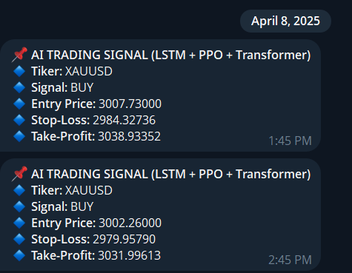
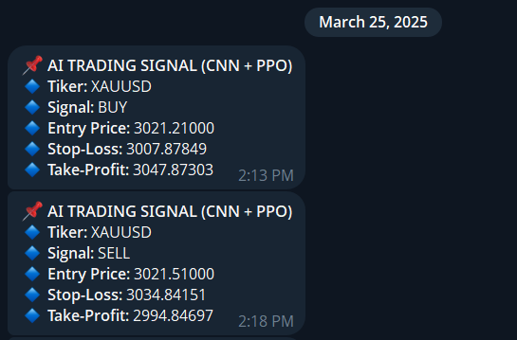
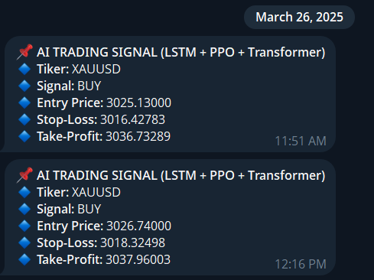
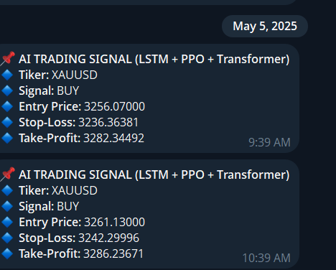
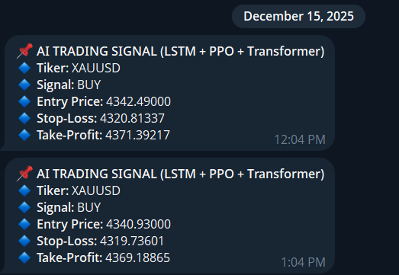
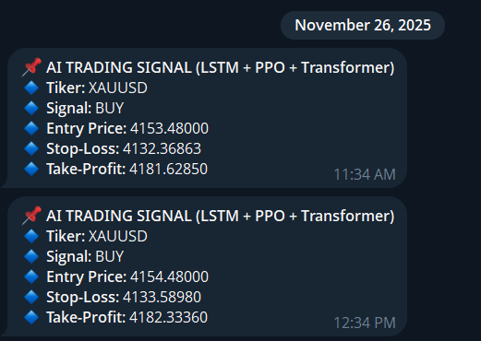
Telegramdan berilgan signallar

Slide 17
AFZALLIKLARI
Tizimning Kuchli Tomonlari
⚡
< 50ms
🧠
3 AI
📈
87.3%
Tezkor Real-Time Tahlil
Ko'p modellik yondashuv
Yuqori Aniqlik
Millisekundlarda qaror qabul qilish — inson tezligidan 1000x tez
CNN+LSTM + RL + NLP — uch xil AI tizim birgalikda ishlaydi
87%+ precision — an'anaviy modellardan sezilarli ustunlik
🔄
24/5
📊
Multi
🎯
Smart
Avtomatlashtirish
Keng Ma'lumot Tahlili
Risk Management
24/5 to'xtovsiz monitoring va savdo — charchamaydi, xato qilmaydi
Narx, hajm, sentiment va makro ko'rsatkichlarni birgalikda tahlil
Avtomatik Stop-loss va position sizing bilan kapital himoyasi

Slide 18
XULOSA
AI Trading — Kelajak
🏆 Asosiy natija:
CNN+LSTM + PPO + Transformer yondashuvi oltin bozorini 87.3% aniqlik bilan bashorat qildi va yillik 38.4% daromad ko'rsatdi.
Rivojlantirish Yo'llari:
🌐
🧬
☁️
📡
Ko'proq metallar
Model yaxshilash
Cloud deployment
Alternative data
Kumush (XAGUSD), Platina, Mis qo'shish
Transformer + Attention mexanizmi to'liq qo'llash
AWS/GCP da real production serveri
Satellite, on-chain, options flow ma'lumotlari
"Sun'iy intellekt moliya bozorini demokratlashtiradi — katta investorlar va kichik treyderlar uchun teng imkoniyat."

Slide 19
E’TIBORINGIZ UCHUN RAHMAT!
📊 Data Science / AI | 🥇 Gold Market Analysis | 🤖 AI Trading System

