Slide 1
Rotation summary
Spring 2016 rotation

Slide 2
Enhancer
Gene
Gene
Enhancer
Enhancer
?
?
→What is the most “effective” manner for assigning distal peaks to genes?

Slide 3
Potential methods
eQTLs
Chromosome capture (ChIA-PET / HiC / 5C / etc)

Slide 4
eQTLs
Enhancer
Gene
C
Enhancer
Gene
T

Slide 5
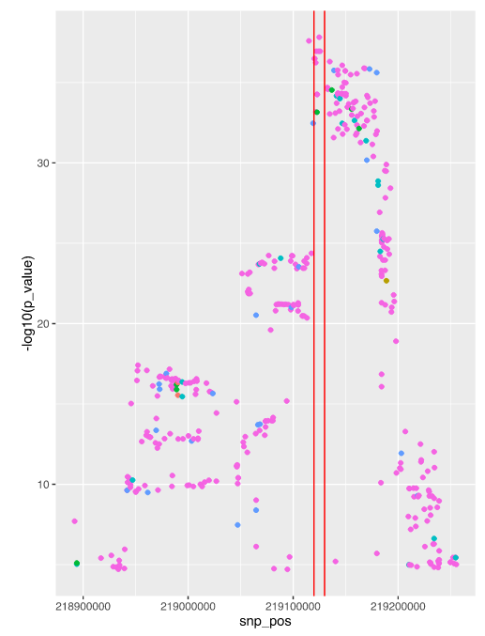
GTEx

Slide 6
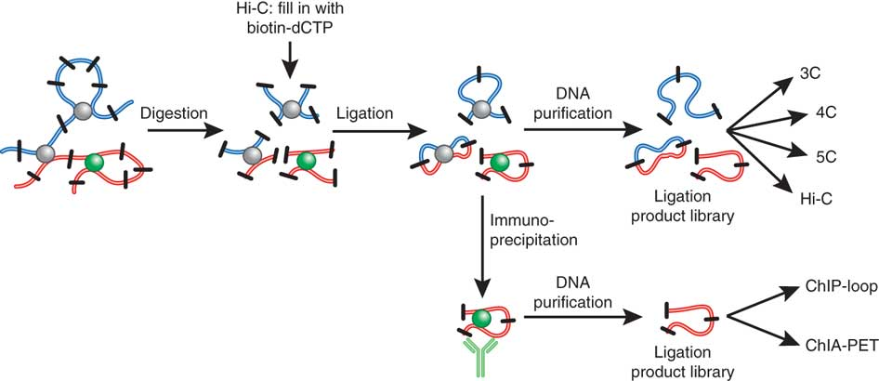
ChIA-PET
Steensel and Dekker 2010. Genomic tools for unraveling chromosome architecture (Nature)

Slide 7
ChIA-PET data sources
ENCODE
  3x Pol2
  2x CTCF
  3x histone marks -- H3K4me1, H3K4me2, H3K4me3
  1x Rad21
Young lab
  2x Cohesin (hESCs)
Ruan lab (recent publication)
  2x CTCF (GM12878, HeLa)
  1x Pol2 (HeLa)
Notes:
Mention also how they were processed. ENCODE: I processed with Mango. Young: old version of Mango. Ruan: less statistically stringent one. Ruan data is very deeply sequenced, great resolution

Slide 8
Expanding enhancer lists
Currently FANTOM5
  Bi-directional transcription, CAGE
  (Extended to 2kb)
ChromHMM (ENCODE)
  9 cell types
DNase-seq (ENCODE)
  125 cell types

Slide 9
ChromHMM enhancers
DNase
Chromhmm.0
Chromhmm_dnase.0
Chromhmm.2000
Chromhmm_dnase.2000

Slide 10
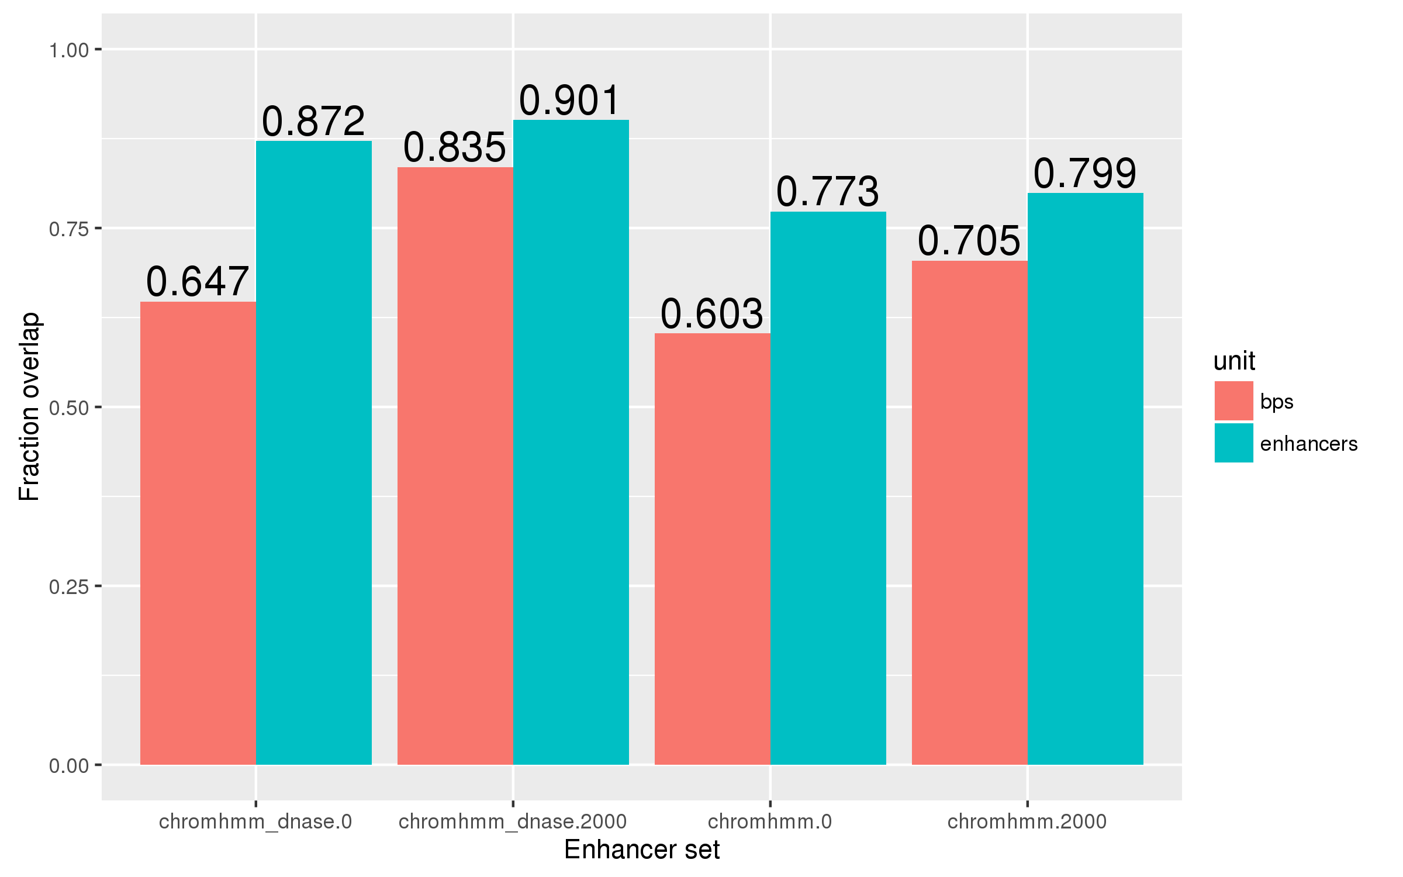
Overlap between old and new
→ e.g., 90.1% of the FANTOM5 enhancer set overlap with at least one of the chromhmm_dnase.2000 set

Slide 11
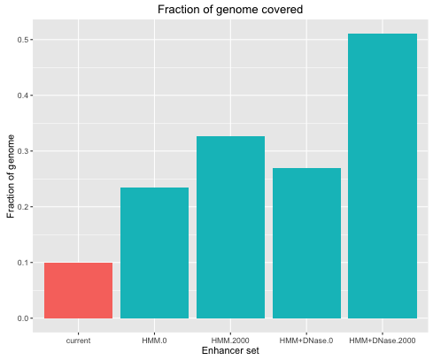
Total genome coverage

Slide 12
Linking genes to enhancers
Enhancer
Gene
“Point-to-point” (P2P)

Slide 13
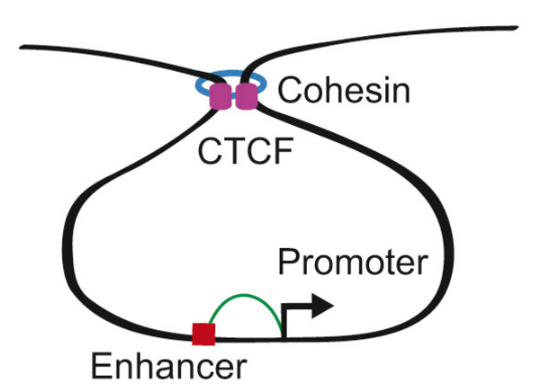
Ji et al 2016 – 3D chromosome regulatory landscape of human pluripotent stem cells

Slide 14
Linking genes to enhancers
Enhancer
Enhancer
Gene
“Encompassing” (E)
(CTCF/Cohesin ChIA-PET only)

Slide 15
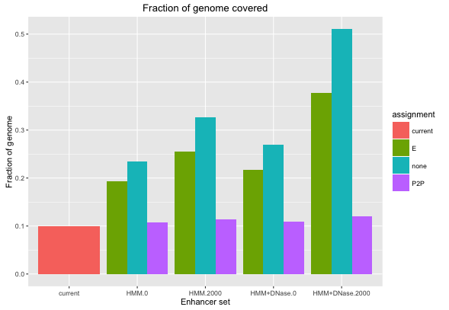
Total genome coverage

Slide 16
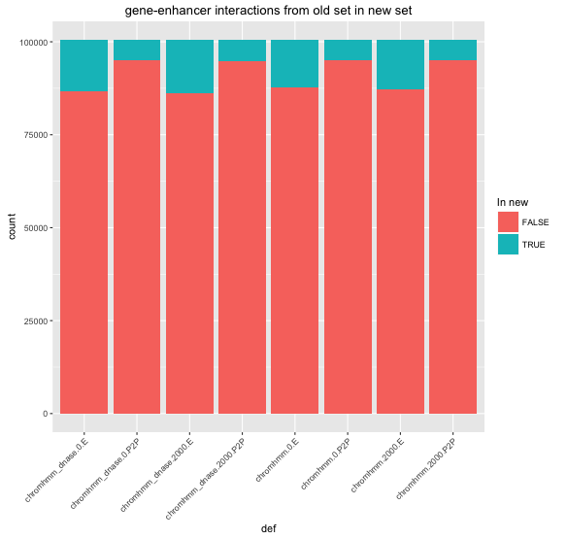

Slide 17
How well do these definitions capture peaks?

Slide 18
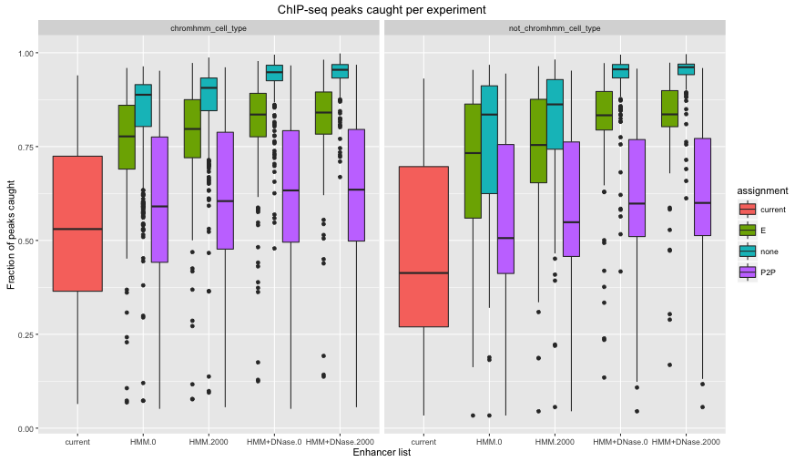
Notes:
Left pane: When cell type of chromHMM and TF match. Right pane: When cell types differ.

Slide 19
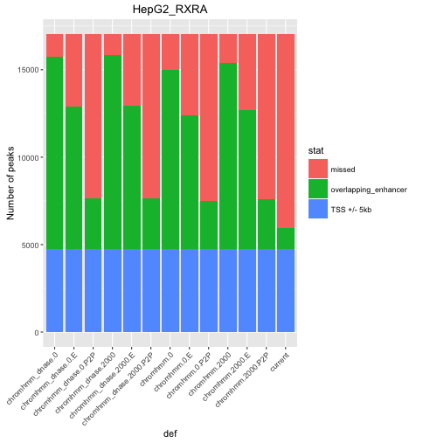
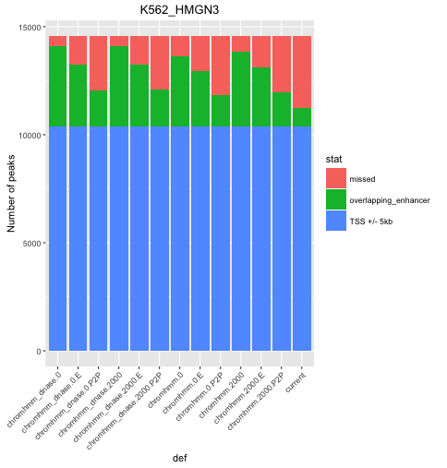

Slide 20
Chipenrich

Slide 21
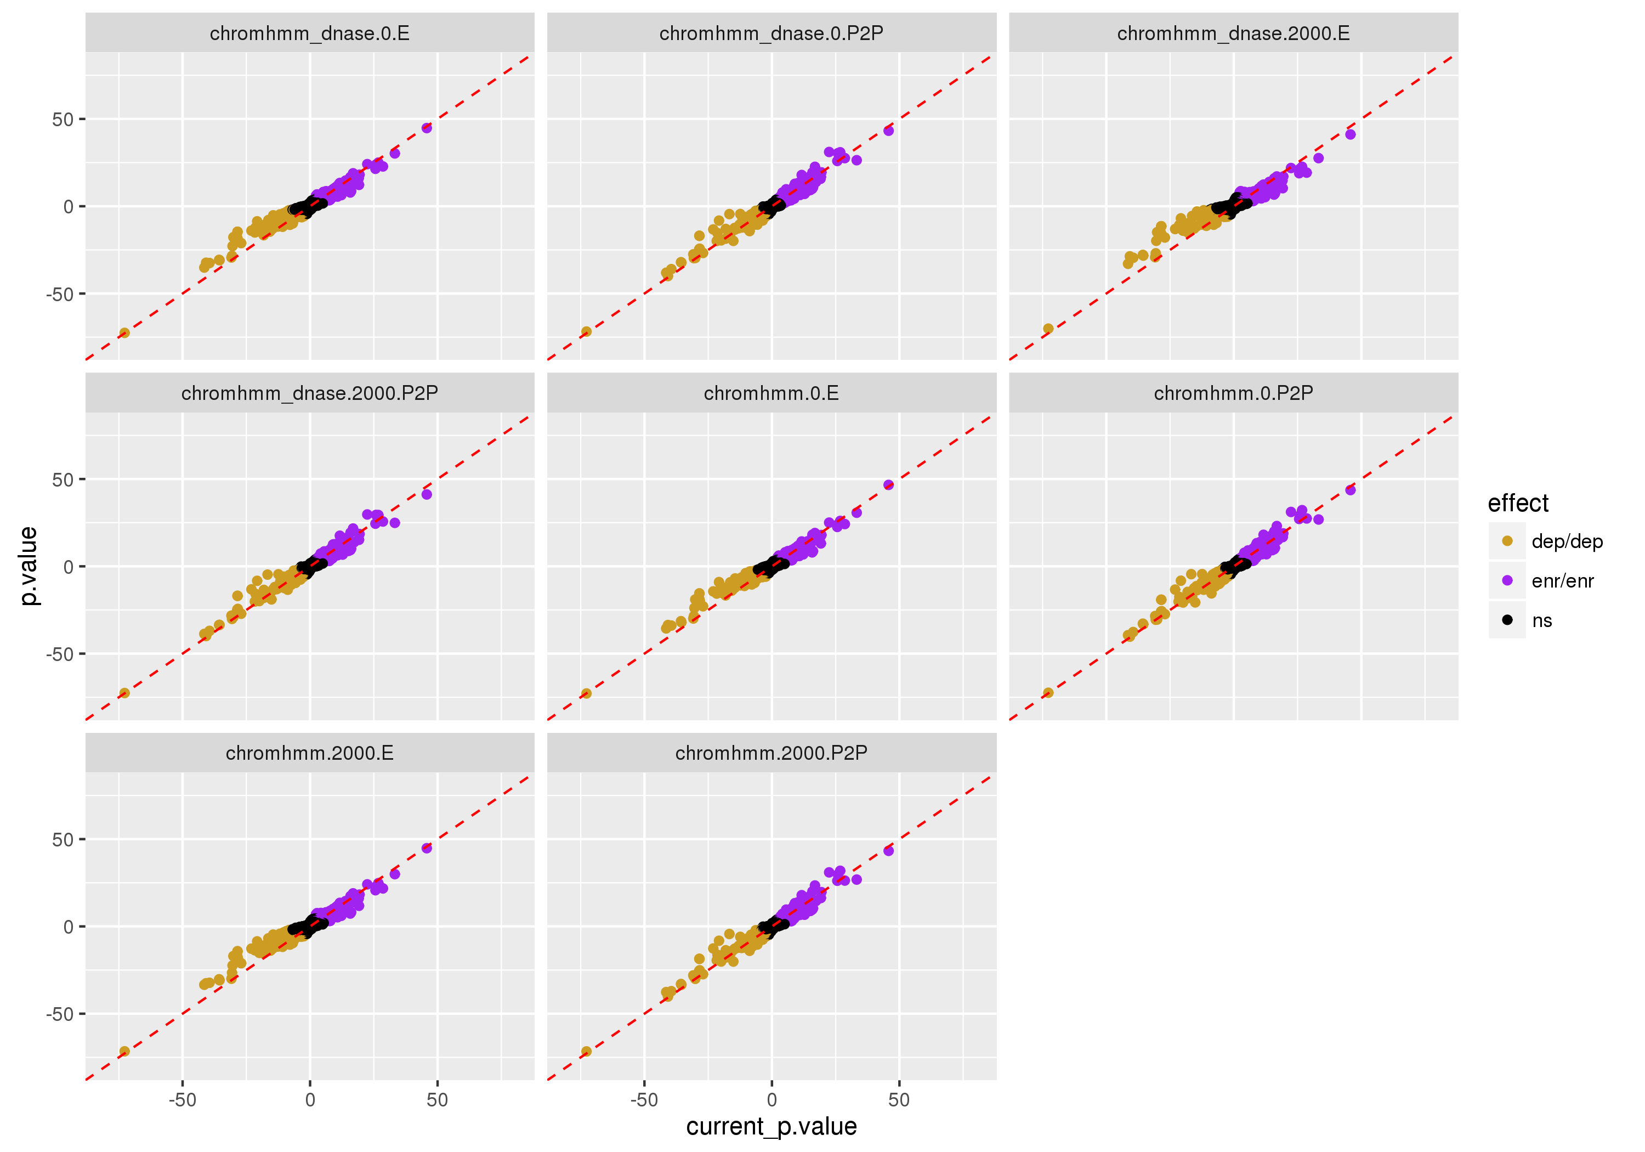
Notes:
Generally, ’E’ does more poorly. This may indicate that looping-based models don’t do as well, which would advise against using TADs…

Slide 22
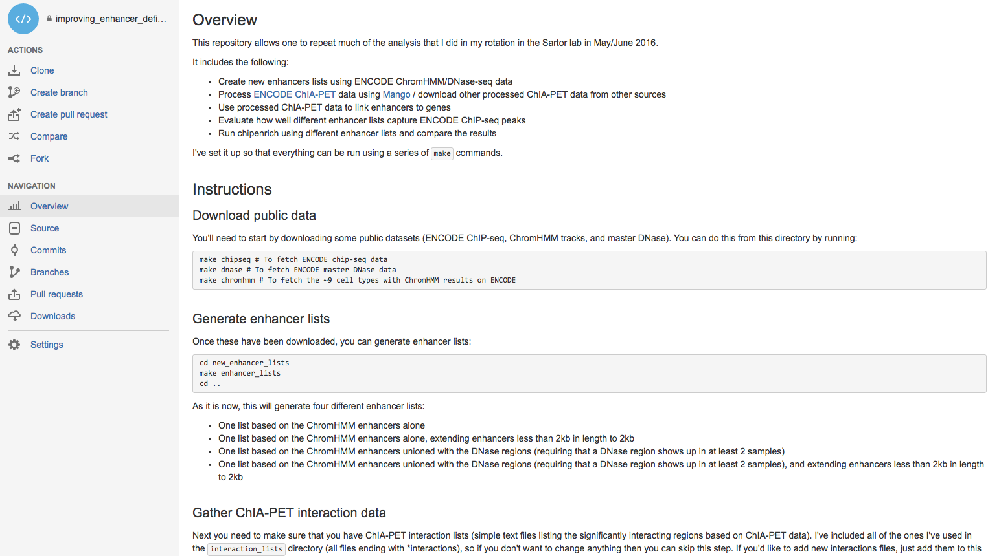

Slide 24
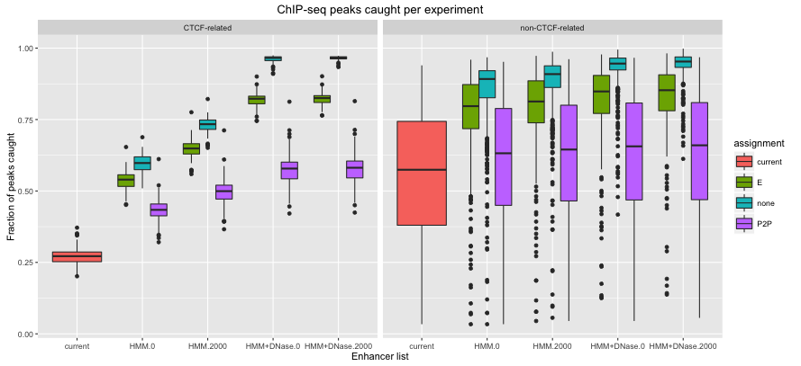
Peak catching

