Slide 1
Digital Security Cryptographic Principles and Secure Communication
Adrian Tasistro-Hart

Slide 2
Outline
Security vs privacy
Cryptography:
Overview
Symmetric key encryption
Asymmetric key encryption
Signing and authentication
Hands on tutorial
In practice
Slack (and others) vs Signal

Slide 3
Security vs Privacy
This teach-in is about security (specifically in communication), which can contribute to but is different from privacy
Security is about protocols, mechanisms, algorithms, technology, etc. that control the flow of information between parties as well as its storage
Privacy is about maintaining the anonymity of those parties and controlling the flow of individually identifying information
In a nutshell:
Security protects information
Privacy protects identity

Slide 4
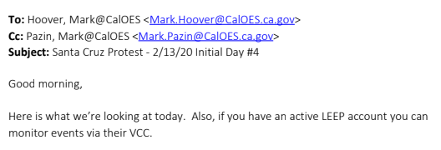


Cryptography
“The study and practice of secure communication.”
“Secure” implies the presence of adversarial eavesdroppers
Modern eavesdroppers include:
Surveillance states
Police forces
Intelligence agencies
Foreign nations
Data-hungry corporations
Notes:
LEEP: Law Enforcement Enterprise Portal
VCC: Virtual Command Center
Information sharing platform between law enforcement agencies, FBI
Police are listening; don’t let them hear!

Slide 5
Aspects of Cryptography
Secure communication entails a several aspects:
Encryption:
Is your communication confidential?
Authentication:
Can you verify who sent you a message?
Signing:
Can you demonstrate to others that you sent a message?

Slide 6
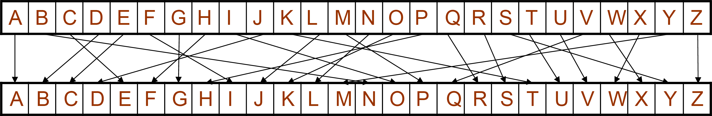
Brief Description of Encryption
Encryption is based on keys
If you know the key, you can read the message. Anybody without the key shouldn’t be able to.
Examples:
Character shift
I love encryption → J mpwf fodsxqujpo
Key is just the character shift, in this case, 1
Character permutation
I love encryption → O jkqc clesmhuokl
Key is the character permutation

Slide 7
Modern Encryption
Previous examples are not secure
Character permutations are easily determined from letter occurrence probability tables
Not clear how to encrypt digital data (0’s & 1’s)
English | e | t | a | o | i | n | s | h | r | d | l | c | u | m | w | f | g | y | p | b | v | k | j | x | q | z
 | 12.70% | 9.06% | 8.17% | 7.51% | 6.97% | 6.75% | 6.33% | 6.09% | 5.99% | 4.25% | 4.03% | 2.78% | 2.76% | 2.41% | 2.36% | 2.23% | 2.02% | 1.97% | 1.93% | 1.49% | 0.98% | 0.77% | 0.15% | 0.15% | 0.10% | 0.07%

Slide 8
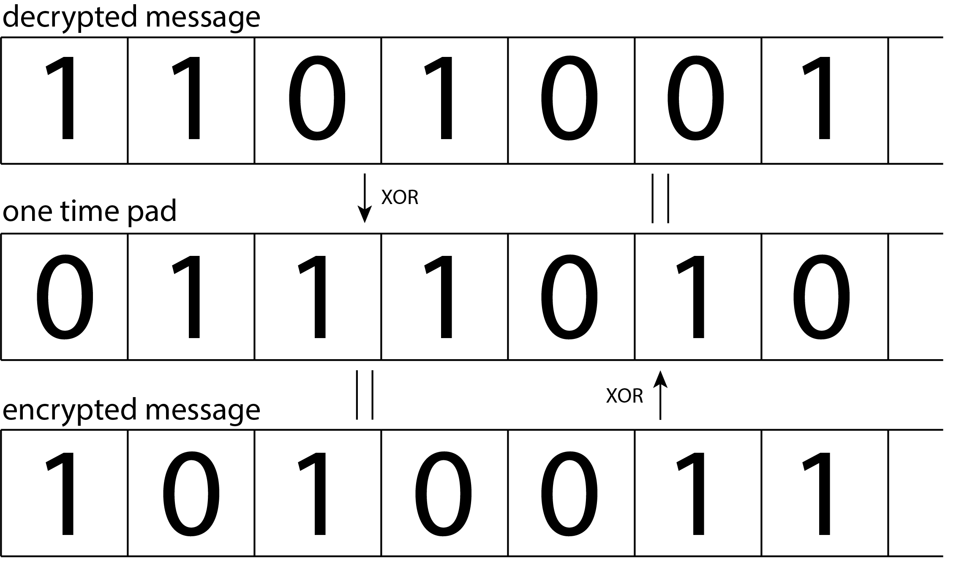
Modern Encryption
One-time pad
Key is a “pad” as long as the message itself
Key is randomly generated
Use XOR to encrypt and decrypt
Pros:
Most secure type of encryption
Cons:
Can only use pad once
Pad must be as long as the message
not useful for things like Zoom or Netflix
Notes:
Can only use pad once because if an adversary knows the encrypted and decrypted messages, they can recover the pad using XOR

Slide 9
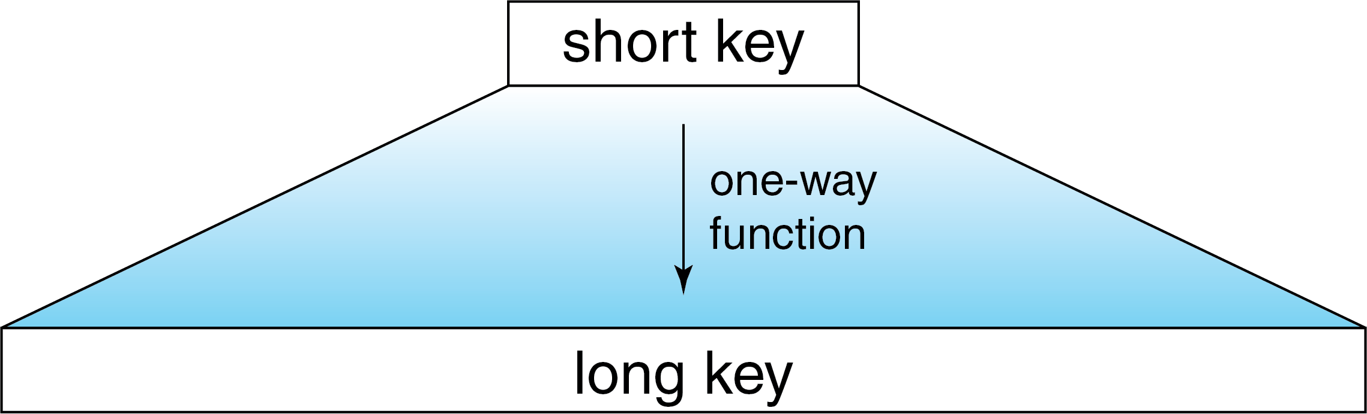
Modern Encryption
In reality, we need keys to be shorter than one-time pads
Introducing: One-way functions
Basic idea is to use a short key to make a long key
The long key then works as a one-time pad for encryption
One-way means that even if an adversary learns the long key, they will not know the short key

Slide 10
Modern Encryption
Caveats/complications to ponder
We must generate a unique long key each time the short key is used
otherwise adversary wins by just deciphering a single long key
The long key must be the same length as our messages, which are not always the same length

Slide 11
Modern Encryption
Aside: Password management
One-way functions are how passwords are managed on most (secure) websites
When you type in your password, the website computes and saves the “hash” of your password
That way, if they’re hacked, hackers only have the hashed versions, not the original passwords
This matters because it’s practically impossible to figure out the password from its hash

Slide 12
Modern Encryption
Aside: Password management
This matters because it’s practically impossible to figure out the password from its hash
The above is only true if your password is long enough
Remember: the point of one-way (e.g., hash) functions is so that from the output, it’s impossible to know the input
BUT: Hackers can (and do) still try to guess which input (i.e., password) generated the output (i.e., password hash)

Slide 13
Modern Encryption
Aside: Password management
Takeaway: You need complicated passwords.
>16 characters
Including numbers, letters, special characters
But how am I meant to remember all of these stupidly complicated passwords?
Use a password manager!
Password managers store all your passwords securely so you don’t have to remember them.
You only have to remember one really strong password to open the manager.
KeePass is a free, open source, and cross platform (including mobile) password manager that can even generate strong passwords for you.

Slide 14
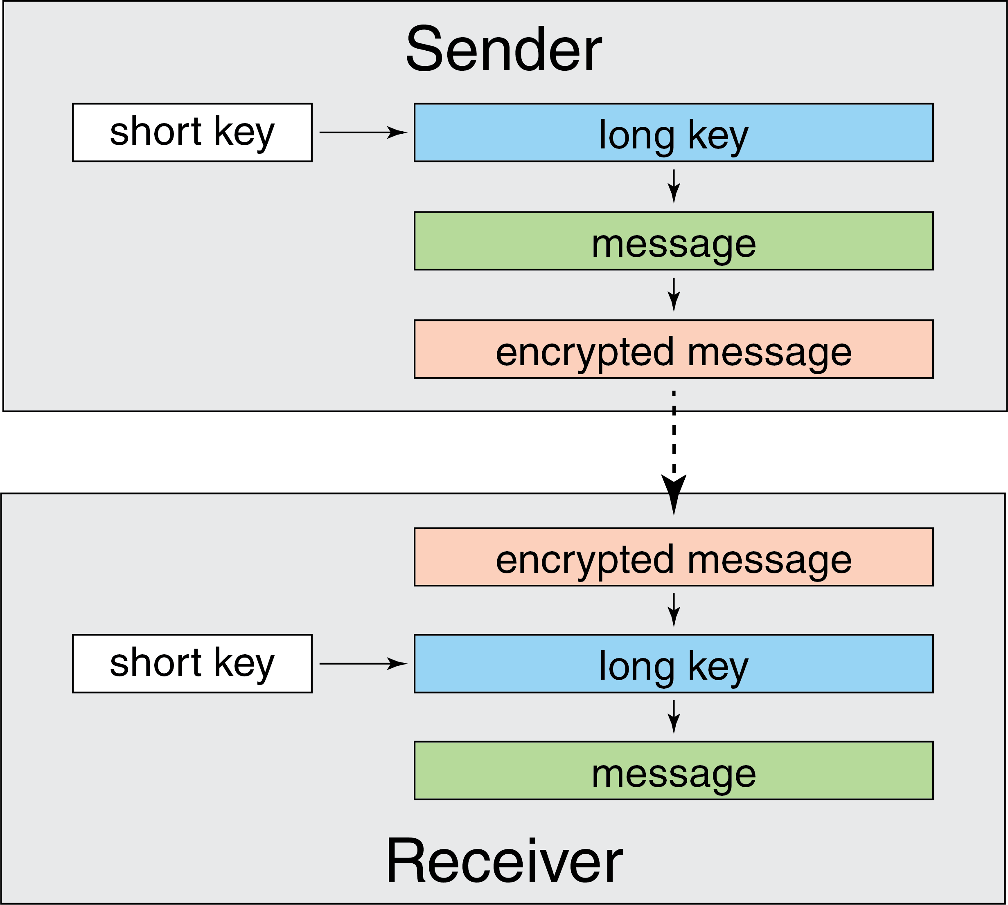
Symmetric key encryption
Encryption/decryption procedure described so far is known as symmetric key encryption
Symmetric means that sender and receiver both must know the same short key
But how do you securely communicate the short key…?

Slide 15
Asymmetric key encryption
Problem solved with asymmetric key encryption
Now, each party has 2 paired keys
Private: this key is kept secret (important)
Public: this key must be available to anybody you want to communicate with
These keys only work with each other
How does it work?

Slide 16
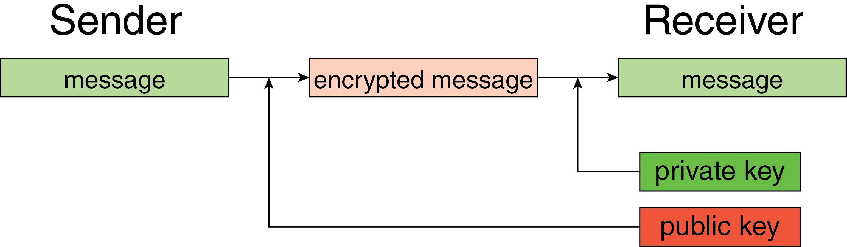
Asymmetric key encryption
Sender uses receiver’s public key to encrypt a message
Encrypted message can only be decrypted with receiver’s private key

Slide 17
Asymmetric key encryption
Revolutionary idea (thanks Diffie and Hellman)
Diffie, W., & Hellman, M. (1976). New directions in cryptography. IEEE Transactions on Information Theory, 22(6), 644–654. https://doi.org/10.1109/TIT.1976.1055638

Slide 18
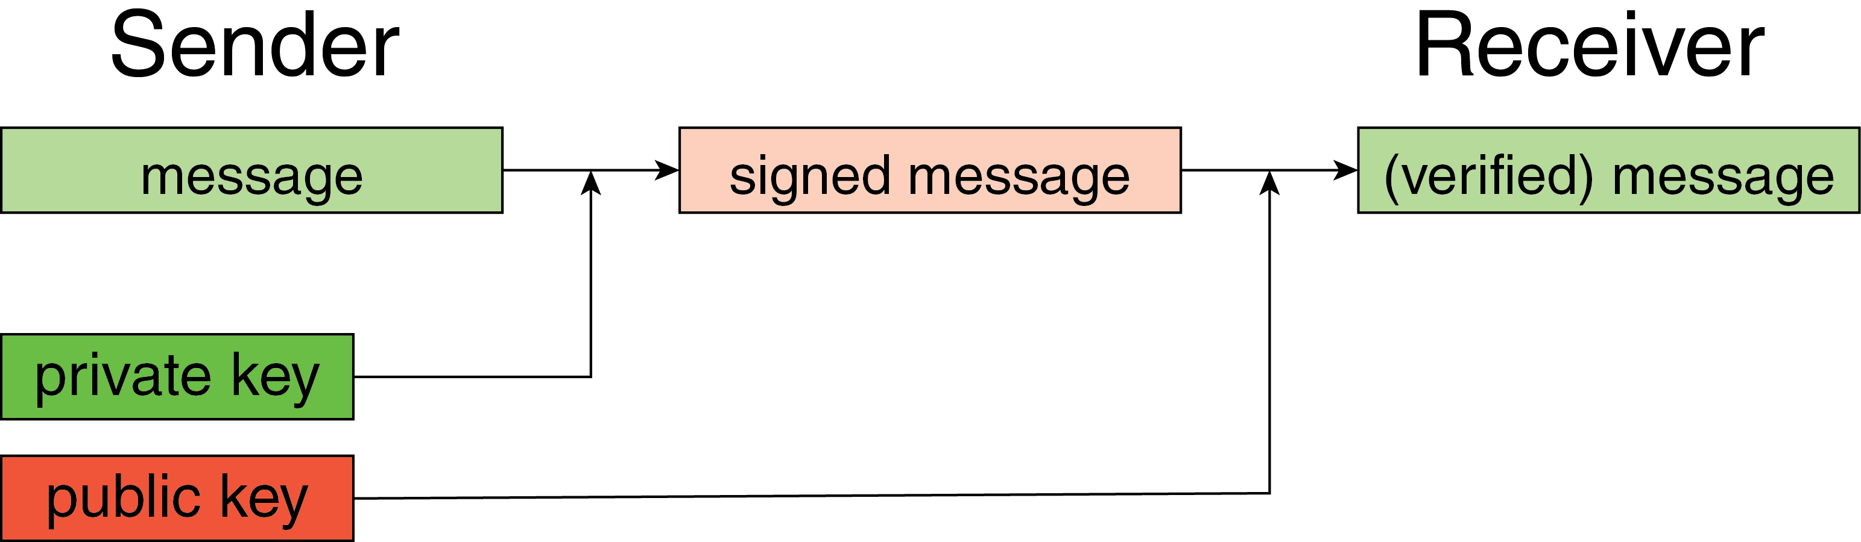
Signing and authentication
Asymmetric key (aka public key) cryptography permits many other forms of digital security in addition to confidentiality
Signing:
Ability of sender to prove that they sent a message
Performed by encrypting message with private key
Authentication:
Ability of receiver to verify who sent a message
Performed by decrypting signed message with sender’s public key
Notes:
NOT confidential (because anybody can read the message), but it is still secure in the sense of authentication.

Slide 19
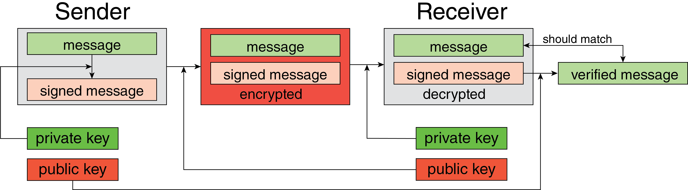
Public key cryptography
In practice, we want to use encryption, signing, and authentication simultaneously

Slide 20
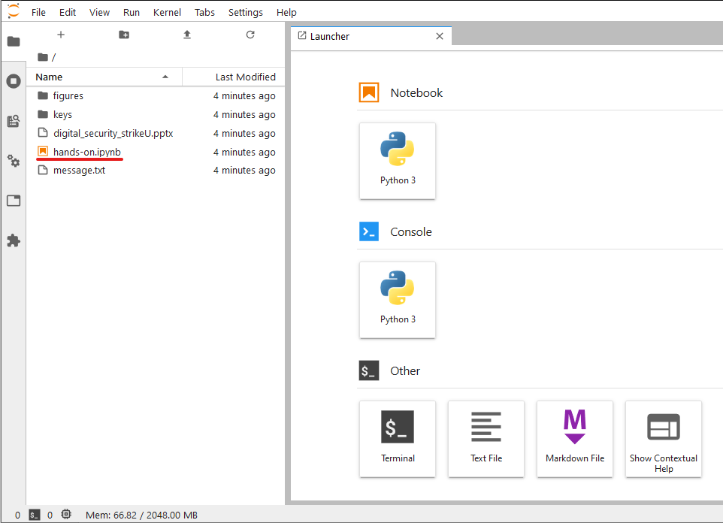
Hands on exercise…
Now that you’re experts, let’s get some hands on practice with these concepts.
Follow this link to get started:
https://mybinder.org/v2/gh/sarttiso/digital-security/b887b43bf6206c874b090000a0cd14000318644e?urlpath=lab
Things will spin for a little while (up to a minute or so), wait until that finishes
Once it’s done, click on the hands-on.ipynb file

Slide 21
Modern Encryption
Why do we have both symmetric and asymmetric key cryptography?
 | Symmetric | Asymmetric
Pros | Fast | Public key eliminates need to exchange private keys
Cons | Must exchange key securely | Slow
Uses | Secure internet surfing¹, password managers, local drive encryption | Messaging (Signal), symmetric key exchanging

Slide 22
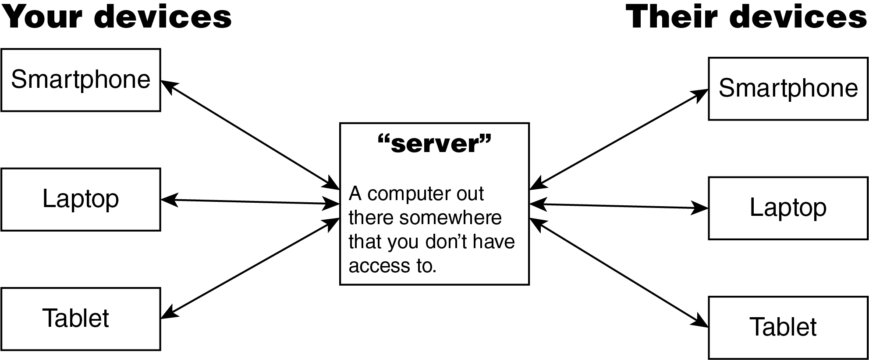
Comparing Slack, Mattermost, Discord, and Signal
Let’s use what we’ve learned to think about some platforms commonly used for organizing
First, we have to understand the flow of data when we use these platforms:

Slide 23
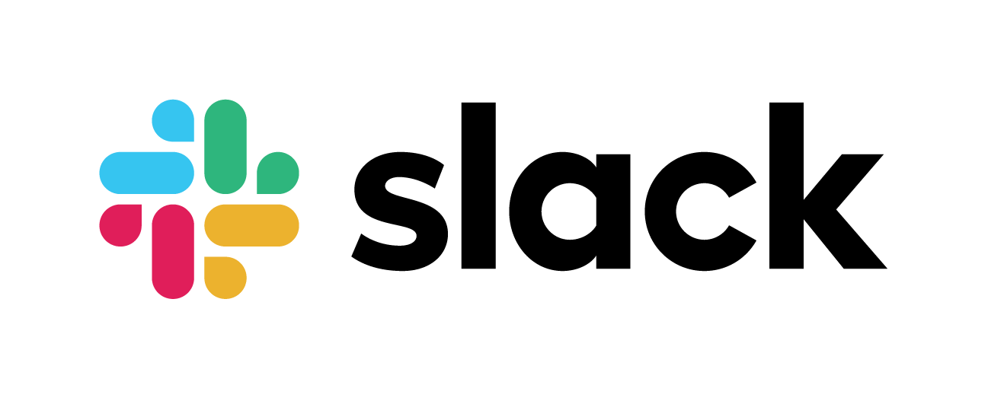
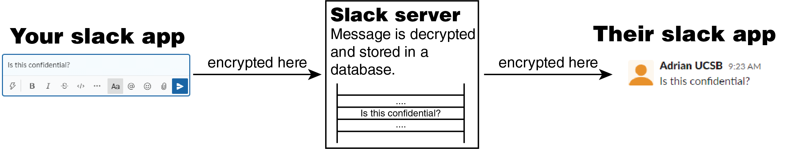
Let’s consider Slack.
Messages are secure on the way to and from the Slack server
On the server, however, Slack has access to and exclusive control over your communications.

Slide 24
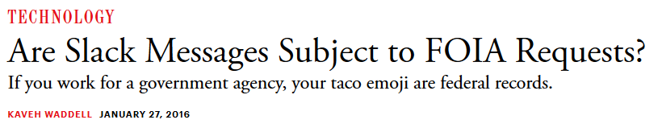
UC not generally subject to FOIA, but it is subject to CPRA: California Public Records Act
If using Slack with your UC email, your messages could be subject to CPRA requests
Law enforcement also requests Slack messages

Slide 25


Most popular communication platforms are like Slack
Messages are decrypted on their servers, meaning they (and potentially hackers) have access to all your communication
Not “end-to-end” encrypted

Slide 26

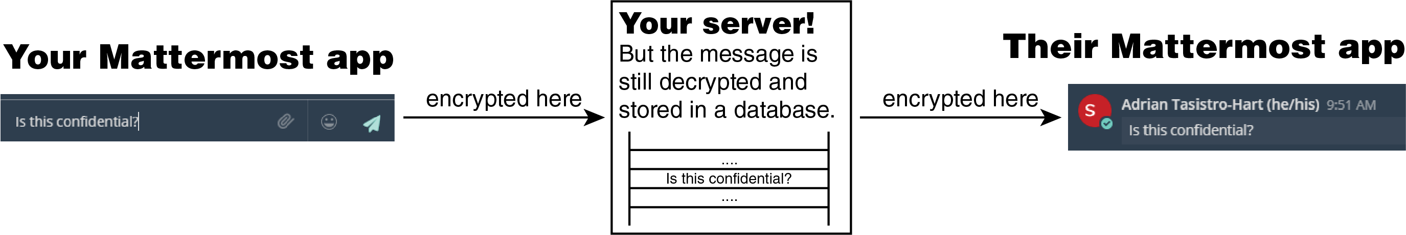
Mattermost is a self-hosted alternative to Slack
Self-hosted means that you control the computer in the middle by running the Mattermost server yourself
More secure than Slack if you trust yourself (or someone else) to securely operate the Mattermost server
But still not end-to-end encrypted…

Slide 27

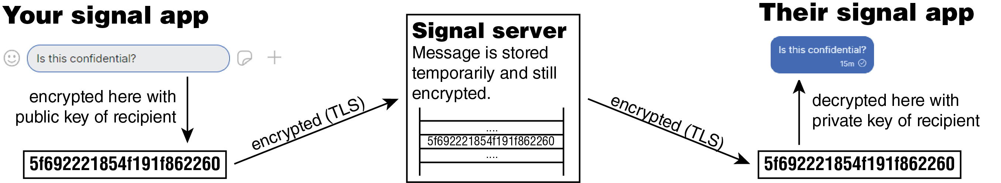
Signal, unlike the other platforms describe so far, is actually end-to-end encrypted
Messages sent to a user can only be read by that user because Signal uses asymmetric key encryption

Slide 28
But why should we trust them? Couldn’t they just be pretending to implement end-to-end encryption?
All code is open source¹
All security algorithms are documented and public²
The code is constantly audited by information security experts³
Unlike, for example, Keybase, an alternative advertising end-to-end encryption but which is closed source and owned by Zoom.

Slide 29
Conclusion
Thanks for your time!
All materials publicly available at
https://github.com/sarttiso/digital-security
Stay tuned for the final installment in the Strike U series, which will cover tools and best practices for maintaining security and privacy with digital organizing
Mid-November

