Slide 1
Digital Security
Adrian Tasistro-Hart

Slide 2
Outline
Cryptography:
Overview
Symmetric key encryption
Asymmetric key encryption
Signing and Authentication
Hands on exercise
In practice
Slack vs Signal
Security vs privacy

Slide 3
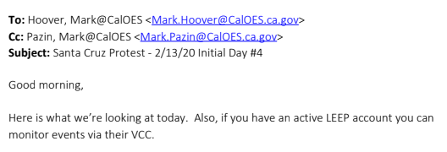


Cryptography
“The study and practice of secure communication.”
“Secure” implies the presence of adversarial eavesdroppers
Modern eavesdroppers include:
Surveillance states
Police forces
Intelligence agencies
Foreign nations
Data-hungry corporations
Notes:
LEEP: Law Enforcement Enterprise Portal
VCC: Virtual Command Center
Information sharing platform between law enforcement agencies, FBI
Police are listening; don’t let them hear!

Slide 4
Aspects of Cryptography
Secure communication entails a several aspects:
Encryption:
Is your communication confidential?
Authentication:
Can you verify who sent you a message?
Signing:
Can you demonstrate to others that you sent a message?

Slide 5
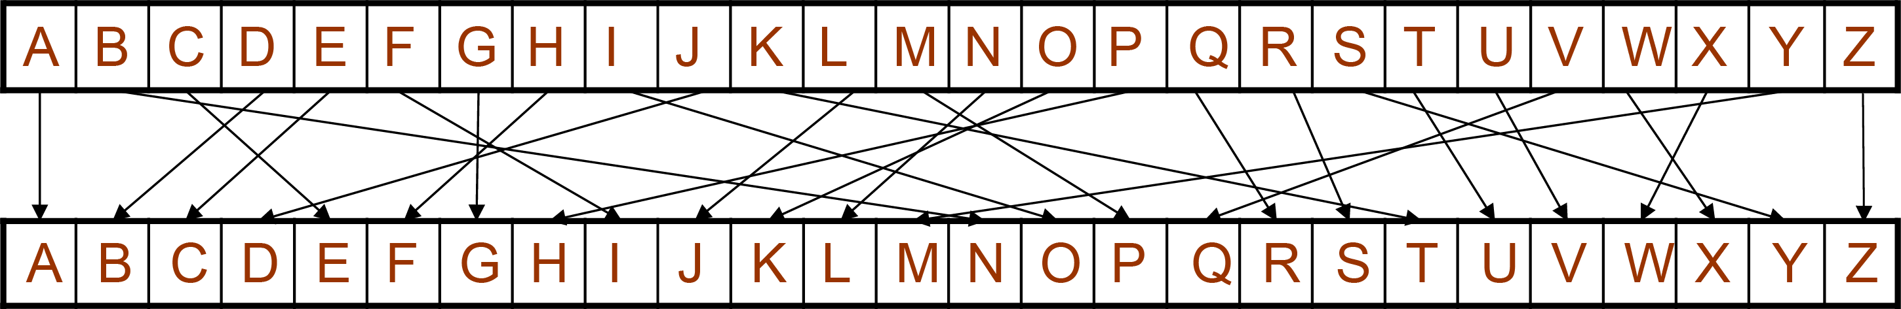
Brief Description of Encryption
Encryption is based on keys
If you know the key, you can read the message. But those without the key, shouldn’t be able to.
Examples:
Character shift
I love encryption → J mpwf fodsxqujpo
Key is just the character shift, in this case, 1
Character permutation
I love encryption → O jkqc clesmhuokl
Key is the character permutation

Slide 6
Modern Encryption
Previous examples are not secure
Character permutations are easily determined from letter occurrence probability tables
Not clear how to encrypt digital data (0’s & 1’s)
English | e | t | a | o | i | n | s | h | r | d | l | c | u | m | w | f | g | y | p | b | v | k | j | x | q | z
 | 12.70% | 9.06% | 8.17% | 7.51% | 6.97% | 6.75% | 6.33% | 6.09% | 5.99% | 4.25% | 4.03% | 2.78% | 2.76% | 2.41% | 2.36% | 2.23% | 2.02% | 1.97% | 1.93% | 1.49% | 0.98% | 0.77% | 0.15% | 0.15% | 0.10% | 0.07%

Slide 7
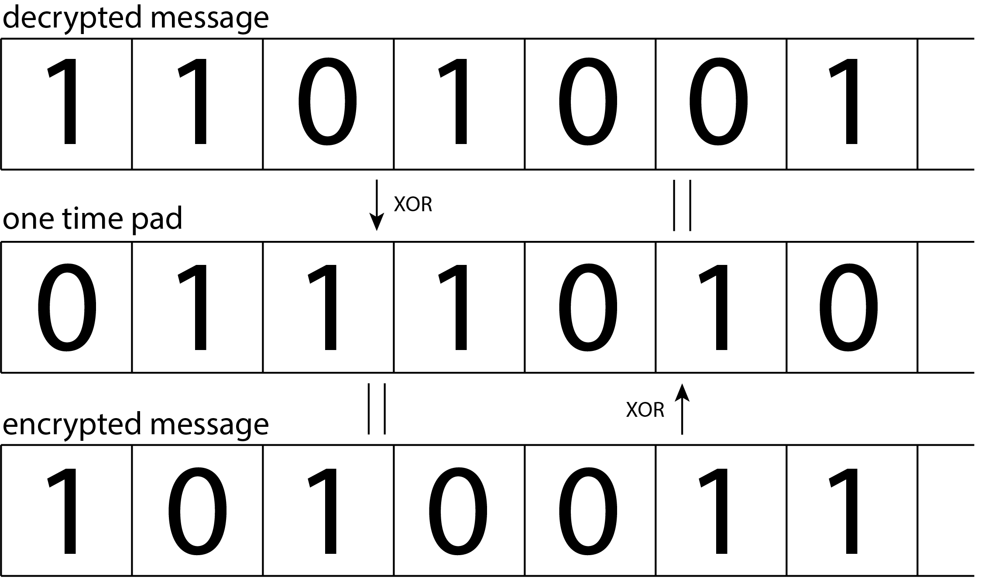
Modern Encryption
One-time pad
Key is a “pad” as long as the message itself
Key is randomly generated
Use XOR to encrypt and decrypt
Pros:
Most secure type of encryption
Cons:
Can only use pad once
Pad must be as long as the message
clearly not useful for things like Zoom or Netflix
Notes:
Can only use pad once because if an adversary knows the encrypted and decrypted messages, they can recover the pad using XOR

Slide 8
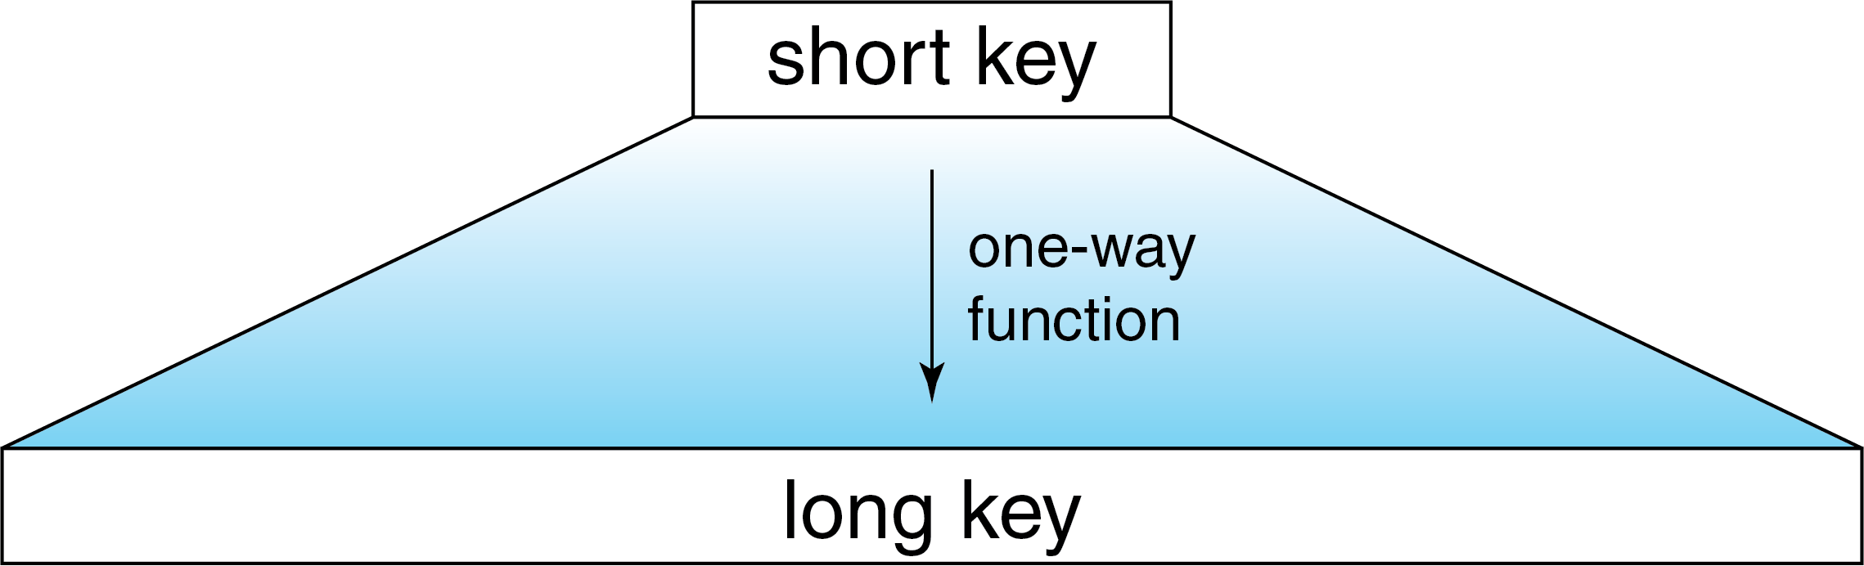
Modern Encryption
In reality, we need keys to be shorter than one-time pads
Introducing: One-way functions
Basic idea is to use a short key to make a long key
The long key then works as a one-time pad for encryption
One-way means that even if adversary learns the long key, they will not know the short key

Slide 9
Modern Encryption
Caveats/complications to ponder
Have to generate a unique long key each time the short key is used
Long key must be the same length as our messages, which are not always the same length

Slide 10
Modern Encryption
Aside:
One-way functions are how passwords are managed on most (secure) websites
When you type in your password, the website computes and saves the “hash” of your password
That way, if they’re hacked, hackers only have the hashed versions, not the original passwords
This matters because it’s practically impossible to figure out the password from its hash

Slide 11
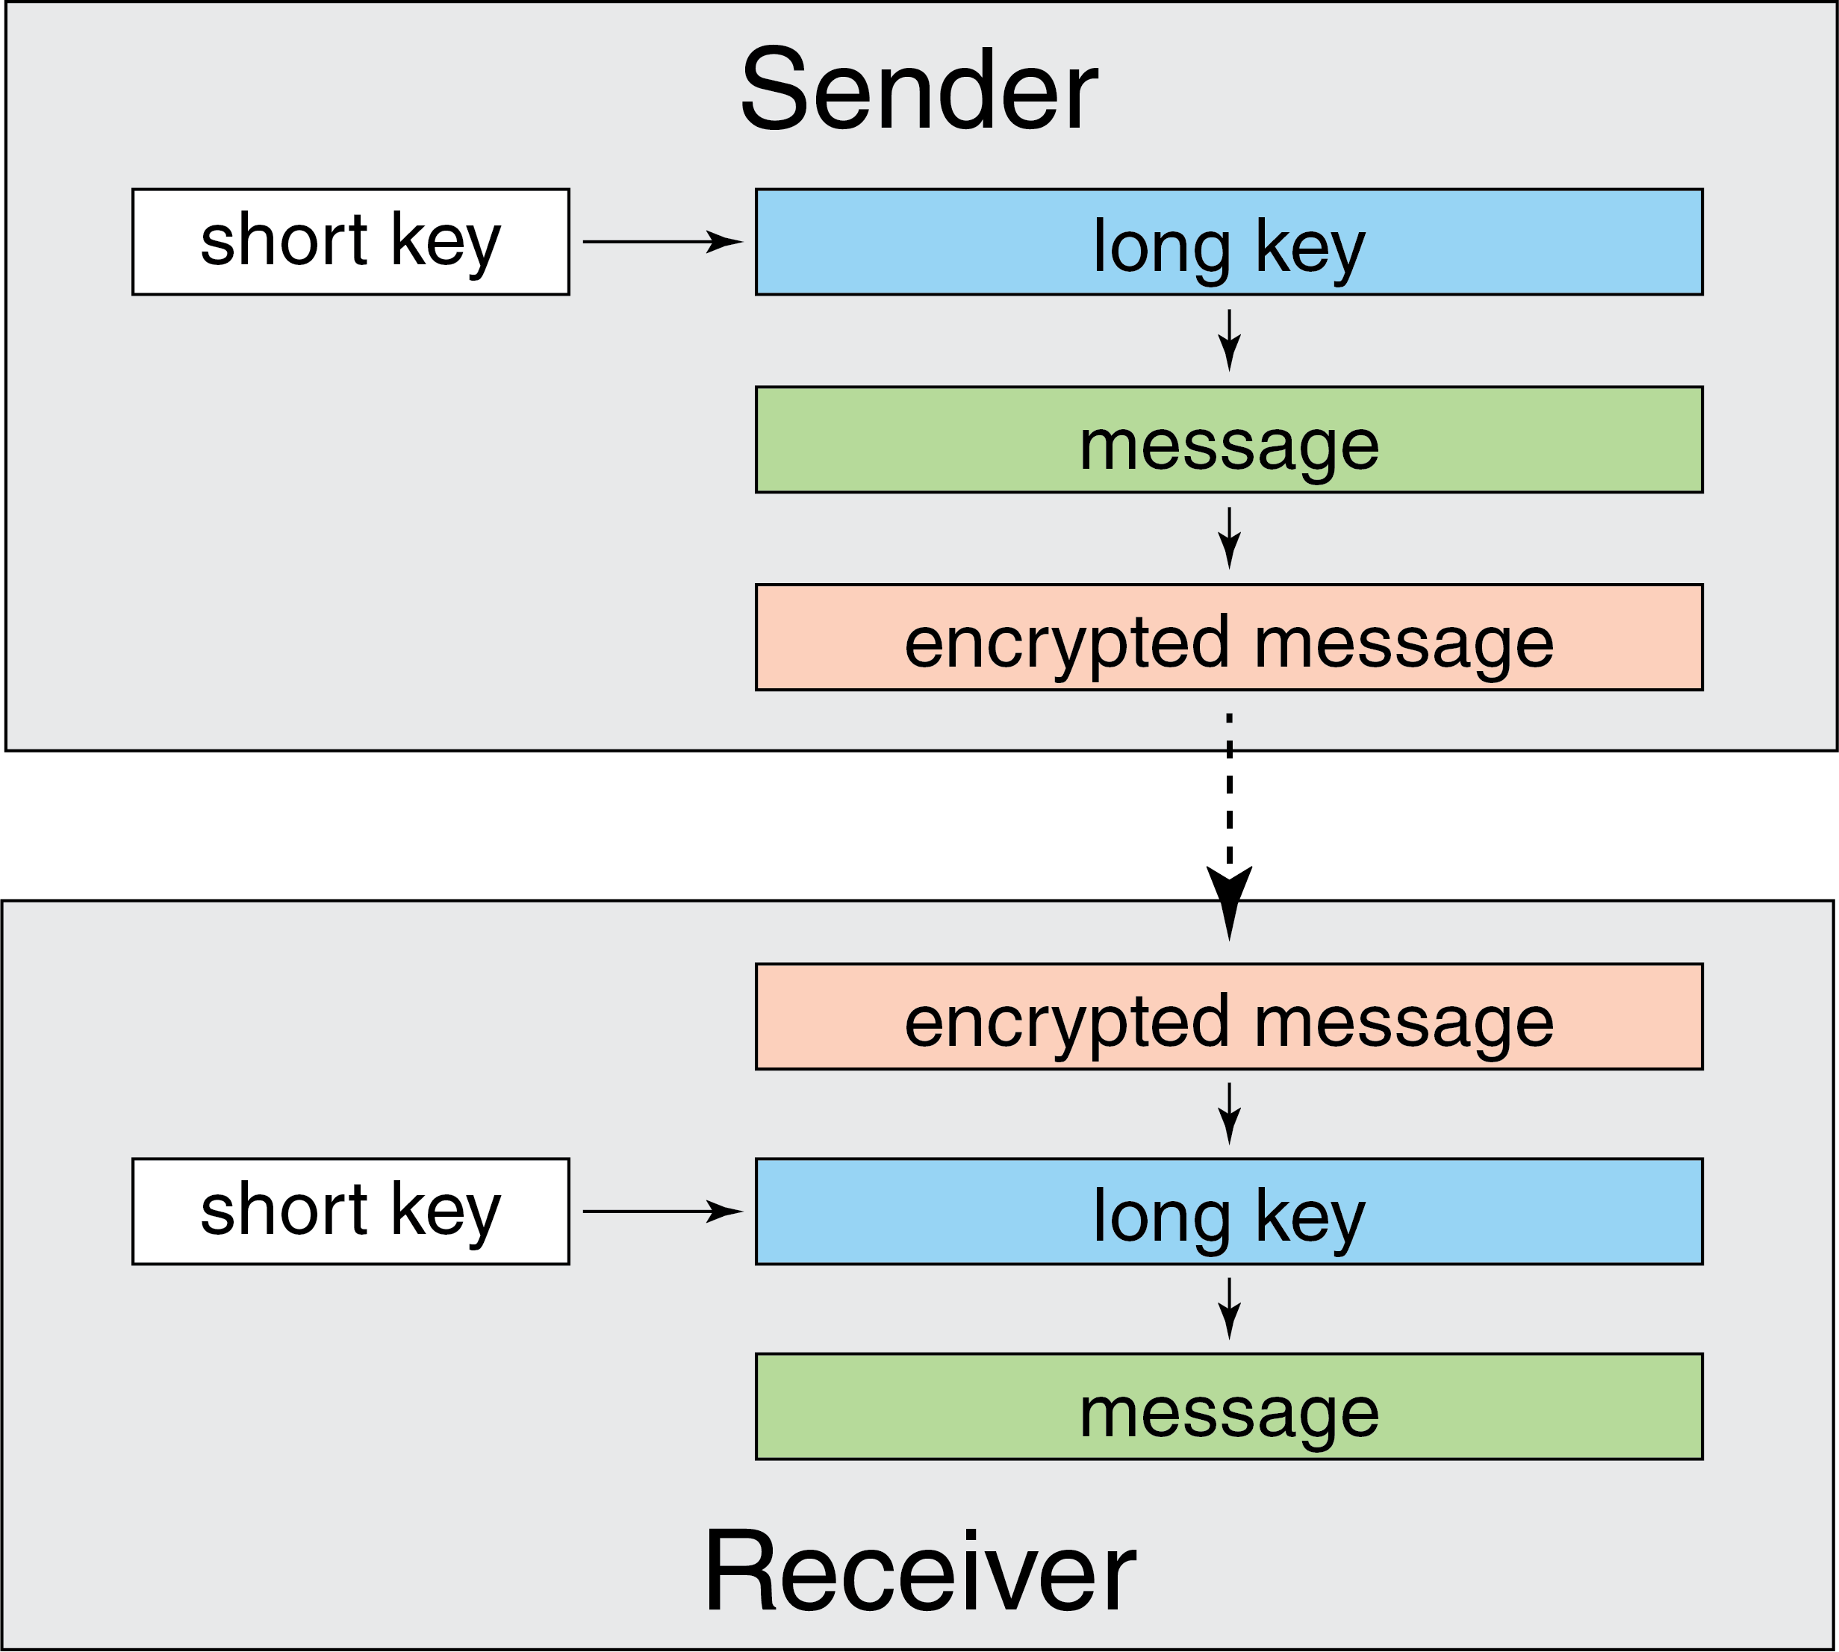
Symmetric key encryption
Encryption/decryption procedure described so far is known as symmetric key encryption
Symmetric means that sender and receiver both must know the same short key
But how do you securely communicate the short key…?

Slide 12
Asymmetric key encryption
Problem solved with asymmetric key encryption
Now, each party has 2 paired keys
Private: this key is kept secret (important)
Public: this key must be available to anybody you want to communicate with
These keys only work with each other
How does it work?

Slide 13
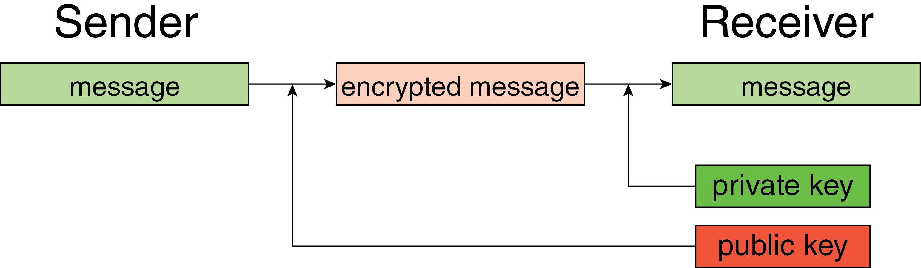
Asymmetric key encryption
Sender uses receiver’s public key to encrypt the message
Encrypted message can only be decrypted with receiver’s private key

Slide 14
Asymmetric key encryption
Revolutionary idea (thanks Diffie and Hellman)
Diffie, W., & Hellman, M. (1976). New directions in cryptography. IEEE Transactions on Information Theory, 22(6), 644–654. https://doi.org/10.1109/TIT.1976.1055638

Slide 15
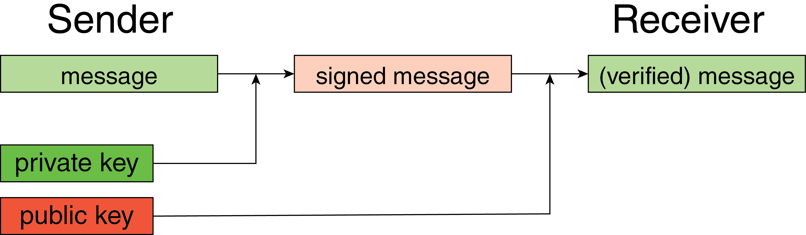
Signing and authentication
Asymmetric key (aka public key) cryptography permits many other forms of digital security in addition to confidentiality
Signing:
Ability of sender to prove that they sent a message
Performed by encrypting message with private key
Authentication:
Ability of receiver to verify who sent a message
Performed by decrypting signed message with sender’s public key

Slide 16
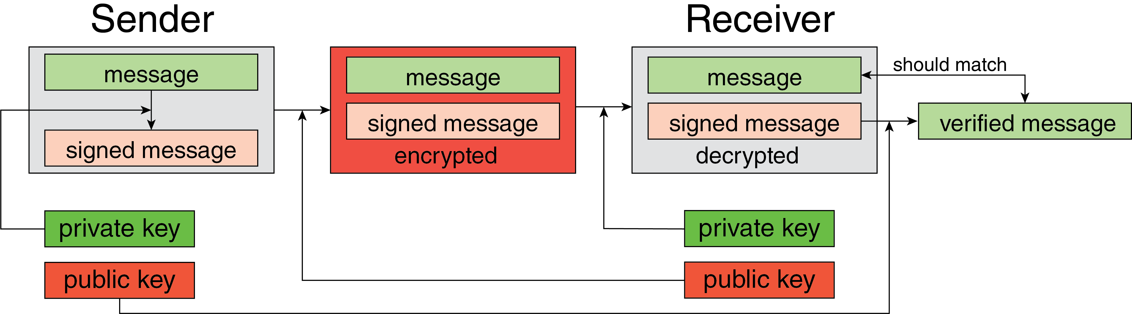
Public key cryptography
In practice, we want to use encryption, signing, and authentication simultaneously

Slide 17
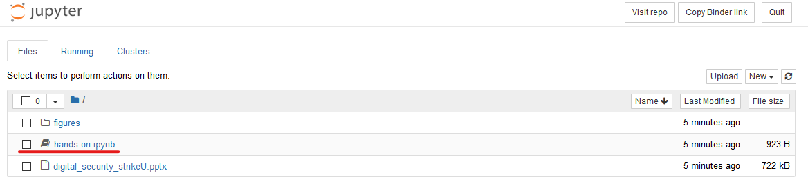
Hands on exercise…
Now that you’re experts, let’s get some hands on practice with these concepts.
Go follow this link to get started:
https://mybinder.org/v2/gh/sarttiso/digital-security/1766ea208d0226cd4229a42530c024a35b7eeb3d
Once it’s open, click on the hands-on.ipynb file

Slide 18
Slack vs Signal

Slide 19
Security vs Privacy

