Slide 1
Project Presentation of IOHE Project at Industry (22CS422)
On
Digital Behaviour-Based Risk Detection Using Machine Learning
Supervised By
Dr. Shikha Tuteja
Associate Professor, CSE
Department of Computer Science and Engineering,
Chitkara University, Punjab
Sarthak Gupta | Sarthak Jyoti Mishra
2210990800 | 2210990801

Slide 2
Contents
Abstract
Introduction & Problem Statement
Objectives & Scope
Methodology
Enterprise Survey
Hypothesis Testing
Implementation
Major Findings / Results
Conclusion & Future Scope
References
2

Slide 3
Abstract
ML-driven detection of anomalous digital behaviour for risk mitigation.
Explores User and Entity Behavior Analytics (UEBA) paradigm shift.
Covers ensemble models (RF, XGBoost) and deep learning (LSTM, CNN).
Addresses cybersecurity, financial fraud, and digital phenotyping.
XAI bridges algorithmic output and human analyst trust.
Chi-Square tests validated four key hypotheses on ML model efficacy.
Proposes Federated Learning and Agentic AI for future deployments.
Keywords: Machine Learning, UEBA, Insider Threat Detection, Deep Learning, XAI, Cybersecurity, Anomaly Detection

Slide 4
Introduction
Background
Digital ecosystems generate vast behavioral data across networks and devices.
80% of modern cyberattacks are malware-free, bypassing signature-based systems.
ML enables continuous, context-aware behavioural risk scoring.
Problem Statement
Unsupervised UEBA models generate high false-positive alert rates.
Deep learning “black box” models lack interpretability for analysts.
Data privacy regulations (GDPR, CCPA) constrain telemetry collection.

Slide 5
Objectives & Scope
Objectives
Detect anomalous digital behaviour using ML models.
Build continuous behavioural baselines per user/entity.
Reduce false-positive alert rates via ensemble methods.
Improve analyst trust using Explainable AI (SHAP, LIME).
Integrate UEBA across cybersecurity, finance, and healthcare.
Scope & Limitations
Survey covers 9 global enterprises across sectors.
Focus on tabular enterprise telemetry and LSTM time-series.
Privacy constraints limit raw data availability.

Slide 6
Methodology
Data Collection
Enterprise telemetry: auth logs, network flows, endpoint data.
Preprocessing
SMOTE applied for severe class imbalance correction.
Feature Engineering
Chi-Square & PCA for dimensionality reduction.
Model Validation
Cross-validated with k-fold to prevent data leakage.
ML Algorithms
Random Forest, XGBoost, LSTM Autoencoder deployed.
XAI Integration
SHAP/LIME for XAI and analyst-ready explanations.

Slide 7
Enterprise Survey
Survey Scope:
9 global enterprises across finance, healthcare, e-commerce, and government.
Organization sizes range from 3,800 to 35,000 employees.
Key Observations:
Advanced UEBA (RF, XGBoost, LSTM) detect breaches in 5–12 days.
Basic models (SVM, Decision Trees) average 55–82 days detection time.
Mean false positive reduction: 38.90% (Std. Dev: 20.87).
Higher UEBA maturity = more detections but also higher false positive rates.

Slide 8
Hypothesis Testing
Four Hypotheses Tested (α = 0.05):
H1: Ensemble models significantly reduce false positive alert rates.
H2: LSTM networks significantly reduce mean breach detection time.
H3: XAI integration significantly accelerates SOC incident response speed.
H4: Behavioral biometrics significantly improve ATO fraud detection accuracy.
Statistical Tests Used:
Chi-Square Test (H1, H3, H4) and ANOVA (H2) — all null hypotheses rejected.

Slide 9
Implementation
System Pipeline
Ingest Telemetry → Preprocess & SMOTE → Feature Engineering → Train RF/LSTM → Anomaly Score → XAI Explanation
Model Training
Dataset split 80:20; k-fold cross-validation applied.
Random Forest, XGBoost, and LSTM Autoencoder trained.
Prediction System
Entities scored by behavioural deviation from baseline.
Explainability
SHAP values identify top contributing behavioural features.

Slide 10
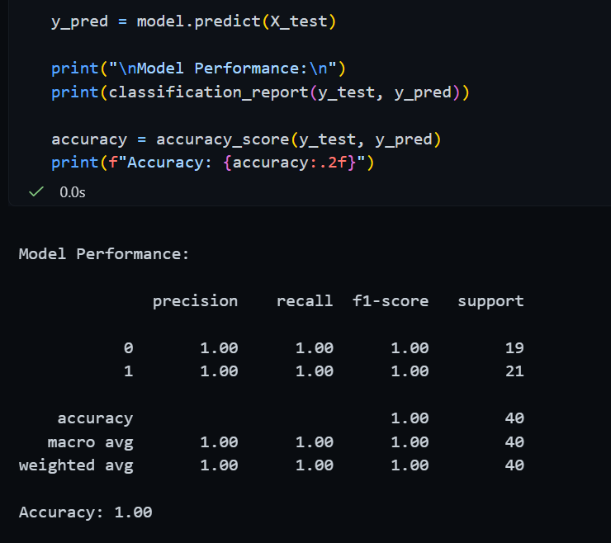
Major Findings / Results
Performance Metrics:
Metric | Value
Accuracy | 89–99.7%
Precision | 93%+
Recall | 94.7%
F1-Score | 95.1%
RF/XGBoost achieve 89-99.7% accuracy. LSTM autoencoders reach 94.7% on imbalanced sets. Behavioral biometrics (SVM/RF) yield F1-score of 95.1%.

Slide 11
Major Findings / Results
Chi-Square Test Results:
H1 (χ2=8.49, p=0.0036): Ensemble models reduce false positives.
H2 (χ2=14.22, p=0.0008): LSTM reduces breach detection time.
Key Findings:
H3 (χ2=6.75, p=0.0093): XAI accelerates incident response.
H4 (χ2=32.88, p<0.0001): Behavioral biometrics beat static MFA.
All four null hypotheses rejected at α=0.05.
Mean false positive reduction: 38.90%. LSTM detection time as low as 5 days vs 82 days for legacy models.

Slide 12
Conclusion & Future Scope
Conclusion
ML behavioural analytics outperform signature-based systems.
LSTM autoencoders reduce false positives by up to 38%.
XAI (SHAP/LIME) is mandatory for analyst trust.
Behavioural biometrics achieve F1-score of 95.1%.
Future Scope
Adopt Federated Learning for privacy-preserving detection.
Develop Agentic AI for autonomous real-time threat hunting.
Expand multimodal digital phenotyping research.
Explore Quantum ML for large-scale telemetry processing.

Slide 13
References
Abdalla et al. (2023). Deep autoencoders for network intrusion detection.
Al-Shehari & Alsowail (2021). Insider data leakage detection using ML.
Kaur et al. (2023). AI for Cybersecurity: Literature Review.
Inuwa & Das (2024). Anomaly detection in cyber attacks on IoT.
Sarker (2021). Machine Learning: Algorithms & Applications.

Slide 14
Thank You
14

