Slide 1
INTERNET SAFETY
Teach students to safely navigate our brave new world!

Slide 2
Haleyville City Schools
How are we currently addressing Internet Safety?
What issues have we faced with the internet, and with devices that have internet capability (i.e. smart phones, ipads, ipods, and laptops?

Slide 3
Why focus on internet safety?
Computer and Internet Use
According to the Pew Internet & American Life Project, 2007,
93% of youth are online, 94% of parents (up from 80% in 2004)
68% of parents surveyed regulate web content, while 55% limit time on the computer (interesting note: more parents restrict TV viewing than internet content)
Time spent using digital media by children aged 13-17 has now surpassed the time they spend watching television

Slide 4
Alabama Course of Study
Technology Education 2008
All teachers are required to teach the state adopted technology curriculum!
The state technology curriculum will help students with technology fluency and in turn life.
Topics include: CIPA, safety and privacy, responsible digital citizenship, personal safety and cyber security.
https://docs.alsde.edu/documents/61/Technology%20COS.pdf

Slide 5
Document technology usage and lessons in you lesson plans on a weekly basis!

Slide 6
Federal Law
The Children’s Internet Protection Act (CIPA) is a federal law enacted by Congress to address concerns about access to offensive content over the Internet on school and library computers. CIPA imposes certain types of requirements on any school or library that receives funding for Internet access or internal connections from the E-rate program – a program that makes certain communications technology more affordable for eligible schools and libraries.
In early 2001, the FCC issued rules implementing CIPA.
Internet filtering and compliance equals money.
FCC: http://www.fcc.gov/cgb/consumerfacts/cipa.html

Slide 7
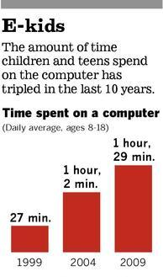
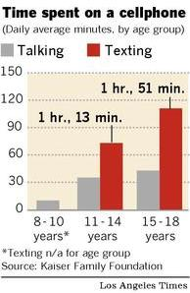
Why is Internet Safety Important?
Today, 8-18 year-olds devote an average of 7 hours and 38 minutes (7:38) to using entertainment media across a typical day (more than 53 hours a week). Kaiser Family Foundation 2010
Notes:
We are here today because the Internet has totally changed our lives. It has changed the way we do business, the way we communicate with one another, the way we shop, travel, and educate ourselves . . . and it has changed the lives of our children, as well.
According to two studies released in February 2006 and April 2006 by Pew/Internet:
Internet usage has now reached 73% for all American adults
52% of Intenet users send/receive email daily
38% of Internet users use a search engine daily
31%of Internet users surf for fun - “On any given day, about 40 million Internet users go online just for fun or to pass the time”
And what about our children???

Slide 8
Student Saftey?
More than half of teens in the U.S. have an online profile on a social networking site, and most have posted photos of themselves and their friends, among other personal information for the world to access or at least friends.
Cyberbullying is common among today’s teens, with over 1/3 having experienced it, engaged in it, or know of someone that has done it or had it done to them.
About one in five teens have engaged in sexting – sending, receiving, or forwarding sexually suggestive nude or nearly nude photos through text message or email – and over a third know of a friend who has sent or received these kinds of messages.
Cox Communications Teen Online & Wireless Safety Survey, 2010

Slide 9

Public Service Announcement

Slide 10
Internet Safety is embedded in
Technology Fluency and our Curriculum.
It’s our job to teach students…
Safe and responsible use of electronic communication
To recognize, avoid and report online solicitations of a sexual nature by peers and strangers alike
To keep personal information on the internet protected
To Recognize and avoid unsolicited or deceptive communications received online and through texts and email.
Recognize and report online harassment and cyber-bullying to adults and save the evidence.
Recognize and report illegal activities on the internet

Slide 11
Digital Communication
Virtual communities
Gaming
Social Networking
Instant Messaging
Microblogging
Text messaging
Social Messaging
Video chats
Examples
Wii, Playstation 3
MySpace, Facebook
GoogleTalk, IM, iChat
Twitter
Cellphones
Facebook Status
Skype, i-Chat

Slide 12
Cyberbullying
    “Cyberbullying is when a child, preteen or teen is tormented, threatened, harassed, humiliated, embarrassed or otherwise targeted by another child, preteen or teen using the Internet, interactive and digital technologies or mobile phones. It has to have a minor on both sides, or at least have been instigated by a minor against another minor.”
    (STOP Cyberbullying)
Notes:
Cyber harassment – over 18

Slide 13

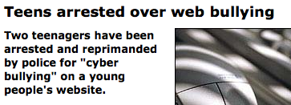
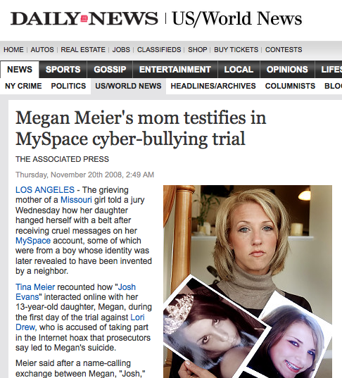
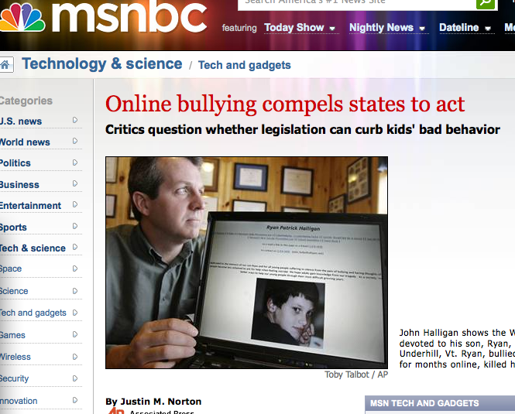
Has your child taken a suicide survey? John’s son did!

Slide 14
CyberSmart! http://cybersmart.org/
Free K-12 Curriculum (scope and sequence available)
Offers online professional development – minimum 20 people, charge
Reproducible student pages
5 units → S.M.A.R.T. – (Safety, Manners, Advertising, Research, and Technology)
Aligned to the NETS and information literacy standards
Mix of online and offline activities

Slide 15

NetSmartz http://www.netsmartz.org
K-12 Interactive presentations, videos, music, online games, and offline content to teach internet safety
Nonsequential, stand alone activities
Reproducible activity cards
Information/activities for parents and law enforcement (translates to Spanish)

Slide 16
National Cyber Security Alliance (NCSA)
http://www.staysafeonline.org/
Resources, resources, resources
Teacher resources for the classroom…

Slide 17
Recommendations
Teach students…
Safe and responsible use of social networking sites, chat rooms, electronic mail, bulletin boards, instant messaging and other Internet based communication.
Recognition, avoidance and reporting of online solicitation.
Risks of transmitting personal information on the Internet.
Recognition and avoidance of unsolicited or deceptive communications.
Recognition and reporting of online harassment and cyberbullying.
Reporting of illegal activities and communications on the Internet.

Slide 18
Advice? Questions?
Dr. William “Bill” Bishop
wbishop@havc.k12.al.us

