Slide 1
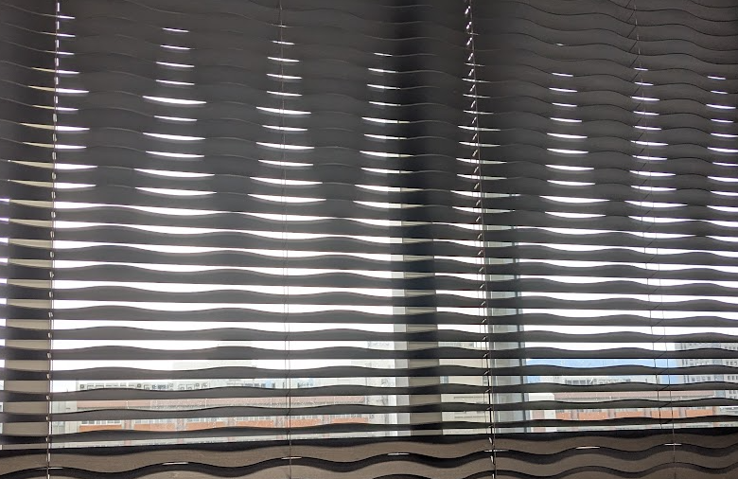
When text is overlaid on a raster image like this, converting the document to PDF in Word causes the text itself to be converted into a raster image as well.

Slide 2
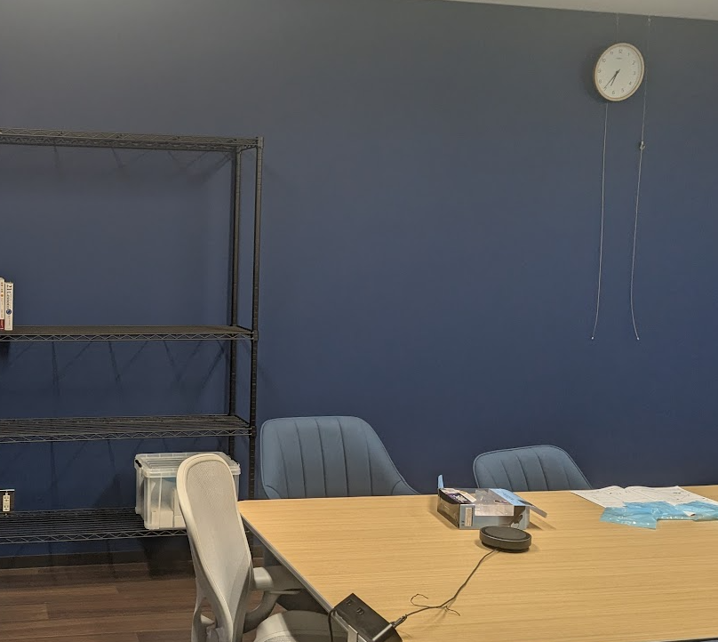
こんな感じでラスタ画像の上に文字を重ねていた場合、Wordでpdfに変換すると文字ごとラスタ画像に変換されてしまいます。

Slide 3

When text is overlaid on a raster image like this, converting the document to PDF in Word causes the text itself to be converted into a raster image as well.

