Slide 1
Advertisement Success Prediction

Slide 2
Problem Statement
To predict whether an ad buy will lead to a netgain.

Slide 3
Business Problem
Retail brands big and small want to earn considerable profits, and therefore, are investing significantly in advertising
Advertising company need to improve on revenue that can be generated by a proposed Ad. Based on the demographic information provided, we need to predict whether the revenue generated will cover costs to produce and air the ad(Whether there will be a net gain from an ad or not).
Stakeholders :
Ad Executive Officer

Slide 4
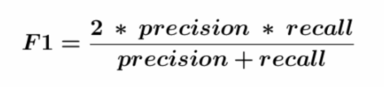
Business and Data Science Metric
Business Metric: Net gains generated by ads more than 75%
Data Science Metric: F1_Score

Slide 5
Data
Dataset Information : The training dataset consists of data corresponding to 19536 records and the test dataset consists of 6512 records . Following are the features of the dataset.
Feature | Datatype | Description
UserID | object | Unique id for each row
ratings | float64 | Metric out of 1 which represents how much of the targeted demographic watched the advertisement
airlocation | object | Country of origin
airtime | object | Time when the advertisement was aired
average_runtime(minutes_per_week) | int64 | Minutes per week the advertisement was aired
targeted_sex | object | Sex that was mainly targeted for the advertisement
genre | object | The type of advertisement
industry | object | The industry to which the product belonged
relationship_status | object | The relationship status of the most responsive customers to the advertisement
expensive | object | A general measure of how expensive the product or service is that the ad is discussing
Target Column y | Datatype | Description
netgain | int64 | Target, Whether the ad will incur a gain or loss when sold

Slide 6
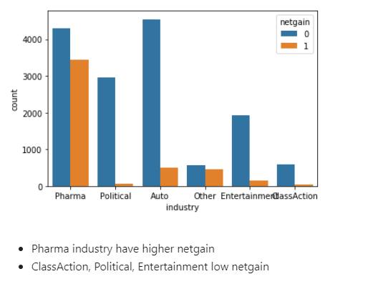
Exploratory Data Analysis
Which industry made most gain?

Slide 7
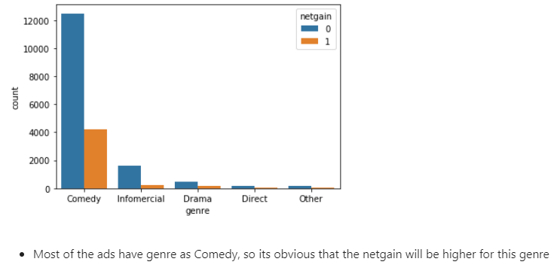
Exploratory Data Analysis
Which genre increases netgain?

Slide 8
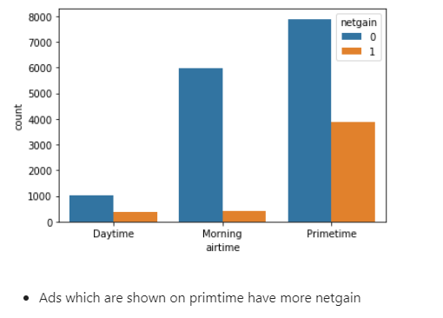
Exploratory Data Analysis
Does airtime affects netgain?

Slide 9
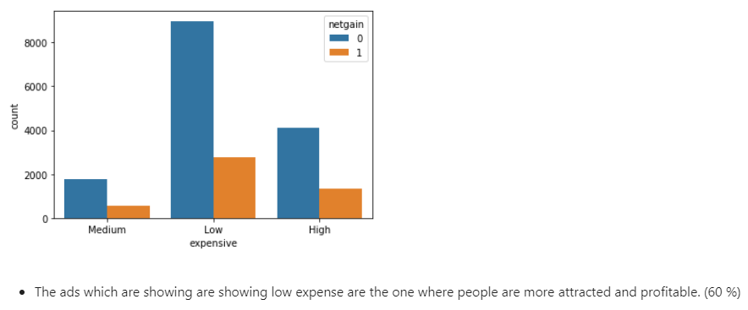
Exploratory Data Analysis
Distribution of ads with expensive

Slide 10
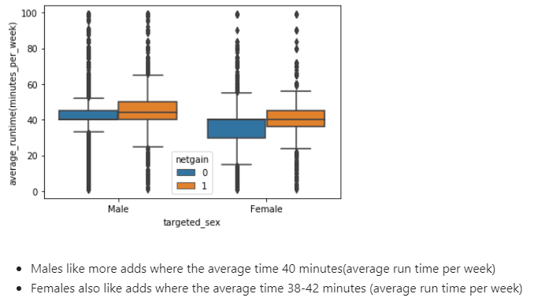
Exploratory Data Analysis
Does average runtime and Gender affects netgain?

Slide 11
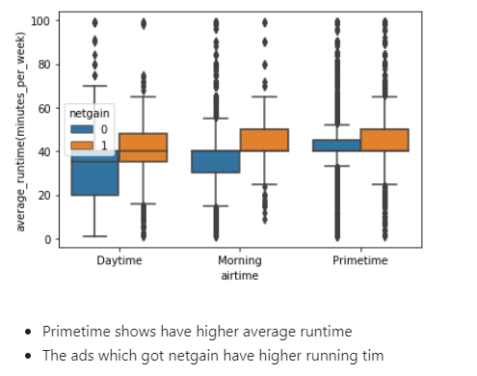
Exploratory Data Analysis
Does average runtime and airtime affects netgain?

Slide 12
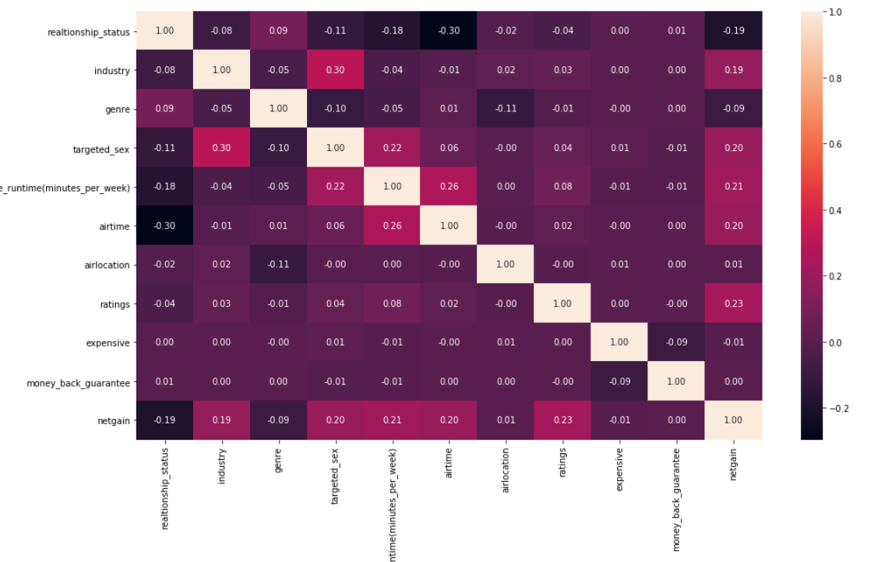
Feature Selection
Does average runtime and airtime affects netgain?

Slide 13
Models and Approaches
Three vanilla models were assessed without performing any hyper parameter tuning and without treatment of class imbalance of the target. The models were
Logistic Regression
Random Forest Classifier
AdaBoost
None of the three vanilla models were able to give an F1_score above 40% on actual test data.
This called for performing hyper parameter tuning using Grid Search and also treatment of class imbalance using SMOTE and Class weights for further improvement of the F1_score and ROC_AUC score.

Slide 14
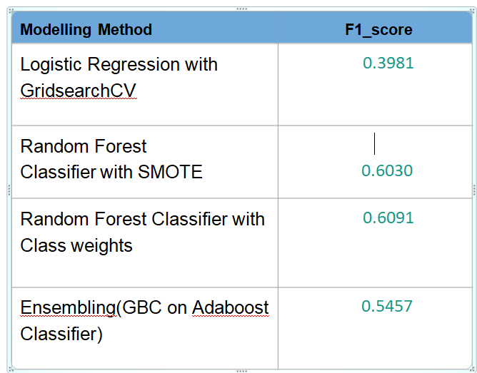
Models Score with Model Tuning
After performing hyper parameter tuning using Grid Search and treating imbalanced classes also RF with Class Weights and SMOTE along with Ensemble model of GradientBoostingClassifier and Ad boost yielded the following results:

Slide 15
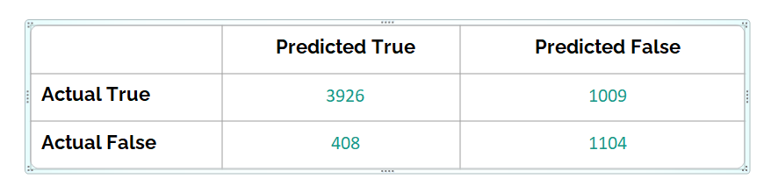
Final Result
From the above observations and plotting it can be inferred that the best performing model was Random Forest with Class weights giving an F1 score of 61 %.
Confusion Matrix :

Slide 16
Insights and Recommendations
Insights:
Pharmacy industry have higher netgain
Most of the ads have genre as Comedy, so its obvious that the netgain will be higher for this genre
Ads which are shown on primetime have more netgain
United States have higher no. ads shown (90%)
The ads which are showing low expense are the one where people are more attracted and profitable. (60 %)
Primetime shows have higher average runtime
Recommendations:
Promote more ads for Pharmacy industry to Increase net gain
Focus more on ‘Comedy’ genre ads
Try to show ads giving more net gains in ‘Prime Time’

Slide 17

Thank you .

