Slide 1

TTMI
LEAVE
MANAGEMENT
Leave management for a better quality of work life
Presented by Saruj Chutapornpong · Intern

Slide 2
THE PROBLEM
Pain Point
Today, leave is manual. You DM your manager, and they jot it down by hand. Requests get lost, balances drift, and nothing lands on a calendar.
THE LOOP, IN ONE CLICK
YOU
MGR
THE FIX
request
approve
One Slack command. The manager approves or declines with a single click — then it auto-saves to the database and shows up on the calendar.
TTMI

Slide 3
WHAT WE'RE BUILDING
Scope
Slack-native — no new app to learn
In-Slack admin control plane
1
4
Built for small-to-medium teams
Lands on the calendar and a sheet
2
5
Covers the full leave-request cycle
3
TTMI

Slide 4
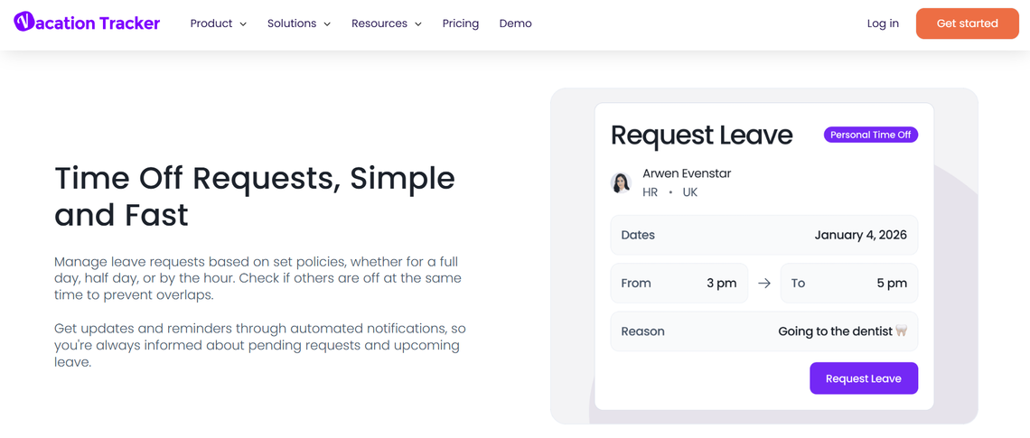
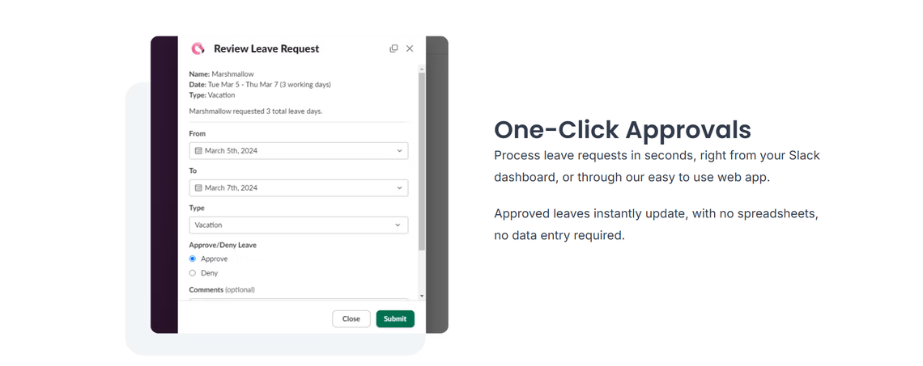
THE OBVIOUS QUESTION
Why not just buy SaaS?
Cost
Subscription pricing is too expensive for a small team.
Privacy
Leave data is sensitive — we'd rather keep it in-house.
Feature fit
Vacation Tracker · Flamingo — polished, but…
TTMI
Off-the-shelf tools rarely match our exact policy.

Slide 5
HOW WE DECIDED
Design Principles
Cost
Pay-per-use — you only pay for what you run
Place
Lives inside Slack, where people already are
Features
Fits our exact rules — no bending policy to a product
Control
We own the data and the logic
TTMI

Slide 6
FIVE COMMANDS, TWO GROUPS
Core Functions
FOR EVERYONE
/dayoff
Open the request modal
/dayoff-cancel
Cancel a pending request, or early-return an active leave
/advance
Leave Optimizer — find your longest possible break
FOR ADMINS & MANAGERS
/control
Admin control plane: policy, holidays, reports & more
/burnout
TTMI
Track team burnout risk and nudge people to rest

Slide 7
DEMO
Part 1 — the commands everyone uses
/dayoff · /dayoff-cancel · /advance

Slide 8
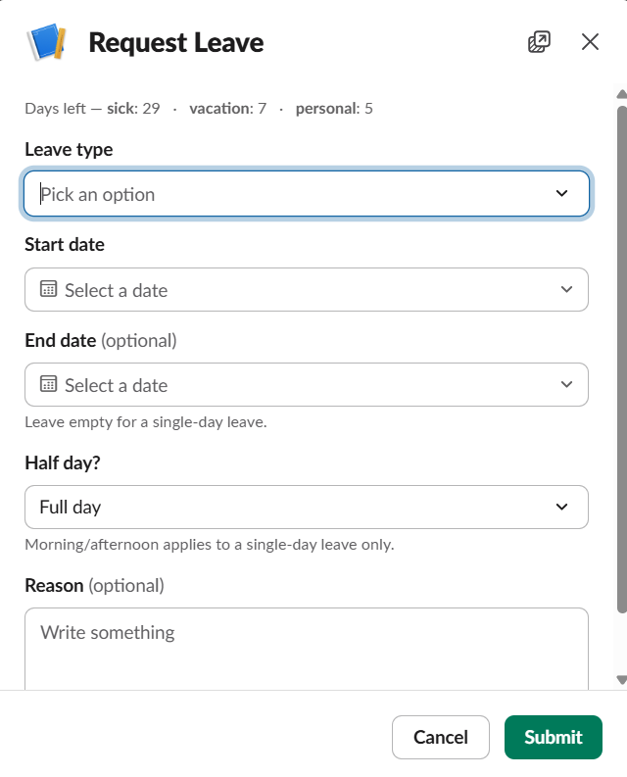
/dayoff
REQUEST A LEAVE
IN ONE FORM
Pick a leave type — each has its own quota
Choose a start date (and end date for multi-day)
Optionally take just a morning or afternoon
Add a reason if you'd like
One modal, everything on it
TTMI

Slide 9
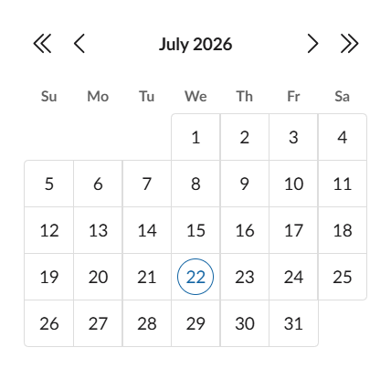
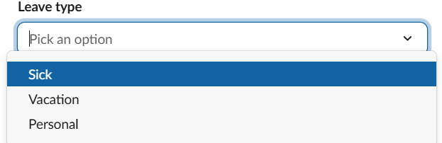
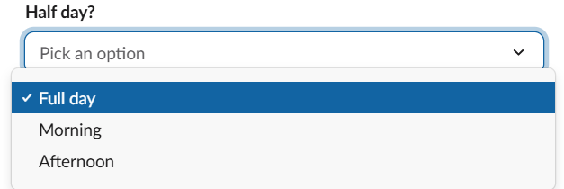
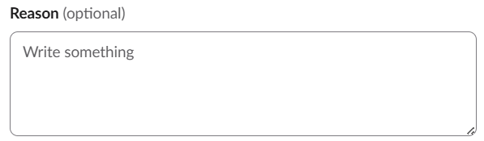
/dayoff
THE OPTIONS
Leave type
Dates
Sick · Vacation · Personal — each tracks its own balance
Start date for a single day;
add an end date for longer
Half day
Reason
Take just a morning or an afternoon
Optional note to your approver
TTMI

Slide 10
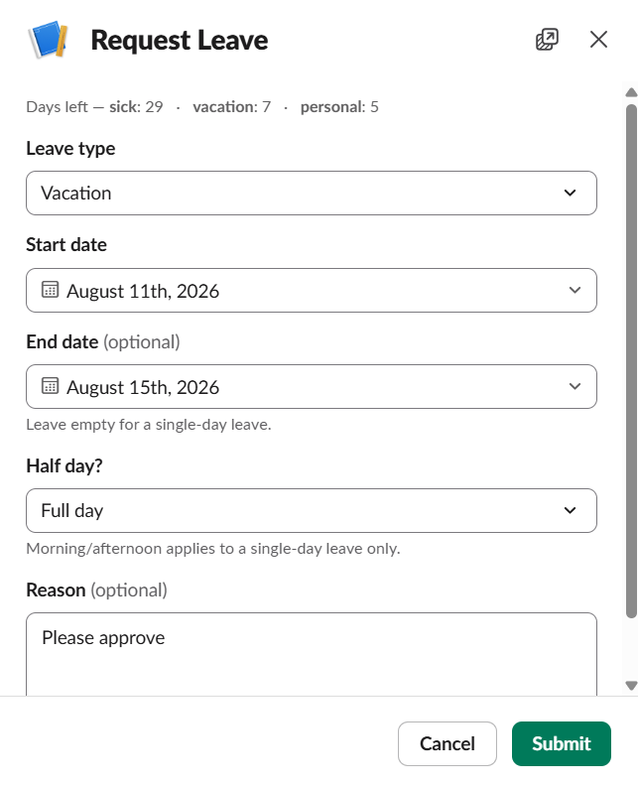
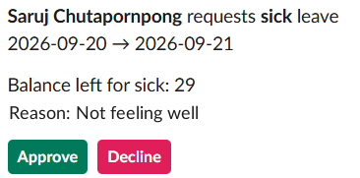
/dayoff
SUBMIT → APPROVE
submit
The manager gets a one-click card
Sees who, what type, dates, balance & reason
Approve or Decline — no spreadsheet, no typing
TTMI

Slide 11

/dayoff
TWO PATHS
AUTO
MANAGER
Auto-approve
Approval needed
For people at the top of the chain — the leave clears the moment they submit.
Routed to a manager as an approve / decline ticket.
TTMI

Slide 12
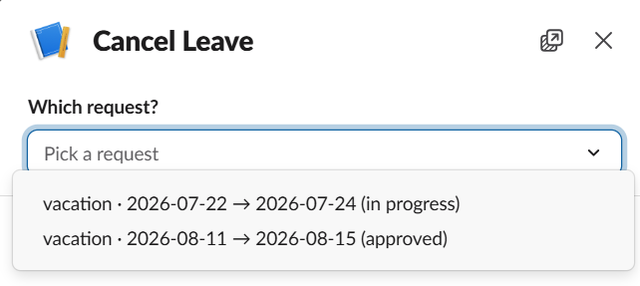
/dayoff-cancel
UNDO A LEAVE
WHAT IT DOES
Cancel any pending or future request
Get the reserved quota back instantly
Early-return a leave already in progress — you're only charged for the days you took
Pick the request you want to drop
TTMI

Slide 13
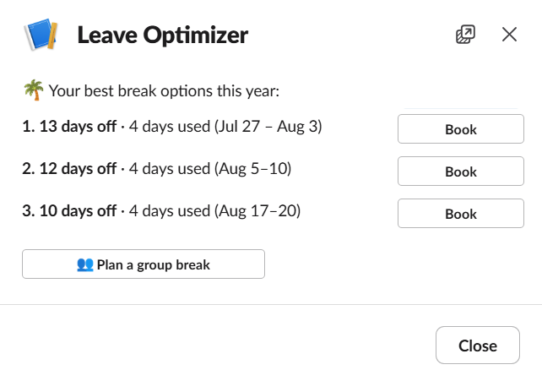
/advance
LEAVE OPTIMIZER
PLAN SMARTER
Stretch your days off
Finds the longest break your remaining days can buy
Uses weekends and public holidays as free bridges
Book the winning window straight from the card
TTMI

Slide 14
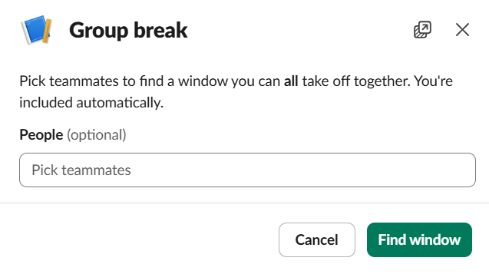
/advance
GROUP BREAK
TAKE TIME OFF TOGETHER
One window for the whole team
Pick your teammates — you're included automatically
The optimizer finds a window everyone can take off
Great for team offsites or a shared long weekend
TTMI

Slide 15
DEMO
Part 2 — admin & manager tools
/control · /burnout

Slide 16
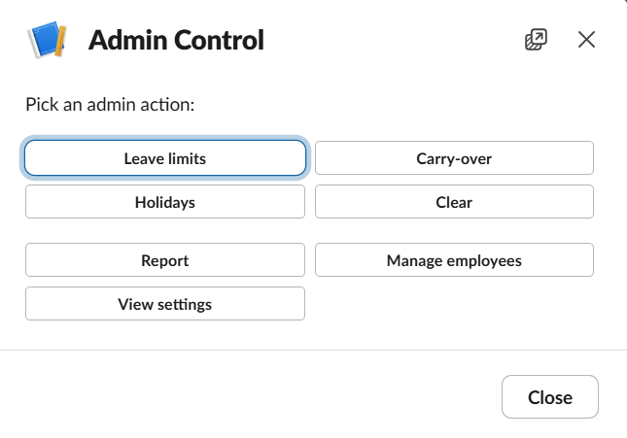
/control
ADMIN MENU
Leave limits — set global quota
Carry-over — roll days into next year
Holidays — add, remove or import
Report — usage & burnout, as CSV
Manage employees — names, managers, overrides
View settings — current policy at a glance
Clear — reset the database
TTMI

Slide 17
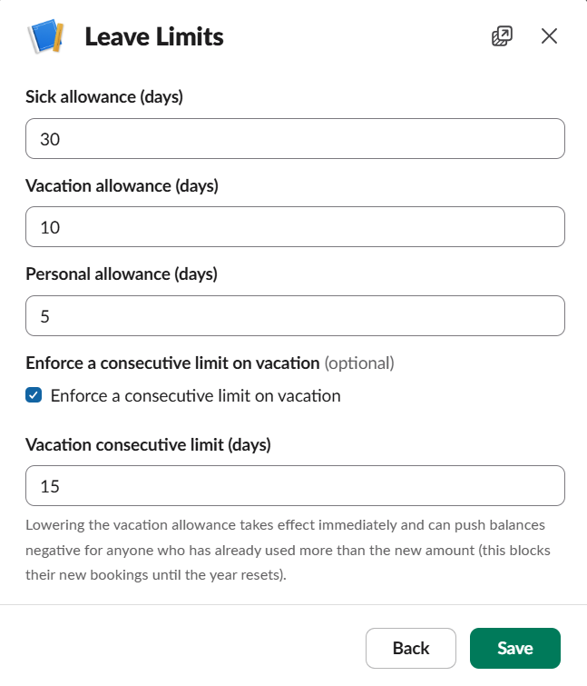
Leave limits
/control › Leave limits
SET THE RULES ONCE
Global quota for each type — sick, vacation, personal
Optional consecutive-day cap on vacation
Changes take effect immediately across the team
TTMI

Slide 18
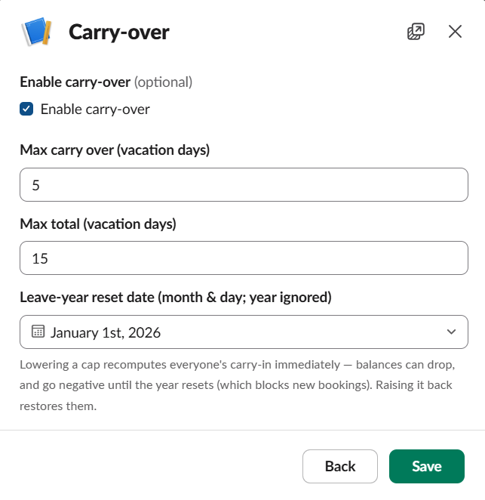
Carry-over
/control › Carry-over
REWARD UNUSED DAYS
Let people keep unused quota for next year
Cap how much carries over — and the max total balance
Set the leave-year reset date (month & day)
TTMI

Slide 19
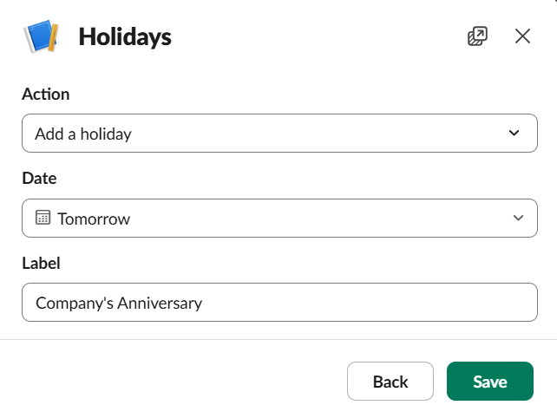
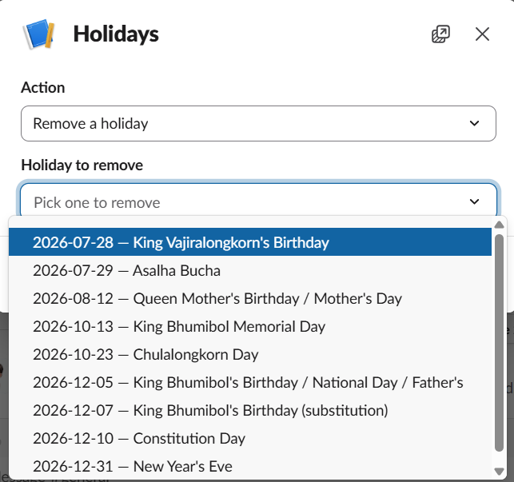
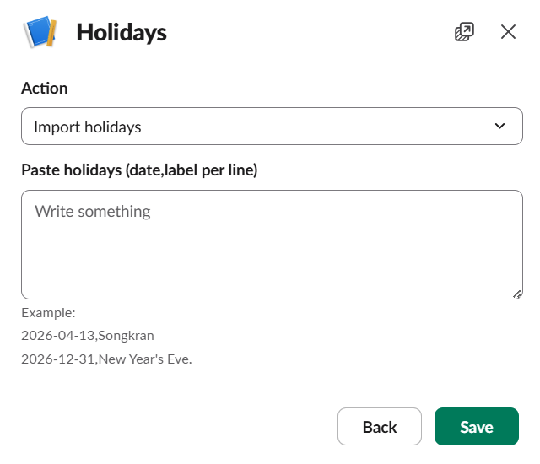
Holidays
/control › Holidays
Add
Remove
Import
Add one holiday with a date & label
Pick from the list to delete
Paste many at once, one per line
TTMI

Slide 20
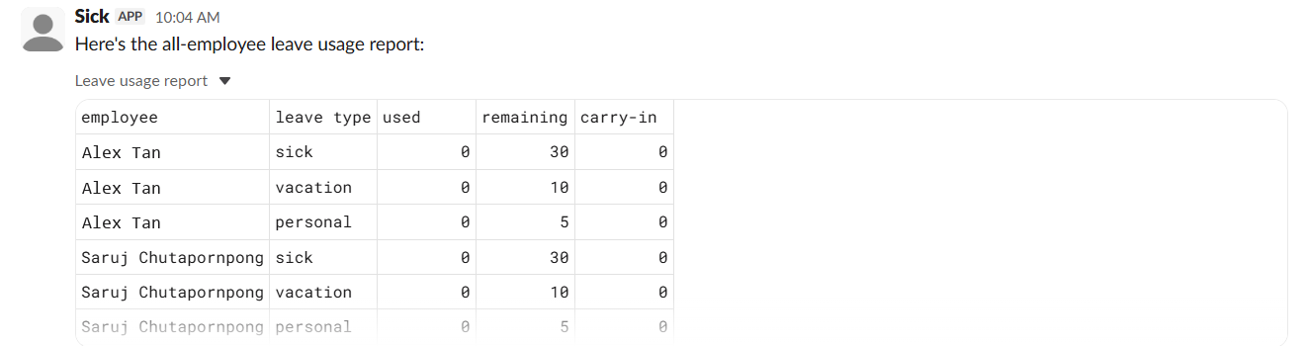
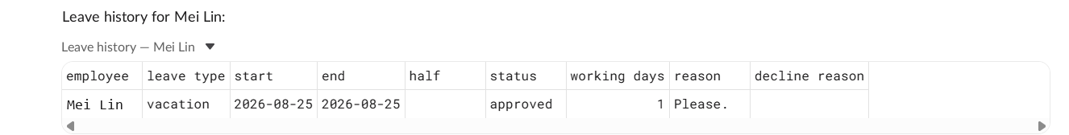
Report
/control › Report
DELIVERED TO YOUR DM · AS CSV
All-employee quota — used, remaining, carry-in
One person's full leave history
Team burnout risk (next slide)
Every report exports as a downloadable CSV
All-employee quota
A single person's history
TTMI

Slide 21
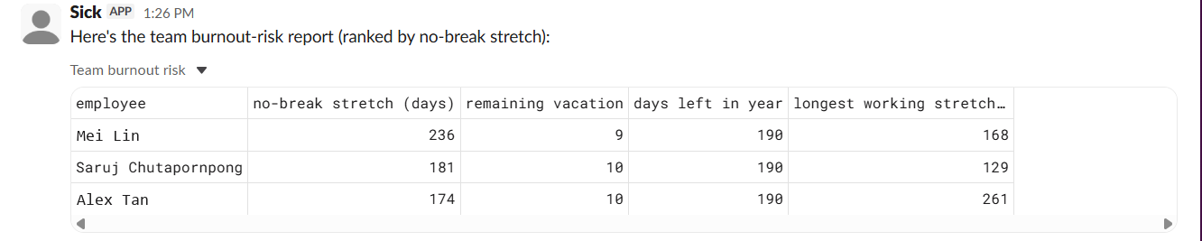
Report
TEAM BURNOUT RISK
/control › Report
RANKED BY RISK
Longest no-break stretch
Remaining vacation
Days left in the year
Longest working stretch
TTMI

Slide 22
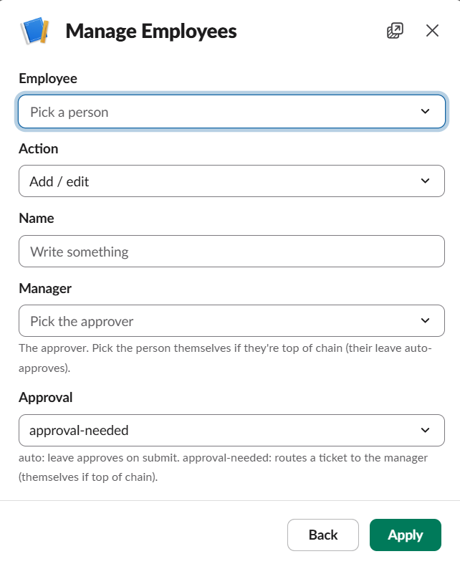
Manage Employees
/control › Manage employees
THREE ACTIONS
Add / edit
Set a person's name, their manager, and whether leave auto-approves or needs sign-off
Allowance override
Give one person a custom quota, apart from the central policy
Delete
Remove an employee (once their reports are reassigned)
TTMI

Slide 23
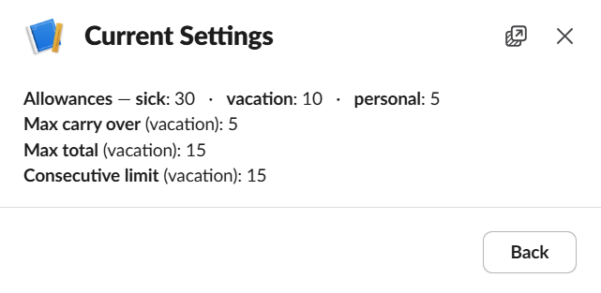
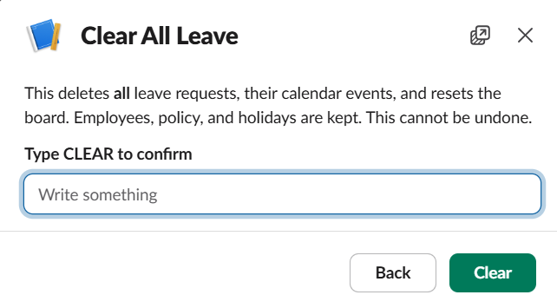
Settings & reset
/control › View settings · Clear
View settings
Clear
Current policy — allowances, carry-over, caps — at a glance.
Wipe all requests & calendar events. Type CLEAR to confirm — employees, policy and holidays are kept.
TTMI

Slide 24
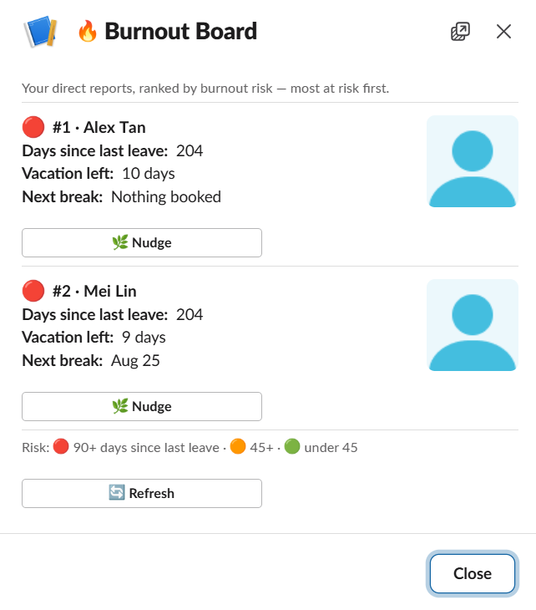
/burnout
BURNOUT BOARD
LOOK AFTER THE TEAM
Spot burnout early
Ranks your direct reports by burnout risk
Shows days since last leave, balance left & next booked break
One-click Nudge to gently suggest someone takes a rest
90+ days
45+ days
under 45
TTMI

Slide 25
IN SHORT
Leave that runs itself
1 command
0 spreadsheets
Full control
replaces the manual DM-and-jot-down loop
everything auto-saves and lands on the calendar
our data, our policy, our rules — priced pay-per-use
Plus a Leave Optimizer and a Burnout Board — so the team actually rests.
TTMI

Slide 26
TTMI
THANK YOU
Leave management that lives where your team already woks.
Presented by Saruj Chutapornpong · Intern

