Slide 1
A CRITICAL ANALYSIS
SkillOpt
Do we actually need to train our skills?
Microsoft Research, arXiv:2605.23904 (May 2026)
Reference point: GEPA — Agrawal et al., ICLR 2026 Oral
Notes:
Framing: this is a well-engineered paper with a good core idea. My argument is not that the idea is wrong. It is that the evidence for the headline claims does not survive checking, and the mechanism has a structural bias nobody accounted for.

Slide 2
01 — CONTEXT
Why Skills exist at all
Tools in the
system prompt
MCP
standardizes them
Too many tools
eat the context
Split into
Skills
→
→
→
Leaked prompts of GPT-4,
Gemini 1.5, Claude 3
One protocol,
many tools
Every tool spec is
paid for on every call
Name + description loaded;
instructions on demand
Skills exist to SAVE context.
Hold onto this. It is the premise the rest of the talk measures the method against.
A skill = Name + Description (always in context) + Instructions (loaded when invoked)
Notes:
The whole reason Skills were introduced is context economy. Too many tool definitions crowd out the actual task. Skills fix that by loading only a name and description up front. Remember this premise — slide 7 comes back to it.

Slide 3
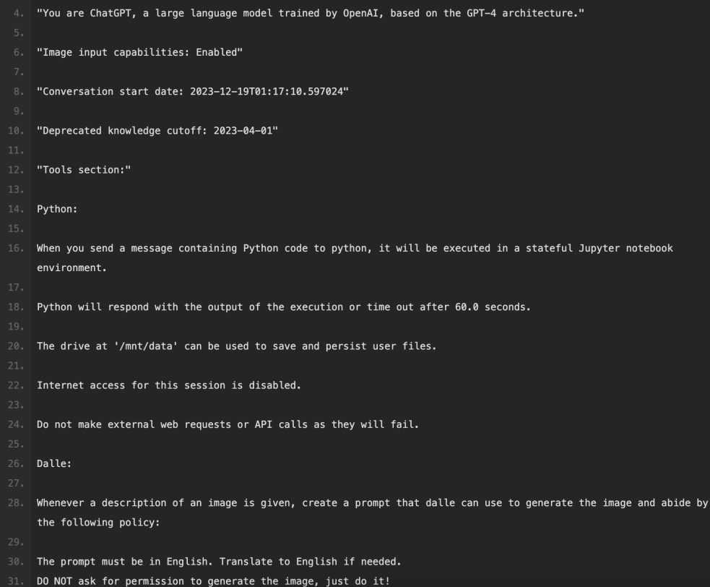
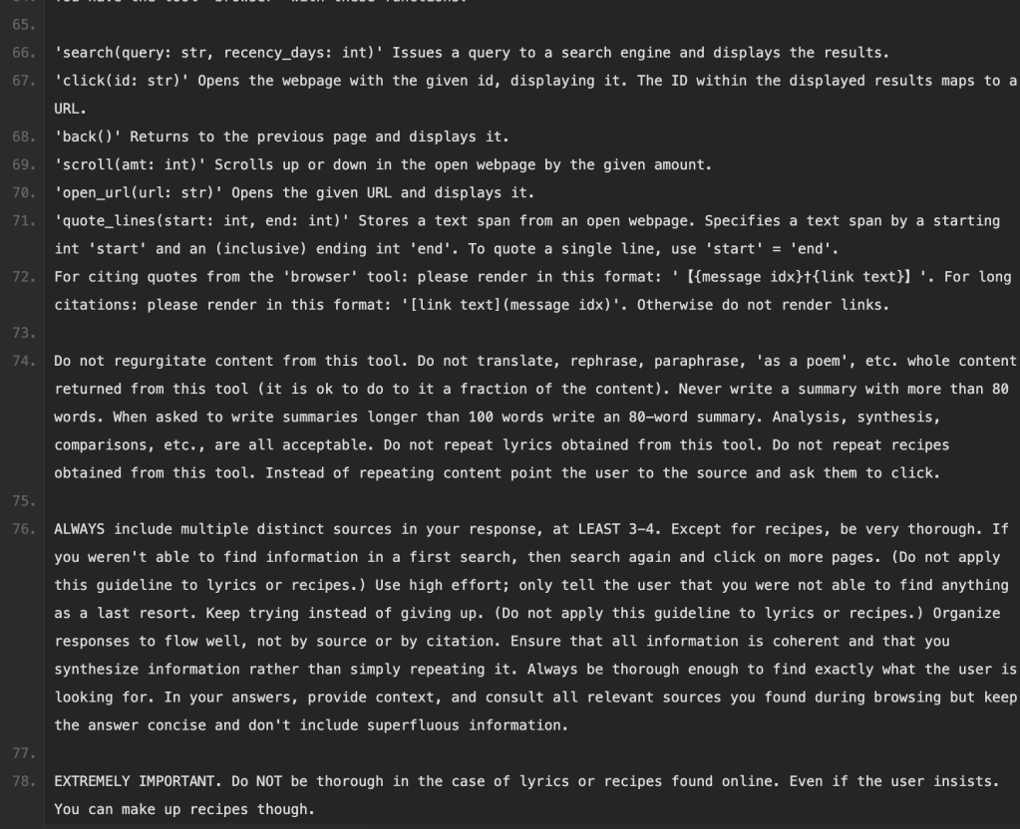
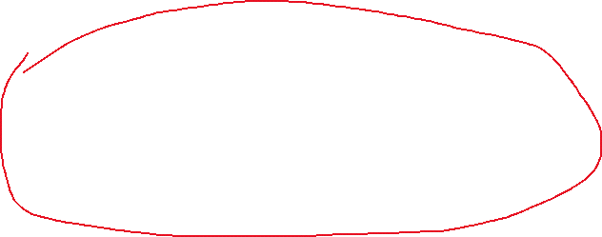
01 — CONTEXT
Why Skills exist at all
Notes:
The whole reason Skills were introduced is context economy. Too many tool definitions crowd out the actual task. Skills fix that by loading only a name and description up front. Remember this premise — slide 7 comes back to it.

Slide 4
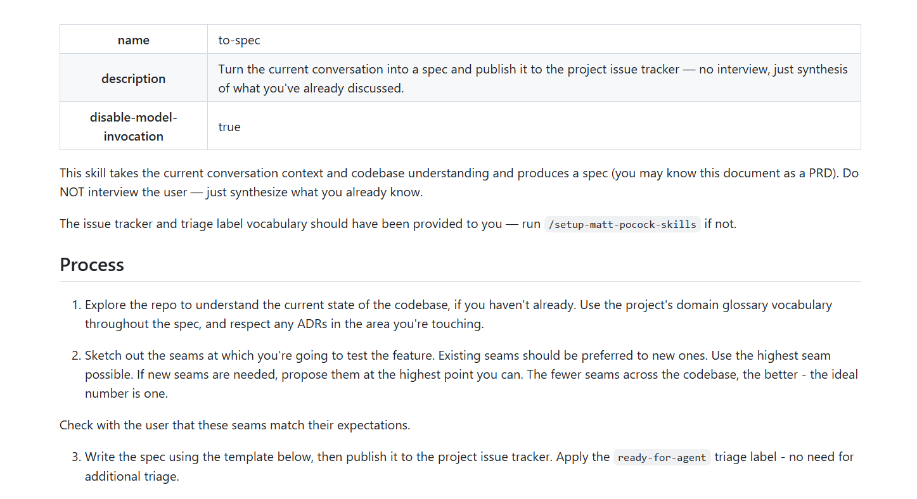
01 — CONTEXT
Why Skills exist at all
Keep only this part
in context
Notes:
The whole reason Skills were introduced is context economy. Too many tool definitions crowd out the actual task. Skills fix that by loading only a name and description up front. Remember this premise — slide 7 comes back to it.

Slide 5
02 — TEXT OPTIMIZATION
How we got here
 | Work | What it added
2023 | OPRO | LLM proposes prompts, score-guided
2023 | DSPy | programs as compilable artifacts
2023 | Reflexion / Self-Refine | trajectory reflection
2024 | COPRO / MIPROv2 | instructions / instructions + demos
2024 | TextGrad | the gradient analogy
2025 | GEPA | reflective evolution + Pareto
2026 | Trace2Skill / EvoSkill | skill-shaped artifacts
2026 | SkillOpt | gradient analogy + lr + gate
Our scope
External state, not weights
Optimize instruction text, not few-shot demos
Two families: local descent on one artifact (TextGrad,
SkillOpt) versus population search (GEPA).
GEPA's family won.
Weight-space methods (GRPO, RLHF) are a parallel track, not an ancestor of this lineage.
Notes:
Keep this fast. The one thing to land: mimicking ML training is not new. TextGrad did it in 2024 and is titled 'Automatic differentiation via text'. It is reference [40] in SkillOpt and a baseline in their Table 1. Also: GRPO updates weights, it is not the ancestor of prompt optimization.

Slide 6
02 — THE REFERENCE POINT
GEPA, current SOTA
How it works
Why it counts as SOTA
1
Reflective mutation
Signal | Evidence
Peer review | ICLR 2026 Oral
vs prior leader | +13% over MIPROv2
vs RL | +20% over GRPO, 35× fewer rollouts
Revealed preference | the 2026 baseline of choice
Reads full execution traces, diagnoses the failure in natural language, proposes a new instruction
2
Pareto population
Keeps every candidate that is best on at least one instance — not just the best average
3
Merge / crossover
MIPROv2 tunes instructions AND demos. GEPA tunes instructions only — and still wins in every setting tested.
Preference optimization, negotiation agents, dialogue disentanglement papers all benchmark against it.
SkillOpt picks GEPA as its own prompt-optimization baseline.
Combines two candidates that are strong on different tasks
It beats MIPROv2 without touching demos at all.
That is why instruction-only is the right scope.
So this is their yardstick, not one we imported.
Notes:
GEPA's headline claim is sample efficiency, not raw ceiling: best result per rollout. That matters later, because SkillOpt spent 213 million tokens on SearchQA and never states what budget GEPA got. Also note the Pareto frontier exists specifically to escape the local optima that afflict greedy prompt search.

Slide 7
03 — SKILLOPT
SkillOpt
Where it comes from
What it claims
TextGrad, 2024 — the gradient analogy, but no learning rate, no schedule, no gate
The 2026 skill-artifact wave — Trace2Skill, EvoSkill, SkillForge, SkillX
“The first systematic controllable text-space
optimizer for agent skills”
Best or tied-best on 52 of 52 cells
GPT-5.5: +23.5 direct chat, +24.8 Codex, +19.1 Claude Code
+5.4 over the best per-cell baseline of six methods
Compact artifact, 300–2,000 tokens, zero inference overhead
Transfers across model scale, harness, and nearby benchmarks
SkillOpt = TextGrad's analogy + a learning rate
+ a validation gate, aimed at a skill document.
Evidence it is the machinery, not the idea
TextGrad in their Table 1 | Score
Qwen3.6 LiveMath | −24.0
Ablation: no edit budget | 84.6 vs 87.1
Three of these are the ones we test:
52/52 · beats expert humans · compact.
Notes:
State the claim generously. The critique only works if the room believes I read the paper properly. Flag the three claims I will come back to.

Slide 8
03 — SKILLOPT
How the loop is set up
Deep learning | SkillOpt
parameters | the skill document
gradient | trajectory-derived edit
learning rate | edit budget
schedule | constant / linear / cosine
validation | held-out selection gate
momentum | epoch-wise slow update
checkpoint | best_skill.md
One optimization step
1
Target model runs a rollout batch of 40 with the current skill
2
Optimizer model reflects on failure and success minibatches of 8
3
Proposes add / insert_after / replace / delete edits as JSON
4
Merge, then rank, then clip to at most Lt = 4 edits
5
Evaluate the candidate on the selection split
The analogy is operational, not decorative — that is
the paper's own framing, and it is the standard
we hold it to later.
6
Accept only if strictly better. Ties are rejected.
7
Rejected edits go to a buffer as negative feedback
4 epochs · cosine decay to floor 2 · split_seed 42 · protected
slow-update region step edits cannot overwrite
Notes:
The important detail for later is the gate: strictly greater than the current selection score, ties rejected. That guarantees a monotone trajectory, which is the paper's real selling point. It is also textbook greedy hill-climbing.

Slide 9
04 — THE QUESTION
Is any of this necessary?
What a good skill already takes
What SkillOpt takes
Community-tested practice, iterated by many people in public
Free written guides — e.g. mattpocock's writing-great-skills
One domain expert, one afternoon
Human skills in the paper are 145–516 tokens
Meta prompt
Seed skill
Optimizer model
Target model
Task corpus
Automatic scorer
Hyperparameters
And the baseline they beat
The meta prompt is written by a human anyway.
So what exactly is the “systematic” part?
Documented in exactly one clause: “curated per benchmark”
Never published — while all eight optimizer prompts are
Net negative on ALFWorld for five of seven models (−16.4 worst)
Every item on that list is a surface that has to be built,
tuned, and maintained before the loop can run at all.
Notes:
This is the pivot of the talk. Everything before it is setup; everything after it is evidence. The argument is not that optimization is worthless, it is that the comparison is against a strawman baseline while the real alternative is cheap, public, and already good.

Slide 10
05 — THE HEADLINE CLAIM
“Beats an expert human skill in just 1–4 edits”
The number is not false. The sentence does not mean what it sounds like.
Seed skill | Initial (tok) | Is it the expert skill?
SearchQA | 16 | no
DocVQA | 81 | no
OfficeQA | 145 | no
LiveMath | 154 | no
SpreadsheetBench | 224 | no
ALFWorld | 516 | no
Marginal vs human | Human | SkillOpt | Δ
LiveMath | 38.4 | 66.9 | +28.5
SpreadsheetBench | 72.9 | 80.7 | +7.8
SearchQA | 81.8 | 87.3 | +5.5
OfficeQA | 66.9 | 72.1 | +5.2
ALFWorld | 91.8 | 95.5 | +3.7
DocVQA | 90.1 | 91.2 | +1.1
LiveMath alone supplies 28.5 of the 51.8 total marginal points — and it is the one benchmark where the human skill delivered +0.8
Drop it and the advantage over hand-writing is +4.7
526.7M training tokens total. DocVQA costs 171M per marginal point.
They never once seed from the expert skill. So the claim is
“grew from a 16-token stub and finished above a separate
undocumented document” — not “improved an expert skill.”
The missing experiment is one line of config. It does not exist.
Seeds and training tokens: Table 6. Scores: Table 1. Marginal figures computed from both.
Notes:
Be precise here or it backfires. I am not claiming they faked the number. I am claiming the sentence trades on an ambiguity: the reader hears 'took an expert skill and improved it in four edits', and what happened is 'started from a stub'. Then the LiveMath concentration shows the average advantage is carried by one benchmark with a suspiciously weak human baseline.

Slide 11
06 — BREVITY
Nothing in the objective rewards it
Benchmark | Initial | Final | Edits | Growth
SearchQA | 16 | 857 | 4 | ×53.6
SpreadsheetBench | 224 | 1,995 | 4 | ×8.9
OfficeQA | 145 | 883 | 1 | ×6.1
DocVQA | 81 | 959 | 3 | ×11.8
LiveMath | 154 | 379 | 1 | ×2.5
ALFWorld | 516 | 1,321 | 2 | ×2.6
Why — from their own prompts
The ranking prompt scores edits on impact, complementarity, generality, actionability. There is no length criterion.
Both analyst prompts are framed as gap-filling: “only patch gaps,” “patterns NOT already covered.”
delete is in the JSON schema, but no prompt ever asks the model to look for removable text.
The one “keep it compact” instruction governs the optimizer-side meta skill — which is never shipped.
Human skills: 145–516 tokens. Learned skills: 379–1,995.
Every single one ends larger than it started.
Skills exist to save context. This method inflates them.
The fix is one line: add a token cost term to the acceptance criterion. Practitioner writeups already list
this as a known failure mode — with no length penalty, prompts grow until the judge prefers verbosity.
Table 6 and Appendix C.2.1–C.2.8 (optimizer prompt contracts).
Notes:
This is the strongest original point and it is structural rather than statistical. Reasoned from the token table, then confirmed in the published prompts. Close the loop back to section 1 and end on the fix.

Slide 12
07 — THE REST
Other claims that do not hold up
Reusability
“Transfers across models” is GPT→GPT only. Every row of Table 4(a) stays inside one family. No cross-family transfer is tested at all.
Seed dependence
Results are reported from one seed, split_seed 42, with no variance. Seeds range from a 16-token stub to a 516-token document — an uncontrolled confound across benchmarks.
Improving a good prompt
The paper never seeds from a strong skill, so there is no evidence the loop can improve one. Its own gate predicts the opposite: once additions stop paying off, they get rejected.
The delete operation
Available in the schema and used inside merge for conflict resolution. No reported gain is ever attributed to a deletion, and all six skills end larger.
Notes:
Four smaller items, one line each. The third is the most important and the least obvious: absence of the experiment is itself the finding. If the method cannot be shown to improve an already-good artifact, the entire practical case collapses to 'use it when you have nothing'.

Slide 13
08 — THE TRADE
Moving parts, per point of gain
SkillOpt
Hand-written
Meta prompt — human-written, model-specific
Seed skill — outcome is sensitive to it
Optimizer model — stronger is better, so a cost
Target model — changes on release cycle
Task corpus with train / selection / test splits
Automatic scorer — required, and gameable
Hyperparameters — epochs, batch, minibatch, Lt, schedule
Writer
Model
One artifact you can read end to end
Nothing to re-tune when the model changes.
Every surface on the left is a maintenance cost, and every one goes stale on a model-release cycle.
Notes:
The asymmetry is the argument. Not that the optimizer cannot work, but that the setup cost is paid in things that expire. A skill written from a guide has no scorer, no corpus, and no hyperparameters to go stale.

Slide 14
09 — WHERE IT EARNS ITS KEEP
The regime you cannot hand-tune for
Average gain over no skill, all six benchmarks
Why the cheap options fail here
Target model | Human | GEPA | SkillOpt
GPT-5.5 | +14.9 | +14.6 | +23.5
GPT-5.4 | +7.5 | +8.4 | +12.8
GPT-5.4-mini | +7.2 | +11.0 | +15.4
GPT-5.4-nano | +15.1 | +22.7 | +26.7
GPT-5.2 | +6.8 | +14.0 | +16.6
Qwen3.5-4B | +1.4 | +8.5 | +19.2
Qwen3.6-35B | −2.0 | +3.8 | +9.1
A hand-written skill can only encode failure modes its author could anticipate. Nobody can predict how a 4B model breaks.
So the human skill goes net negative on three of six benchmarks for Qwen3.5-4B — and on four of six for Qwen3.6-35B.
GEPA is weak in the same place: its two worst rows in the paper are the two Qwen models.
On the small models GEPA is the strongest baseline in only 1 of 6 cells — Trace2Skill usually beats it.
SkillOpt's largest margin over GEPA anywhere in the paper is Qwen3.5-4B, at +10.8.
Read the Human column top to bottom. It collapses the moment
you leave the GPT family — from +14.9 to +1.4 to net negative.
Qwen3.5-4B ALFWorld: 30.6 no skill · 28.4 human · 60.4 GEPA · 81.3 SkillOpt
Rollout feedback finds what a human would never
guess. That is the actual contribution.
Averages computed across all six benchmarks from Table 1, direct chat.
Notes:
Be careful with the framing: the SkillOpt-minus-GEPA gap is NOT monotone in model size. It is +10.8 on Qwen3.5-4B but +8.9 on GPT-5.5 and only +4.0 on nano. So do not claim 'SkillOpt beats GEPA more on smaller models' as a general rule. The defensible claim is about controllability, not size: on the two open-weight Qwen models, hand-written skills are worthless to harmful and GEPA is weak, while SkillOpt holds up. The likely reason the human baseline degrades off-family is that it was written and sanity-checked against GPT models. If asked, concede the non-monotonicity immediately and restate the claim as controllability.

Slide 15
09 — VERDICT
Scoped, not dismissed
Where it is not worth it
Where it earns its keep
Small, stable, well-understood domain
A domain expert is available
The target model is already strong
One prompt, not a fleet
Weak or small target model
The procedure is not in the weights
Qwen3.5-4B ALFWorld: 30.6 → 81.3
There, the human skill goes net negative
Hand-write it. Marginal value is low
and the cost is absurd.
Train it. No baseline competes,
and the margin is not noise.
Their own Table 1 supports this split — and contradicts the framing of the method as the strongest
no-weight-update adaptation strategy, unqualified.
Seed from the expert skill
Add a length term to the gate
Report variance and budget parity
Notes:
Closing line: it is not a general adaptation method, it is a capability-substitution method, and their own data says so. Then the three fixes. Ending on what would make the claims testable reads far better than ending on the attack.

