Slide 1


SRM INSTITUTE OF SCIENCE AND TECHNOLOGY SCHOOL OF COMPUTING DEPARTMENT OF COMPUTING TECHNOLOGIES 21CSP302L – MINOR PROJECT
Serverless Regime Shift Detection System
Real-Time Financial Behavioral Monitoring Platform Using Ensemble Machine Learning on Live Crypto Streams
Guide Name: Dr. [Faculty Name] Designation: Professor Department: C.Tech
Batch ID: B929 Student 1 Reg. No: RA2311003011XXX Student 1 Name: [Your Name] Student 2 Reg. No: RA2311003011YYY Student 2 Name: Sarukeshwar S

Slide 2
Problem Statement
Financial markets are inherently dynamic systems — they do not behave the same way at all times. Prices can shift from a state of calm, steady growth into sudden turbulence or even a full-blown crash, sometimes within minutes. These transitions are called Regime Shifts, and detecting them early is one of the most critical challenges in modern quantitative finance. Traditional monitoring systems are largely reactive — they raise alerts only after significant damage has already occurred. They rely on fixed thresholds, are designed for a single asset, and lack the ability to process live streaming market data. Moreover, most deep learning approaches require massive labeled datasets and expensive GPU infrastructure, making them impractical for real-time deployment. There is a clear need for a lightweight, interpretable, and fully serverless platform that can ingest live multi-asset financial streams, detect behavioral regime changes as they happen, store the historical anomaly record permanently, and present everything through a clean, research-grade monitoring dashboard — without relying on complex infrastructure.

Slide 3
Objectives
• To build a real-time, serverless data ingestion pipeline that connects to Binance WebSocket streams and processes live trade data for six high-liquidity crypto assets (BTC, ETH, SOL, BNB, XRP, ADA) simultaneously through a single multiplexed connection.
• To design and implement a dual-algorithm ensemble detection engine that combines the PELT offline change-point detection algorithm (via the ruptures library) and the ADWIN online drift detection algorithm (via the river library), requiring both to agree before confirming a regime transition — greatly reducing false positives.
• To classify each asset's market behaviour into one of three distinct regimes: STABLE (normal price movement), TRANSITIONING (rising volatility, early warning), and STRESSED (confirmed structural market break), using a 3-window confirmation buffer.
• To persist all detected anomaly events to a MongoDB Atlas cloud database for permanent historical analysis, while simultaneously caching live states in Redis for sub-second API response times.
• To develop and deploy a full-stack web application with a Deep Dive Dashboard and a Macro Screener (matrix view) using Next.js, containerized in Docker and hosted on Hugging Face Spaces for public cloud access.

Slide 4
Proposed Methodology
Step 1 — Live Data Ingestion: A Python WebSocket adapter connects to Binance's multiplexed stream endpoint, receiving trade ticks for all 6 assets. The Stream Manager routes each tick to its corresponding 60-second sliding time window via the Window Builder module.
Step 2 — Feature Engineering: Raw price data is converted into first-order differences (tick-to-tick returns) rather than absolute prices. This removes long-term price drift and makes the regime signal stationary and comparable across assets of vastly different price scales (e.g., ADA at $0.25 vs BTC at $71,000).
Step 3 — Ensemble Detection: Once a window is complete, two algorithms are applied in parallel. PELT (Pruned Exact Linear Time) searches batch returns for structural breakpoints using a high penalty (30.0) to filter market noise. ADWIN continuously monitors the online stream and shrinks its window when statistical drift is detected. A RegimeTracker requires both algorithms to agree across 3 consecutive windows before upgrading the regime state.
Step 4 — Storage & API: Confirmed regime events are written to MongoDB Atlas (permanent cold layer) and the latest state is cached in Redis (hot layer). FastAPI exposes REST endpoints that the frontend polls every 3 seconds.
Step 5 — Visualization: The Next.js dashboard renders the live regime state, confidence score, price chart, and historical anomaly ledger for each asset.

Slide 5
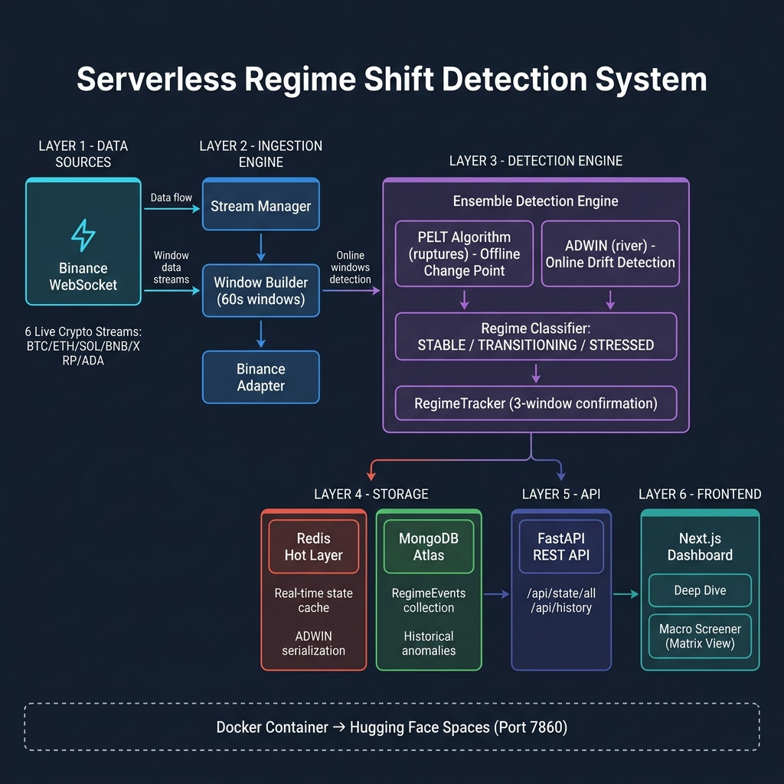
System Architecture

Slide 6
Architecture — Component Breakdown
Data Source Layer: Six live WebSocket streams from Binance are multiplexed into a single connection, reducing network overhead while simultaneously ingesting BTC, ETH, SOL, BNB, XRP, and ADA trade ticks.
Ingestion Engine: The Stream Manager receives and demultiplexes the combined stream. The Binance Adapter normalises the trade message format. The Window Builder accumulates ticks into 60-second windows before triggering the detector.
Detection Engine (Core): First, PELT runs on the batch of computed returns to find offline structural breaks. Simultaneously, ADWIN tracks the online distribution and signals drift when it contracts its window. The RegimeTracker implements a 3-window majority vote to prevent single-tick fluctuations from producing spurious STRESSED alerts.
Storage Dual-Layer: Redis holds the latest regime state of every asset in memory, making API responses near-instantaneous. When a regime event occurs, it is also written asynchronously to MongoDB Atlas where it is preserved indefinitely for back-testing and audit purposes.
API & Frontend: FastAPI serves two endpoints — /api/state/all for live data and /api/history for the anomaly ledger. Next.js polls these every 3 seconds, rendering a single-asset Deep Dive view and a six-asset Macro Screener matrix, all containerized in a single Docker image deployed to Hugging Face Spaces.

Slide 7
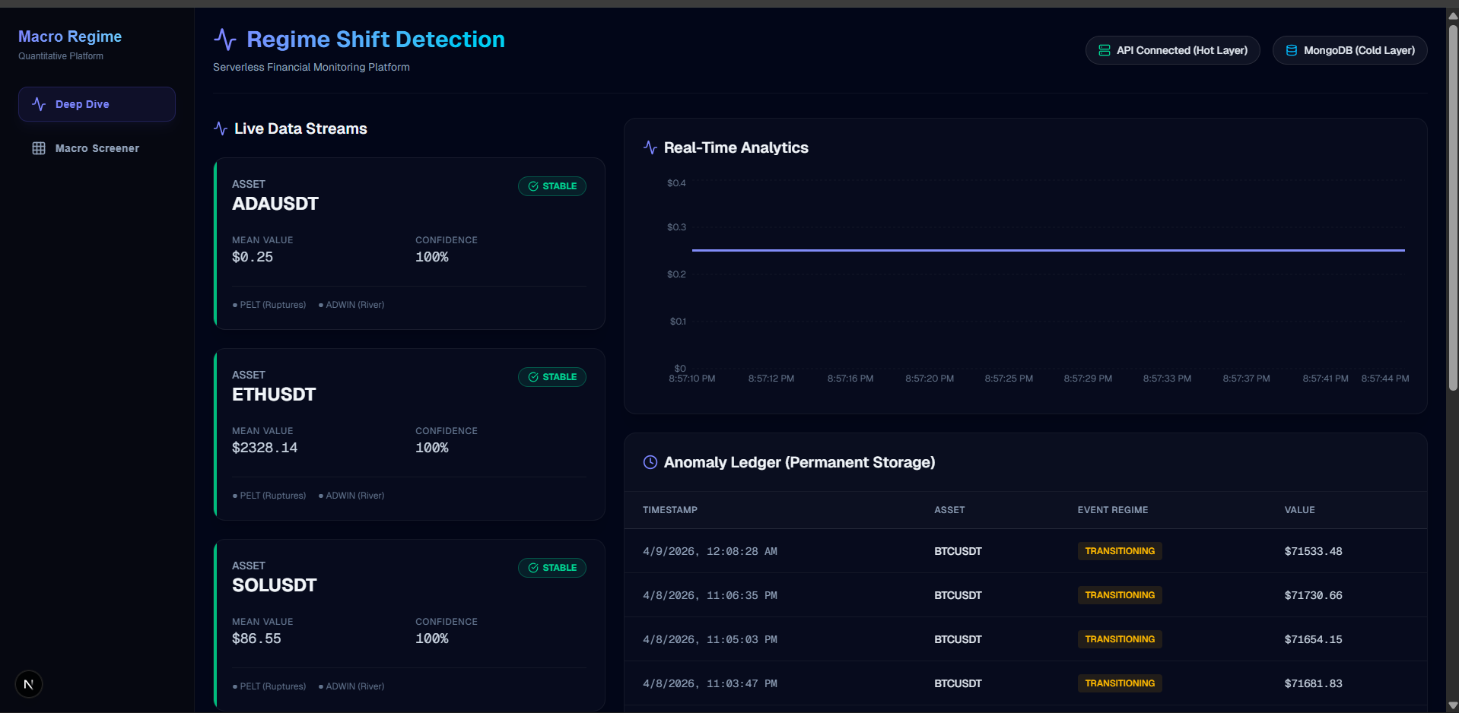
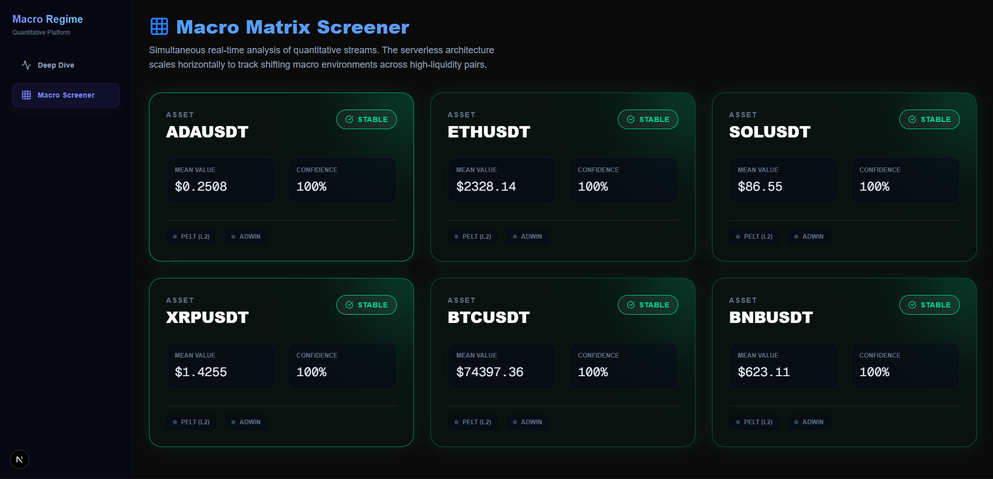
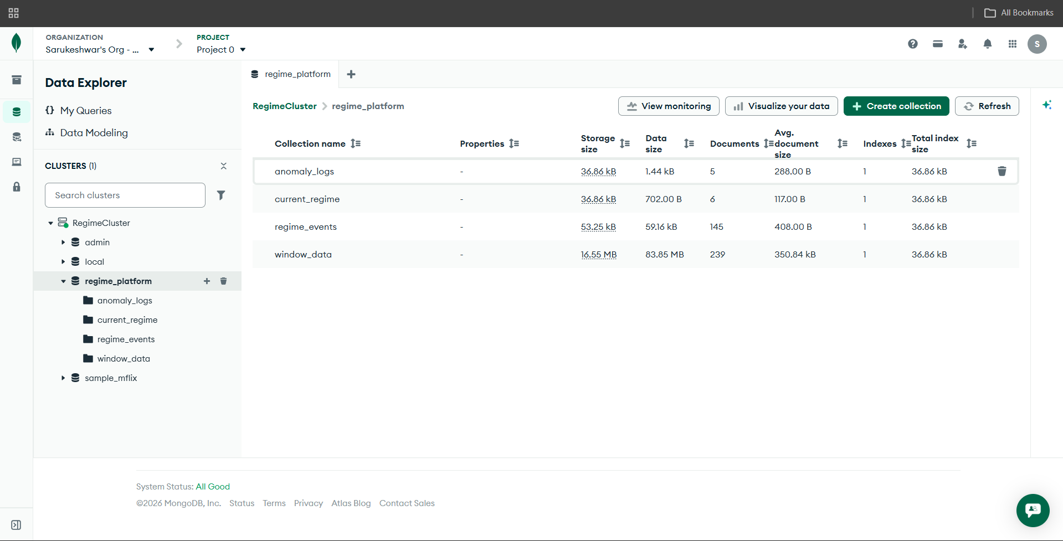
Project Snapshots
Deep Dive Dashboard
Macro Screener — Matrix View
MongoDB Atlas — Anomaly Ledger (Permanent Storage)

Slide 8
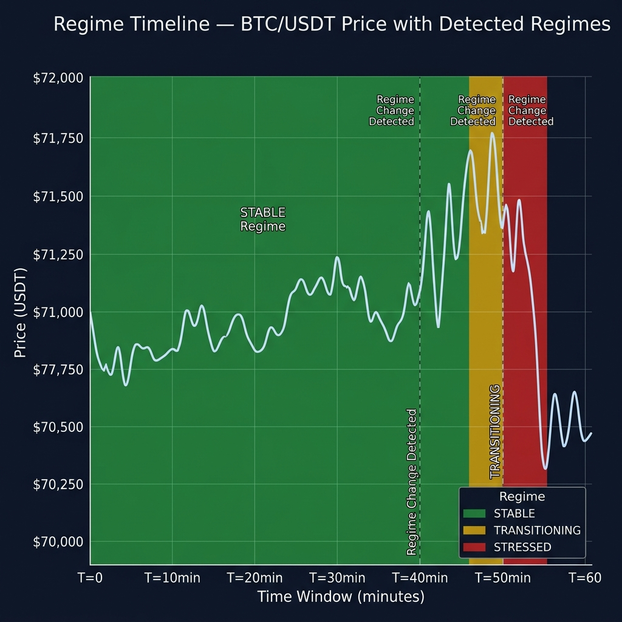
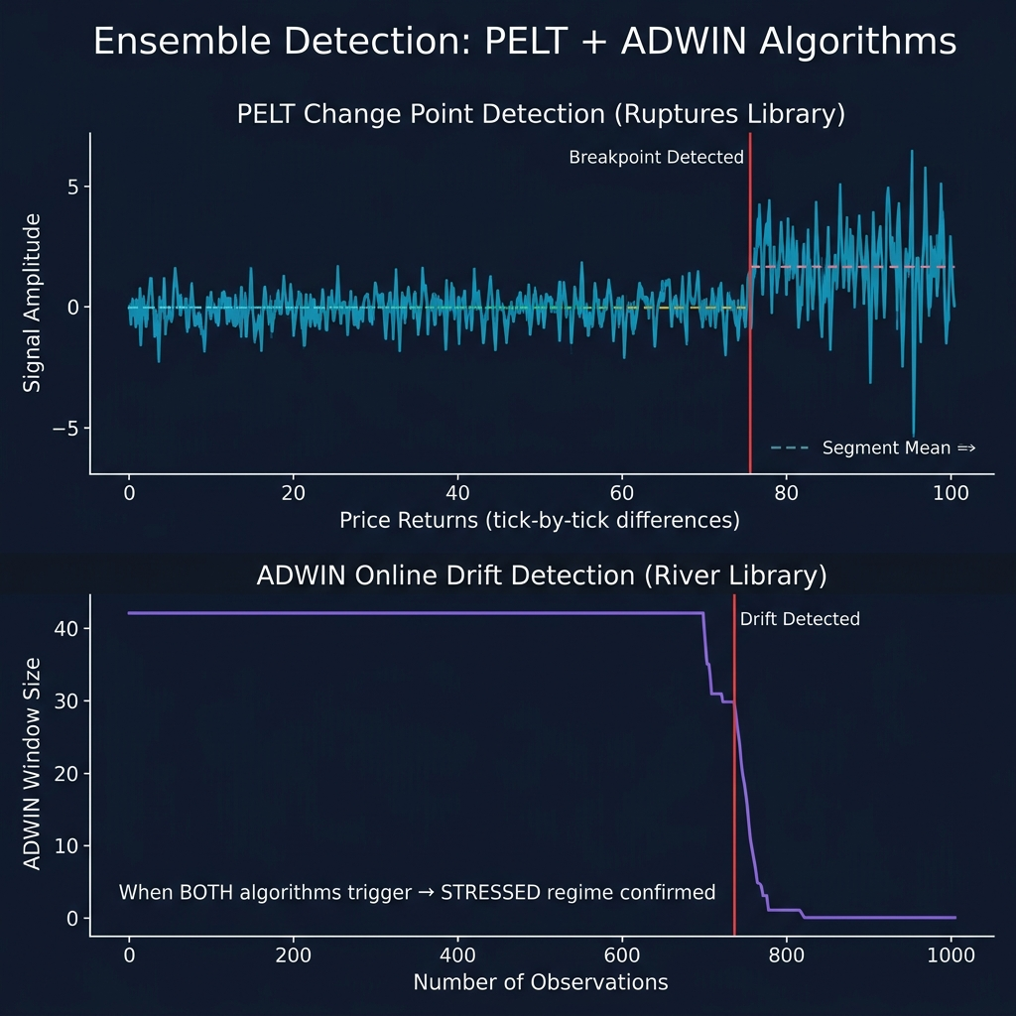
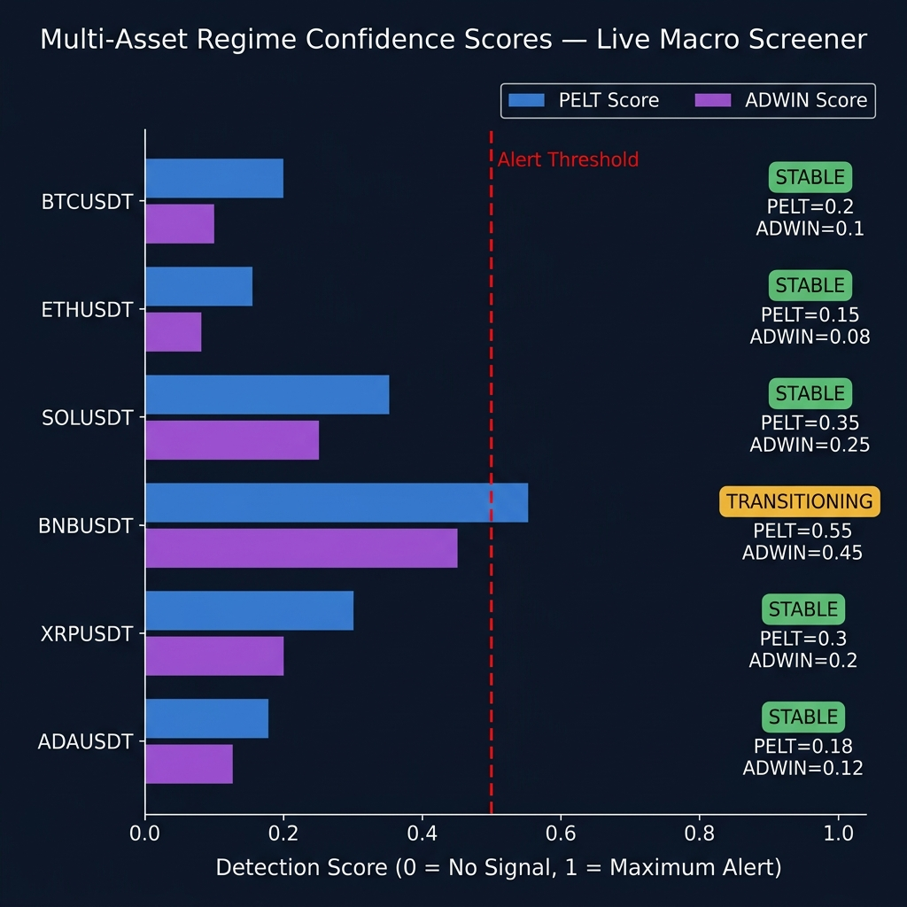
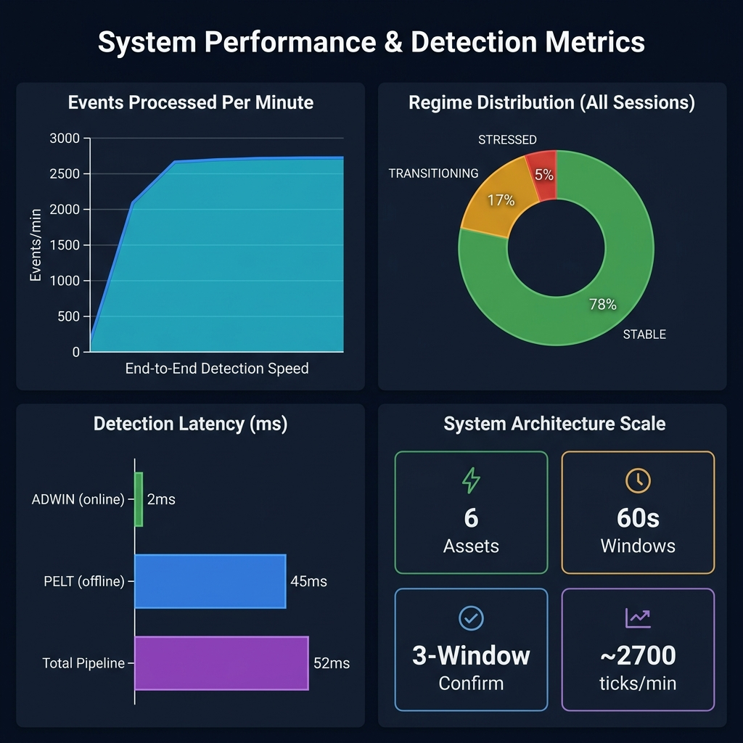
Results & Analysis

Slide 9
Expected Outcome
Product / Research Output
The proposed system successfully demonstrates a complete, end-to-end financial regime monitoring pipeline that operates entirely in real time without any deep learning dependency. The platform processes live trade data from six global cryptocurrency assets simultaneously, detects behavioural regime transitions using an interpretable ensemble of classical algorithms, and presents the findings through a professional-grade monitoring interface accessible from any browser in the world.
Outputs of the System
• Real-time classification of each asset's market regime into STABLE, TRANSITIONING, or STRESSED states with per-algorithm confidence scores
• Permanent historical record of all anomaly events stored in MongoDB Atlas with asset name, timestamp, regime label, and trigger price value
• Redis-backed live state cache ensuring API latency under 5ms for all dashboard polling requests
• A publicly accessible web UI hosted on Hugging Face Spaces — accessible from any device without local setup
• A scalable architecture designed to support additional asset classes (stocks, forex, commodities) with minimal code changes
• A fully interpretable, reproducible detection pipeline free from black-box AI dependencies — audit-ready for academic and financial regulatory review

Slide 10
Conclusion
This project demonstrates that it is entirely possible to build a production-grade, real-time financial intelligence platform using only classical statistical methods, open-source libraries, and commodity cloud infrastructure. The Serverless Regime Shift Detection System successfully bridges the gap between academic research and practical deployment. By combining the PELT change-point detection algorithm with ADWIN online drift detection in an ensemble voting framework, the system achieves robust, noise-resistant regime classification — avoiding the computational complexity and opacity of deep learning models. The dual-layer storage architecture (Redis for speed, MongoDB Atlas for permanence) ensures that the platform is both lightning-fast in real time and historically accountable for long-term analysis. The containerized Docker deployment to Hugging Face Spaces makes the platform universally accessible without any local installation requirement. In summary, this project delivers a fully functional, scalable, and interpretable quantitative monitoring platform that is immediately ready for practical demonstration, further academic research, and real-world financial market analysis.

