Slide 1
Fig. 1
Fig 1A. Age-specific prescription volume per 100,000 population (FY2024)
Interval = identification interval (lower bound = published value; upper bound accounts for suppressed cells). No bar is drawn: the true value lies somewhere inside the interval and its position is not identified.
Fig 1B. Age-specific volume per 100,000 by drug (FY2024)
Bars = lower bound (published value); whiskers = upper bound. Age 100+ excluded (interval exceeds 10x the lower bound).
Fig 1C. Share of each drug within the top-3 total, by age (FY2024)
Points = ratio of published values (lies between the bounds); whiskers = identification interval on both sides. Width 4.9-8.2 pp at age 0-4 and 23.0-26.9 pp at age 95-99; do not compare levels at 95+.

Slide 2
Fig. 2
Fig 2. Sex- and age-specific volume per 100,000 (top 3 drugs, FY2024)
Bars = lower bound (published value); whiskers = upper bound. Age 100+ excluded (+4,442% for males).

Slide 3
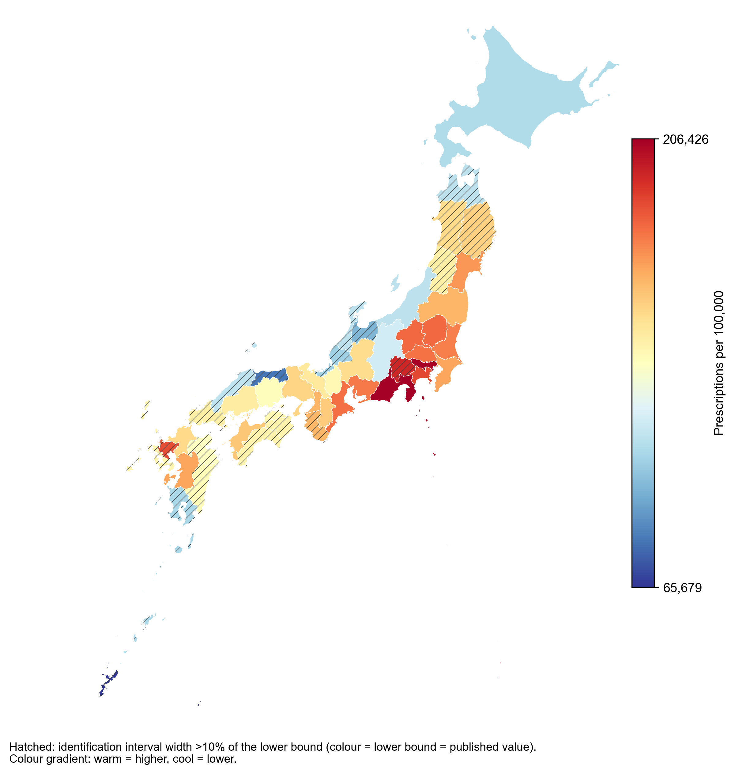
Fig. 3
Fig 3A. Prefecture ranking (Epinastine + Olopatadine + Levocabastine, FY2024)
Fig 3B. Prefecture map (same colour gradient as Fig 3A)
Colour = lower bound; hatching = the 21 prefectures whose interval width exceeds 10% of the lower bound (level and rank not identified). Prefecture = location of the facility/pharmacy, not the patient's residence.
Bars = lower bound = published value, coloured by magnitude (warm = higher, cool = lower); whiskers = upper bound. Order is by lower bound and does not imply rank: ranks of prefectures with overlapping intervals are not identified.

Slide 4
Fig. 4
Fig 4A. Trends in volume per 100,000, FY2014-2024
Points = lower bound (published value); whiskers = upper bound, including the rank-based bound for non-listed products in FY2021 and earlier. FY2014 top-3 total: upper bound is 1.9x the lower bound.
Fig 4B. Share within the top 3 drugs, FY2014-2024
Points = ratio of published values; whiskers = identification interval on both sides. Width <0.01 pp from FY2022 but up to 37.7 pp in FY2014. Values for FY2021 and earlier are affected by the top-N cut-off.

Slide 5
Fig. 5
Fig 5A. Epinastine: share of the 0.1% (high-concentration) formulation
National totals are published, so the interval width is <0.01 pp in every fiscal year; the whiskers are not visible at this scale.
Fig 5B. Epinastine: share of the 0.1% formulation by age (FY2024)
Bars = ratio of published values; whiskers = identification interval on both sides. Age 100+ excluded (the 0.05% cell is suppressed, making the share appear to be 100%).

Slide 6
Fig. 6
Fig 6A. Generic share by drug, FY2015-2024 (combined identification interval)
Points = lower bound = published value; whiskers = identification interval combining censored totals AND products absent from NDB under the top-N cut-off (FY2021 and earlier). Max width 34.7 pp (Levocabastine FY2021); <=0.01 pp for FY2022-2024. Zero width in FY2015-2020 for epinastine and olopatadine means no generic was on the NHI price list (a true 0%). THE UPPER BOUND IS ITSELF A LOWER BOUND: the count of absent products is a minimum (brand/Y-code unit).
Fig 6B. Epinastine: brand/generic x 0.1%/0.05% composition
National totals are published, so the interval width is <0.01 pp. The 0.1% generic first appears in FY2024 (listed 6 Dec 2024, about four months of the fiscal year).

Slide 7
Fig. 7
Fig 7A. Between-prefecture Gini coefficient, FY2014-2024
Points = value computed from the lower bounds (published values); whiskers = min/max the index can take while every prefecture stays inside its interval. Prefecture-level intervals exclude the non-listing adjustment, so the comparable start year differs by drug: FY2014 for epinastine and olopatadine, FY2022 for levocabastine and the top-3 total.
Fig 7B. Between-prefecture coefficient of variation, FY2014-2024
Same construction as Fig 7A. Levocabastine has the widest intervals (small volume, high proportion of suppressed cells); its CV upper bound reaches 1.9-3.2 in FY2015-2017 and may fall outside the plotted range.

