Slide 1


DemoCart – Profile and AddressBook
IGATE is now a part of Capgemini

Slide 2
TEAM MEMBERS
Employee Id | Employee Name
150943 | R. Sarulatha
150763 | K. Jahnavi
150782 | K. Swathi
150757 | U. Geethika
150760 | V. Bhavya

Slide 3
Application Link
https://demo.opencart.com/

Slide 4
OVERVIEW OF THE PROJECT
It is a web based application.
Project aims at testing an online shopping application.
User can edit his account information.
User can change his password.
User can update, delete or add new address in the Address Book.
User can modify things added in their wish list.

Slide 5
Flow Steps
Edit your account information-
Edits personal information and clicks on continue.
The common functions for edit your account information are :
OpenWebsite() – Opens the browser as per the data_sheet.
LoginUser() – opens the login page of the site.
goToEditYourAccountInformation() – system displays “edit your account information” page.
Continue() – On successful validation system displays a message ”Your account has been successfully updated”.

Slide 6
Flow Steps (Continued)
Change your password-
Changes password if user requires.
The common functions to change your password are :
openWebsite() – Opens the browser as per the data_sheet.
LoginUser() – opens the login page of the site
Password() – User enters new password.
PasswordConfirm() – User re-enters the new password.
Continue() – On clicking continue, system displays “Your password has been successfully updated”.

Slide 7
Flow Steps (Continued)
Modify your Address Book Details-
Adds new address in the Address book Entries or modifies the address book details.
The common functions to modify your address book details -
openWebsite() – Opens the browser as per the data_sheet.
LoginUser() – opens the login page of the site
goToAddressBook() – directs the user to the Address book entries page.
FillNewAddressDetails() – Directs to the new address page and fills-up it according to the data_sheet.
isResultElementPresent() – checks whether a specific alert or field is present or not.

Slide 8
Feasibility Study
Address is not editable in given address book.
New address can be added in case if user hasn’t entered one.

Slide 9
Challenges Faced
Finding Defects in the module.
Problems in running test cases in different browsers.
Fetching data from excel sheets.
Handling data sheet and object repository in .xlsx format.
Writing manual test cases.
Converting the manual test cases to automated test cases.
Implementing Keyword Driven Framework.

Slide 10
Test Cases
Total | Automated | Non-Automated | Browser | Test Executed | Passed | Failed | Defects | No Run
68 | 40 | 28 | Mozilla Firefox | 68 | 22 | 46 | 4 | 0
68 | 40 | 28 | Internet Explorer | 68 | 22 | 46 | 4 | 0
68 | 40 | 28 | Google Chrome | 68 | 22 | 46 | 4 | 0

Slide 11
Test Case Effectiveness
Software Test Efficiency is number of test cases executed divided by unit of time (generally per hour).
Test Efficiency test the amount of code and testing resources required by a program to perform a particular function.
Some formulas to calculate Software Test Efficiency (for different factors):
Test efficiency = (total number of defects found in unit + integration + system) / (total number of defects found in unit + integration + system + User acceptance testing)
Testing Efficiency = (No. of defects Resolved / Total No. of Defects Submitted)* 100
Software Test Effectiveness: Software Test Effectiveness covers three aspects: - How much the customer's requirements are satisfied by the system. - How well the customer specifications are achieved by the system. - How much effort is put in developing the system.

Slide 12
Test Case Efficiency
Test case passed efficiency -> 40.8%
Test case fail efficiency -> 59.2%
Test case automated efficiency -> 76%
Test case non automated efficiency-> 24%

Slide 13
DFDR
DFDR stands for Defect Free Defect Reporting .
A defect is an error or a bug, in the application.
A programmer while designing and building the software can make mistakes or error.
These mistakes or errors mean that there are flaws in the software. These are called defects.
These defects are captured in a defect report

Slide 14
DEFECTS FOUND
The First name is accepting all special and numerical characters.
The Last name is accepting all special and numerical characters.
The Telephone is accepting alphabets characters.
Post code is accepting characters and symbols and it doesn’t throw any exception.

Slide 15
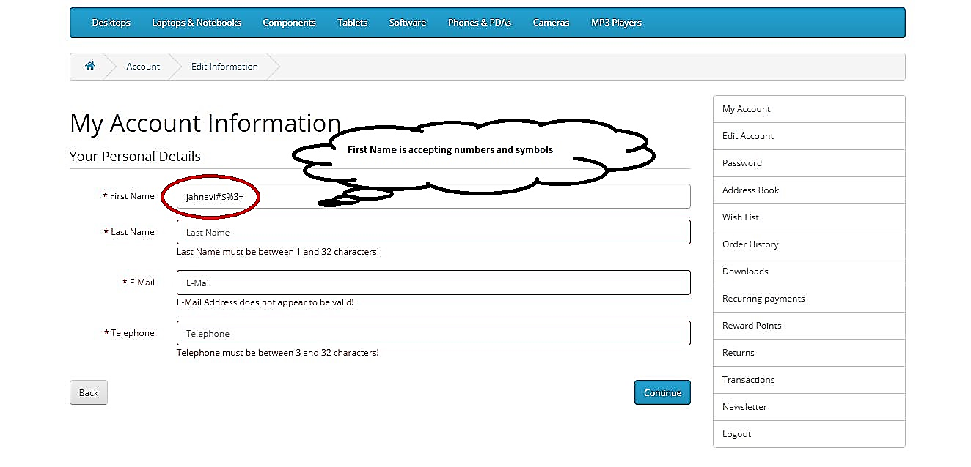
DEFECT SNAPSHOTS - FIRSTNAME

Slide 16
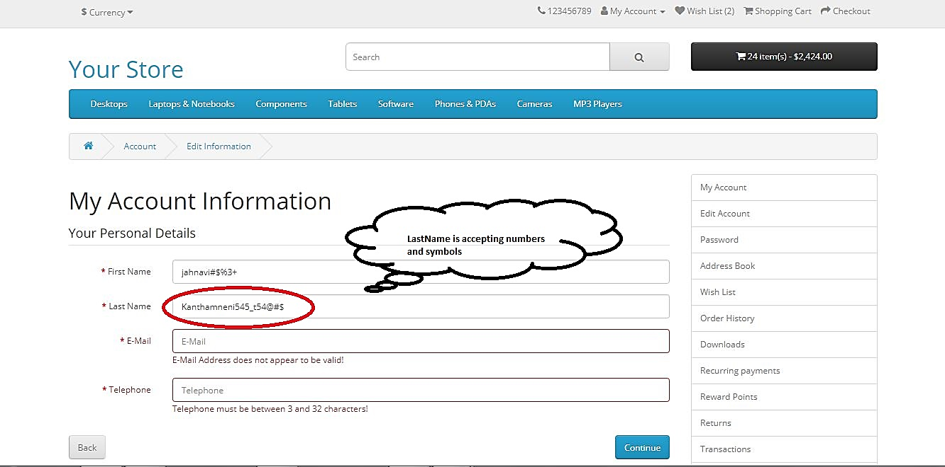
DEFECT SNAPSHOTS - LASTNAME

Slide 17
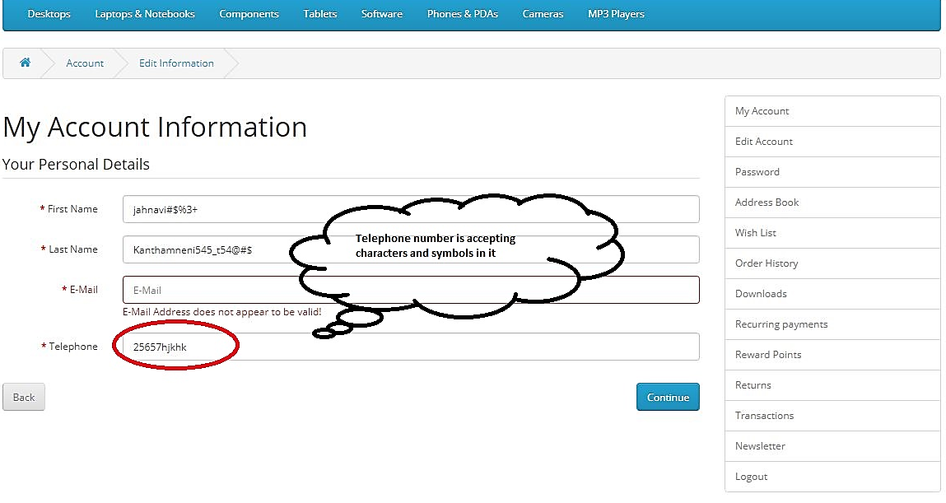
DEFECT SNAPSHOTS - TELEPHONE

Slide 18
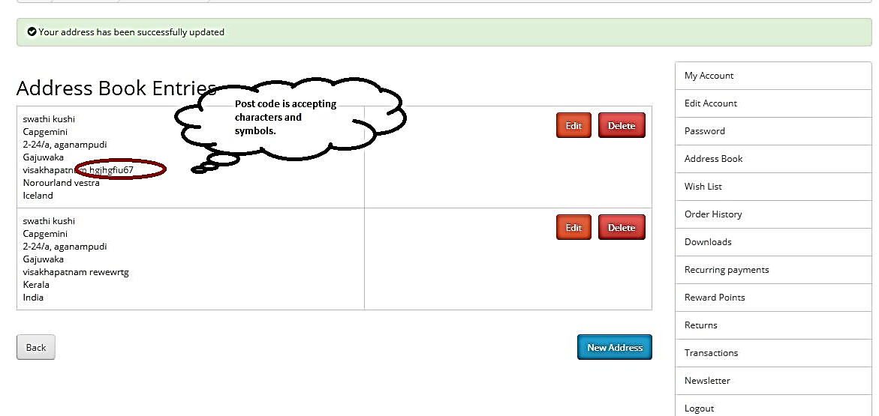
DEFECT SNAPSHOTS – POST CODE

Slide 19
DFDR, Object Repository & Data Sheet
Defect Sheet
Data Sheet
Test Cases

Slide 20
Thank You

