Slide 1
Public Auction.
Course: CS351L - Design of Large Programs. Author: Jacob Hurst, Jaehee Shin, Sarun Luitel, Vincent Huber. Design Documentation.

Slide 2
Overview.
Public Auction is a socket-based simulation of a real-time auction!
Agents are created/cleared dynamically as users connect/disconnect to the servers (Bank & AuctionCentral).
Upon connecting, agent's are given a bank account with a private key & an initial deposit.
From there, the Agent's connection to Auction Central is made & the agent may begin bidding when Auction Houses are opened.
Auction Houses are created dynamically & exit when they no longer have items to sell.
Auction Houses are registered & accessed via Auction Central.
Auction Central (static @ known address) acts as a middle-man between the agent, the agent's bank, & the auction house by mitigating transactions & providing updates from houses.
The Bank (static @ known address) opens agent bank accounts & accepts fund requests from auction central.

Slide 3
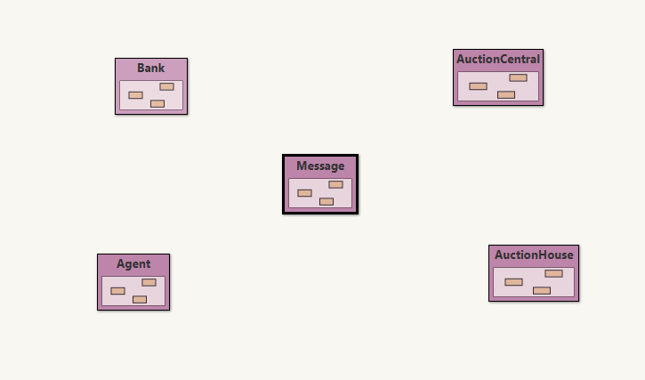
Program(s) Overview:

Slide 4
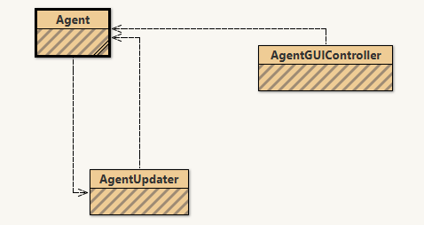
Agent (Package).
Agent is controlled by end-user via the AgentGUIController. Updates are provided automatically via the AgentUpdater.

Slide 5
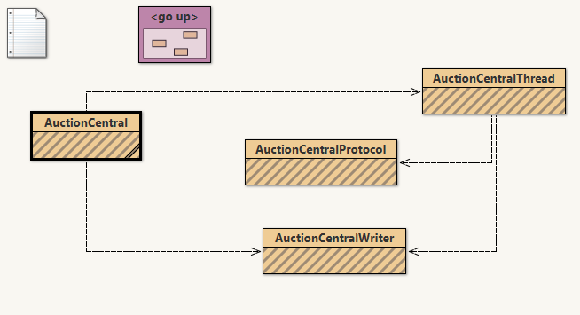
Auction Central (Package).
Auction Central is the main broadcasting server. It relays message to all agents, houses, and the bank, as needed. Auction Central creates a thread for each socket and each thread creates a writer to broadcast & a protocol to handle requests.

Slide 6
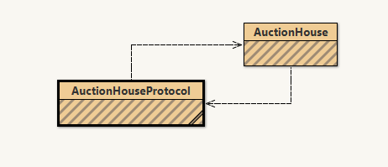
Auction House (Package).
Auction House is an automated client of the servers, it provides listings & holds auctions on items. Auction House also uses a protocol to handle requests.

Slide 7
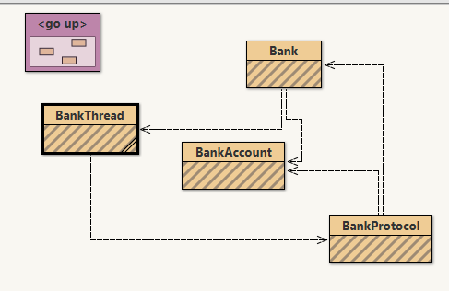
Bank (Package).
Bank is another server – mainly used as a data server for agent accounts & information. Bank creates threads upon connections & threads create protocols to follow, if the socket connection is with an Agent, the bank also initializes a bank account for the agent.

Slide 8
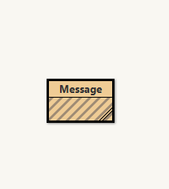
Message (Package).
Messages are lightweight objects to be passed as requests
between the sockets using ObjectStreams.
Messages take a sender, signature, message, item, key, &
an amount. Messages also hold the timestamp of their
creation.

Slide 9
Additional Details.
https://github.com/jacobdhurst/PublicAuction

