Slide 1
ACT or SAT
Which should you take ?

Slide 2
THE PROBLEM
Suppose I am an education advisor.
My advisees can’t decide which test
they should be working on.
I have datasets of average student
performances by state.
I need to give a recommendation – ACT or SAT.

Slide 3
THE OUTLINE
Background
Datasets
Analysis
Conclusion

Slide 4
THE BACKGROUND (1)
ACT : American College Testing
Accepted by all US colleges and universities
Score range (composite) : 1 – 36
https://blog.prepscholar.com/what-does-act-stand-for
https://blog.prepscholar.com/what-is-a-good-act-score-a-bad-act-score-an-excellent-act-score

Slide 5
THE BACKGROUND (2)
SAT : Stands for nothing since 1997
Accepted by all US colleges and universities
Score range (total) : 400 – 1600
https://blog.collegevine.com/what-does-sat-stand-for
https://blog.prepscholar.com/sat-sections

Slide 6
THE BACKGROUND (3)
Some states require ACT/SAT.
ACT : 11 states
  Alabama, Hawaii, Kentucky, Mississippi, Montana, …
SAT : 10 states
  Colorado, Connecticut, Delaware, District of Columbia, …
https://blog.prepscholar.com/act-vs-sat

Slide 7
THE DATASETS (1)
Included in project
ACT mean scores by state 2017 - 2019
SAT mean scores by state 2017 - 2019

Slide 8
THE DATASETS (2)
Outside research
ACT percentiles
  Based on ACT-tested high school graduates in 2017 - 2019
SAT percentiles
    Based on actual SAT scores of students in 2016 - 2020 who took the new SAT

Slide 9
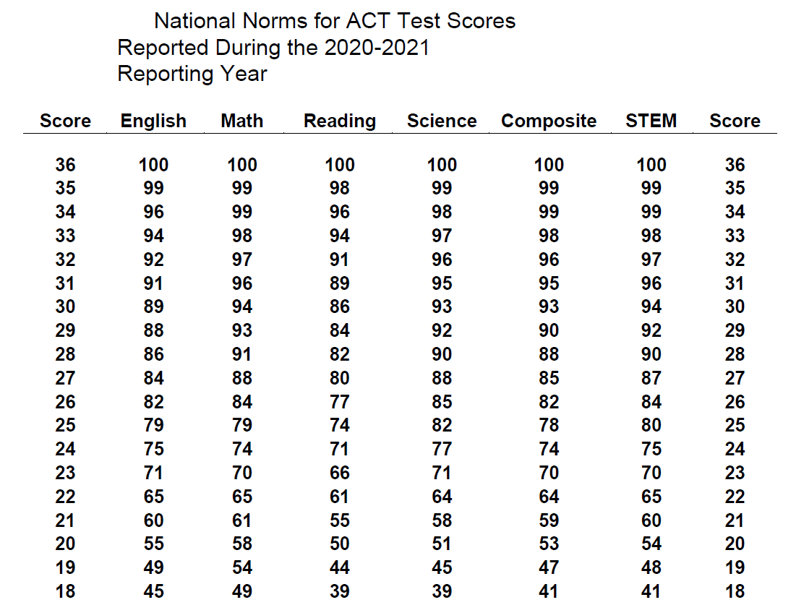
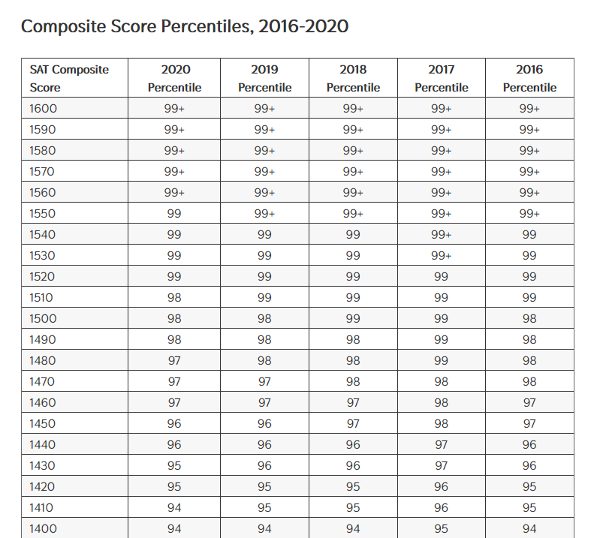
THE DATASETS (3)

Slide 10
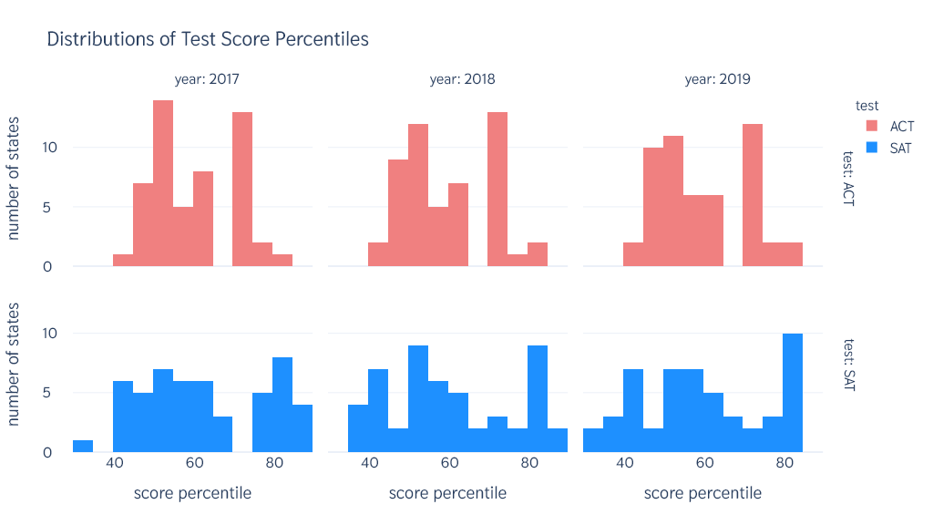
THE ANALYSES
(1)
Not quite normally distributed.
SAT percentiles are more widely spread.
ACT : conservative
SAT : high risk, high return

Slide 11
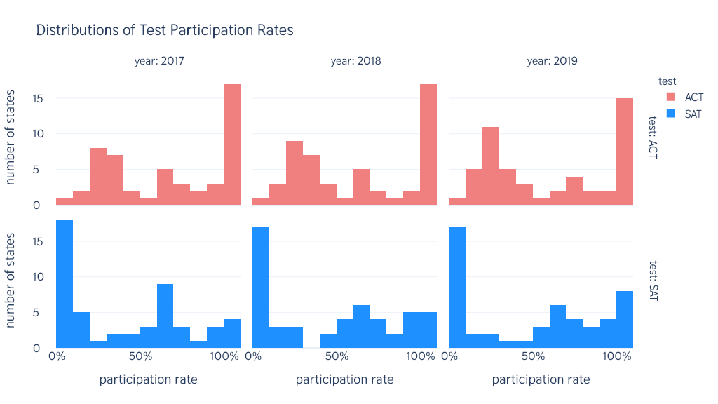
THE ANALYSES
(2)
Do not follow normal distributions.
ACT : left skewed
SAT : right skewed
ACT is more popular.

Slide 12
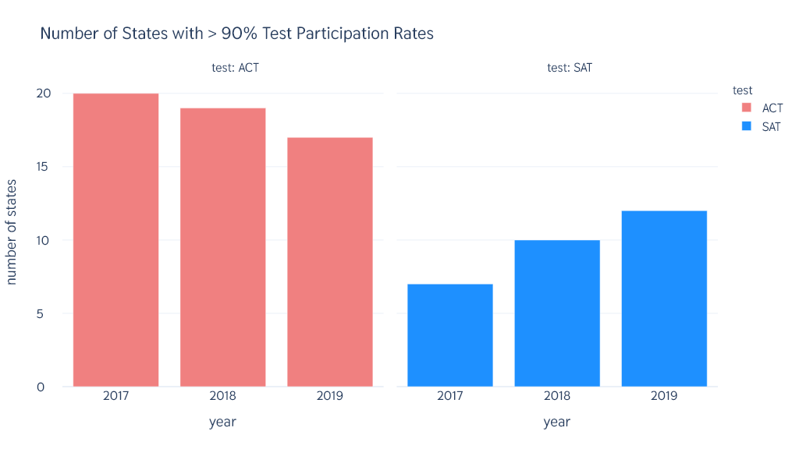
THE ANALYSES
(3)
Perhaps state mandatory policies or sponsorship.
ACT : downward trend
SAT : upward trend
ACT has lost popularity to SAT.

Slide 13
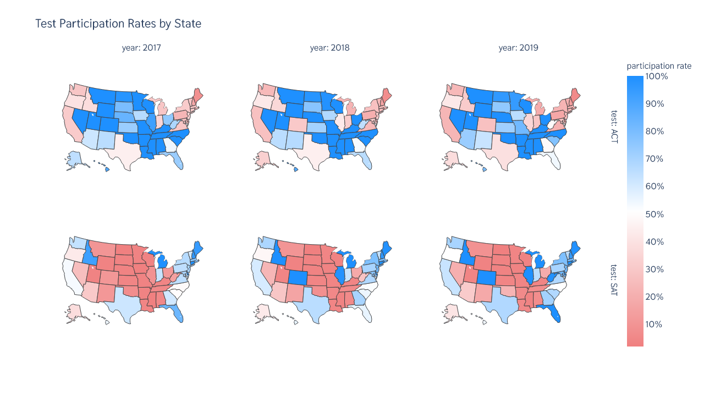
THE ANALYSES
(4)
ACT : more popular in mainland states.
SAT : more popular in coastal states.

Slide 14
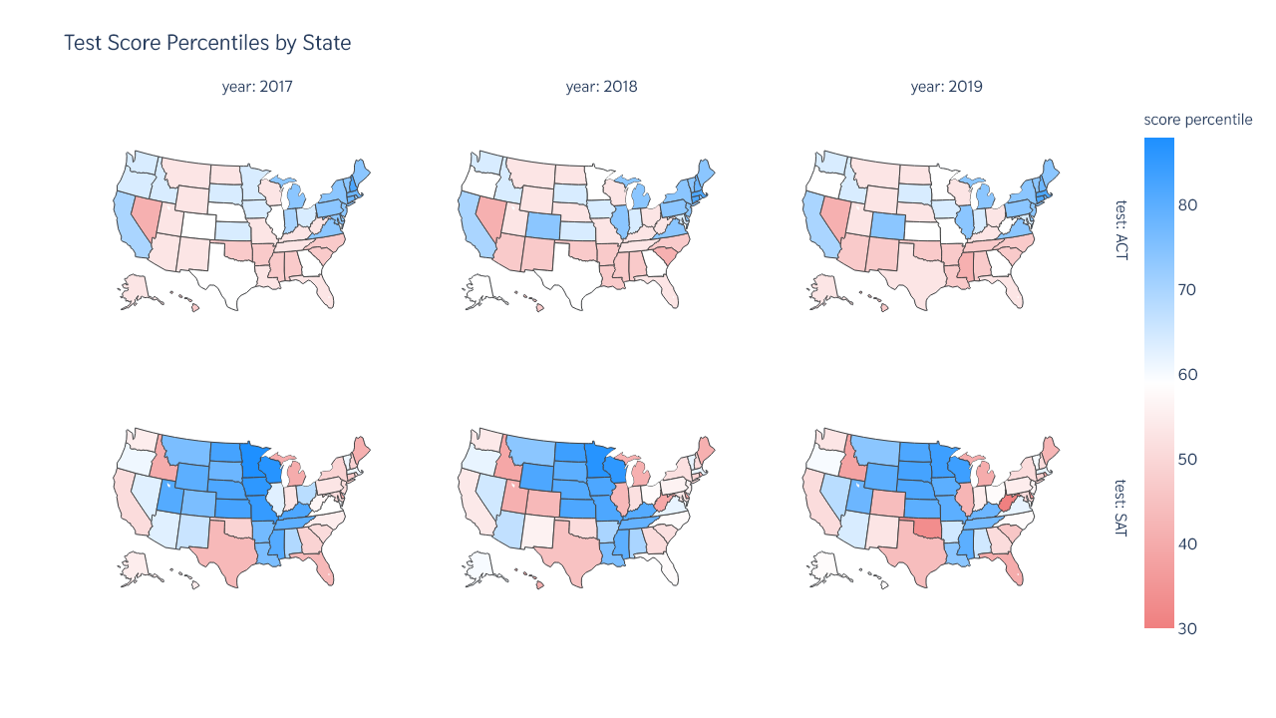
THE ANALYSES
(5)
Contrast between participation rates and score percentiles
States with lower participation rates perform better on score percentiles and vice versa.

Slide 15
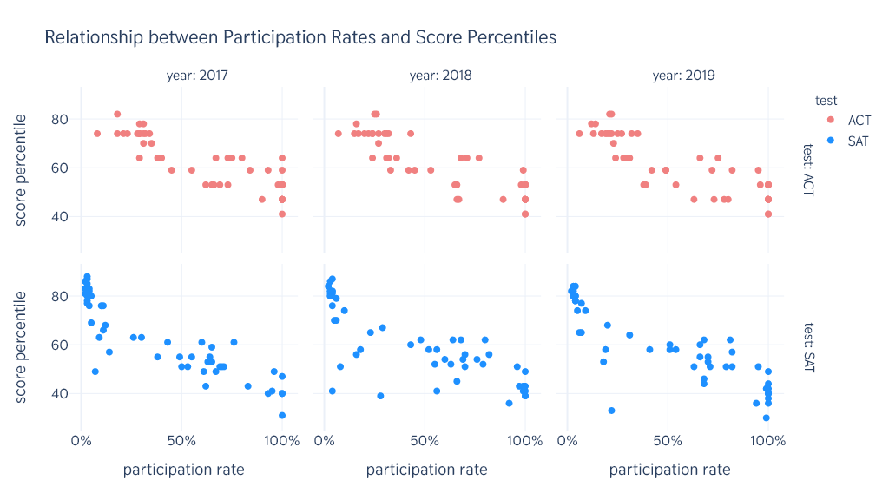
THE ANALYSES
(6)
Negative correlation between score percentiles and participation rates.
Perhaps, students with high scores prepared exclusively for the tests.

Slide 16
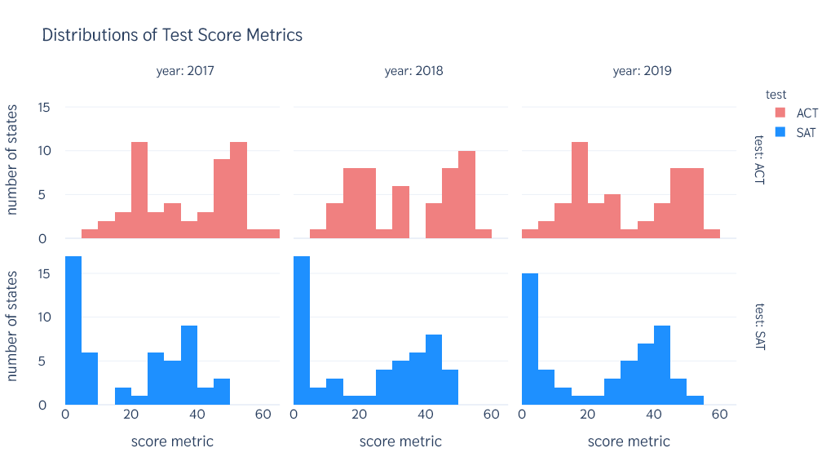
THE ANALYSES
(7)
Take the negatively correlated participation rates into consideration.
In general, the ACT yields higher score metrics.

Slide 17
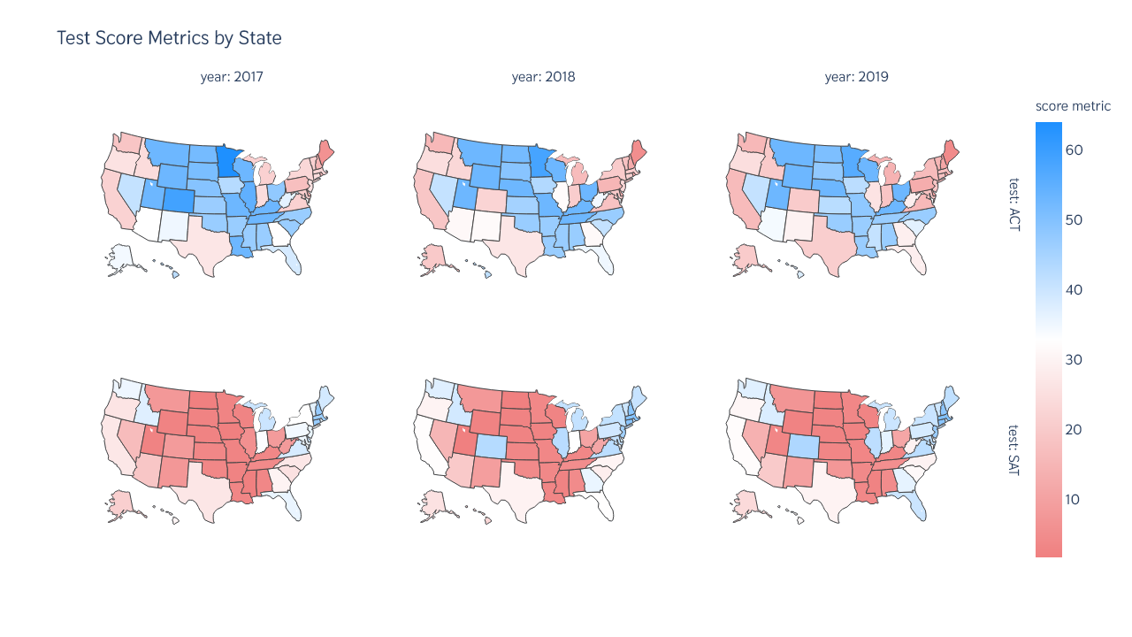
THE ANALYSES
(8)
ACT : still recommended for the mainland states.
SAT : preferred by the coastal regions.

Slide 18
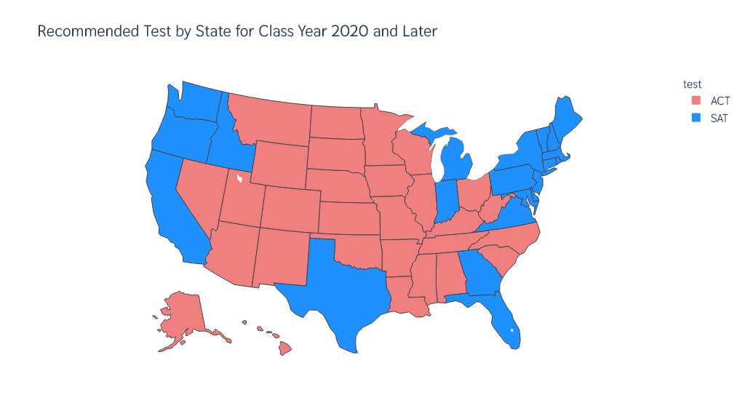
THE CONCLUSION

Slide 19
THANK YOU

