Slide 1


Slide 2

Table of contents
Introduction to Jira
Key Features of Jira
Jira Project Types
Jira Issue Types
Jira Workflows
Jira Boards
Setting Up a Jira Project
Creating and Managing Issues
Customizing Jira
Jira Integrations
Best Practices
Conclusion

Slide 3

introduction to Jira
Definition: Jira is a powerful tool developed by Atlassian for project management, issue tracking, and bug tracking.
Key Concepts:
Projects: Organizational units to track work.
Issues: Tasks, bugs, or user stories within a project.

Slide 4
Key Features of Jira
Issue and Project Tracking: Manage tasks, bugs, user stories, and epics.
Agile Project Management: Supports Scrum and Kanban methodologies.
Customizable Workflows: Tailor workflows to fit specific project needs.
Reporting and Analytics: Generate detailed reports and dashboards.
Integration: Integrate with various tools like Confluence, Bitbucket, Slack, etc.

Slide 5

Jira Project Types
Software Projects: For development teams using Agile methodologies (Scrum, Kanban).
Business Projects: For teams managing tasks and projects without Agile.
Service Desk Projects: For IT service management and customer support.
Ops Projects: For operations teams to manage incidents and changes.

Slide 6
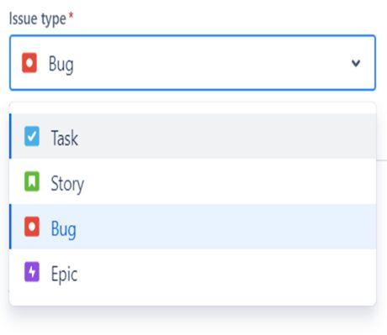
Jira Issue Types
Story: A single piece of work that can be completed within a sprint.
Task: A general work item.
Bug: A defect or problem in the software.
Epic: A large body of work that can be broken down into smaller tasks or stories.
Sub-task: A smaller part of a task or story.

Slide 7
Jira Workflow
Definition: A workflow is the series of steps an issue goes through from creation to completion.
Components:
Statuses: The current state of an issue (To Do, In Progress, Done).
Transitions: The actions that move an issue from one status to another.
Resolutions: How an issue is resolved (Fixed, Won't Fix, Duplicate).
Customization: Workflows can be customized to fit the team’s processes.

Slide 8
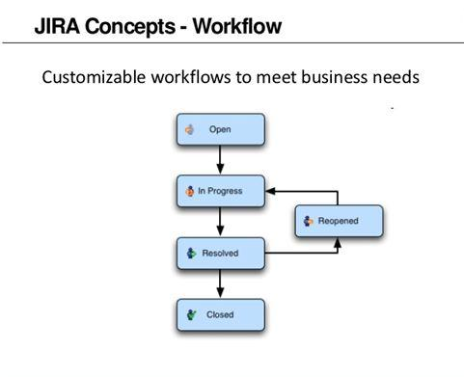

Slide 9
Jira Workflow
Once an issue is assigned and work begins, it transitions to the In Progress stage.
Open: This is the initial stage where a new issue is created. The issue can be a bug, task, story, or any other type of work item.
In Progress: Once an issue is assigned and work begins, it transitions to the In Progress stage.
Resolved: After the work on an issue is completed, it is marked as Resolved.
Closed: An issue transitions to the Closed stage when it has been verified and accepted as completed.
Responding to Closed Issues: In some cases, closed issues may require follow-up actions, additional comments, or reopening if further work is needed.

Slide 10

Jira Boards

Slide 11
Jira Boards
Components:
Scrum Boards: Used to manage work in sprints. Displays backlog, current sprint, and task progress.
Kanban Boards: Visualize the flow of work. Focuses on continuous delivery.
Columns
Represents statuses in work flow.
Swim lanes
Organize issues into horizontal rows
Cards
Reprsent Individual issues

Slide 12
Setting Up a Jira Project
Create a New Project: Choose the project type (Software, Business, Service Desk).
Configure Project Settings: Set project details, permissions, and notifications.
Define Workflows: Customize the workflow to match your processes.
Create Issue Types: Define the types of issues you will track.
Set Up Boards: Create Scrum or Kanban boards to visualize work.
Best Practices:
Keep project settings consistent.
Regularly review and update workflows.

Slide 13
Creating and Managing Issues
Assign: Allocate the issue to a team member.
Transition: Move the issue through the workflow.
Comment: Add comments to provide updates or ask questions.
Link: Link-related issues for better tracking.
Creating Issues:
Use the "Create" button in Jira.
Fill in the necessary details (Summary, Description, Assignee, Priority)

Slide 14
Customizing Jira
Custom Fields: Add fields to capture specific information.
Screens: Define which fields are displayed during issue transitions.
Permissions: Control who can view, create, and edit issues.
Notifications: Set up email notifications for issue updates.
Automation Rules: Create rules to automate repetitive tasks.

Slide 15
Jira Integrations
Confluence: Link Jira issues to Confluence pages for documentation.
Bitbucket: Integrate with Bitbucket for continuous integration and deployment.
Slack: Receive Jira notifications in Slack channels.
Other Tools: Integrate with tools like GitHub, Jenkins, Trello, and more.

Slide 16
Best Practices
Define Clear Workflows: Ensure all team members understand the workflow.
Regularly Groom Backlog: Keep the backlog up-to-date with prioritized tasks.
Use Labels and Components: Organize issues for better tracking.
Automate Where Possible: Use automation to reduce manual effort.
Review and Improve: Continuously review and improve processes.

Slide 17
Conclusion
Jira is a versatile tool for project management and issue tracking, supporting Agile methodologies and customizable workflows.
Key Points:
Jira’s flexibility allows for tailored workflows and issue types.
Boards help visualize and manage work effectively.
Integrations and automation enhance productivity and collaboration.

Slide 18
References
Wikipedia.org
Google.com
Seminarppt.com
Studymafia.org

