Slide 1
DATA COMMUNICATION NETWORKS

Slide 2
A Communications Model
Source
generates data to be transmitted
Transmitter
Converts data into transmittable signals
Transmission System
Carries data
Receiver
Converts received signal into data
Destination
Takes incoming data

Slide 3
Communications Tasks
Transmission system utilization | Addressing
Interfacing | Routing
Signal generation | Recovery
Synchronization | Message formatting
Exchange management | Security
Error detection and correction | Network management
Flow control

Slide 4
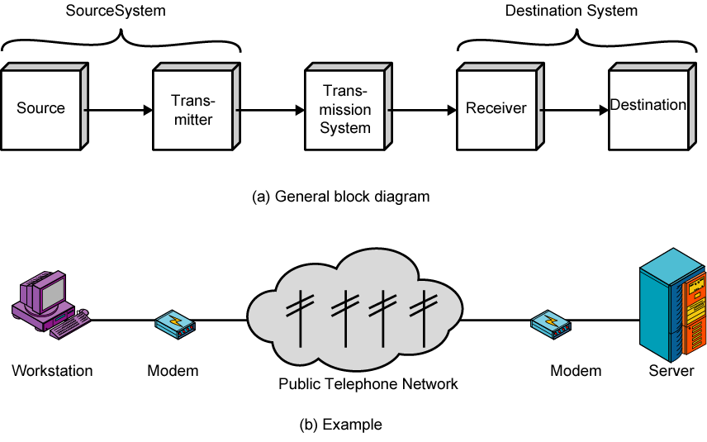
Simplified Communications Model - Diagram

Slide 5
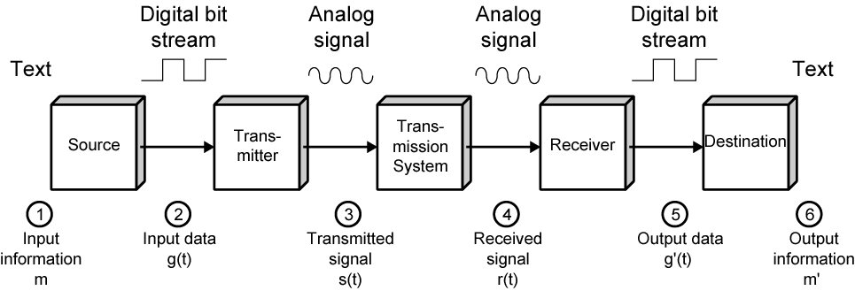
Simplified Data Communications Model

Slide 6
Basic Concepts

Slide 7
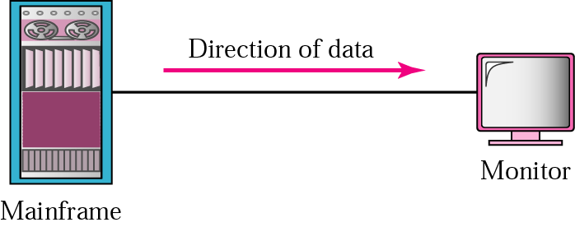


TRANSMISSION MODES
Simplex
Half Duplex
Full Duplex

Slide 8
Networks: key issues
Network criteria
Performance
Throughput
Delay
Reliability
Data transmitted are identical to data received.
Measured by the frequency of failure
The time it takes a link to recover from a failure
Security
Protecting data from unauthorized access

Slide 9
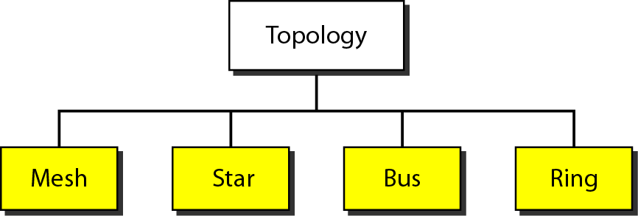
Categories of Topology

Slide 10
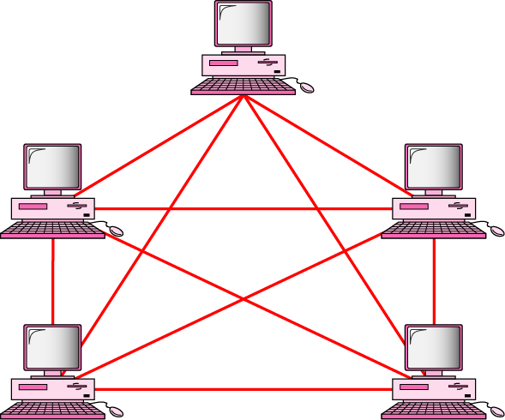
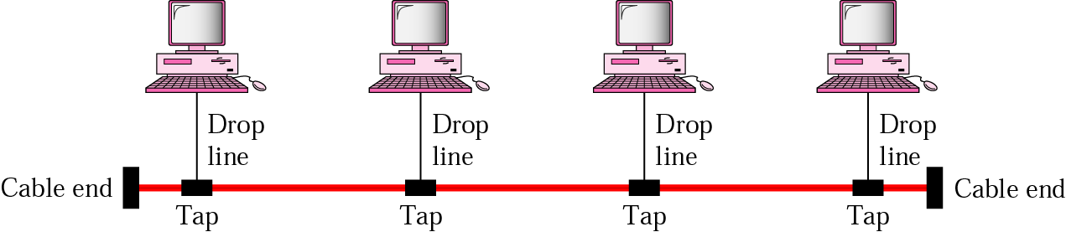
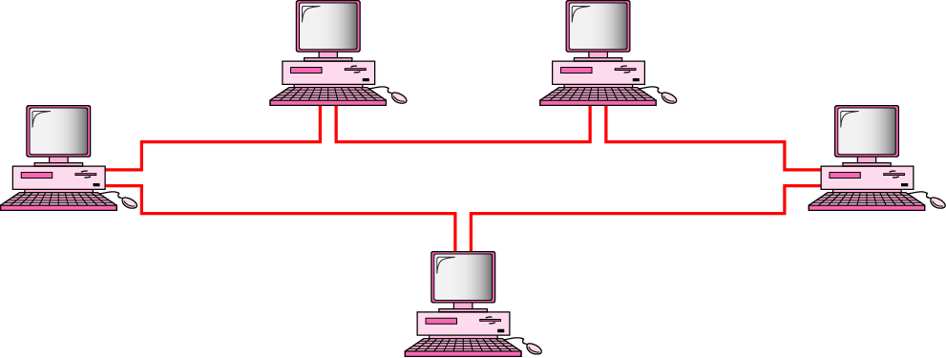
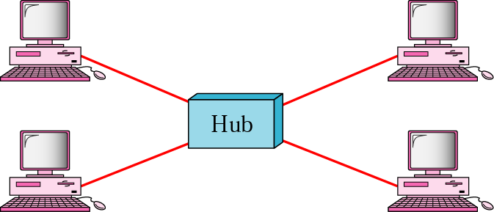
Mostly used network topologies
bus
mesh
ring
star

Slide 11
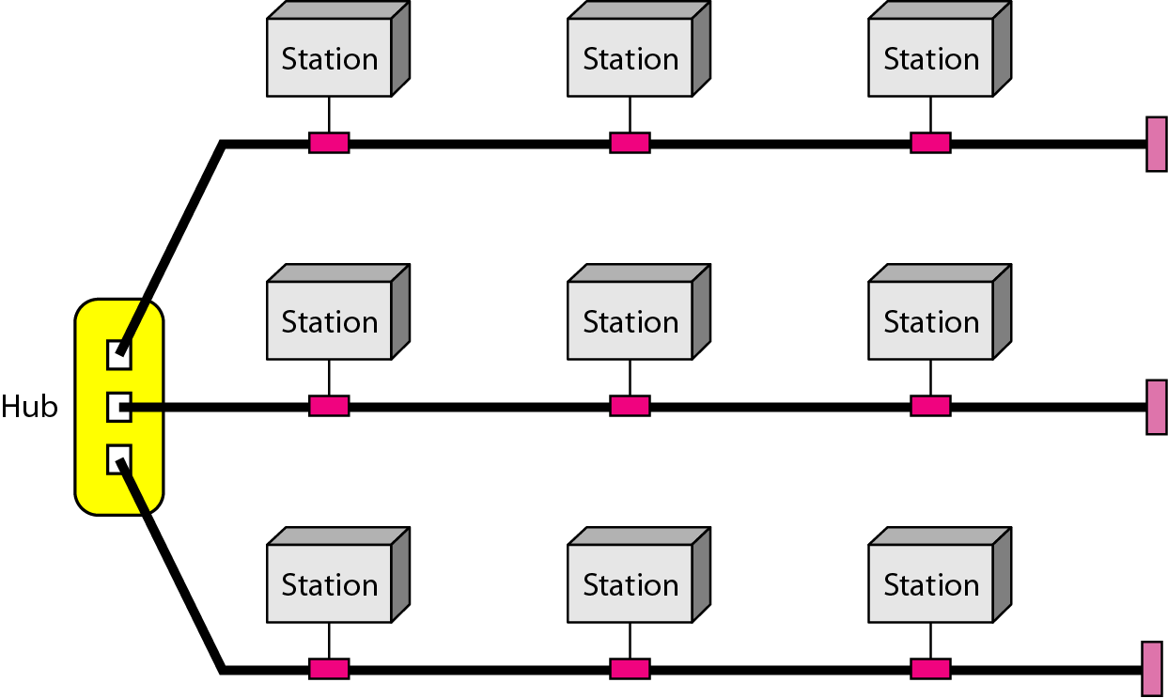
A hybrid topology: a star backbone with three bus networks

Slide 12
Networking
Point to point communication not usually practical
Devices are too far apart
Large set of devices would need impractical number of connections
Solution is a communications network
Wide Area Network (WAN)
Local Area Network (LAN)

Slide 13
Network Types (based on Scale)
Local Area Networks (LANs) - room, building
a group of PCs that share a circuit.
Backbone Networks - less than few kms
a high speed backbone linking the LANs at various locations.
Metropolitan Area Networks (MAN) - (< few 10 kms)
connects LANs and BNs at different locations
leased lines or other services used to transmit data.
Wide Area Networks (WANs) - (> few 10 kms)
Same as MAN except wider scale

Slide 14
OSI
Open Systems Interconnection
Developed by the International Organization for Standardization (ISO)
Seven layers
A theoretical system delivered too late!
TCP/IP is the de facto standard

Slide 15
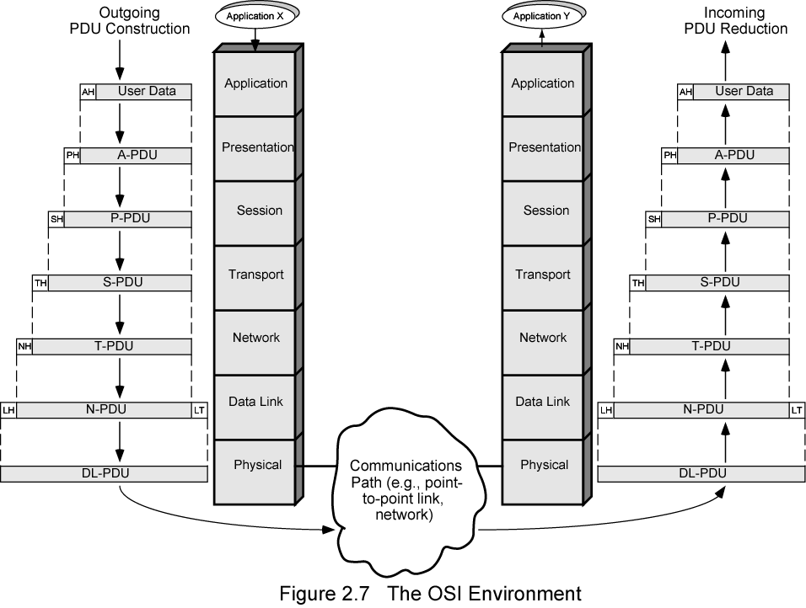
The OSI Environment

Slide 16
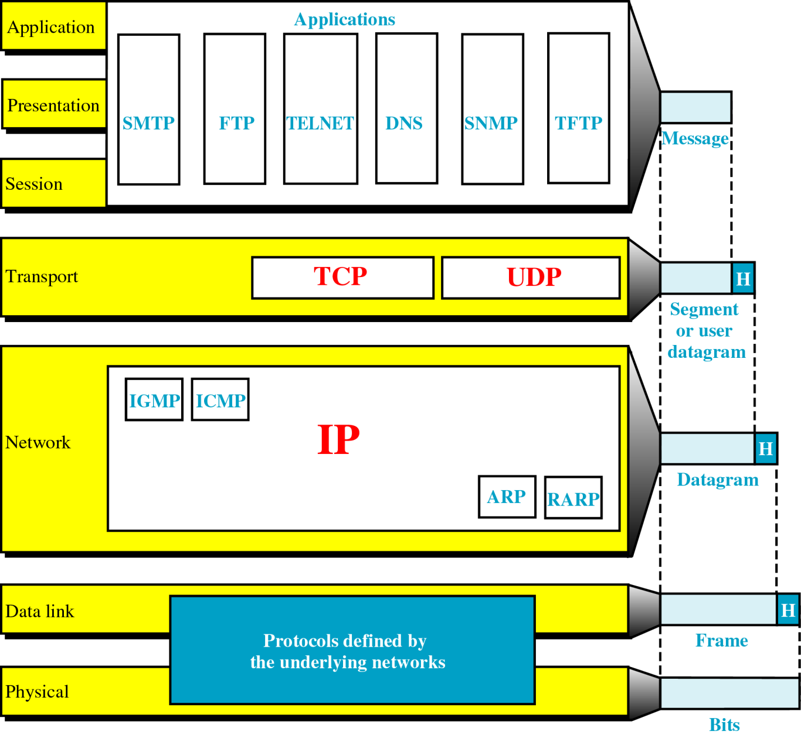
TCP/IP and the OSI Model

Slide 17
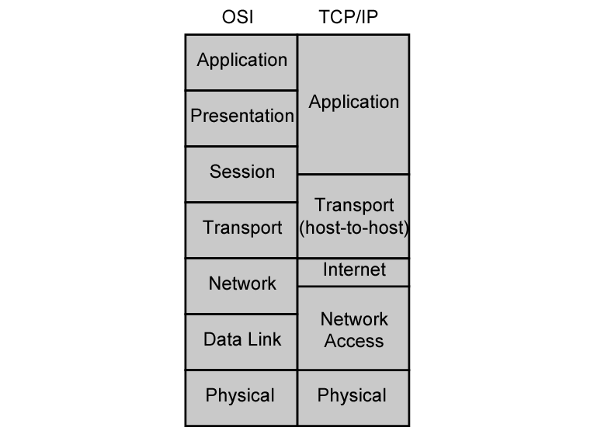
OSI v TCP/IP

Slide 18
IEEE 802 Focus
OSI Reference
Data Link layer
Physical layer
Areas
Network cards and cables
Network electronic/optical/ wireless communication standard as they apply to the lower two layers mentioned above
WAN connectivity

Slide 19
IEEE 802 Committees And Responsibilities
802.1
Internetworking
802.2
Logical Link Control (LLC)
802.3
CSMA/CD
802.4
Token Bus LAN

Slide 20
IEEE 802 Committees and Responsibilities (Cont.)
802.5
Token Ring LAN
802.6
Metropolitan Area Network
802.7
Broadband Technical Advisory Group
802.8
Fiber-Optic Technical Advisory Group

Slide 21
IEEE 802 (Cont.)
802.9
Integrated Voice/Data Networks
802.10
Network Security
802.11
Wireless Networks
802.12
Demand Priority Access LANs
Ex: 100BaseVG-AnyLAN

Slide 22
INTERNETWORKING PROTOCOL
It is unreliable and connectionless datagram protocol.
The IP provides no error checking or tracking.
IP transports data in Packets called datagrams , each of which transported separately.
Datagrams can travel along different routes and can arrive out of sequence or be duplicated.
IP does not keep track of the routes and has no facility for reordering datagrams once they arrive at their destination.

Slide 23
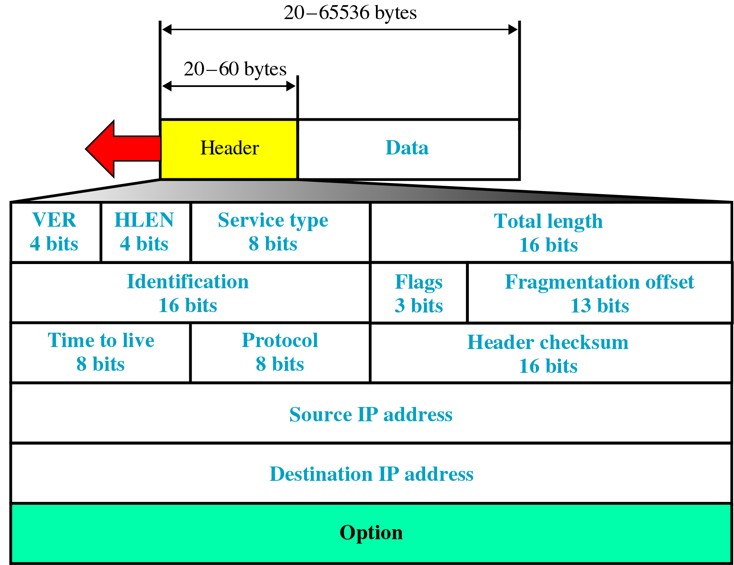
IP Datagram

Slide 24
Different types of address
Three different levels of addresses are used in an internet using TCP/IP protocols:
Physical Address
Logical Address
Port Address

Slide 25
Physical Address
It is also known as link address.
It is defined by its LAN or WAN.
It is lowest level address.
It can be either
Unicast ( One single recipient)
Multicast (a group of a recipients)
Broadcast ( To be received by all systems in the network.)
Some networks supports all three addresses.

Slide 26
Addressing

Slide 27
Logical Address
The logical addresses are designed for internetwork communication.
It is currently 32-bit address that can uniquely define a host connected to the internet.
It can be either unicast, broadcast or multicast.

Slide 28
Port Address
IP address and physical address are necessary for source to destination host transmission.
The aim of internet communication is a process communicating with the another process.
For example,
Computer A can communicate with C by TELNET
Computer A communicate with B by FTP.
For these process occur simultaneously, each process should be labeled. They are labeled by an address called port address.

Slide 29
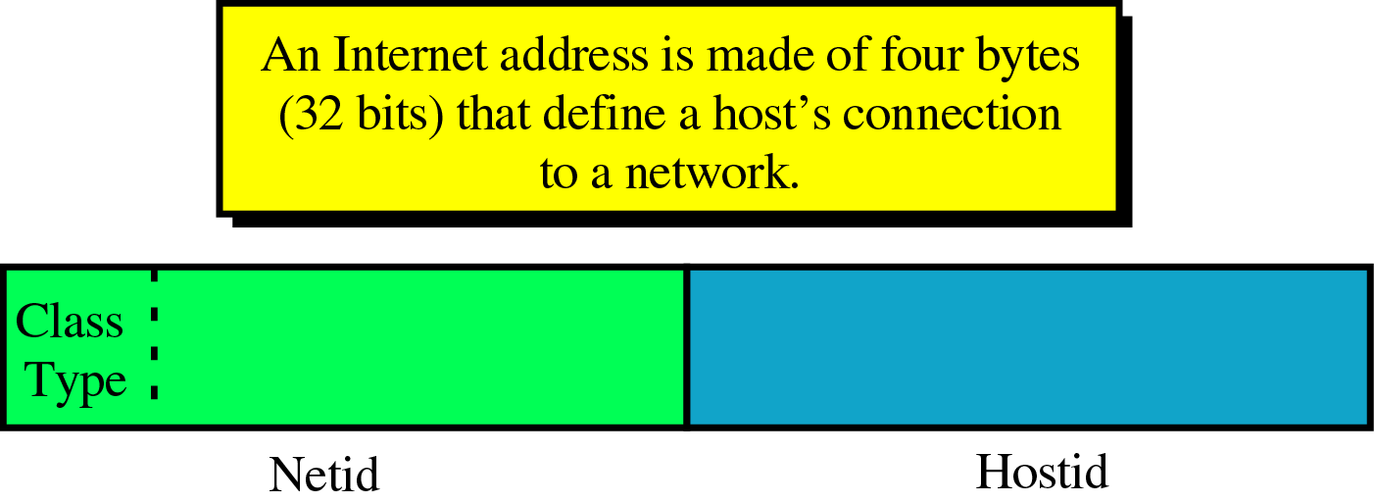
Addressing

Slide 30
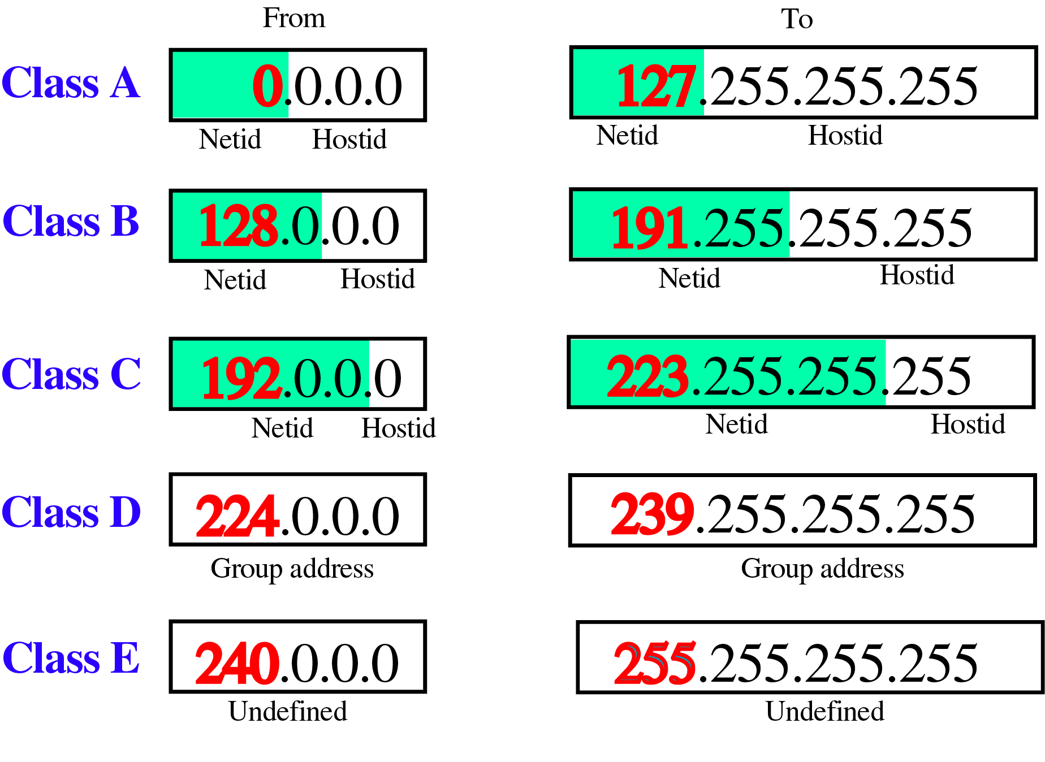
Class ranges if Internet Addresses

Slide 31
Given the network address 132.21.0.0, find the
class, the block, and the range of the addresses
The 1st byte is between 128 and 191.
Hence, Class B
The block has a netid of 132.21.
The addresses range from
132.21.0.0 to 132.21.255.255.

Slide 32
IPv6
IPv6 (Internet Protocol version 6) is a set of specifications from the Internet Engineering Task Force (IETF) that's essentially an upgrade of IP version 4 (IPv4).
32 bits to 128 bits.
2^128 = 340,282,366,920,938,463,463,374,607,431,768,211,456
And a new type of address called an "anycast address" is defined,
used to send a packet to any one of a group of nodes.
Authentication and Privacy Capabilities Extensions to support authentication, data integrity, and (optional) data confidentiality are specified for IPv6.

Slide 33
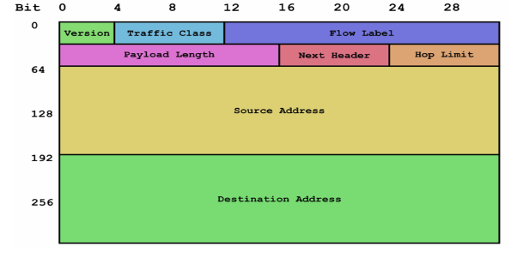
IPv6 Address Scheme :
An IP packet contains several types of information, as
illustrated.

