Slide 1
An
Introduction to
Agile SCRUM
Methodology

Slide 2
Agenda
Introduction
What is Agile Methodology?
What is Scrum?
History of Scrum
Functionality of Scrum
Components of Scrum
Scrum Roles
The Process
Scrum Artifacts
Scaling Scrum
Q & A Session

Slide 3
Introduction
Classical methods of software development have many disadvantages:
huge effort during the planning phase
poor requirements conversion in a rapid changing environment
treatment of staff as a factor of production
New methods:
Agile Software Development Methodology

Slide 4
What is Agile ?
Agile proponents believe
Current software development processes are too heavyweight or cumbersome
Too many things are done that are not directly related to software product being produced
Current software development is too rigid
Difficulty with incomplete or changing requirements
Short development cycles (Internet applications)
More active customer involvement needed
CMM focuses on process

Slide 5
Contd…
Agile methods are considered
Lightweight
People-based rather than Plan-based
Several agile methods
No single agile method
XP most popular
No single definition
Agile Manifesto closest to a definition
Set of principles
Developed by Agile Alliance

Slide 6
Agile Manifesto
A Statement of Values
Individuals and interactions over processes and tools
Working software over comprehensive documentation
Customer collaboration over contract negotiation
Responding to change over following a plan
http://www.agilemanifesto.org

Slide 7
Agile Methods
Agile methods:
Scrum
Extreme Programming
Adaptive Software Development (ASD)
Dynamic System Development Method (DSDM)
…
Agile Alliance (www.agilealliance.org)
A non-profit organization promotes agile development

Slide 8
History of Scrum
1995:
analysis of common software development processes → not suitable for empirical, unpredictable and non-repeatable processes
Design of a new method: Scrum by Jeff Sutherland & Ken Schwaber
Enhancement of Scrum by Mike Beedle & combination of Scrum with Extreme Programming
1996:
introduction of Scrum at OOPSLA conference
2001:
publication “Agile Software Development with Scrum” by
Ken Schwaber & Mike Beedle
Successful appliance of Scrum in over 50 companies
Founders are members in the Agile Alliance

Slide 9
Characteristics
Self-organizing teams
Product progresses in a series of month-long “sprints”
Requirements are captured as items in a list of “product backlog”
No specific engineering practices prescribed
Uses generative rules to create an agile environment for delivering projects
One of the “agile processes”

Slide 10
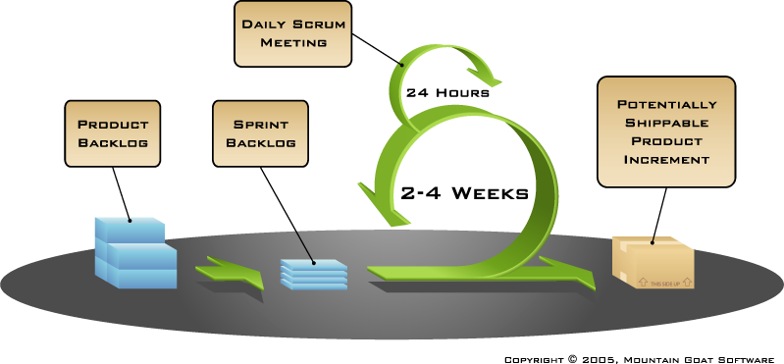
How Scrum Works?

Slide 11
Sprints
Scrum projects make progress in a series of “sprints”
Analogous to XP iterations
Target duration is one month
+/- a week or two
But, a constant duration leads to a better rhythm
Product is designed, coded, and tested during the sprint

Slide 12
Sequential vs. Overlapping Dev.
Requirements
Design
Code
Test

Slide 13
No changes during the sprint
Change
Inputs
Sprint
Tested Code
Plan sprint durations around how long you can commit to keeping change out of the sprint

Slide 14
Scrum Framework
Roles : Product Owner, ScrumMaster, Team
Ceremonies : Sprint Planning, Sprint Review, Sprint Retrospective, & Daily Scrum Meeting
Artifacts : Product Backlog, Sprint Backlog, and Burndown Chart

Slide 15
Product Owner
Define the features of the product
Decide on release date and content
Be responsible for the profitability of the product (ROI)
Prioritize features according to market value
Adjust features and priority every iteration, as needed
Accept or reject work results.

Slide 16
The Scrum Master
Represents management to the project
Responsible for enacting Scrum values and practices
Removes impediments
Ensure that the team is fully functional and productive
Enable close cooperation across all roles and functions
Shield the team from external interferences

Slide 17
Scrum Team
Typically 5-10 people
Cross-functional
QA, Programmers, UI Designers, etc.
Members should be full-time
May be exceptions (e.g., System Admin, etc.)
Teams are self-organizing
What to do if a team self-organizes someone off the team??
Ideally, no titles but rarely a possibility
Membership can change only between sprints

Slide 18
Ceremonies
Sprint Planning Meeting
Sprint
Daily Scrum
Sprint Review Meeting

Slide 19
Spring Planning Meeting
Product Owner
Scrum Team
Customers
Management
Product Backlog
Sprint Planning
Meeting
Team Capabilities
Sprint Goal
Business Conditions
Technology
Sprint Backlog
Current Product

Slide 20
Parts of Sprint Planning Meeting
1st Part:
Creating Product Backlog
Determining the Sprint Goal.
Participants: Product Owner, Scrum Master, Scrum Team
2nd Part:
Participants: Scrum Master, Scrum Team
Creating Sprint Backlog

Slide 21
Pre-Project/Kickoff Meeting
A special form of Sprint Planning Meeting
Meeting before the begin of the Project

Slide 22
Sprint
A month-long iteration, during which is incremented a product functionality
NO outside influence can interfere with the Scrum team during the Sprint
Each Sprint begins with the Daily Scrum Meeting

Slide 23
Daily Scrum
Parameters
Daily
15-minutes
Stand-up
Not for problem solving
Three questions:
What did you do yesterday
What will you do today?
What obstacles are in your way?
Chickens and pigs are invited
Help avoid other unnecessary meetings
Only pigs can talk

Slide 24
Daily Scrum
Is NOT a problem solving session
Is NOT a way to collect information about WHO is behind the schedule
Is a meeting in which team members make commitments to each other and to the Scrum Master
Is a good way for a Scrum Master to track the progress of the Team

Slide 25
Product Backlog
Requirements for a system, expressed as a prioritized list of Backlog Items
Is managed and owned by a Product Owner
Spreadsheet (typically)
Usually is created during the Sprint Planning Meeting
Can be changed and re-prioritized before each PM

Slide 26
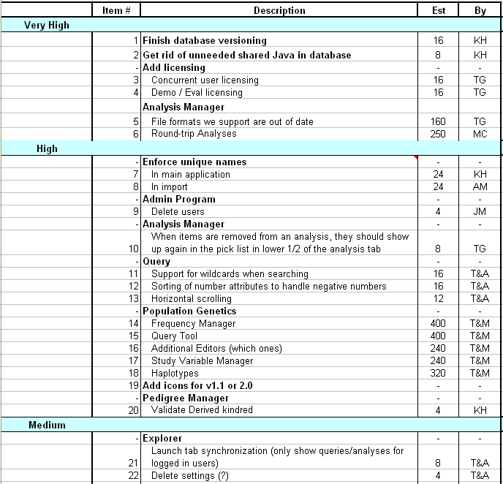
Sample Product Backlog

Slide 27
Sprint Burn down Chart
Depicts the total Sprint Backlog hours remaining per day
Shows the estimated amount of time to release
Ideally should burn down to zero to the end of the Sprint
Actually is not a straight line
Can bump UP

Slide 28
Information Radiator
"Two characteristics are key to a good information radiator. The first is that the information changes over time. This makes it worth a person's while to look at the display... The other characteristic is that it takes very little energy to view the display."

Slide 29
Release Burndown Chart
Will the release be done on right time?
X-axis: sprints
Y-axis: amount of hours remaining
The estimated work remaining can also burn up

Slide 30
Product Burndown Chart
Is a “big picture” view of project’s progress (all the releases)

Slide 31
Scalability of Scrum
A typical Scrum team is 6-10 people
Jeff Sutherland - up to over 800 people
"Scrum of Scrums" or what called "Meta-Scrum“
Frequency of meetings is based on the degree of coupling between packets

Slide 32
Pros/Cons
Advantages
Completely developed and tested features in short iterations
Simplicity of the process
Clearly defined rules
Increasing productivity
Self-organizing
each team member carries a lot of responsibility
Improved communication
Combination with Extreme Programming
Drawbacks
“Undisciplined hacking” (no written documentation)
Violation of responsibility
Current mainly carried by the inventors

