Slide 1
Using C++ Functions
4
Object-Oriented Programming Using C++
Second Edition

Slide 2
Objectives
4
In this chapter, you will learn:
About using function
How to use procedural abstraction
About scope rules
How to construct function headers and prototypes
How to return values from, and pass values to, functions
How to use classes and objects as arguments to functions and as return types of functions

Slide 3
Objectives
4
In this chapter, you will learn:
How to pass addresses to functions
How to use reference variables
How to pass arrays to functions
How to use inline functions
How to use default arguments
How to overload functions

Slide 4
Using Functions and Include Files
4
Functions are modules that perform a task or group of tasks
In other programming languages, the counterpart to a function is known as a subroutine, procedure, or method
You can write new C++ functions, and you can use functions that other programmers have written
Any statement allowed in the main( ) function of a C++ program can be used in any other function

Slide 5
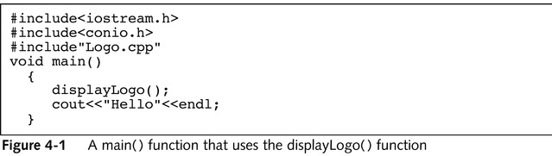
Using Functions and Include Files
4
In Figure 4-1, the statement displayLogo(); is known as the call to the function
When the call is made, control of the program is transferred to displayLogo() and statements written in displayLogo() execute
When displayLogo() is completed, control of the program returns to main(), which then proceeds to the next instruction

Slide 6
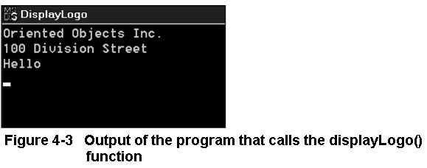
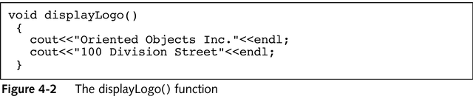
Using Functions and Include Files
4

Slide 7
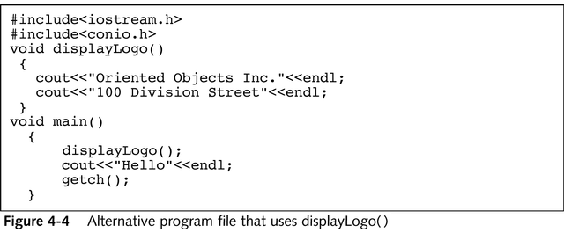
Using Functions and Include Files
4
You are never required to place functions in their own files
The program file shown in Figure 4-4 compiles and executes in the same manner as the one shown in Figure 4-1

Slide 8
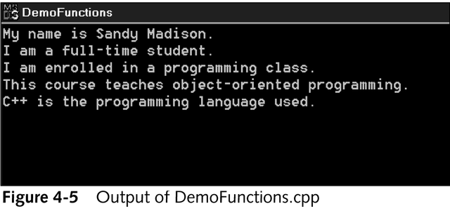
Using Functions and Include Files
4
In the set of steps on pages 111 and 112 of the textbook, you write three functions—two functions that cannot execute alone, and the main() function that calls them

Slide 9
Using Procedural Abstraction
4
When you write functions that you include in other programs, you gain several benefits:
The functions can be written once and subsequently included in any number of programs
When you need to change the contents of the functions you write, you make the change in one location, and all the programs that use the function automatically receive the change
When you write a main() program, you can condense many related actions into as single function call, making the main() program easier to write and simpler to read
When you use functions that already have been written for you, you gain an additional benefit: you do not need to worry about how the function works; you simply call it and let it work for you

Slide 10
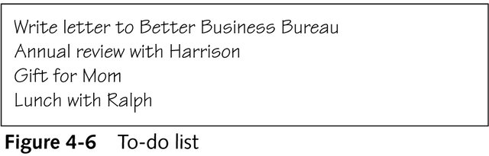
Using Procedural Abstraction
4
Using functions is one way to employ procedural abstraction in C++
When you write a main() function, you can use the names of other functions that perform a variety of tasks

Slide 11
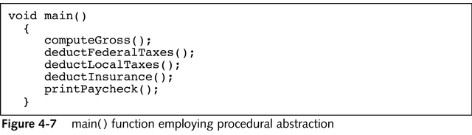
Main() Function Employing Procedural Abstraction
4

Slide 12
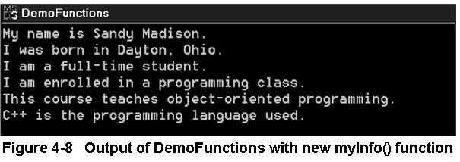
Using Procedural Abstraction
4
Alter the myInfo() function you wrote in the last set of steps so that it includes additional information by using the processes outlined on pages 114 and 115 of the textbook

Slide 13
Understanding Scope
4
Some variables can be accessed throughout an entire program, while others can be accessed only in a limited part of the program
The scope of a variable defines where it can be accessed in a program
To adequately understand scope, you must be able to distinguish between local and global variables

Slide 14
Distinguishing Between Local and Global Variables
4
Celebrity names are global because they are known to people everywhere and always refer to those same celebrities
Global variables are those that are known to all functions in a program
Some named objects in your life are local
You might have a local co-worker whose name takes precedence over, or overrides, a global one

Slide 15
Distinguishing Between Local and Global Variables
4
Variables that are declared in a block are local to that block and have the following characteristics:
Local variables are created when they are declared within a block
Local variables are known only to that block
Local variables cease to exist when their block ends
Variables declared within a function remain local to that function
In contrast, variables declared within curly braces within any function are local to that block

Slide 16
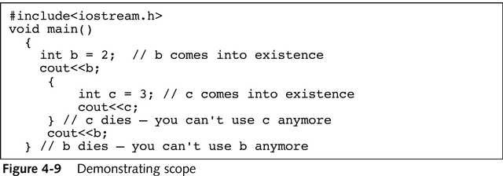
Demonstrating Scope
4

Slide 17
Distinguishing Between Local and Global Variables
4
Programmers would say that c is accessible only within braces
No variable can be accessed outside its scope, that is, beyond the block in which it is declared
The program shown in Figure 4-10 demonstrates that you can declare variables prior to or anywhere within a function, but the program does not demonstrate good technique for declaring variables
C++ programmers usually declare most of their variables inside and at the beginning of the function that uses the variables

Slide 18
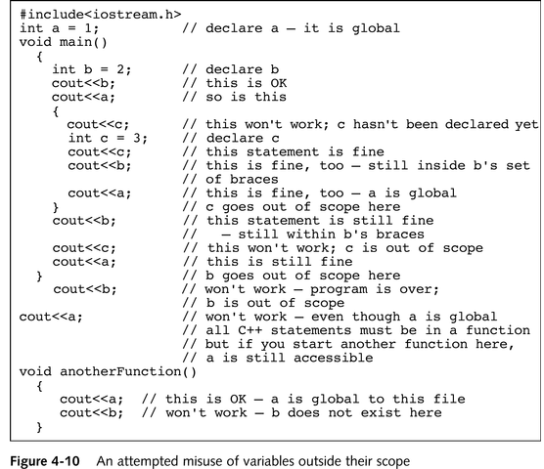
An Attempted Misuse of Variables Outside Their Scope
4

Slide 19
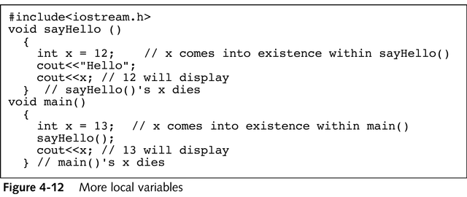
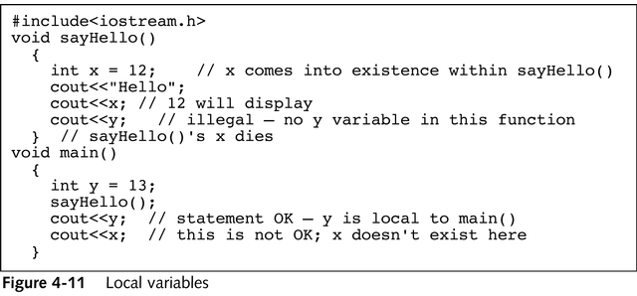
Distinguishing Between Local and Global Variables
4

Slide 20
Using the Scope Resolution Operator
4
Each programmer can use x as a variable name without destroying any values in the other’s function
A major advantage of using local variables is that many programmers can work on a large program, each writing separate functions, and they can use any variable names inside their own functions
If you choose to create a global variable, you can use it even when a local variable with the same name exists

Slide 21
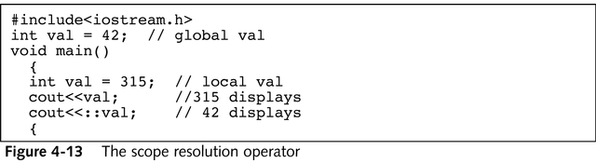
Using the Scope Resolution Operator
4
To do so, you use the scope resolution operator
Place this operator (the symbol ::) directly before the variable name
Although you can declare global variables in any file, it is almost always considered better style to use local variables rather than global ones

Slide 22
Using the Scope Resolution Operator
4
This strategy represents a preliminary example of encapsulation, or data hiding
Using global variables, rather than creating local variables in functions, is actually disadvantageous for the following reasons:
If variables are global in a file and you reuse any functions in a new program, the variables must be redeclared in the new program. They no longer “come along with” the function
Global variables can be affected by any function, leading to errors. In a program with many functions, finding the functions that caused an error can prove difficult

Slide 23
Constructing Function Headers and Prototypes
4
The header of a function consists of three parts:
The type of object or variable that the function returns to the function that calls it (also known as the function’s type)
The name of the function
In parentheses, the types and names of any variables that are passed to the function
To prototype, you create either a sample function outline or a description of how the actual function will look

Slide 24
Constructing Function Headers and Prototypes
4
When you prototype a function, you declare it, so you give it a type and a name as well
A prototype contains four features:
The type of object or variable that the function returns to the function that calls it
The name of the function
In parentheses, the types of any variables that are passed to the function (the names of the variables are not required, but as a rule programmers frequently include the names)
A semicolon. A prototype, unlike a function header, is a statement; therefore it ends with a semicolon

Slide 25
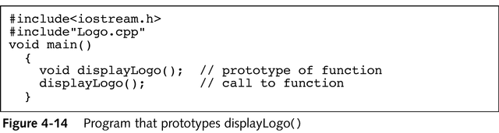
Program That Prototypes DisplayLogo()
4

Slide 26
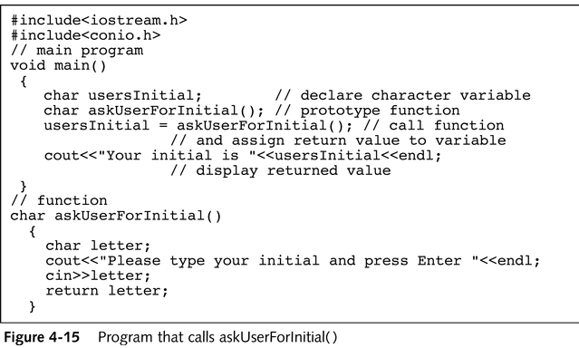
Program That Calls askUserForInitial()
4

Slide 27
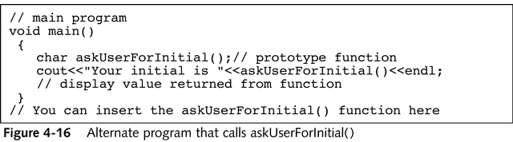
Returning Values from Functions
4
The type of value that a function returns is also known as the function’s type (or the function’s return type)
It is perfectly legal to call a function that returns a value and then not use the value

Slide 28
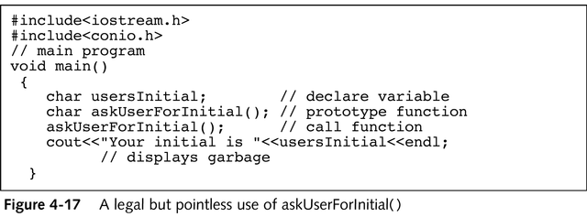
Returning Values from Functions
4
Write a program that uses two functions to retrieve from the keyboard a worker’s hourly rate and hours worked, using the instruction on pages 124 to 126 of the textbook. The program uses the returned values to calculate and display weekly pay

Slide 29
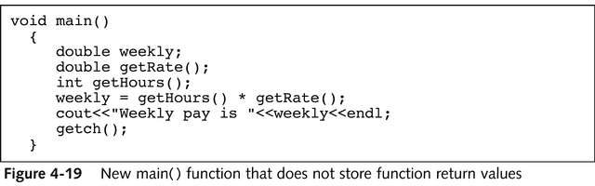
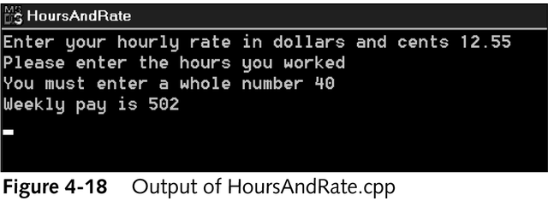
Returning Values from Functions
4

Slide 30
Returning Values from Functions
4
Each function in a C++ program can have only a single return type, and each time a function executes, it can return only one object or variable
A function can contain more than one return statement, but when that statement executes, it can return only one value

Slide 31
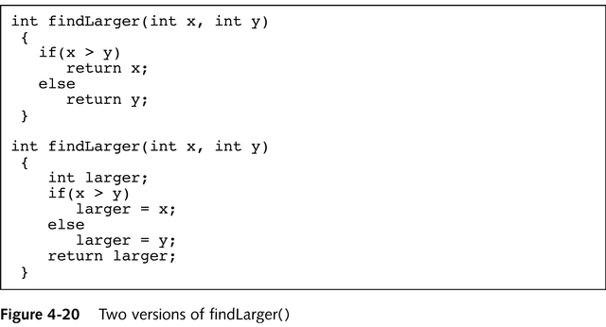
Two Versions of findLarger()
4

Slide 32
Passing Values to Functions
4
Many real-world functions you perform require that you provide information
A particular task might always be carried out in the same way, but with specific data
Consider a program that computes the amount of sales tax due on an item
You can write the prototype for computeTax() in one of two ways:
void computeTax(int);
OR
void computeTax(int price);

Slide 33
Passing Values to Functions
4
If you use a name such as price, you do so to provide documentation; you help someone reading the function prototype to understand the function’s purpose
If more than one argument is passed into a function, you provide a list of arguments and separate them with commas
When price is passed to computeTax(), price is called an argument to the function, or an actual parameter, because price holds the value that will actually be used by the function computeTax()

Slide 34
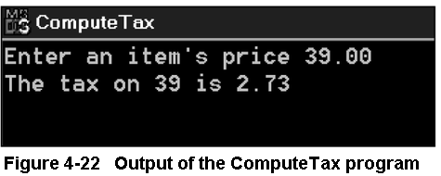
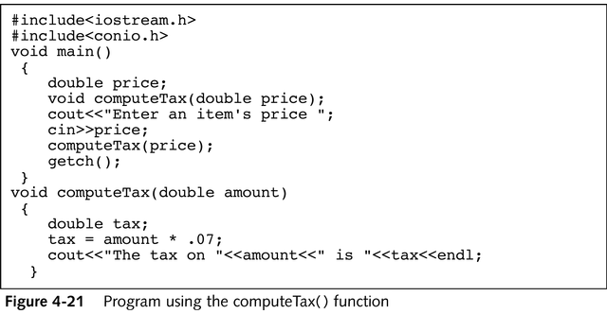
Passing Values to Functions
4

Slide 35
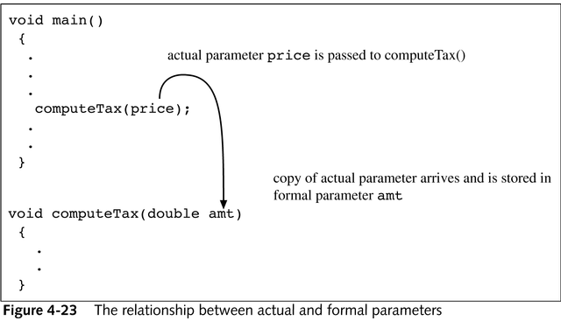
Passing Values to Functions
4
Perform the steps on page 131 of the textbook, to modify the HoursAndRate program you wrote earlier so that results now print from within a function

Slide 36
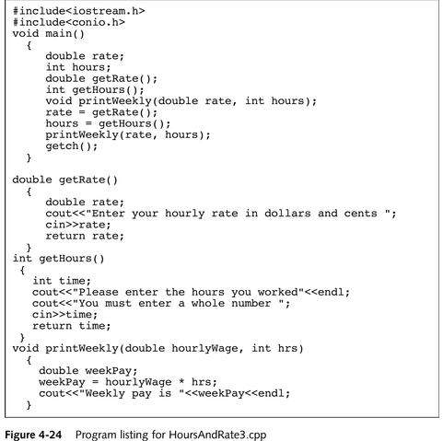
Program Listing for HoursAndRate3.cpp
4

Slide 37
Using Classes and Objects as Arguments to Functions and as Return Types of Functions
4
A function can contain a variety of combinations of actions
Some functions contain local variables declared within the function body
Some functions return and receive nothing
Others return values, receive values, or both
Functions may receive any number of variables as parameters, but may return, at most, only one variable of one type

Slide 38
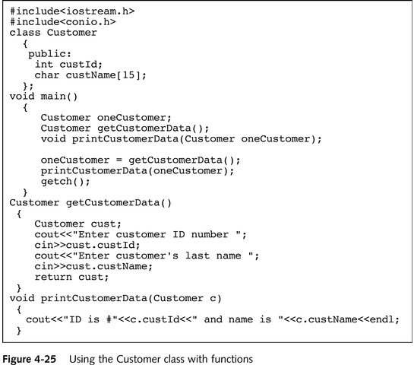
Using the Customer Class with Functions
4

Slide 39
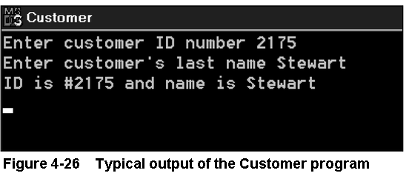
Using Classes and Objects as Arguments to Functions and as Return Types of Functions
4
Any action you can perform with a simple, scalar variable within a function, such as declaring the variable locally, using it as an argument, or returning it, you can also perform with a class object

Slide 40
Passing Addresses to Functions
4
Just as variable values may be passed to and returned from functions, so may variable addresses
Passing an address to a function avoids having the function copy the passed object, a process that takes time and memory
You also can pass addresses to a function if you want a function to change multiple values
If you pass addresses to function, however, the function can change the contents at those actual memory addresses, eliminating the need to return any values at all

Slide 41
Passing Addresses to Functions
4
As an alternative to the program shown in Figure 4-27, you can pass two memory addresses to one function, making a single function call, as shown in Figure 4-28
In the program shown in Figure 4-28, four items are passed to the results() function: the value of a, the value of b, the address of dividend, and the address of modulus
In turn the results() function receives four items:
num1, which holds the value of a
num2, which holds the value of b
oneAddress, a pointer that holds the address of dividend
anotherAddress, a pointer that holds the address of modulus

Slide 42
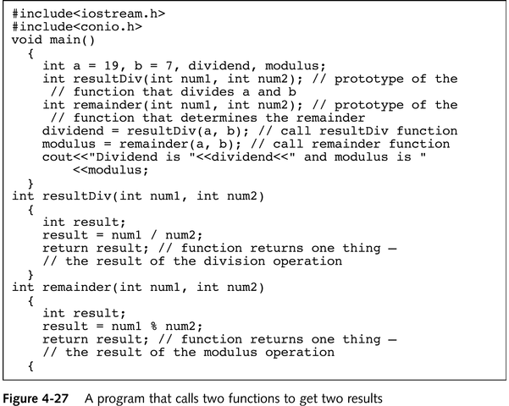
A Program That Calls Two Functions to Get Two Results
4

Slide 43
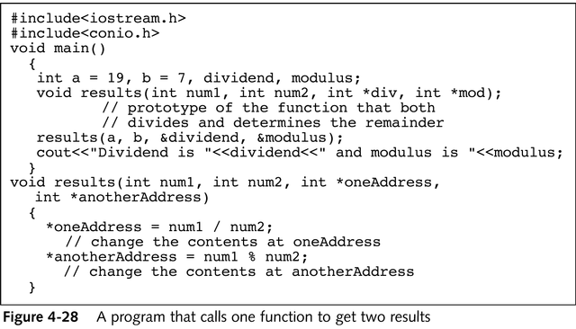
A Program That Calls One Function to Get Two Results
4

Slide 44
Passing Addresses to Functions
4
Passing an address of a variable to a function has a number of advantages:
If the function is intended to alter the variable, it alters the actual variable, not a copy of it
You can write the function to alter multiple values
When you send the address of a variable to a function, the function does not need to make a copy of the variable

Slide 45
Passing Addresses to Functions
4
The disadvantages of passing an address of a variable to a function include:
The syntax of using the & and * is awkward and more difficult to understand than using plain variable names
Even if a function is not intended to alter a variable, it may do so when it has access to a variable’s address
To take advantage of the benefits of passing addresses to functions, storing them in pointer variables, you can use reference variables and constant arguments

Slide 46
Using Reference Variables with Functions
4
To create a second name for a variable in a program, you can generate an alias, or an alternate name
In C++ a variable that acts as an alias for another variable is called a reference variable, or simply a reference

Slide 47
Declaring Reference Variables
4
You declare a reference variable by placing a type and an ampersand in front of a variable name, as in double &cash; and assigning another variable of the same type to the reference variable
double someMoney;
double &cash = someMoney;
A reference variable refers to the same memory address as does a variable, and a pointer holds the memory address of a variable

Slide 48
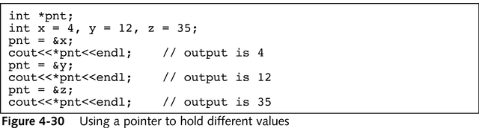
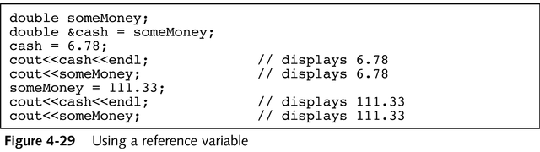
Declaring Reference Variables
4

Slide 49
Declaring Reference Variables
4
There are two differences between reference variables and pointers:
Pointers are more flexible
Reference variables are easier to use
You assign a value to a pointer by inserting an ampersand in front of the name of the variable whose address you want to store in the pointer
Figure 4-30 shows that when you want to use the value stored in the pointer, you must use the asterisk to dereference the pointer, or use the value to which it points, instead of the address it holds

Slide 50
Passing Variable Addresses to Reference Variables
4
Reference variables are easier to use because you don’t need any extra punctuation to output their values
You declare a reference variable by placing an ampersand in front of the variable’s name
You assign a value to a reference variable by using another variable’s name
The advantage to using reference variables lies in creating them in function headers

Slide 51
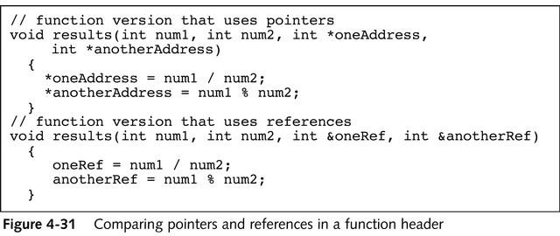
Comparing Pointers and References in a Function Header
4

Slide 52
Passing Variable Addresses to Reference Variables
4
When you pass a variable’s address to a function, whether with a pointer or with a reference, any changes to the variable made by the function also alter the actual variable
In addition, the function no longer needs to make a copy of the variable
A function that receives an address may change the variable—but sometimes you might not want the variable changed

Slide 53
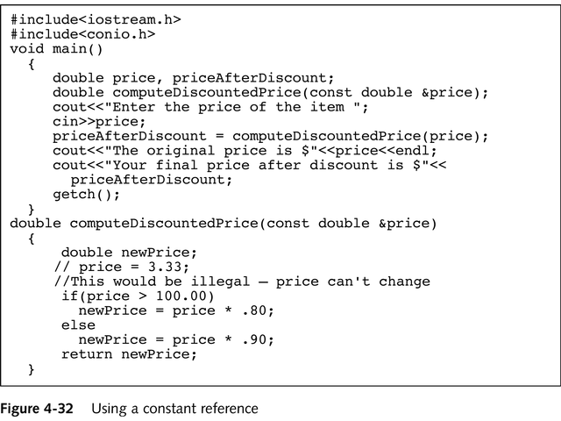
Using a Constant Reference
4

Slide 54
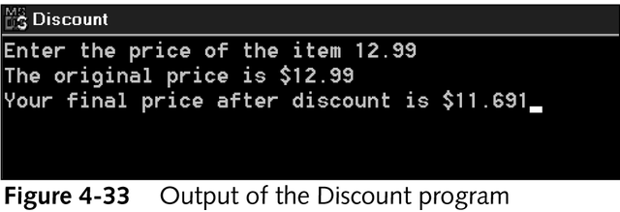
Passing Variable Addresses to Reference Variables
4
To pass an address and still protect the variable from change, you may pass a reference as a constant
Use the const modifier for all variables passed to functions when the variable should not change within the function
This practice is safe because the compiler checks to ensure that the variable is not changed inadvertently
In addition, this tactic makes your intentions clear to anyone reading your program

Slide 55
Passing Arrays to Functions
4
An array name actually represents a memory address
Thus, an array name is a pointer
The subscript used to access an element of an array indicates how much to add to the starting address to locate a value
When you pass an array to a function, you are actually passing an address
Any changes made to the array within the function also affect the original array

Slide 56
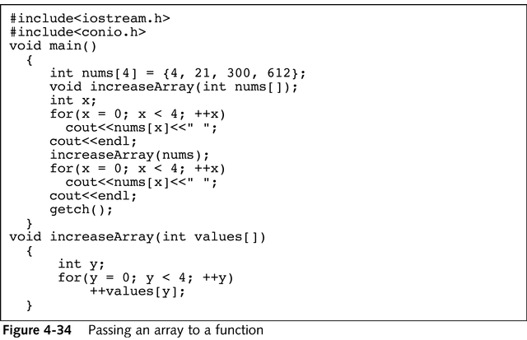
Passing an Array to a Function
4

Slide 57
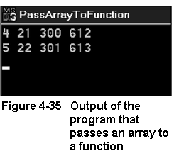
Passing Arrays to Functions
4
In both the function prototype and the function header in Figure 4-34, the array name is written with empty brackets
Although passing an array name to a function involves passing an address, passing an array element to a function is no different than passing any single scalar variable of the same type

Slide 58
Inline Functions
4
Each time you call a function in a C++ program, the computer must do the following:
Remember where to return when the function eventually ends
Provide memory for the function’s variables
Provide memory for any value returned by the function
Pass control to the function
Pass control back to the calling program
This extra activity constitutes the overhead, or cost of doing business, involved in calling a function

Slide 59
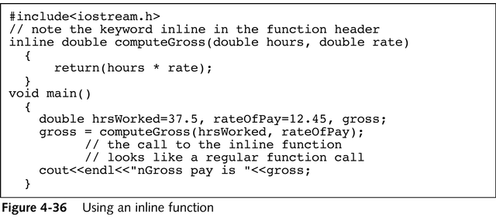
Using an Inline Function
4

Slide 60
Inline Functions
4
An inline function is a small function with no overhead
Overhead is avoided because program control never transfers to the function
A copy of the function statements is placed directly into the compiled calling program
The inline function appears prior to the main(), which calls it
Any inline function must precede any function that calls it, which eliminates the need for prototyping in the calling function

Slide 61
Inline Functions
4
When you compile a program, the code for the inline function is placed directly within the main() function
You should use an inline function only in the following situations:
When you want to group statements together so that you can use a function name
When the number of statements is small (one or two lines in the body of the function)
When the function is called on few occasions

Slide 62
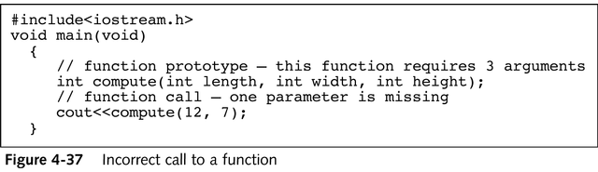
Using Default Arguments
4
When you don’t provide enough arguments in a function call, you usually want the compiler to issue a warning message for this error
Sometimes it is useful to create a function that supplies a default value for any missing parameters

Slide 63
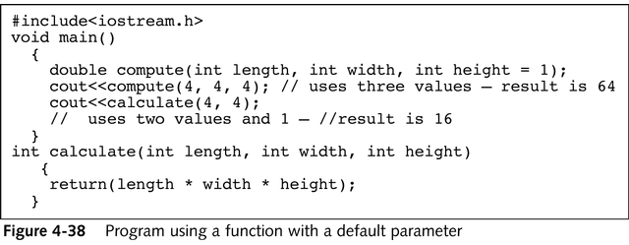
Using Default Arguments
4
Two rules apply to default parameters:
If you assign a default value to any variable in a function prototype’s parameter list, then all parameters to the right of that variable also must have default values
If you omit any argument when you call a function that has default parameters, then you also must leave out all arguments to the right of that argument

Slide 64
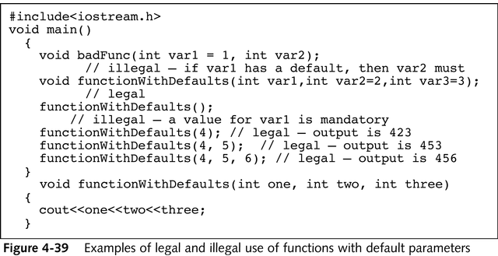
Examples of Legal and Illegal Use of Functions with Default Parameters
4

Slide 65
Overloading Functions
4
In most computer programming languages, each variable used in a function must have only one name, but C++ allows you to employ an alias
Similarly, in most computer programming languages, each function used in a program must have a unique name
You don’t have to use three names for functions that perform basically the same task, C++ allows you to reuse, or overload, function names

Slide 66
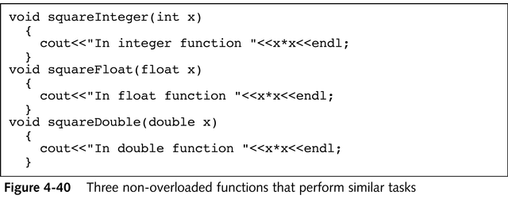
Overloading Functions
4
Whether you use the function shown in Figure 4-40 or 4-41, you still must write three versions of the function—one for each type of argument you want to support
When you overload a function, you must ensure that the compiler can tell which function to call
When the compiler cannot tell which version of a function to use, you have created ambiguity

Slide 67
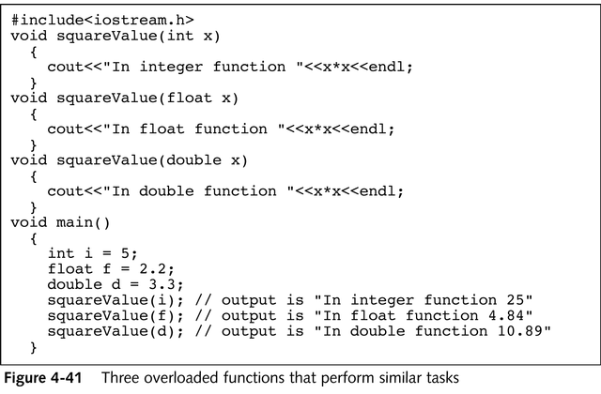
Three Overloaded Functions That Perform Similar Tasks
4

Slide 68
Summary
4
Functions are programming modules
You can define a function by writing it above the function that uses it, or by including the function’s filename at the top of the file that uses it
When you write functions, you employ procedural abstraction—the process of extracting the relevant attributes of an object
Global variables are known to every function and block in a program

Slide 69
Summary
4
Local variables are accessible or in scope only within the block where they are defined
The header of a function consists of the return type, the name, and the argument list
A function can return a value that the calling function can use
You can pass an argument or parameter to a function
You can pass class objects to functions and return them from functions in the same way you work with scalar variables

Slide 70
Summary
4
Passing an address to a function allows you to avoid having the function copy the passed object and allows a function to change multiple values without returning them
In C++ a variable that acts as an alias for another variable is called a reference variable
Because an array name is a memory address, when you pass an array name to a function, you are actually passing an address

Slide 71
Summary
4
An inline function is a small function with no overhead
You should use inline functions when the number of statements is small and when the function is called infrequently
Default parameters provide values for any parameters that are missing in the function call
C++ allows you to reuse, or overload, function names
To prevent ambiguity, overloaded functions must have argument lists of different types

