Slide 1
Predicting Earnings Manipulation by indian firms
Presented By:
Mayurakshi Paul (17030242013)
Sarvagna Mahakali (17030242012)
Lakshmi Challa (17030242004)

Slide 2
Do you think the Beneish model developed in 1999 will still be relevant to Indian context?

Slide 3
How can one handle datasets with imbalanced classes?
Problem :
Unreliable accuracy
Tricky to train the model
Treating fraudulent cases as noise
Solution :
Re-sampling techniques
Modify existing Algorithms
Penalizing the model

Slide 4
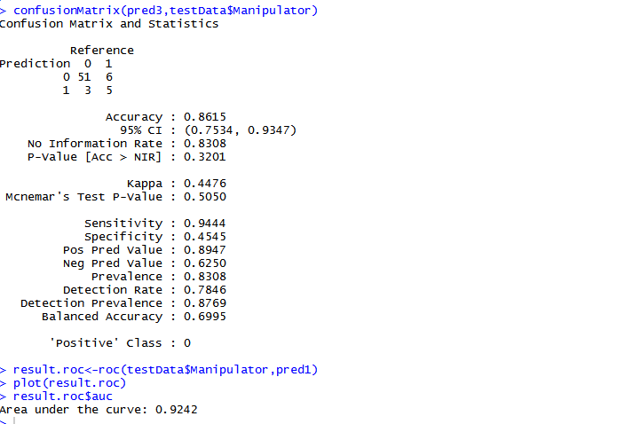
Logistic regression model on sample data
We observed the following results after applying logistic regression on the sample data:

Slide 5
Strategy behind Adopting logistic regression
1. Specify Performance Requirements
2. Separate Prediction Algorithm From Model Coefficients
2a. Select or Implement The Prediction Algorithm
2b. Serialize Your Model Coefficients
Develop Automated Tests For Your Model
4. Develop Back-Testing and Now-Testing Infrastructure
Challenge Then Trial Model Updates

Slide 6
M-score( Manipulator)
Based on the models developed in questions 4 and 5 suggest a M score(manipulator score) that can be used by regulators to identify potential manipulators ?
M = -4.84 + 0.92 DSRI + 0.528 GMI + 0.404 AQI + 0.892 SGI + 0.115 DEPI – 0.172 SGAI + 4.679 TATA – 0.327 LVGI
Earnings Manipulation Risk (Beneish M-Score) J Sainsbury has an M-Score of 1.50. As the score is above the -1.78 threshold, this indicates a potential risk that the company may be manipulating earnings. The Beneish M-score is a classification model based on combining multiple ratios.

Slide 7
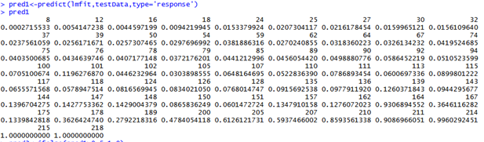
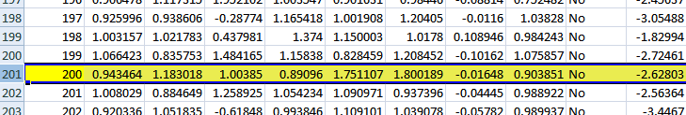
Contd..

Slide 8
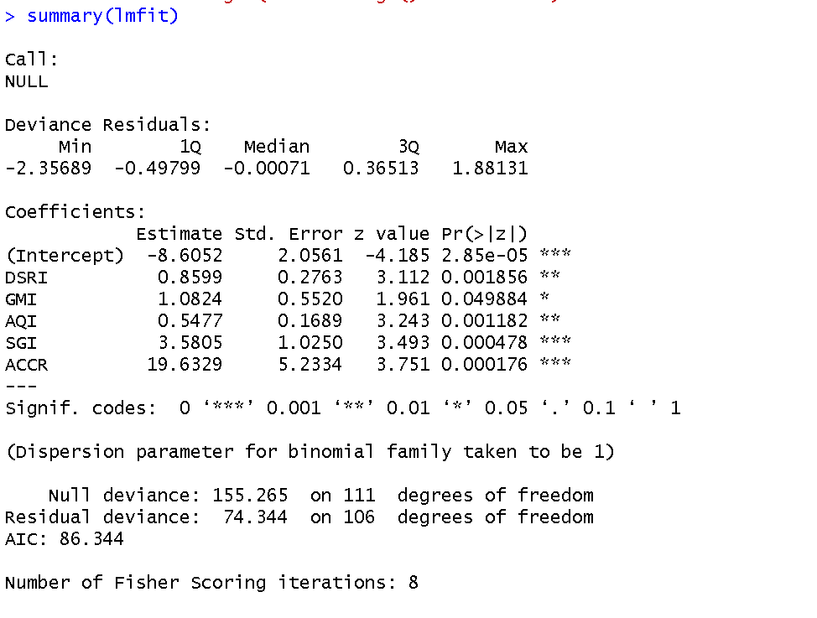
GLM using complete data
We observed the following results after applying logistic regression on the complete data:

Slide 9
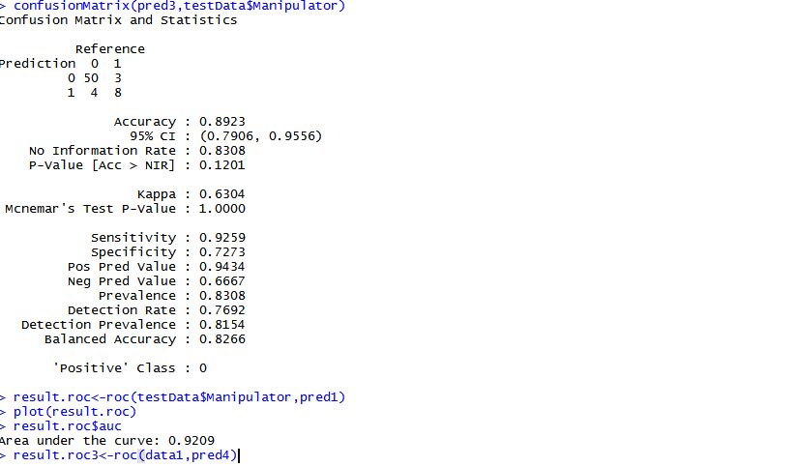
Contd..

Slide 10
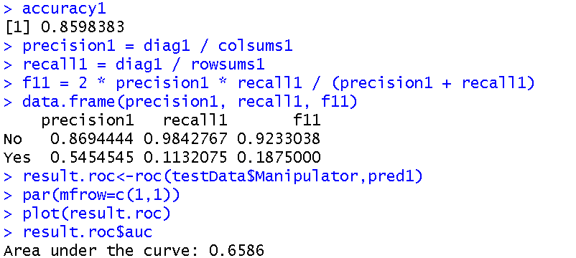
Camparing GLM of Sample data and Complete data
Sample Data
Complete Data

Slide 11
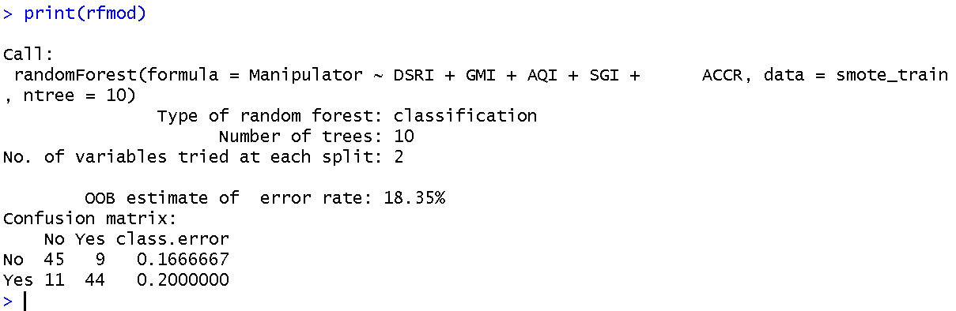
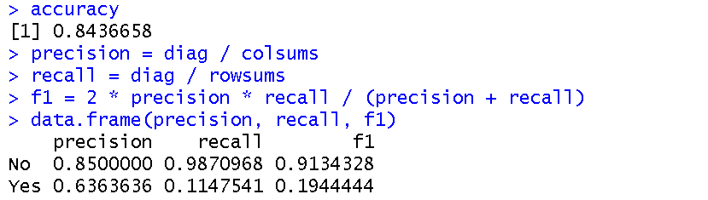
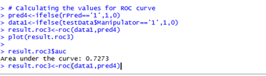
Random forest model and results
We observed the following results after applying RandomForest on the sample data:

Slide 12
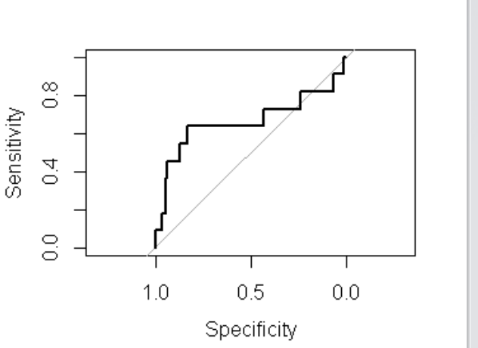
Contd..

Slide 13
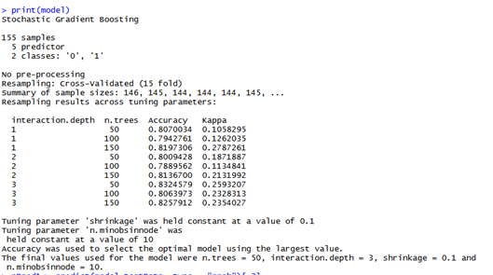
Boosting model and results
We observed the following results after applying Boosting model on the sample data:

Slide 14
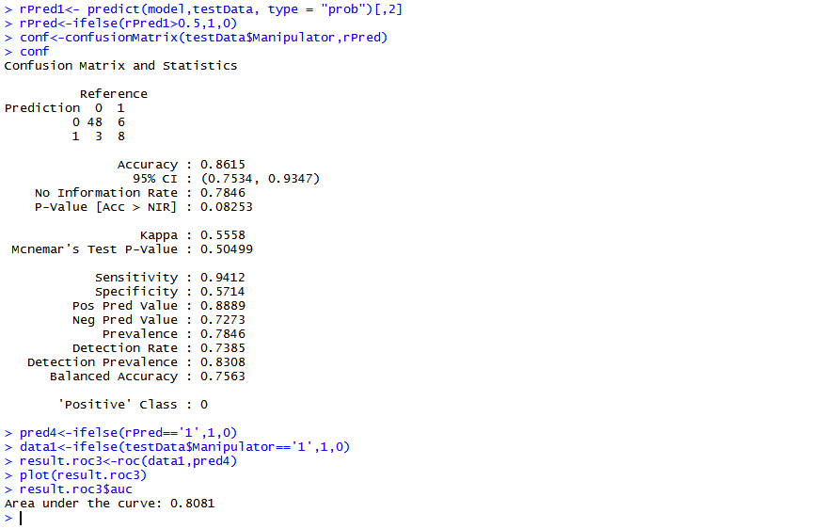
Contd..

Slide 15
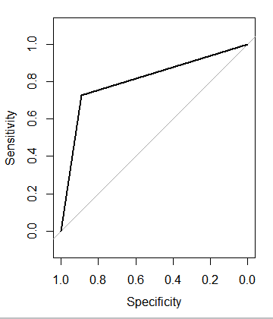
Contd..

Slide 16
Comparing Machine learning algorithms with Logistic Regression and Classification
Random Forest
Logistic Regression

Slide 17
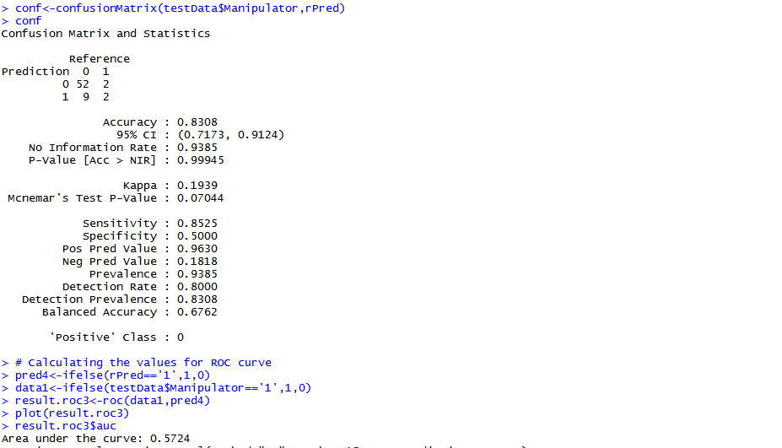
Contd..
Boosting
CART

Slide 18
Conclusion
 | Accuracy | Sensitivity | AUC
Logistic Regression | 86% | 0.4476 | 92.42
CART | 83% | 0.8525 | 57.24
RandomForest | 84% | 0.114 | 72.17
Boosting | 86% | 0.942 | 80.81

