Slide 1
YouTube Data Analysis using Apache PIG and HIVE
Presented by :
Challa Prasanna
Sarvagna Mahakali

Slide 2
WorkFlow
Generate API key to fetch YouTube Data
Python Application to use YouTube API
Analysis using PIG and HIVE

Slide 3
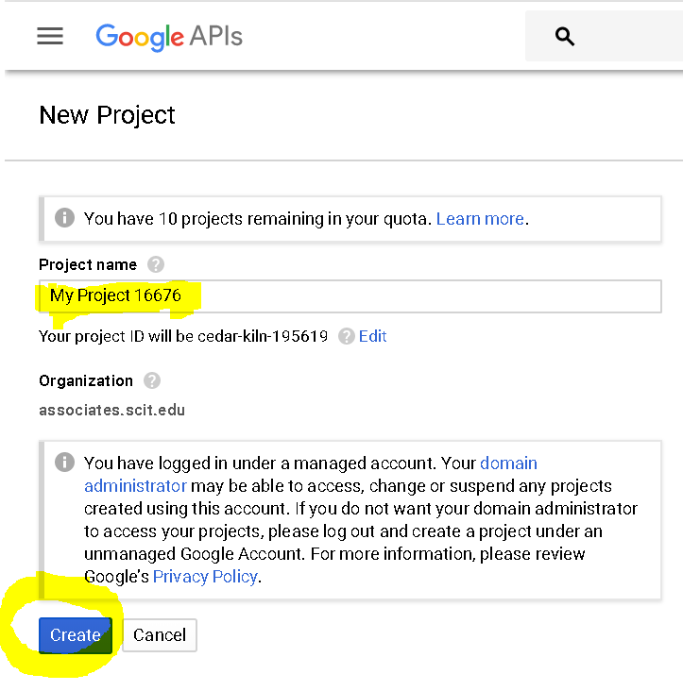
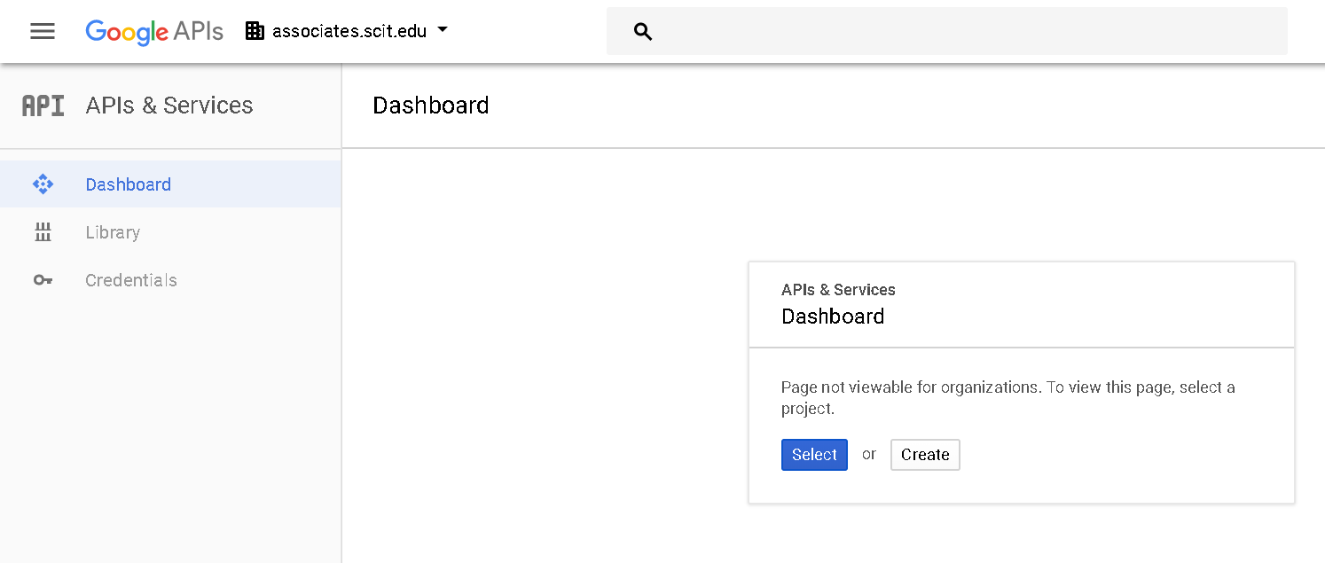
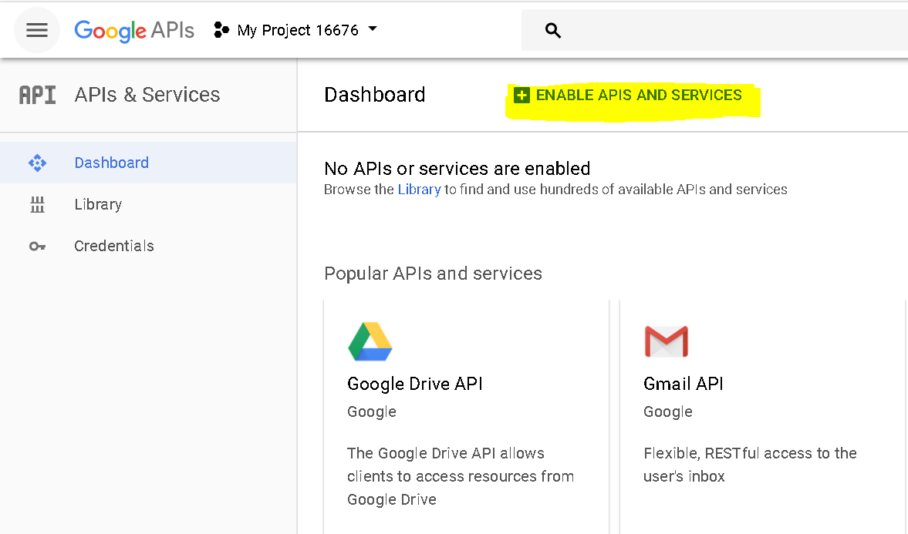
GENERATE YOUTUBE DATA API

Slide 4
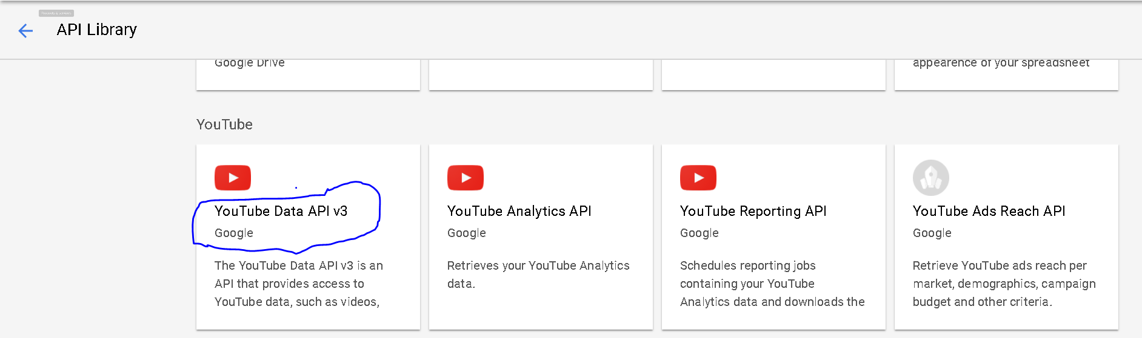
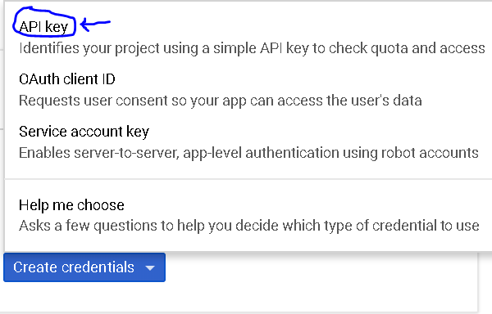
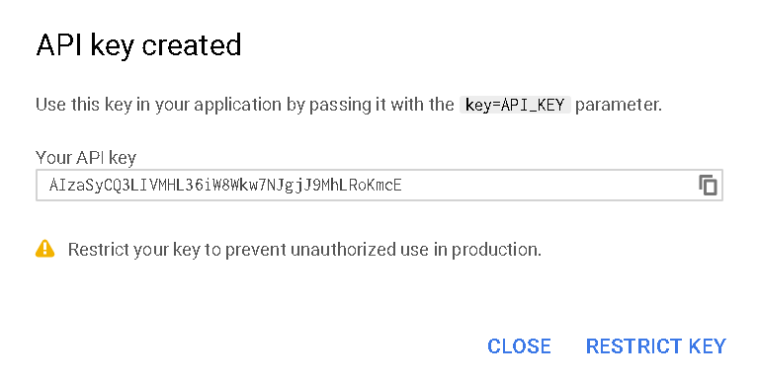
Contd..

Slide 5
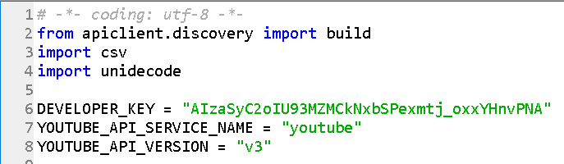
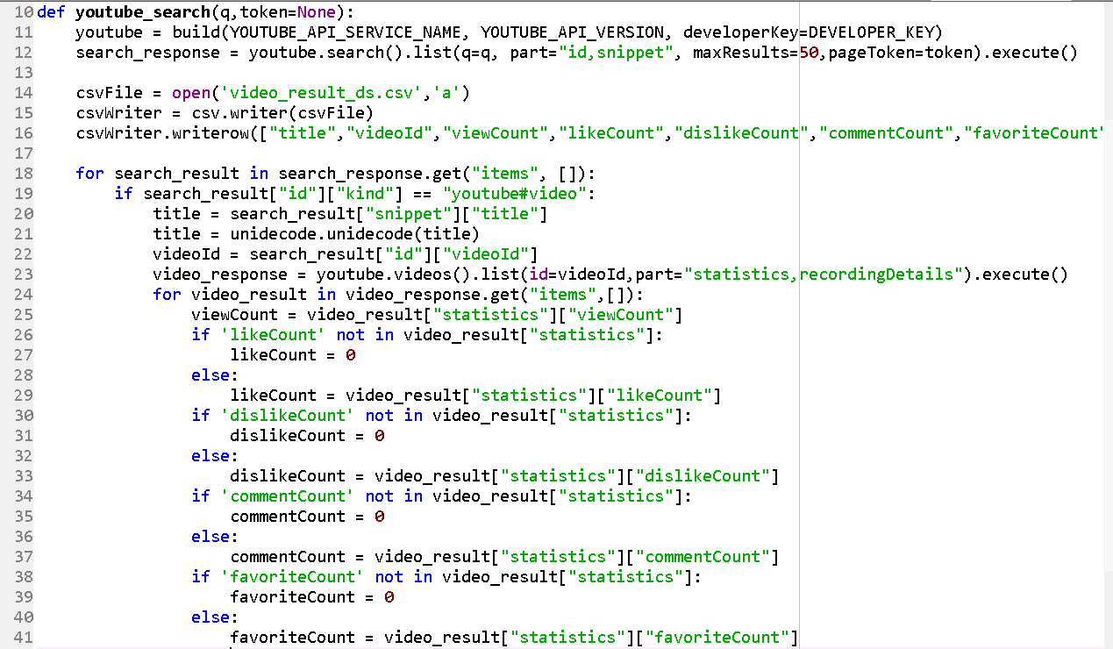
Python Code for Fetching YouTube Data

Slide 6
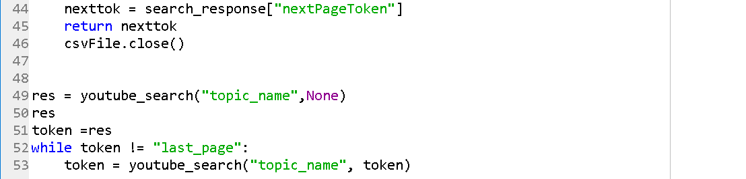
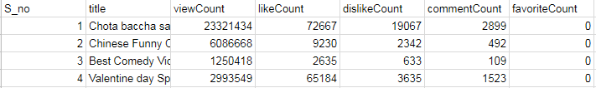
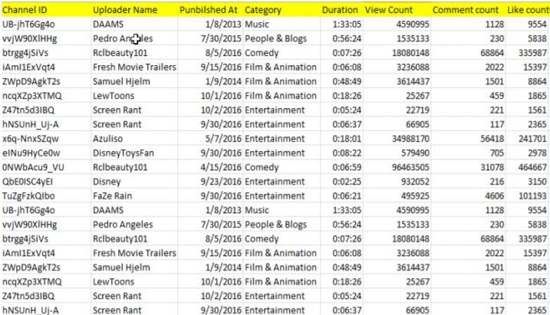
Data Extracted :

Slide 7
Data Description
Serial Number
Title - Title of the Video
Video ID – 11 character String
View Count - unsigned long integer, Maximum number of views possible are 9,223,372,036,854,775,808 (as defined by YouTube)
Like Count -unsigned long integer, No limit on maximum number of likes
Dislike Count
Comment Count
Favourite Count
Category

Slide 8
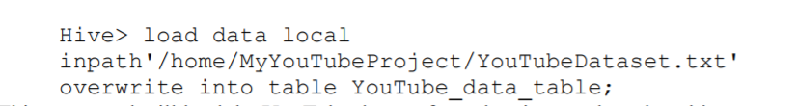
Analysis using HIVE
Creating a table in hive :
Loading the data to the table :

Slide 9
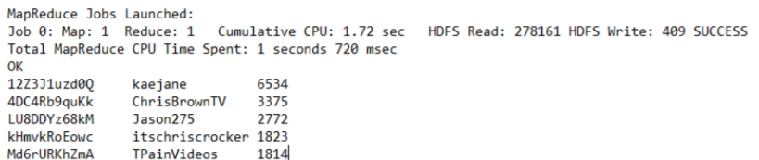
Query 1 : Calculate top 5 channels with maximum number of likes
Output :

Slide 10

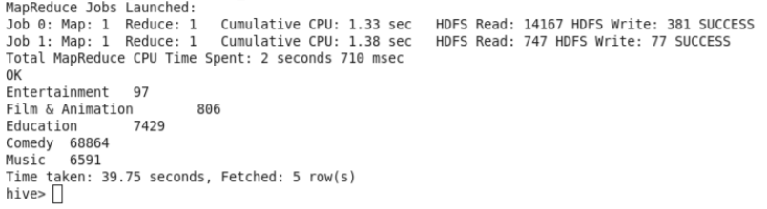
Query 2 : Calculate top 5 categories with maximum number of comments
Output :

Slide 11

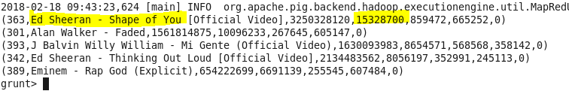
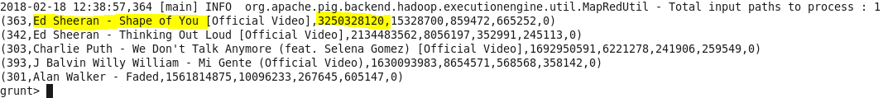
Analysis using Apache PIG
Loading data into PIG
Category : Music
Query 3 : Calculate Top 5 videos with Maximum number of likes in the category MUSIC
Query 4 : Most Viewed Video in the MUSIC category

Slide 12
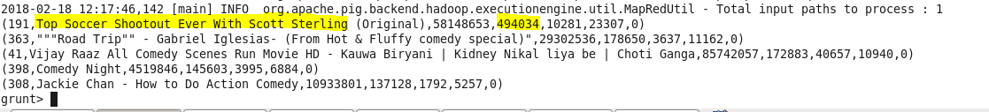
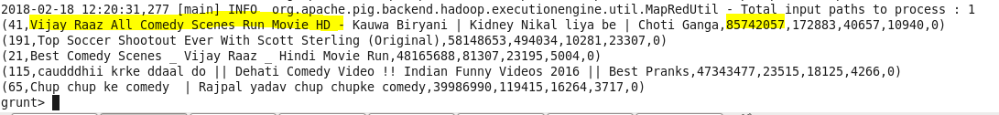
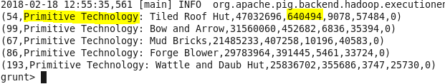
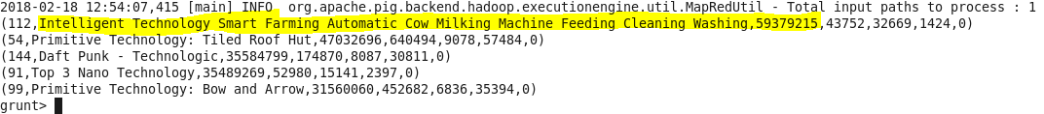
Category : Comedy
Query 5 : Calculate Top 5 videos with Maximum number of likes in the category COMEDY
Query 6 : Most Viewed Video in the COMEDY category
Category : Technology
Query 7 : Calculate Top 5 videos with Maximum number of likes in the category Technology
Most Viewed video in category Technology

Slide 13
Conclusion
Comedy
Education
Music

Slide 14
THANK YOU

