Slide 1

23CSE301
Machine Learning Capstone
Phase - I Review
Name: NAGARAMPALLI SARVAN KUMAR
Roll Number: CH.SC.U4CSE24130
Paper ID: 045
Paper Title: Improving Phishing Email Detection Performance Through Deep Learning With Adaptive Optimization

Slide 2
Understanding the Problem:
Problem Statement:
Interpretation:
  Phishing attacks are growing more sophisticated, closely imitating trusted sources and placing a heavy burden on cybersecurity.
  This makes it difficult for both users and traditional filters to tell legitimate messages from malicious ones.
  Traditional filters rely on known keywords and patterns, so they often fail against new or cleverly worded phishing attempts.
  This gap creates the need for a smarter, context aware detection system.
  The problem can be modeled as a Supervised Learning problem, since the dataset provides labeled examples (Phishing / Safe).
  It is a Classification problem, and falls under Binary Classification.
  It is a Deep Learning problem, since detecting phishing requires understanding context, not just matching keywords.
  To catch phishing, we need to understand the context behind an email and what it is really trying to say, not just the words it uses.

Slide 3
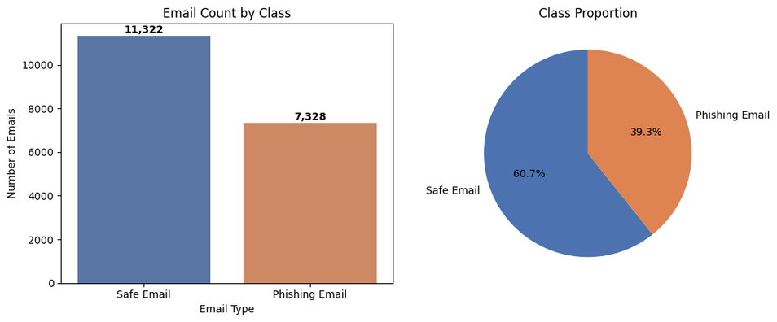

Dataset Description & Interpretation:
  URL: https://www.kaggle.com/datasets/subhajournal/phishingemails/data
  Shape: 18,650 rows x 3 columns
  Total No. of Samples: 18,650
  Total No. of Columns: 3
  Column Headers: ['Unnamed: 0', 'Email Text', 'Email Type']
  Distribution of Safe vs Phishing Emails in the Dataset used:
    Safe Emails - 11,322 (60.71 %)
    Phishing Emails - 7,328 (39.29 %)
  It is a mildly imbalanced classification problem. As the dataset is a
bit skewed towards Safe Emails (60.71%) Compared to Phishing
Emails (39.29%).

Slide 4
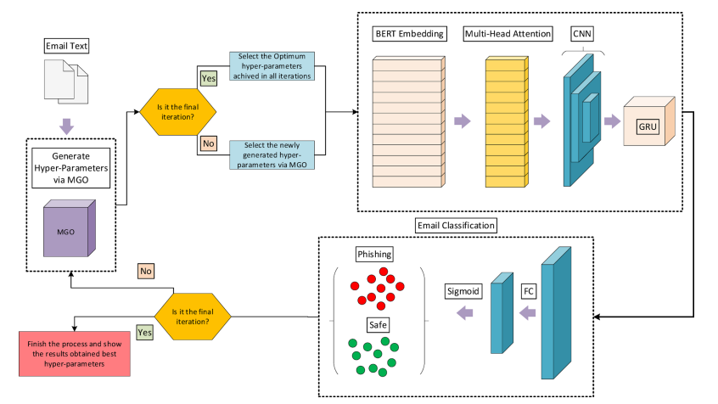
Interpretation of Approach Used:
Key Terms:
  Tokenization
  MGO (Mountain Gazelle Optimizer)
  BERT (Bidirectional Encoder Representations from Transformers)
  Multi-Head Attention
  CNN (Convolutional Neural Network)
  GRU (Gated Recurrent Unit)
Source: The above image has been extracted from the base paper.

