Slide 1
SMART INDIA HACKATHON 2026
AI-Powered Procurement Bid Compliance Verification Platform
AI Verifies | Evidence Explains | Officers Decide
PROJECT & TEAM SPECIFICATIONS
THE PROBLEM STATEMENT
Problem Statement ID: SIH26100
Problem Statement Title: AI-Assisted Procurement Bid Compliance Verification Platform
Team Name: Tech_nova
Team ID: 179363
Theme: Smart Automation / GovTech
PS Category: Software
Platform Status: Live Deployed & Verified Working Application
"Government procurement officers manually verify large numbers of tender requirements against bidder documents.
This makes compliance checking time-consuming, difficult to compare, and vulnerable to missed evidence."
⏱ Time-Consuming: Manual verification across hundreds of pages of complex tender BOQs and bidder documents takes days to weeks, creating severe procurement bottlenecks.
⚖ Difficult to Compare: Bidders submit documents in disparate formats and structures without unified criteria alignment, making objective cross-bid comparison cumbersome.
⚠ Vulnerable to Missed Evidence: Critical compliance clauses, financial thresholds, and non-compliance risks easily slip through manual human inspection under heavy workloads.
@SIH Idea submission- Template • Smart India Hackathon 2026
Slide 1 of 7

Slide 2
Team: Tech_nova
PS: SIH26100
Smart India Hackathon 2026
OUR SOLUTION
End-to-End Automated Compliance Pipeline: Extraction, Verification, Grounded Evidence & Decision Support
STEP 01
STEP 02
STEP 03
STEP 04
STEP 05
STEP 06
STEP 07
Tender / Bid
Documents
AI Document
Extraction
Requirement &
Evidence Mapping
Rule / AI
Verification
Compliance +
Risk Findings
Officer
Review
Final
Decision
RFP, BOQ, Technical proposals, financials, and vendor certificates
OCR parsing, table extraction, metadata structuring & clause separation
Semantic vector retrieval linking tender criteria to exact bidder document pages
Two-stage checks: deterministic threshold checks + deep LLM verification
Actionable PASS / REVIEW / FAIL flags, risk matrix & discrepancy alerts
Side-by-side multi-bid comparison with interactive evidence inspector
Human officer records reasoned decision backed by immutable audit trail
AI Verifies
Automatically extracts tender requirements & bidder facts
Evidence Explains
Every finding tied to exact document & page citations
Officer Decides
AI never picks winner; human retains final decision
@SIH Idea submission- Template • Smart India Hackathon 2026
Slide 2 of 7

Slide 3
Team: Tech_nova
PS: SIH26100
Smart India Hackathon 2026
SYSTEM ARCHITECTURE
Complete Multi-Tier Technical Architecture with Unified Officer, Admin, and Bidder Operational Flows
TECHNICAL ARCHITECTURE STACK
UNIFIED USER & ADMIN WORKFLOWS
USERS LAYER
👤 Procurement Officer • 🏢 Bidder Applicant • 🛡 System Administrator
👤 PROCUREMENT OFFICER FLOW:
Login → Tender/Bid Management → Upload Documents → AI Verification → Evidence & Findings → Review → Final Decision
• Defines tender qualification criteria & publishes RFP
• Ingests bidder dossiers into AI parsing pipeline
• Inspects evidence citations & records reasoned procurement award
REACT + VITE FRONTEND (TypeScript & Tailwind CSS)
Responsive UI • Evidence Inspector • Multi-Bid Comparison Matrix • JWT Auth
SPRING BOOT BACKEND + JAVA 21 (REST API Engine)
Spring Security + RBAC • Deterministic Verification Rules • Audit Trail Logger
🛡 SYSTEM ADMINISTRATOR FLOW:
Login → User Management → Tender/System Monitoring → Verification Monitoring → Audit / Traceability
• Role-Based Access Control (RBAC) & user lifecycle management
• Health monitoring of Spring Boot backend & FastAPI AI service
• Immutable audit logging for CAG & CVC compliance
POSTGRESQL
Database Layer
• Tender & Bid Metadata
• Verification Records
• User Accounts & Roles
• Immutable Audit Logs
• JPA / HikariCP Pool
FASTAPI AI SERVICE
Ollama + Qwen 2.5 3B
• Python FastAPI Service
• Document Parsing & OCR
• Ollama Runtime Engine
• Qwen 2.5 3B Local LLM
• 100% Private / No Data Leak
🏢 BIDDER INTERACTION LAYER:
• Submit Bids & Certificates • View Real-Time Verification Status • Query Grounded AI Assistant for Tender Rules
@SIH Idea submission- Template • Smart India Hackathon 2026
Slide 3 of 7

Slide 4
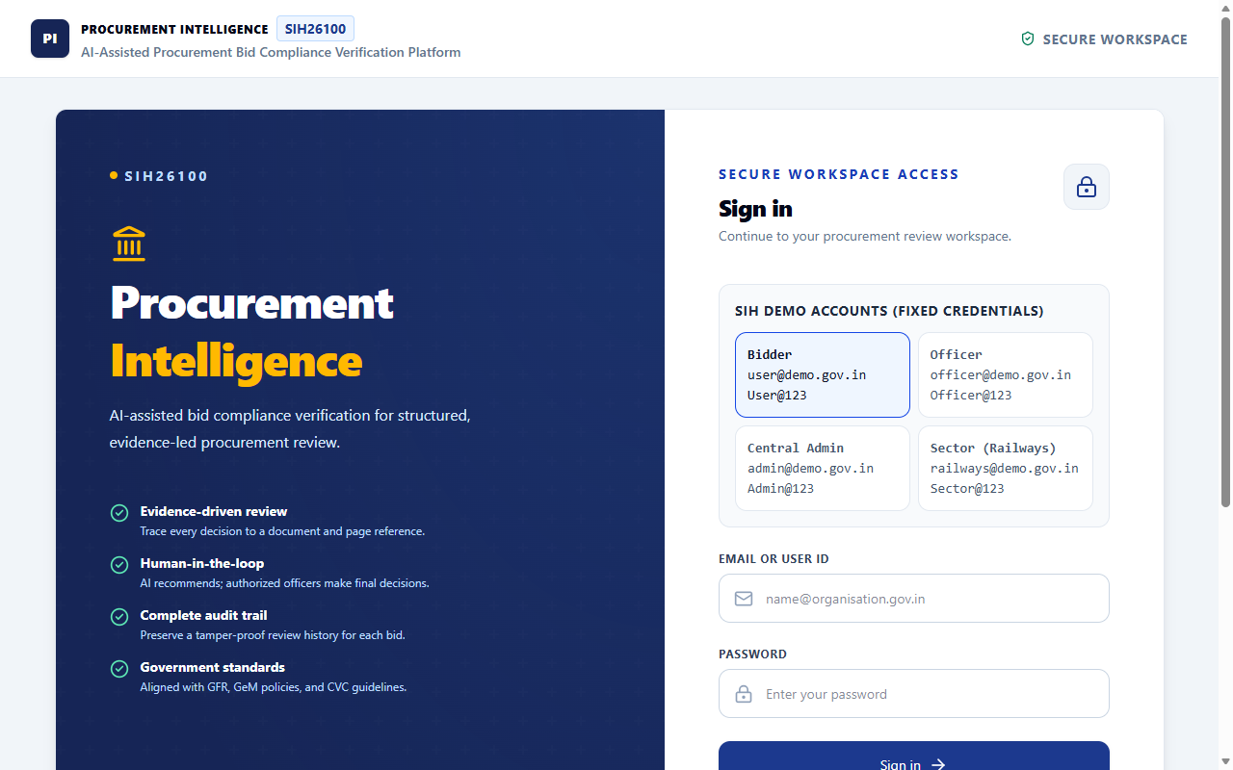
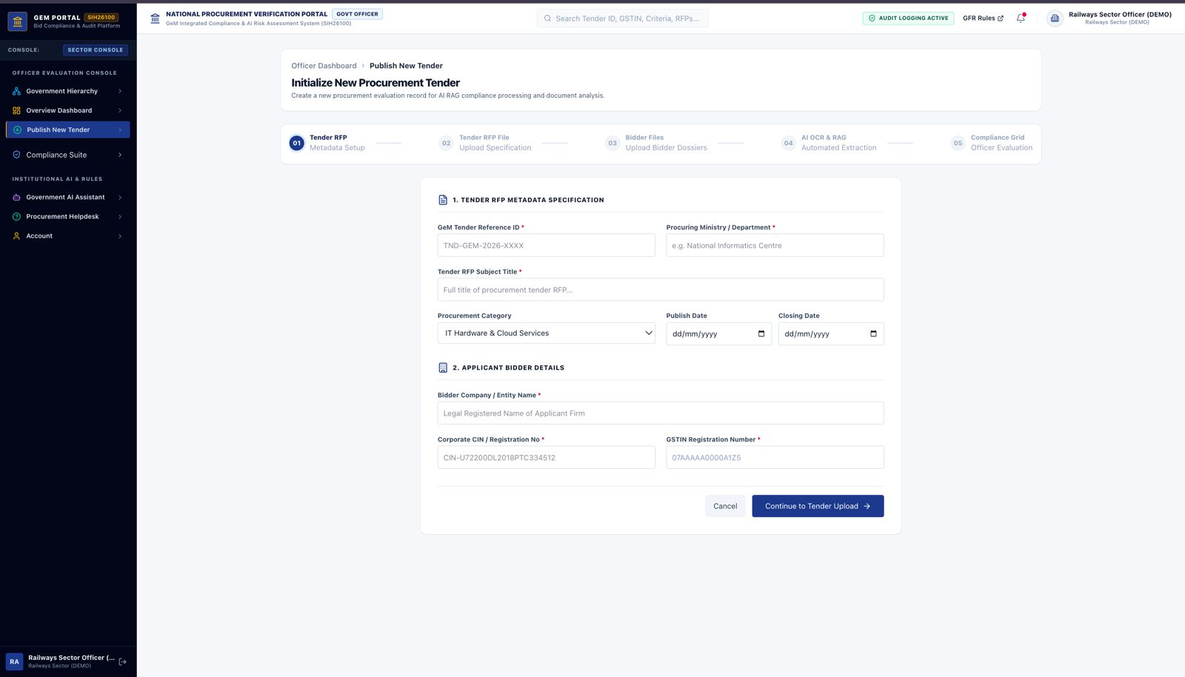
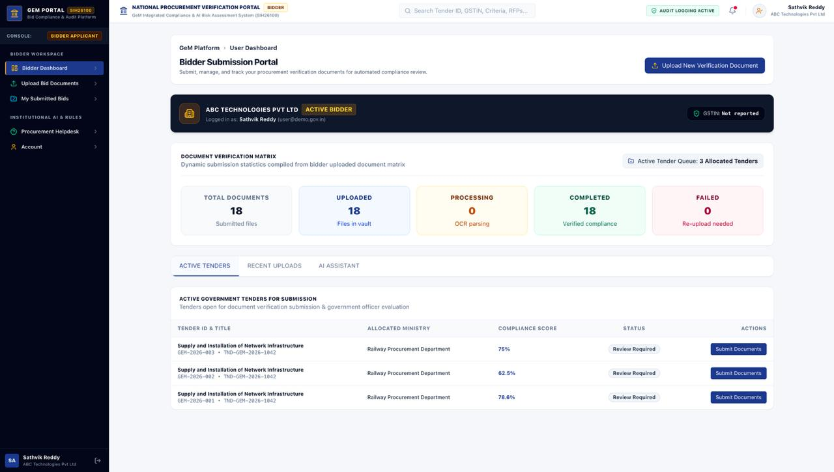
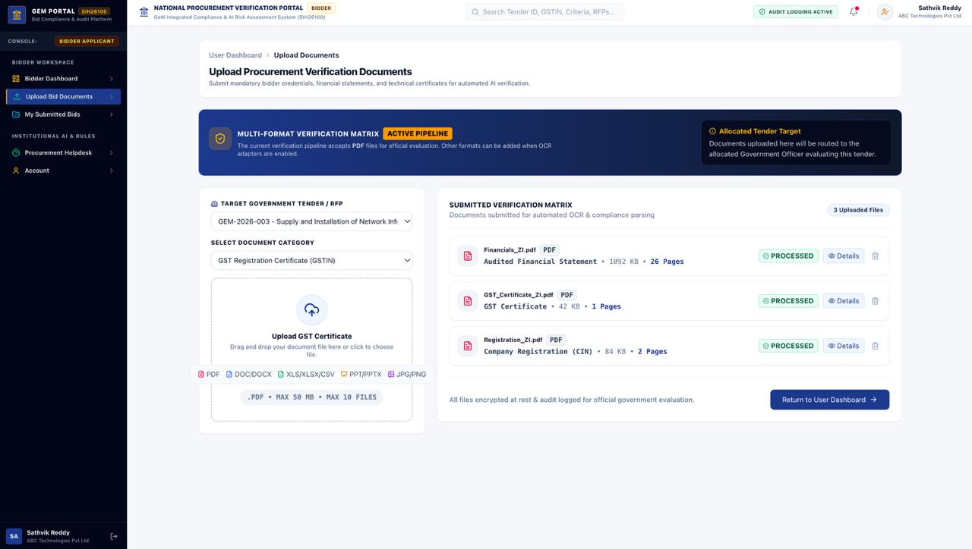
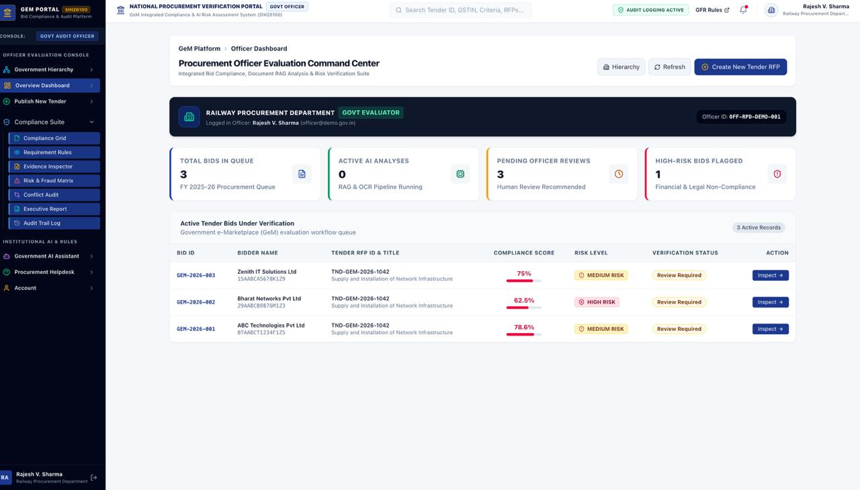
Team: Tech_nova
PS: SIH26100
Smart India Hackathon 2026
LIVE WORKING APPLICATION
MAIN APPLICATION WORKFLOW: LOGIN → TENDER MANAGEMENT → BID SUBMISSION → AI COMPLIANCE VERIFICATION → OFFICER REVIEW
• LOGIN •
• TENDER MANAGEMENT •
• BID SUBMISSION •
Secure Multi-Persona Access (Officer, Bidder, Admin)
Publish Tenders, Upload RFPs & Set Criteria
Bidder Document Matrix & Vault Submission
• AI COMPLIANCE VERIFICATION •
• OFFICER REVIEW •
Multi-Format Verification Pipeline with Grounded Document Citations
Command Center: Multi-Bid Comparison Matrix & Reasoned Award Decision
@SIH Idea submission- Template • Smart India Hackathon 2026
Slide 4 of 7

Slide 5



Team: Tech_nova
PS: SIH26100
Smart India Hackathon 2026
PROJECT LINKS
Interactive Live Application, Full Open-Source Repository, Complete Video Demonstration, and Pre-Configured Test Credentials
LIVE APPLICATION
GITHUB REPOSITORY
YOUTUBE DEMO
ai-bid-compliance-frontend.onrender.com
github.com/tiruvinayak/ai-bid-compliance-platform.git
youtu.be/TsULeHhOB50
OPEN LIVE PLATFORM ↗
VIEW SOURCE CODE ↗
WATCH VIDEO DEMO ↗
PRE-CONFIGURED EVALUATION CREDENTIALS (ROLE-BASED DEMO ACCOUNTS)
Procurement Officer
Email: officer@demo.gov.in
Pass: Officer@123
Tender setup, AI evaluation & review
Bidder / Vendor
Email: user@demo.gov.in
Pass: User@123
Document upload & status tracking
Central Admin
Email: admin@demo.gov.in
Pass: Admin@123
System monitoring & user governance
Sector Admin (Railways)
Email: railways@demo.gov.in
Pass: Sector@123
Sector oversight & compliance audit
@SIH Idea submission- Template • Smart India Hackathon 2026
Slide 5 of 7

Slide 6
Team: Tech_nova
PS: SIH26100
Smart India Hackathon 2026
IMPACT
Measurable Institutional Value Across Procurement Speed, Audit Readiness, and Transparent Competition
IMPACT PROGRESSION FLOWCHART
BENEFICIARY IMPACT BREAKDOWN
OUR PLATFORM: AI-Powered Procurement Bid Compliance Verification
• PROCUREMENT OFFICER
→ Faster review: Drastically reduces hours spent cross-checking multi-page tender criteria against bidder files.
→ Structured evidence: Direct clickable document citations and page excerpts validate every extracted claim.
→ Easier comparison: Side-by-side comparative matrices highlight discrepancies between competing bidders.
Faster Structured Review: Replaces days of manual reading with instant OCR & clause extraction
Evidence-Backed Decisions: Direct page-level citations eliminate guesswork & subjective disputes
• GOVERNMENT & PUBLIC SECTOR
→ End-to-end traceability: Full provenance linking tender rules to bidder evidence and officer decisions.
→ Consistent evaluation: Standardized deterministic rule enforcement eliminates human evaluator variance.
→ Audit readiness: Tamper-evident logs align seamlessly with GFR 2017, GeM policies, and CVC guidelines.
Consistent Evaluation: Standardized rules prevent disparate decisions across officers
Multi-Bid Comparison: Unified criteria matrix enables objective side-by-side assessment
End-to-End Traceability: Complete provenance tracking from RFP clause to vendor document
• BIDDER / VENDOR ECOSYSTEM
→ Clear requirements: Structured checklists give vendors clear visibility into qualification criteria.
→ Verification status: Real-time visibility into document parsing status and verification completeness.
→ AI assistant for queries: Interactive RAG assistant answers bidder questions on tender rules without delays.
Audit-Ready Procurement: Tamper-evident records ready for official oversight (CAG / CVC)
@SIH Idea submission- Template • Smart India Hackathon 2026
Slide 6 of 7

Slide 7
Team: Tech_nova
PS: SIH26100
Smart India Hackathon 2026
KEY BENEFITS & DIFFERENTIATORS
How Our Evidence-First Architecture Elevates Procurement Rigor Over Traditional Manual Evaluation
TRADITIONAL WORKFLOW (Manual, Slow & Vulnerable): Documents → Manual Checking → Officer Decision
• Manual inspection across hundreds of pages • High risk of missed critical clauses • Difficult multi-bid comparison • Zero verifiable audit trail
OUR PLATFORM WORKFLOW (Automated, Evidence-Backed & Explainable): Documents → AI Extraction → Evidence Mapping → Two-Stage Verification → Risk / Conflict Findings → Officer Review → Final Decision
• Instant document parsing • Every fact tied to page numbers • Deterministic rule validation • Multi-bid matrix • Human retains 100% final decision authority
OUR PLATFORM ADDS — 7 CORE DIFFERENTIATORS
1. Evidence-Backed AI
Every finding is strictly linked to source evidence with exact page numbers & clause excerpts.
2. Two-Stage Verification
Stage 1 Integrity Check for document validity, followed by Stage 2 Deep Verification across criteria.
3. Multi-Bid Comparison
Aligns all competing bidders against identical tender requirements in a unified comparison matrix.
4. Grounded AI Assistant
Retrieval-Augmented Assistant strictly bounded to tender documents; zero hallucinations or made-up facts.
5. Human-in-the-Loop
AI assists by verifying and explaining; the authorized procurement officer always makes the final decision.
6. Complete Audit Trail
Immutable event logging captures every document upload, rule evaluation, and user decision for CAG/CVC review.
7. Local / Private AI
Ollama + Qwen 2.5 3B runs on-premise, guaranteeing sensitive procurement data never leaves government servers.
@SIH Idea submission- Template • Smart India Hackathon 2026
Slide 7 of 7

