Slide 1
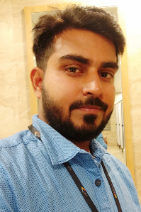
Sarvapriya
Contact Details
Mail : sakumar488@gmail.com
Ph no.. 7989185914
Select Relevant Experience:
Global Pharmaceutical –
Roles and Responsibilities -
Enhancing application by implementing new business requirements.
As a part of application maintenance resolving incidents and service request for more than 250 digital marketing websites hosted on EpiServer Platform.
Supported business on critical platform activities like site launch and DNS changes.
Performed compliance activities for more than 15 applications by coordinating with client compliance team.
Deployed application using weblogic java platform from staging to production after fixing bugs.
Provided Application support for Digital Marketing websites hosted on EPiServer.
Experience Summary:
3.8 years of experience in Episerver tool (CMS) based on
..Net based technology,html,css of more than 200 sites.
CMS TOOL
Ticketing tool: ServiceNow,Remedy
Educational Summary:
B. Tech (Information Technology) from Acharya institute Bangalore in 2015
Skill Set
Industry : Life science and Retail
Functional: Content Management System(CMS) and Devops which include tool like chef,jenkins,git.
Platform : Web,Linux,Windows

