Slide 1

Hibernate: The Evolution of Java Persistence
From manual SQL to seamless object-relational mapping — how one open-source project transformed enterprise Java development.

Slide 2



The Era of Manual Persistence
The Paradigm Mismatch
Java objects and relational tables speak fundamentally different languages — bridging them manually was error-prone and time-consuming.
The Pain of JDBC
Repetitive SQL, manual connection management, and tedious result-set mapping made even simple queries a burden.
Why EJB Entity Beans Failed
Overly complex, heavyweight, and notoriously difficult to test — they became a symbol of enterprise over-engineering.

Slide 3
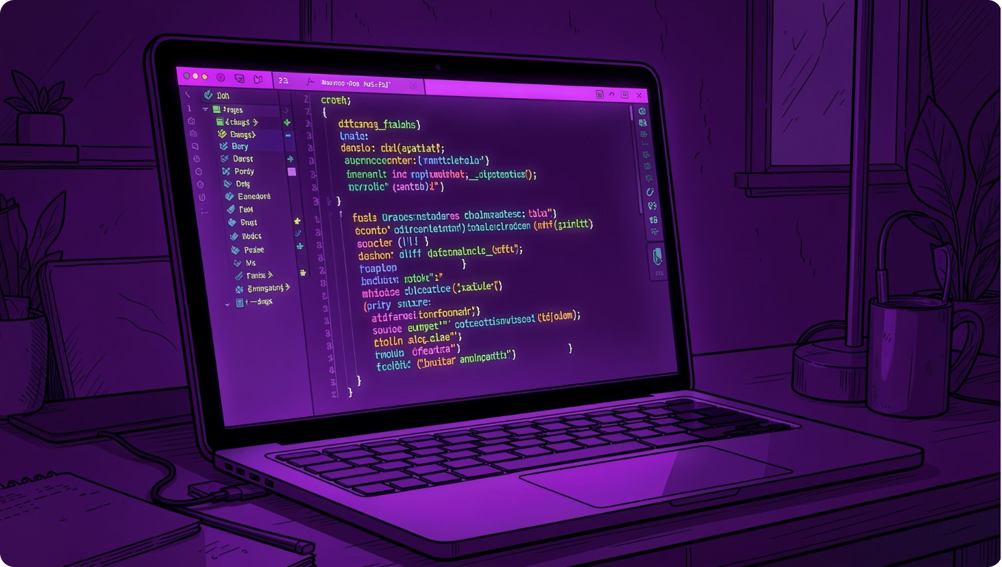
2001 BREAKTHROUGH
Gavin King's Vision
Gavin King introduced Hibernate as an open-source alternative with a clear mission: transparent persistence for Plain Old Java Objects (POJOs).
Minimize LOC
Automate SQL
Dramatically reduce boilerplate code
Generate queries from object state

Slide 4
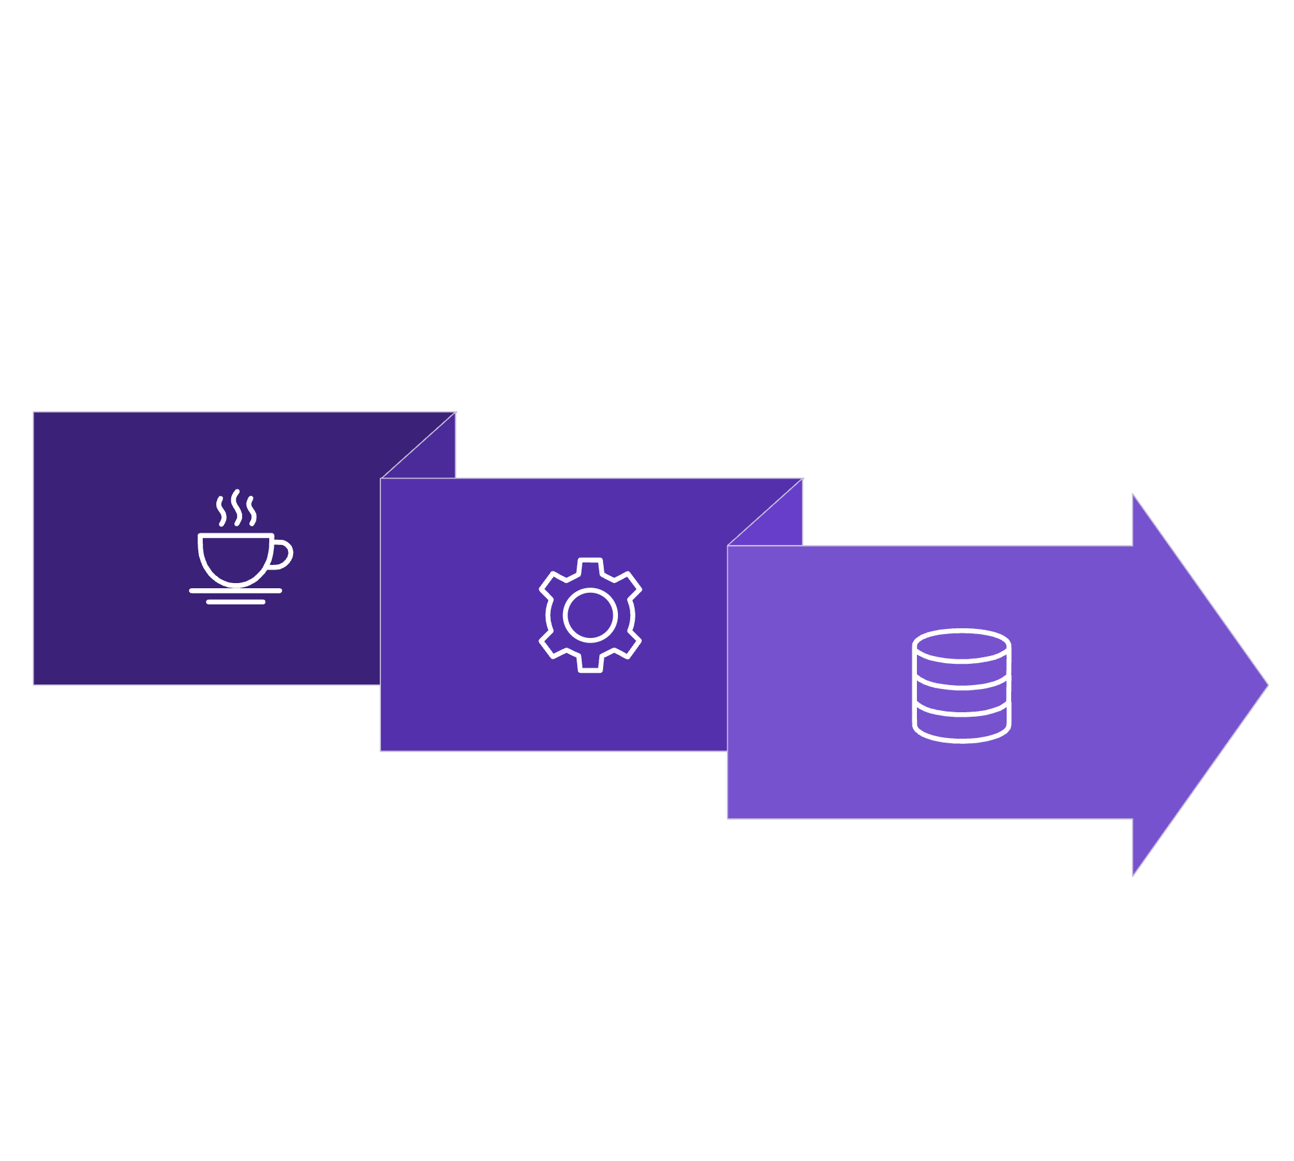
How Hibernate Bridges the Gap
Java POJOs
DB Tables
Hibernate ORM
Hibernate acts as an intelligent translator — automatically mapping Java classes to database tables, converting object graphs into SQL, and eliminating boilerplate while preserving transactional integrity and referential constraints.

Slide 5
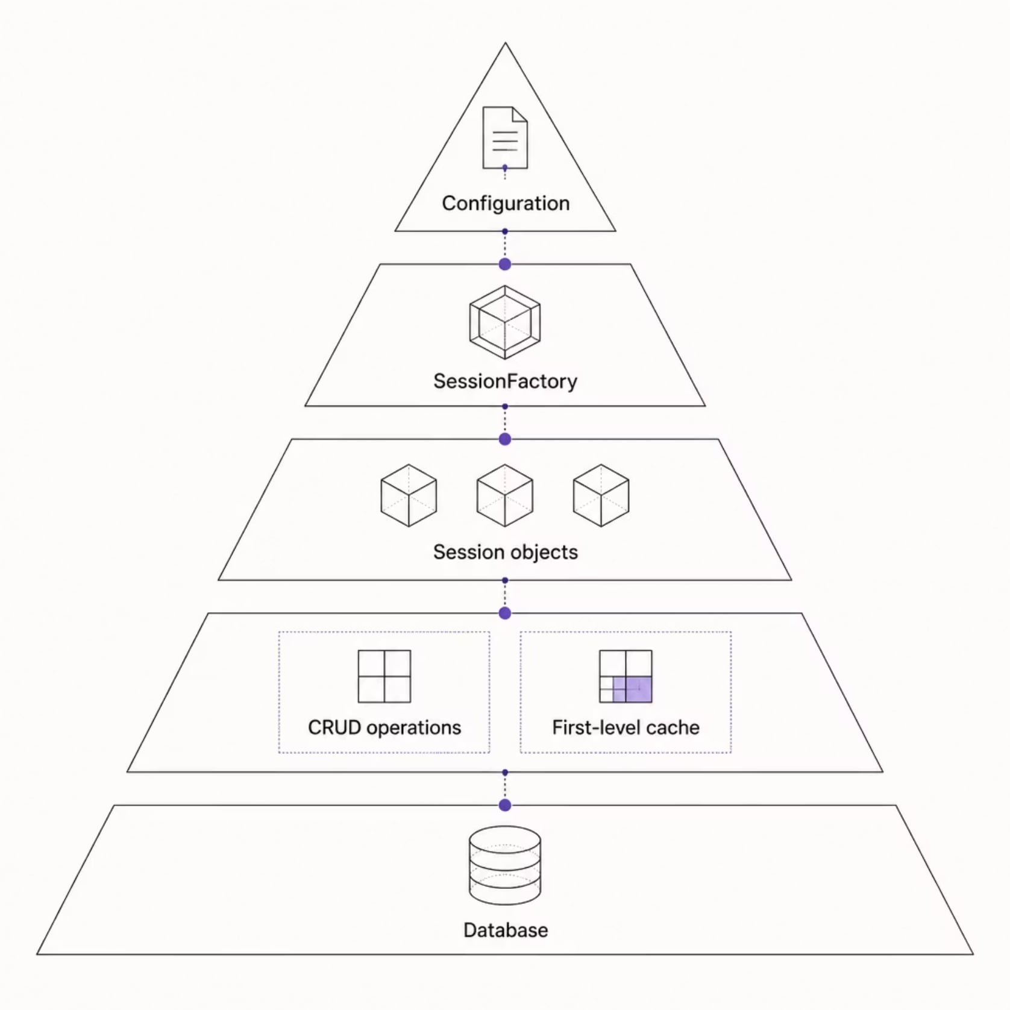


The Core Architecture
1
2
Configuration
SessionFactory
Loads settings and mapping metadata from XML or annotations at startup.
A thread-safe, immutable cache of compiled mappings — created once per application.
3
Session
A single-threaded, short-lived object managing CRUD operations and the first-level cache.

Slide 6




Advanced Persistence Features
Two-Level Caching
First-level (Session) and second-level (SessionFactory) caches dramatically reduce database round-trips.
Lazy Loading
Related entities are fetched only when accessed — avoiding unnecessary queries and boosting performance.
HQL
Hibernate Query Language enables powerful, object-oriented queries independent of the underlying SQL dialect.

Slide 7

Hibernate in the Modern Ecosystem
Standardised by JPA
The Java Persistence API adopted Hibernate's approach as the official standard, cementing its role in enterprise Java.
Complex Mapping Support
One-to-One, One-to-Many, Many-to-Many, and inheritance hierarchies are all handled elegantly.
Annotation-Based Configuration
Replace XML with @Entity, @Table, and @Column annotations for cleaner, more maintainable code.

Slide 8


The Industry Standard for Enterprise ORM
Hibernate remains the leading ORM framework — decoupling business logic from database schema changes and empowering teams to focus on domain-driven design.
Reduce Maintenance
Boost Productivity
Schema changes no longer ripple through your entire codebase
Write less boilerplate, ship features faster
Build for Scale
Leverage caching, lazy loading, and batch operations out of the box
Adopt Hibernate to reduce maintenance overhead and focus on building high-performance, domain-driven Java applications.

