Slide 1

Mastering Java Collections
A Unified Architecture for Organising, Storing, and Manipulating Groups of Objects

Slide 2


Beyond Ad-Hoc Storage
Before the Collections Framework, Java offered scattered, inconsistent classes with no shared design philosophy.
The Problem
Classes like Vector, Stack, and Dictionary existed in isolation — each with its own API and behaviour.
The Cost
No central theme, inconsistent method names, and zero interoperability made code brittle and hard to maintain.

Slide 3



The Core Philosophy
Java's Collections Framework was designed around three guiding principles that transformed how developers work with groups of objects.
Unified Architecture
Performance
Flexibility
Standardised interfaces provide a consistent contract for all collection types, reducing the learning curve.
High-efficiency implementations for dynamic arrays, linked lists, and hash tables — choose the right tool for the job.
Common interfaces enable seamless interoperability — swap implementations without rewriting your logic.

Slide 4
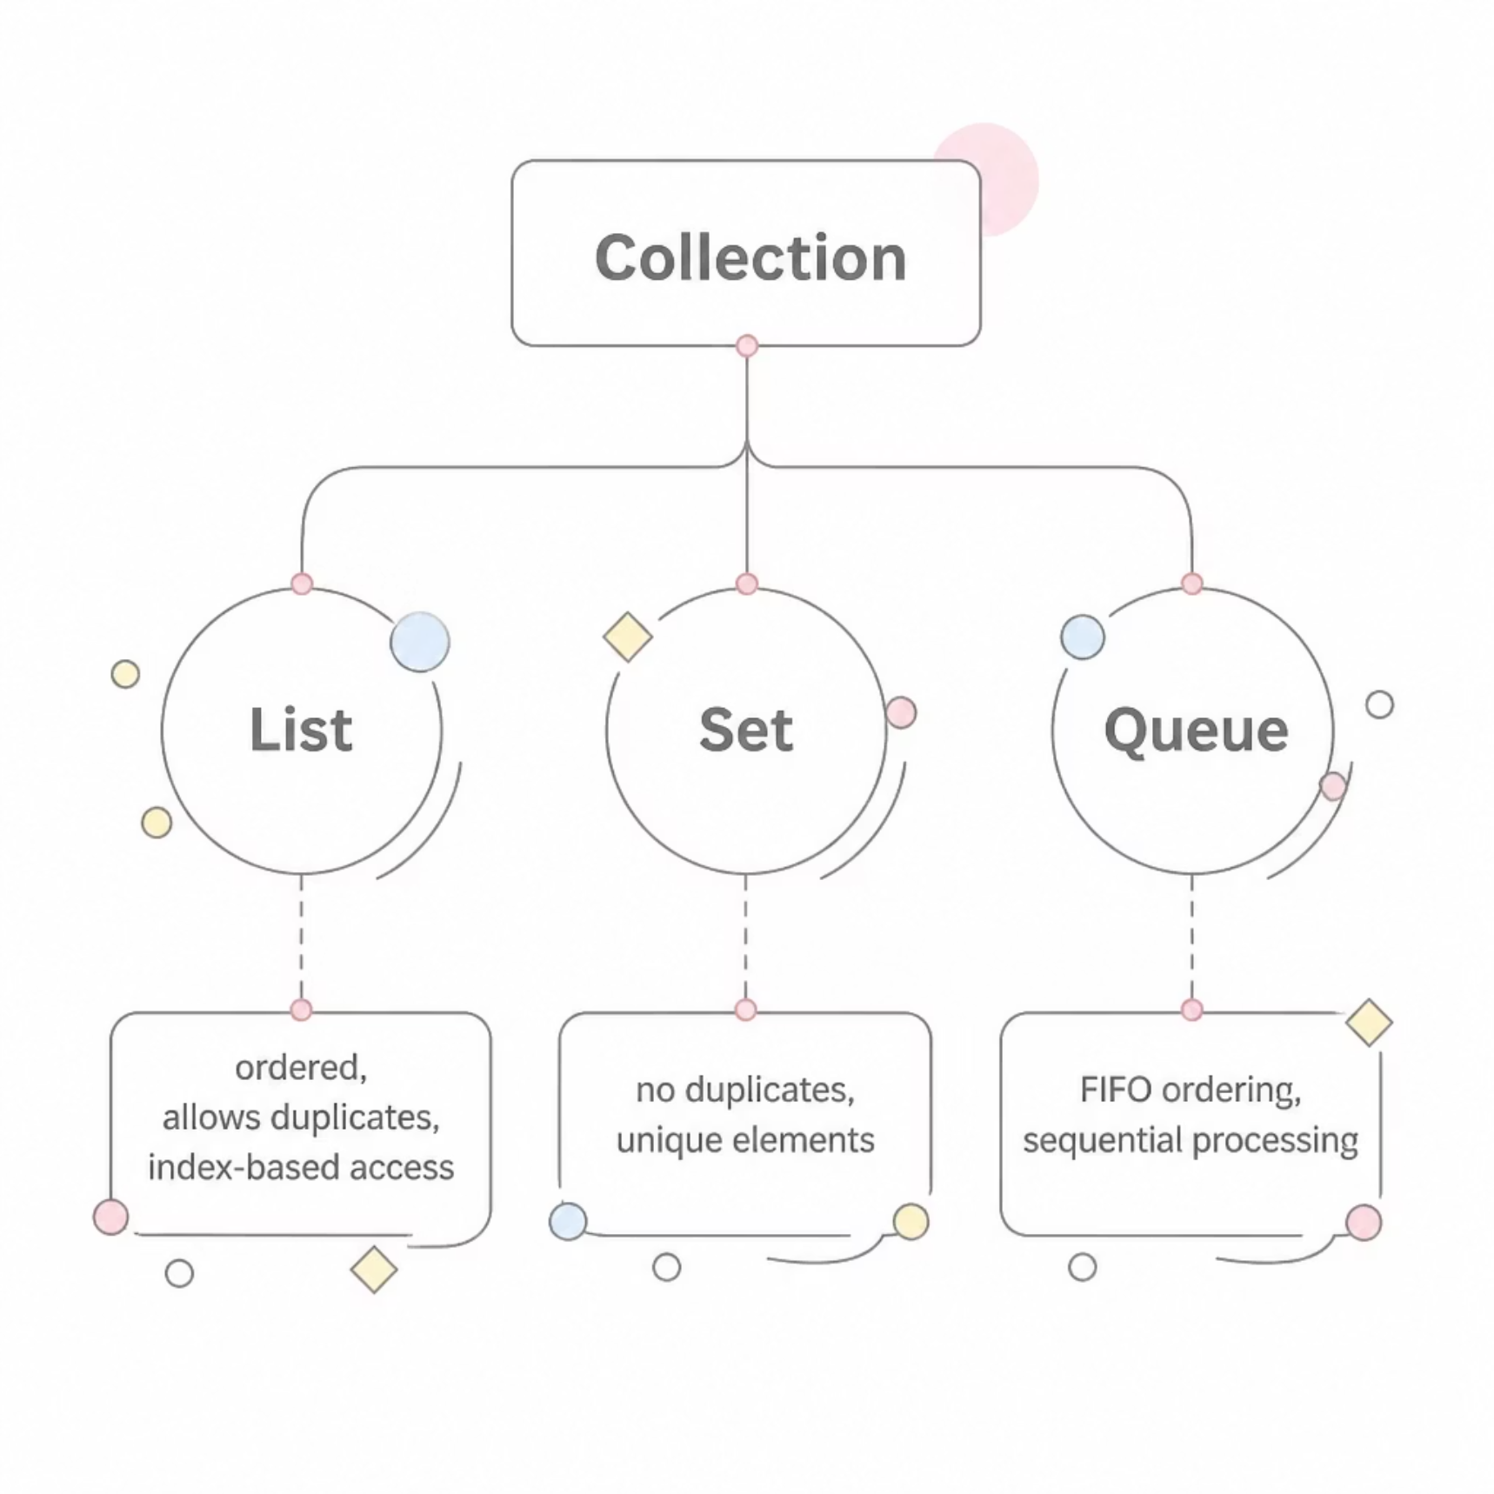
The Hierarchy: Interfaces at the Top
Collection
The root interface — every collection type extends from here, defining the core contract for storing and accessing objects.
List
Ordered sequences that preserve insertion order, allow duplicates, and support index-based random access.
Set
Prohibits duplicates — ideal when uniqueness is a business rule, not an afterthought.
Queue
FIFO-based ordering for processing elements in sequence, essential for task scheduling and buffering.

Slide 5

KEY DISTINCTION
Maps: Key-Value Associations
Maps occupy a unique position — they store key-value pairs, not individual elements, so they sit outside the strict Collection hierarchy.
keySet()
values()
View all keys as a Set for iteration or lookup.
Access all values as a Collection when keys are not needed.

Slide 6




Empowering Developers with Algorithms
The Collections utility class delivers reusable, battle-tested algorithms as static methods — no custom implementation required.
Collections.sort()
Sort any List in place with natural or custom ordering.
Collections.binarySearch()
Locate elements in sorted lists in O(log n) time.
Collections.shuffle()
Randomise element order — useful for testing and games.

Slide 7
Modernising with Generics and Iterators
Generics — Type Safety Since Java 5
Iterator — Safe Traversal
Before generics, collections held Object references, requiring unsafe casts. Generics enforce type constraints at compile time, eliminating ClassCastException at runtime.
The Iterator interface provides a standardised way to traverse and safely modify collections during iteration, avoiding ConcurrentModificationException.
List<String> names = new ArrayList<>();
for (String name : names) { ... }

Slide 8

Architecting for Scalability
Mastering the Collections Framework is not just about knowing classes — it's about designing systems that grow gracefully.
🔁 Software Reuse
⚡ Fine-Tuned Performance
Reduced programming effort — leverage proven implementations instead of reinventing the wheel.
Switch between ArrayList, LinkedList, or HashSet with a single line change.
✅ Cleaner, Safer Code
Master the interfaces, choose the right structure, and write code that is both expressive and robust.

Slide 9

Your Next Steps
The framework is vast — start with these three pillars and build from there.
1
Learn the Interfaces First
2
Choose by Use Case
3
Always Use Generics
Need order? Use ArrayList. Need uniqueness? Use HashSet. Need key-value? Use HashMap.
Write type-safe, readable code from the start — your future self will thank you.
Understand List, Set, Queue, and Map contracts before diving into implementations.
Key Takeaway: The Collections Framework is one of Java's most powerful tools — invest time in mastering it and every project will benefit.

