Slide 1
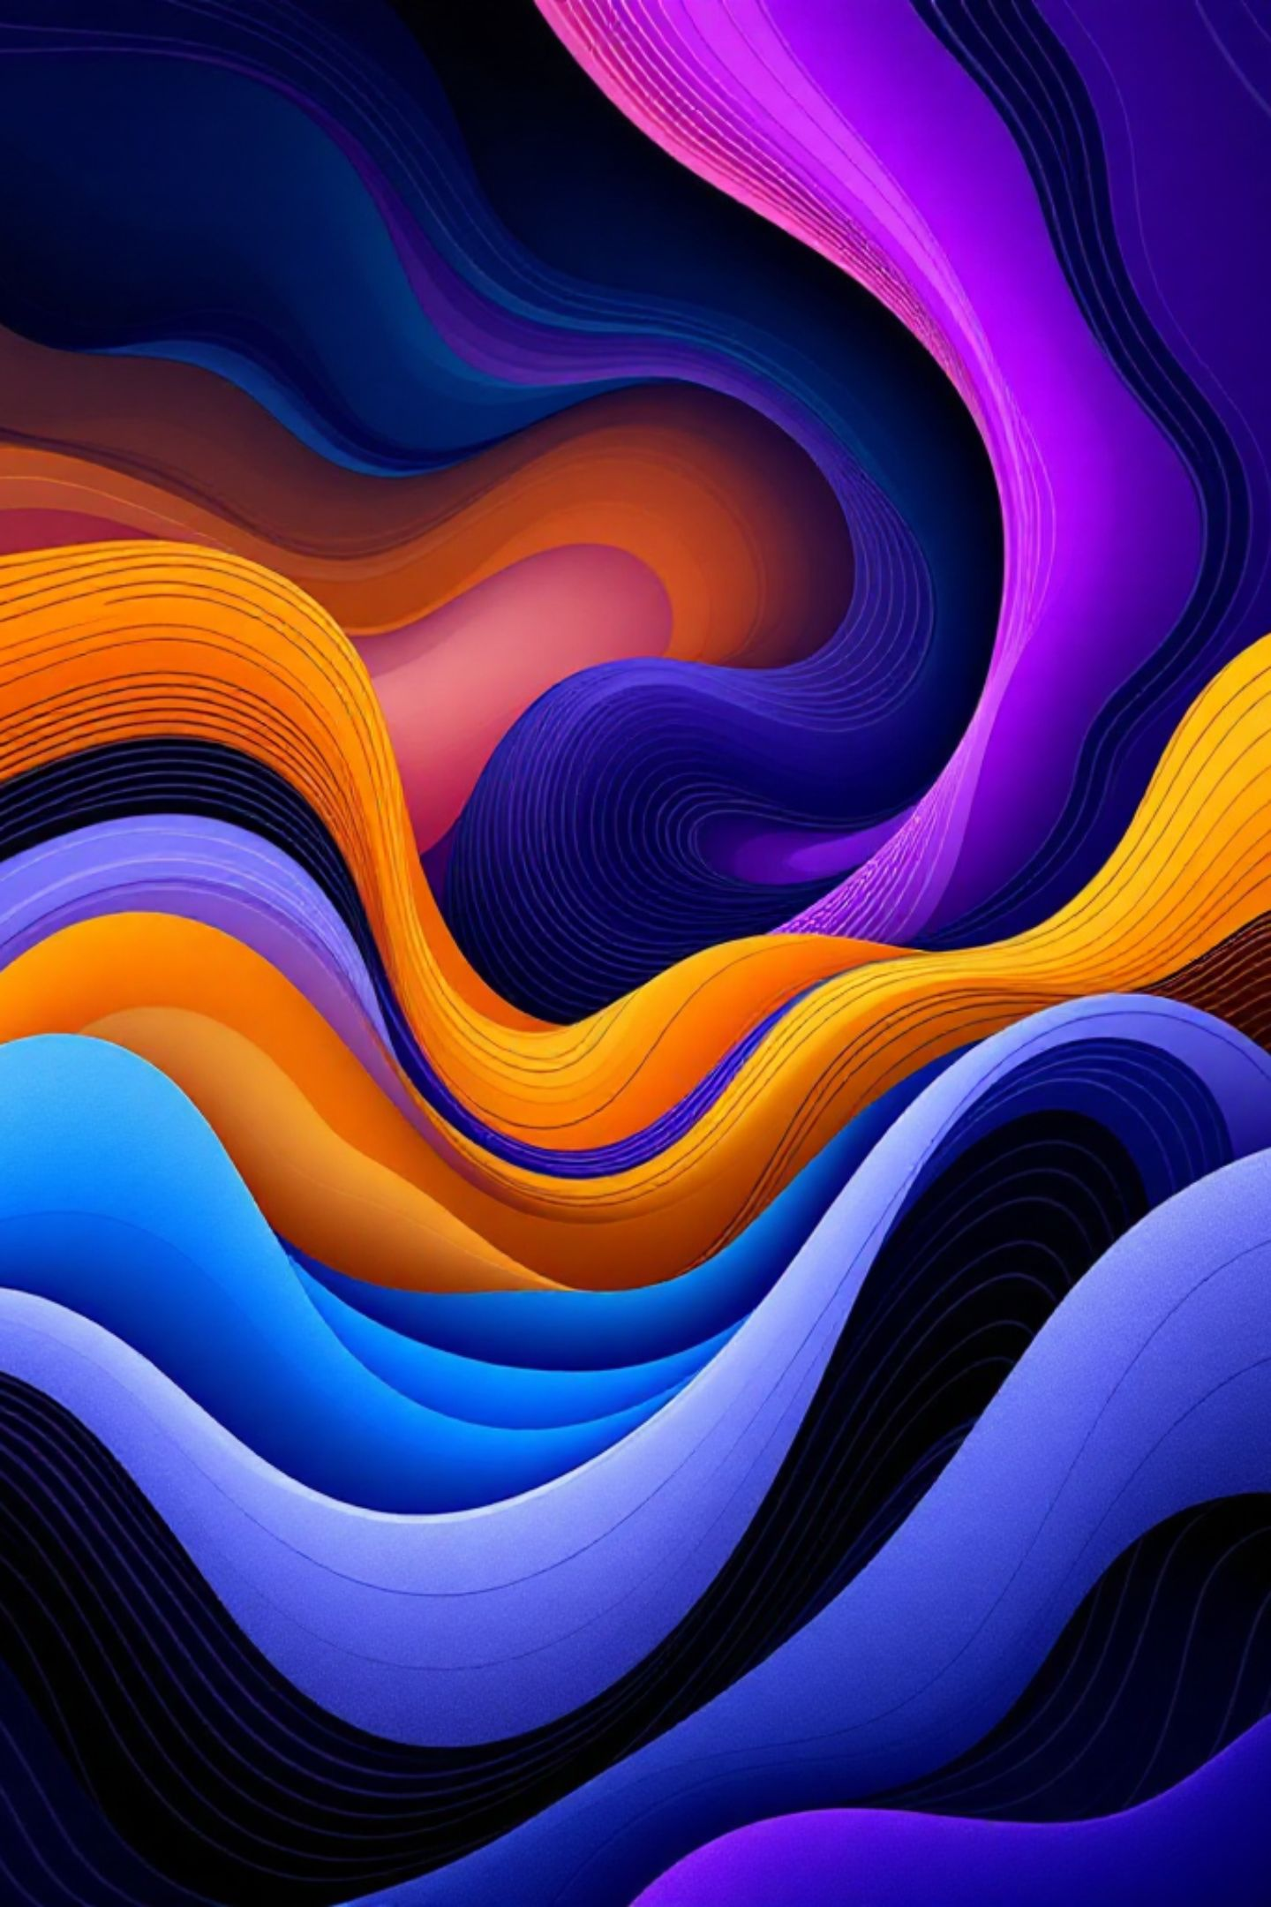
Mastering CSS Colors: From Basics to Dynamic Gradients
A deep dive into defining colors in HTML & CSS — and harnessing the visual power of linear gradients to create stunning, modern web experiences.

Slide 2





The Foundation: Defining Colors in HTML & CSS
Hexadecimal
RGB / RGBA
The most common format. Six-digit hex codes represent color precisely — e.g., #FF5733 for a vibrant orange.
Red, Green, Blue channels (0–255), with optional Alpha for transparency — e.g., rgba(255, 87, 51, 0.7).
HSL / HSLA
Named Colors
More intuitive: Hue (angle), Saturation (%), Lightness (%) — e.g., hsl(11, 100%, 60%). Great for theming.
140+ predefined browser keywords like red, blue, lightgray — simple and readable for quick use.

Slide 3
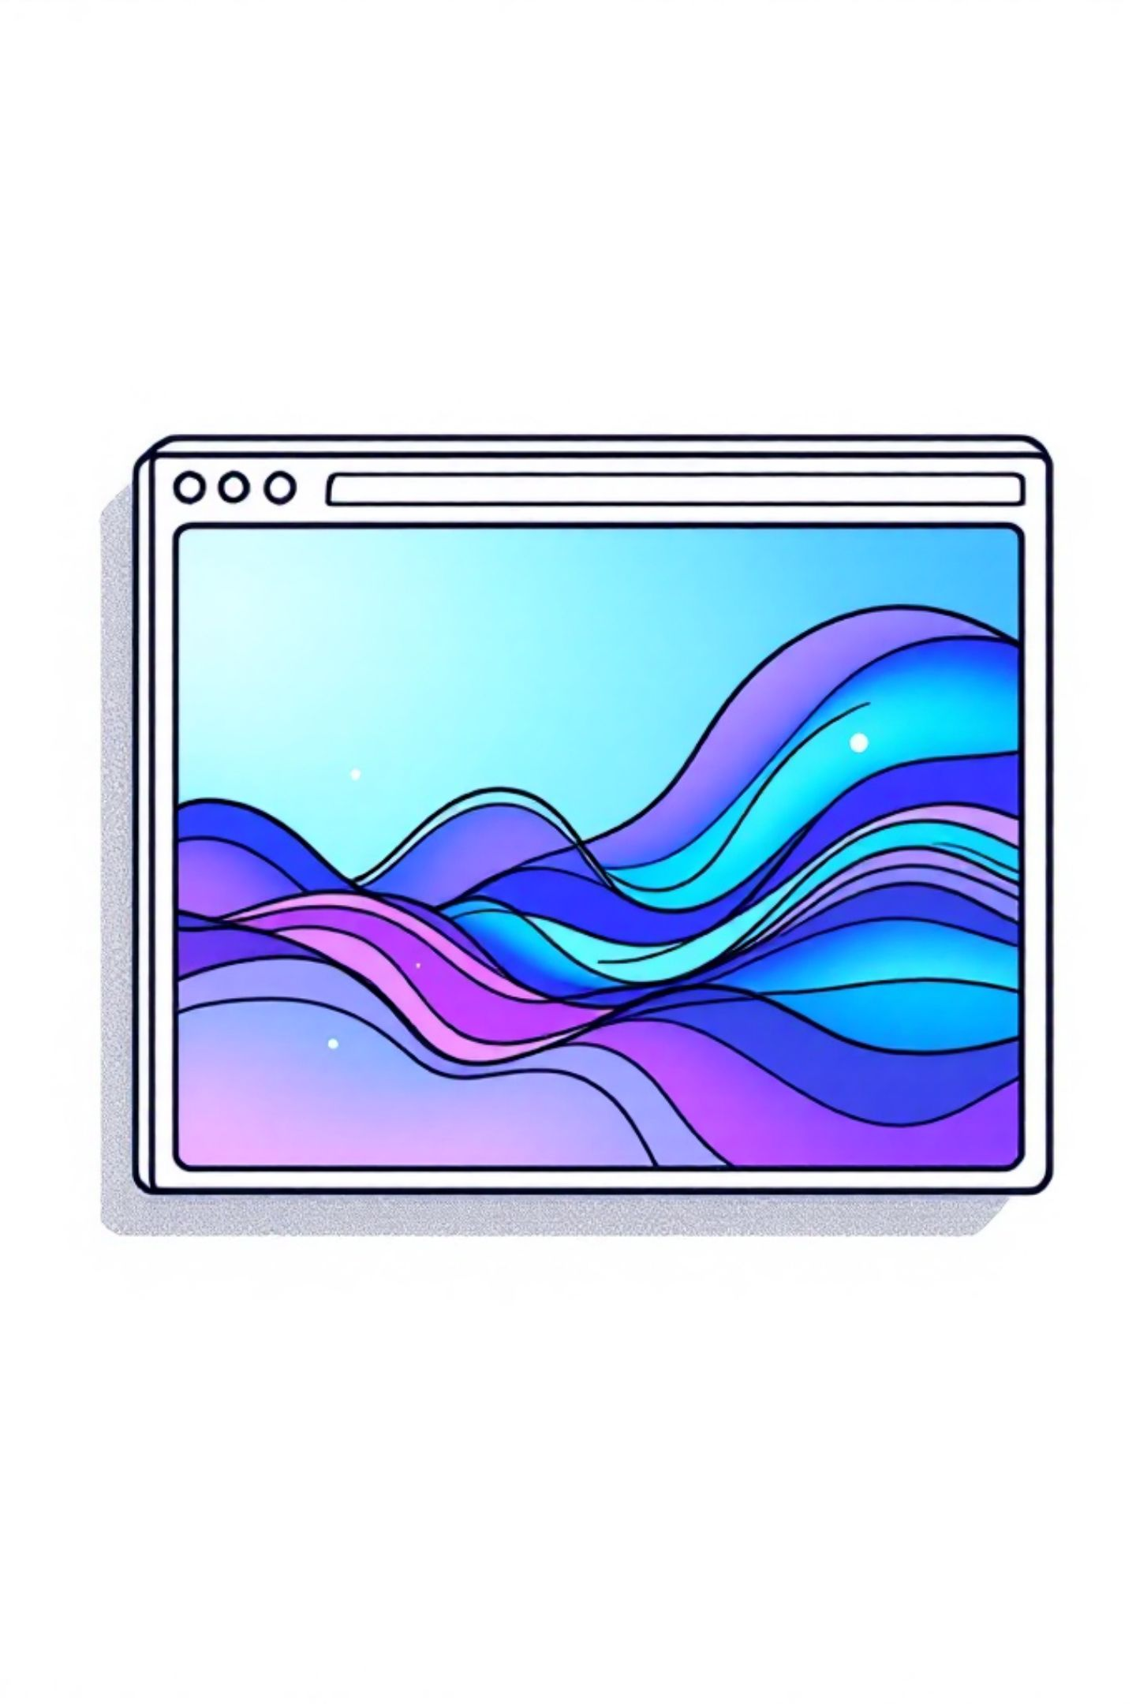
Beyond Solid Colors: Introducing CSS Gradients
What are CSS Gradients?
📐 Scalable
Gradients are dynamically generated images — created entirely with CSS, requiring no external image files. They produce smooth, seamless transitions between two or more colors.
They work anywhere an image value is accepted, most commonly as a background.
Resolution-independent — perfect at any zoom level.
⚡ Lightweight
Zero HTTP requests — no image files needed.
🎨 Flexible
Easily adjusted with variables and media queries.

Slide 4
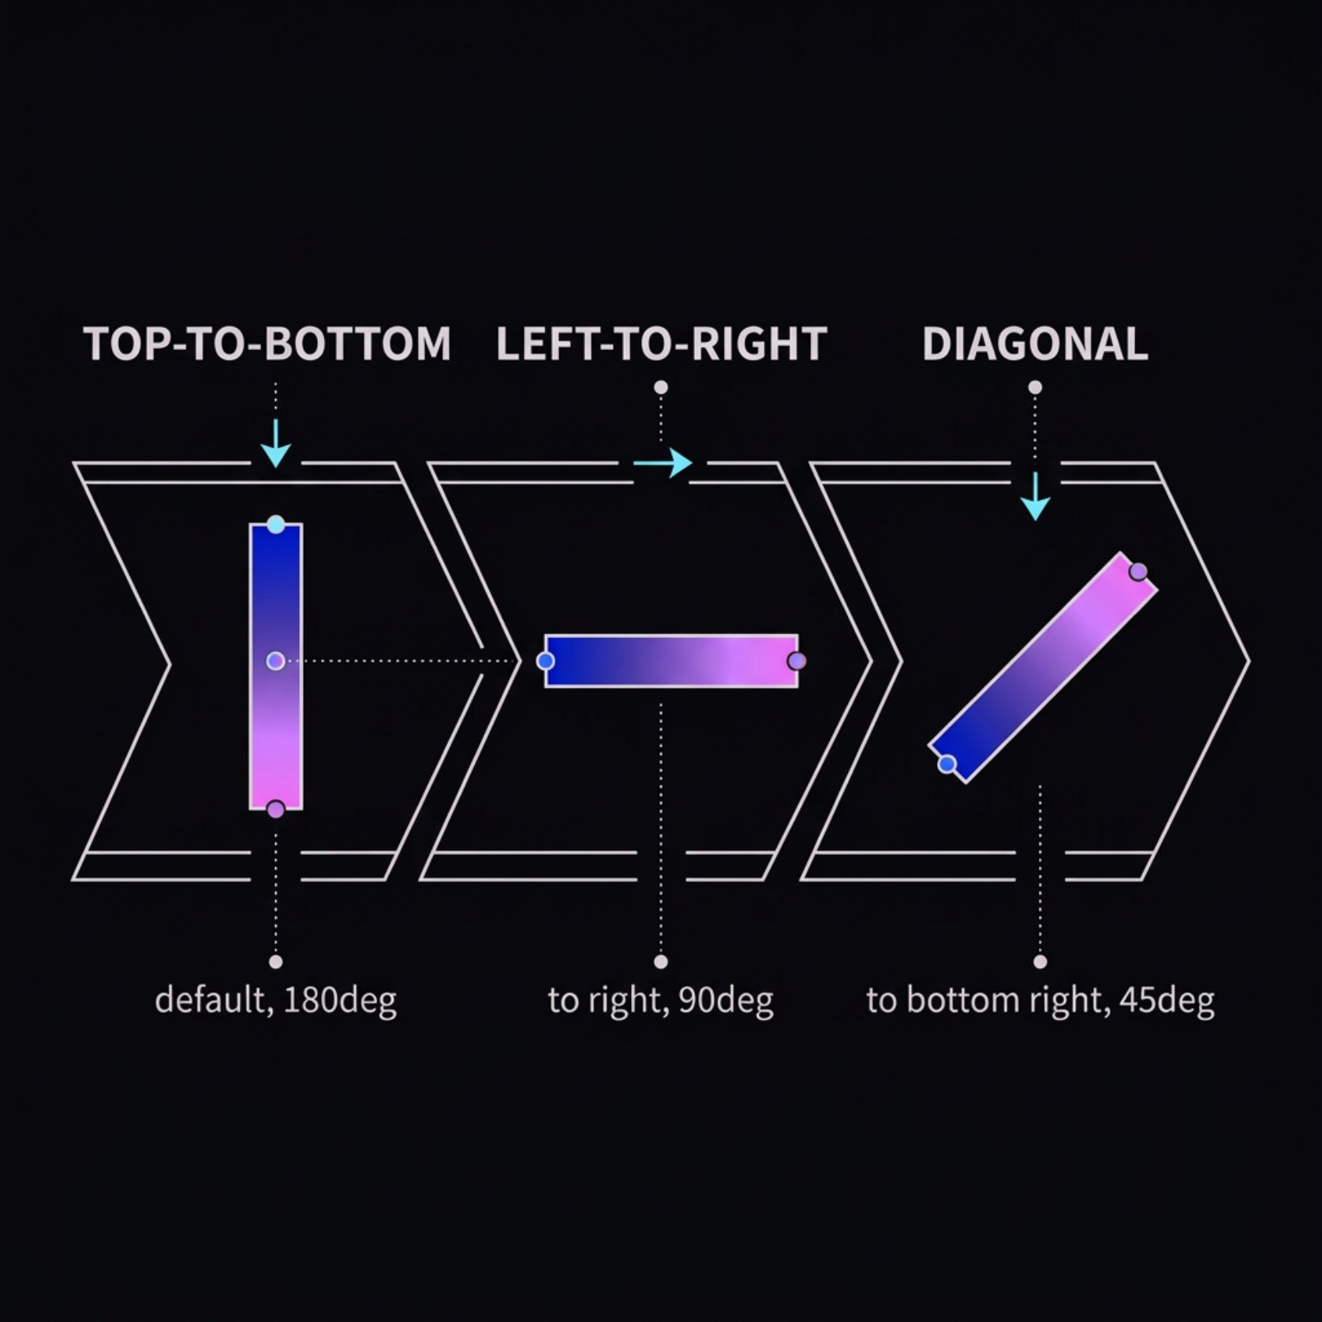
Linear Gradients: The Straight Path of Color
How It Works
The linear-gradient() function generates a smooth color transition along a straight line. The default direction is top to bottom.
Basic Syntax:
background: linear-gradient(color1, color2);
With direction:
background: linear-gradient(to right, blue, pink);
Direction can be set using keywords like to right, to bottom left, or precise angles like 45deg.

Slide 5

Controlling Gradients: Angles & Directions
0deg
1
Bottom → Top
2
90deg
Left → Right
135deg
3
Top-left → Bottom-right
4
180deg
Top → Bottom (default)
270deg
5
Right → Left
Pro tip: Keywords like to top right are equivalent to 45deg — use whichever is more readable in context. Example: background: linear-gradient(to right, #e66465, #9198e5);

Slide 6
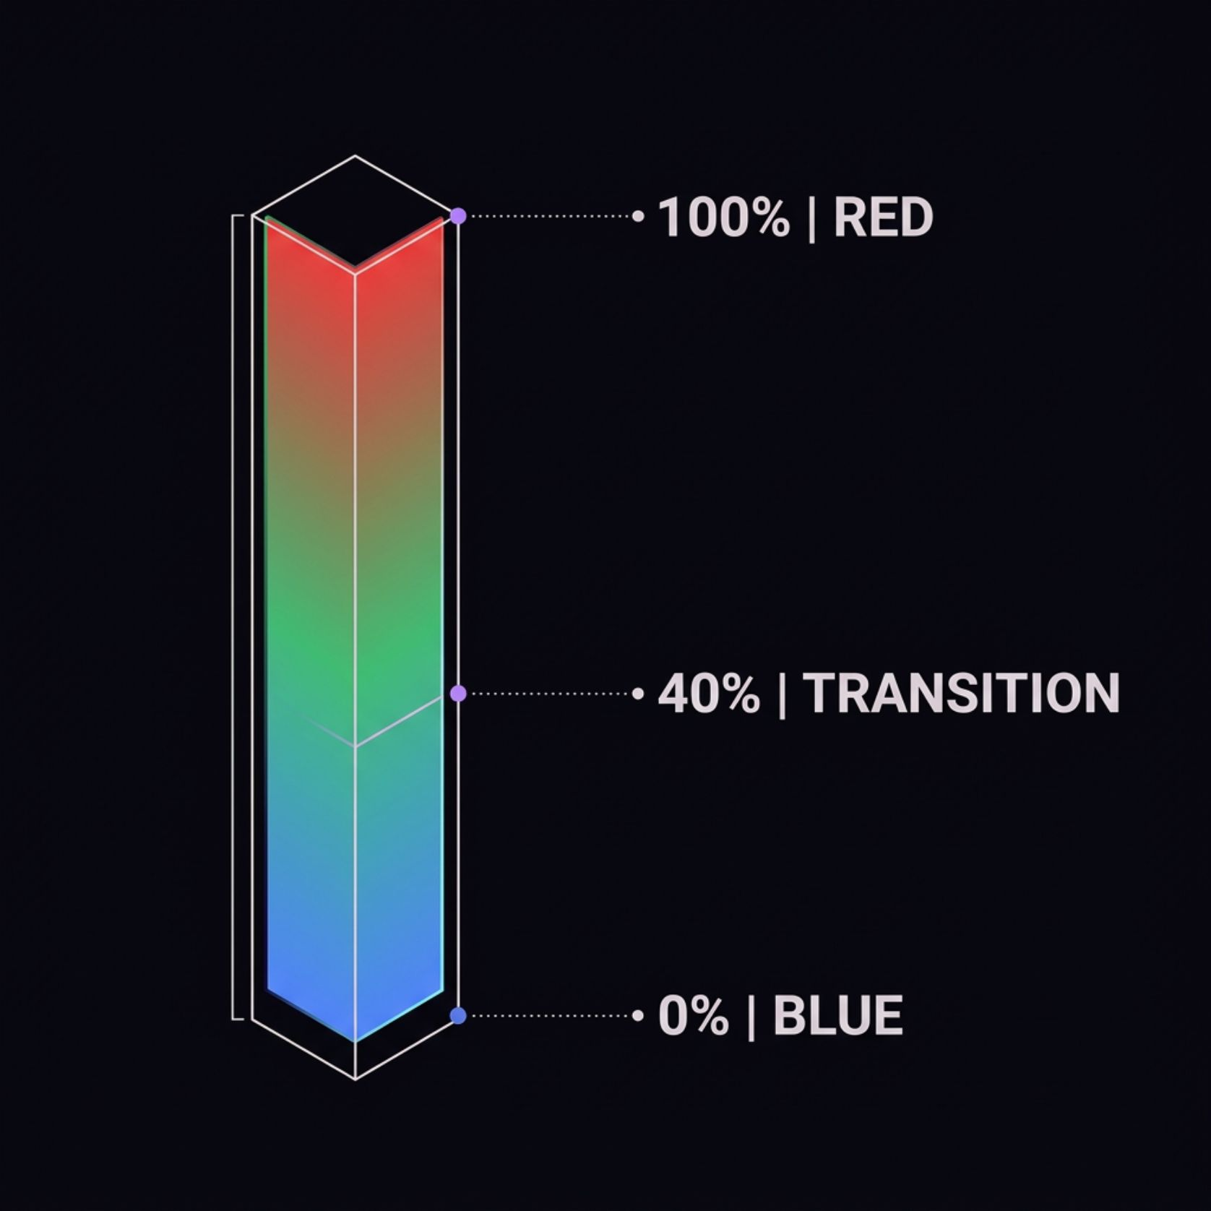
Advanced Linear Gradients: Color Stops & Multi-Color
Color Stops
Color stops control where each color starts and ends along the gradient axis. Specify them as percentages or lengths:
linear-gradient(45deg, darkred 30%, crimson);
darkred holds until 30%, then transitions into crimson.
Multiple Colors
Chain any number of colors to build complex, vibrant effects:
linear-gradient(0deg, blue, green 40%, red);

Slide 7





Visualizing Gradients: Making Web Pages Attractive
Hero Sections
Bold gradient backgrounds in headers create an immediate visual impact and establish brand identity at a glance.
Buttons & UI Elements
Gradients add depth and a polished, three-dimensional feel to interactive components like buttons and cards.
Page Backgrounds
Subtle or dramatic — gradient backgrounds set tone and atmosphere for entire pages or content sections.
Illustrations
Stack and layer multiple gradients to craft complex abstract visuals — no design software required.

Slide 8
Example: A Gradient-Powered Hero Section
The CSS
What This Achieves
This snippet creates a rich, dark hero section with a deep indigo-to-periwinkle diagonal background — and a glowing cyan-to-blue gradient applied directly to the headline text.
.hero {
background: linear-gradient(
135deg,
#120336 0%,
#0D0326 40%,
#97b8ff 100%
);
color: white;
padding: 80px 40px;
text-align: center;
}
.hero h1 {
font-size: 3rem;
background: linear-gradient(
to right, #7AF0FF, #97b8ff
);
-webkit-background-clip: text;
-webkit-text-fill-color: transparent;
}
135deg diagonal
Clipped text gradient
Creates dynamic visual energy vs. flat top-to-bottom.
Modern technique: gradient fills the text itself for a luminous headline effect.

