Slide 1
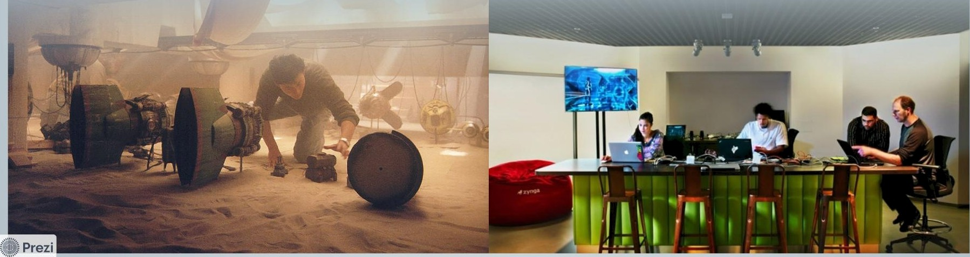
efficiently. Its core philosophy revolves azound ie component-based architecture that fosters reusability and enhances productivity in web application development.

Slide 2
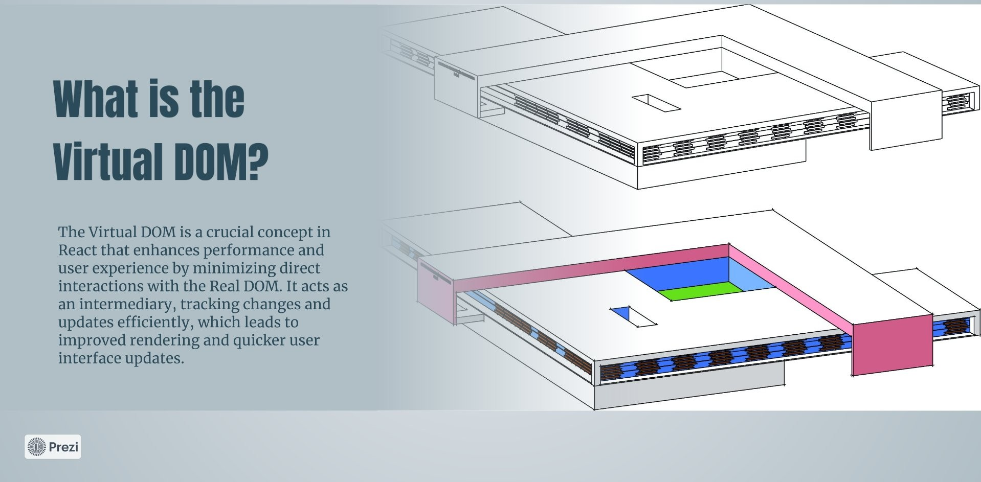

Slide 3



Understanding the Vir...
Public -
Stop presenting •
‹

Slide 4





Und erstanding the Vir... Public • Stop presenting •
Enhanced UI responsiveness
B9helilS
USihg
Reduced rendering times
Facilitates state
management
Minimized direct DOM
manipulations

Slide 5
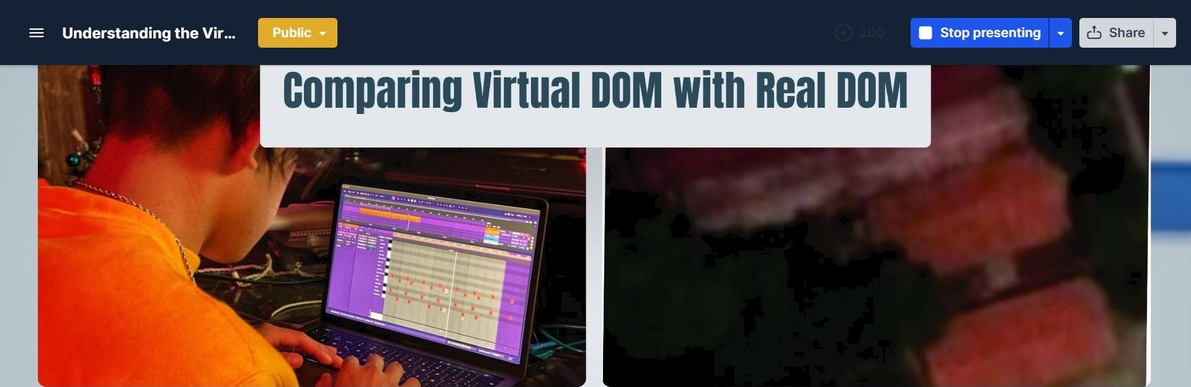


Yiñual BOM: ETTicï0ncy an4 FerÏêrnance
The Virtual DOM is a virtual representation of the UI that altows React to optimize rendering by reducing direct interactions with the Real DOM, thereby increasing performance and efficiency.
. Prezi

Slide 6
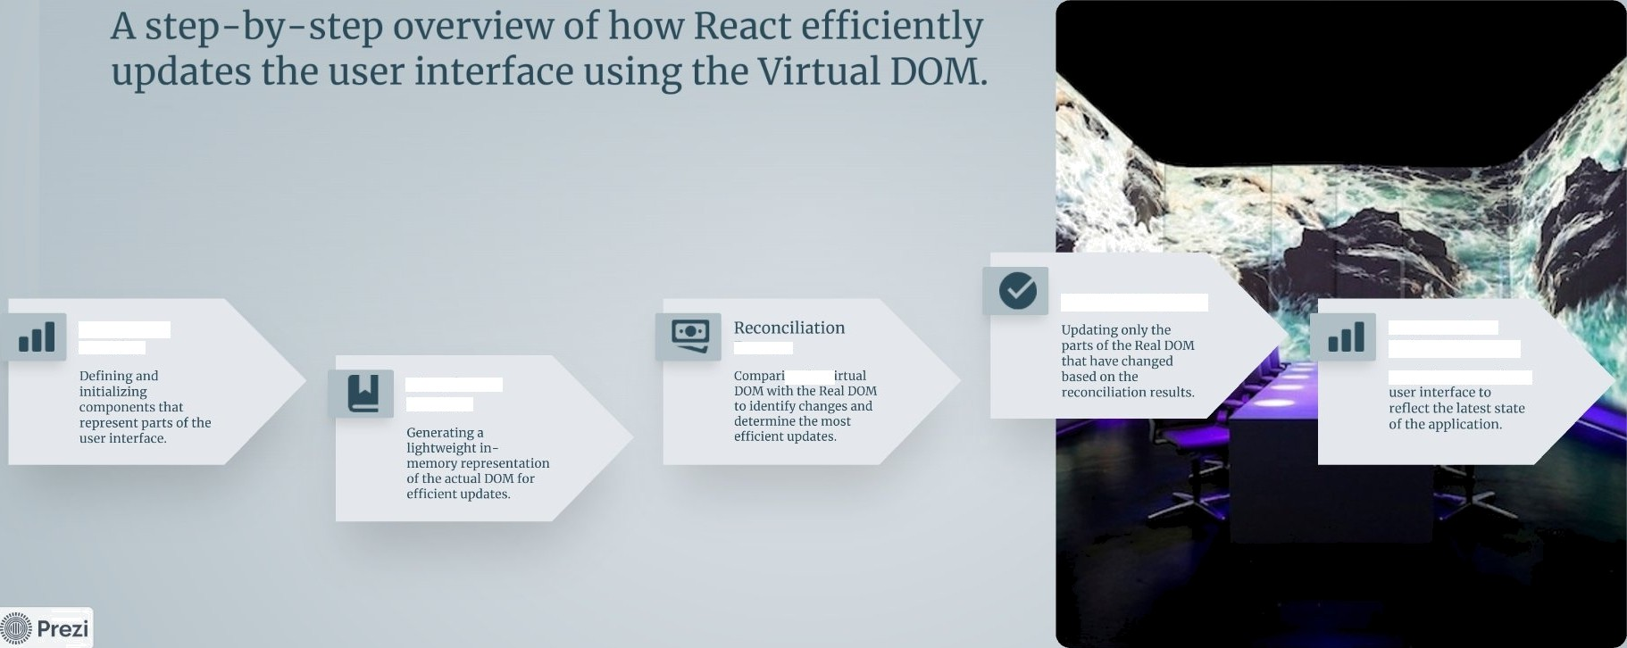



Understanding the Vir...
Public -
Stop presenting •
‹

Slide 7
tasesiuar:rcrIormanceImprsvcmenixiihViriuaissM
A detailed timeline showcasing the impact of adopting the Virtual DOM in a real-world application.
Post- [mplementation Engagement
Before
ciuent metrics showed
].› c' I f c i i 1 \ ‹I \ r’‹.‘ i i 1 \ ]. I c c'i \ i i.'i 1 I ,
After
Implementation
With the introduction of the Virtual DOM, load time improved dramatically to just 1 second, significantly enhancing user experience.

Slide 8
Virtual DOM enhances, not replaces
¢oMM0C MiS¢0‹¢»pli0‹S èb#Ullh9 VÏflUèl DOM
Real DOM still necessary
Performance varies by context

Slide 9


