Slide 1
StoCellAtor
A stochastic whole cell simulator that uses TASEP (explain) to model heterologous protein expression and the resulting burden (explain) on the bacterial cell

Slide 2
Synthetic biology
Synthetic biology
Input: inducible promoters, e.g. Pbad with Arabinose, Ptet with aTc
Output: for example, fluorescent proteins, e.g. GFP, YFP
ALU: promoters can be activated/repressed by produced proteins, this gives rise to different combinations of proteins produced depending on input (logic gates): Tasmir et al, Nature 2011; Wang et al, Nature Comms 2011; Siuti et al, Nature Biotech 2012
Memory: Permanent genetic memory using orthogonal recombinases: Yang et al, Nature 2014
CPU, oscillator: tunable oscillator: Stricker et al, Nature 2008; relaxation oscillator synchronized by intercell signalling: McMillen et al, PNAS 2002; repressilators coupled by quorum sensing: Garcia-Ojalvo et al, PNAS 2004; synchronized quorum of genetic clocks: Danino et al, Nature 2010
We have all the components to build a cellular computer

Slide 3
Synthetic biology 2
Other uses:
Creative new medicines:
Invasion of cancer cells by engineered bacteria: Anderson et al, J. Mol. Biol. 2006
Synchronized cycles of bacterial lysis (to limit growth) with in-vivo delivery (of medicine e.g. cytotoxic agents against tumours): Din et al, Nature, 2016
Detection:
Programmable probiotics for detection of cancer in urine: Danino et al, Science Trans. Med. 2015
Biosensors for arsenic detection: Merulla et al Curr. Opin. Biotechnol. 2013
Biosensor for schistosome cercariae to reduce the spread of schistosomiasis: Webb et al, Sci.Rep. 2015

Slide 4
Design Problem
Elowitz and Liebler (Nature, 2000) came up with a synthetic oscillatory network of transcriptional regulators.
It worked in theory, the oscillations were not regular and dies out in the experimental results
Weisse et al (PNAS, 2015) managed to explain why theory does not correspond to practice: isolated repressilator model ignores resource trade-offs:
Finite proteome
Finite energy
Finite ribosomes

Slide 5
Problem in general
Production of heterologous protein takes away resources from the innate proteins of the cell (e.g. ribosomal proteins), hence cell growth slows down -> this is referred to as burden on the bacterial cell
As a result slower growth might decrease the heterologous protein yield, even though heterologous protein production rate per cell is bigger
Modelling is needed to understand the amount of burden and give estimates for heterologous protein yield

Slide 6
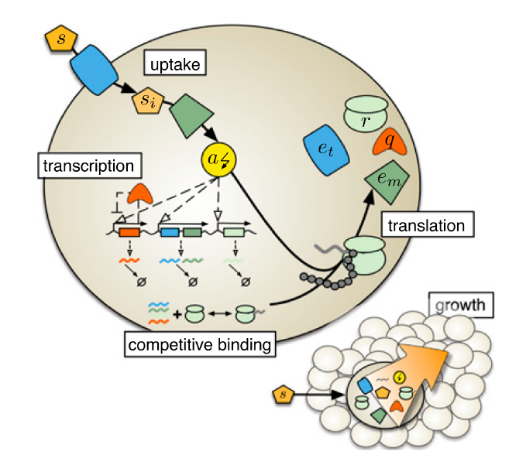
Weisse model (Figure: Weisse et al., PNAS, 2015)
Proteome partition
Transporter/metabolic enzymes (E)
Ribosomal proteins (R)
Housekeeping proteins (Q)
Heterologous proteins (H)
Both translation and transcription rates are Hill functions of energy
Energy is incremented by parameter ns each time an internalized nutrient is metabolized
Energy is used by translation
Polyribosomes are not considered
Unable to model ribosomal queues and ribosome sequestration
Not realistic

Slide 7
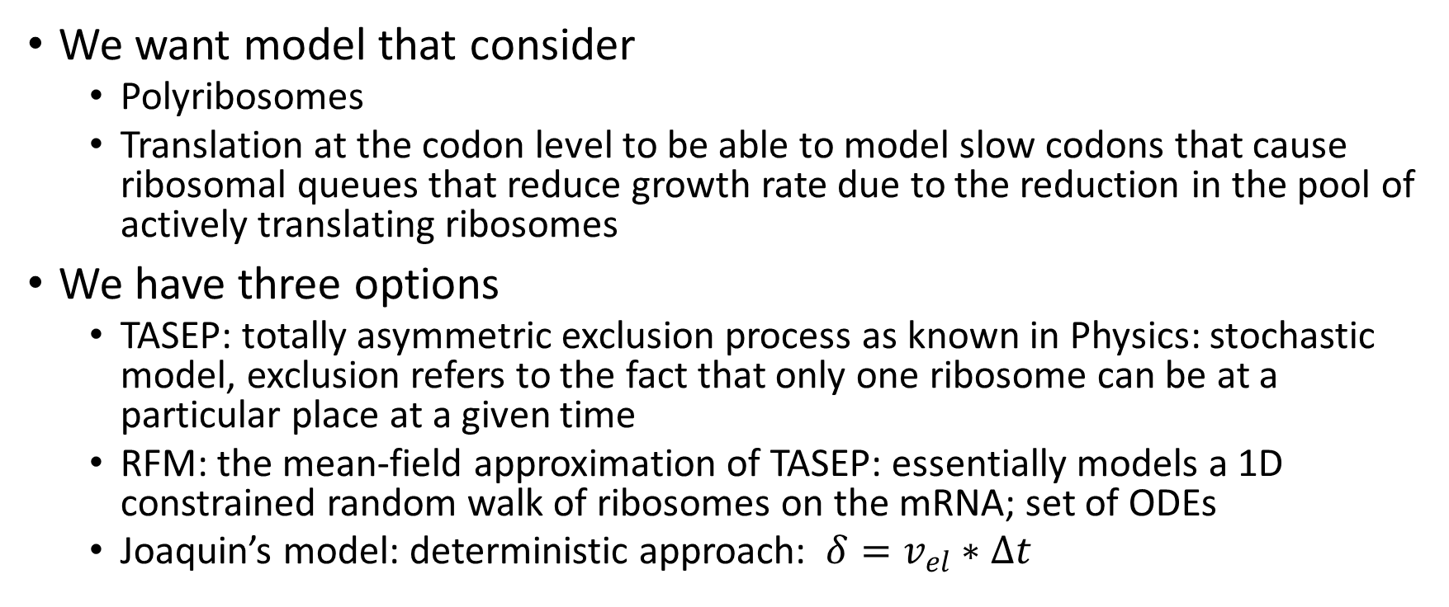
Translation models
We want model that consider
Polyribosomes
Translation at the codon level to be able to model slow codons that cause ribosomal queues that reduce growth rate due to the reduction in the pool of actively translating ribosomes
We have three options
TASEP: totally asymmetric exclusion process as known in Physics: stochastic model, exclusion refers to the fact that only one ribosome can be at a particular place at a given time
RFM: the mean-field approximation of TASEP: essentially models a 1D constrained random walk of ribosomes on the mRNA; set of ODEs
Joaquin’s model: deterministic approach: $δ=v_{el}∗Δt$

Slide 8
Why we chose TASEP
RFM: set of ODEs describing the movement of ribosomes on the mRNA, but at the same time, in a whole-cell setting the number of ribosomes and the number of transcripts are changing -> not clear how to extend RFM to a whole-cell model
Deterministic approach: yields constant ribosome density along the mRNA, whereas TASEP/RFM yields a monotonically decreasing ribosome density along the mRNA, which corresponds to experimental results (Ingolia et al, Science 2009)
TASEP: can be extended to Whole-Cell modelling framework, but then everything needs to be stochastic

Slide 9
Our contribution
Transform Weisse et al’s deterministic model to a stochastic model so that it can be used with TASEP
Made TASEP algorithm faster by recursively changing the transition matrix that only considers transitions to non-restricted states (explain)
Hence we created a stochastic whole cell model that considers heterologous protein production with arbitrary transcript length, promoter and RBS strength and individual codon elongation rates
It tells gives us the average instantaneous growth rate and the mass fraction of different types of proteins in the proteome

Slide 10
Results – changing nutrient quality
Internal energy (a.u.) is incremented by parameter ns (nutrient quality) if the internal nutrient is metabolized
The model reproduces Monod’s growth law (Monod, Ann. Rev. Mic. Biol., 1949): growth rate increases with increased nutrient quality until saturation
Growth rate saturates around ns = 500
By changing only ns, we can achieve experimentally valid growth rates (2 h⁻¹)
n_{s} | 10 | 50 | 100 | 200 | 400 | 500 | 600
Average Inst. Growth Rate | 0.20 | 0.88 | 1.70 | 2.73 | 4.34 | 4.77 | 4.81

Slide 11
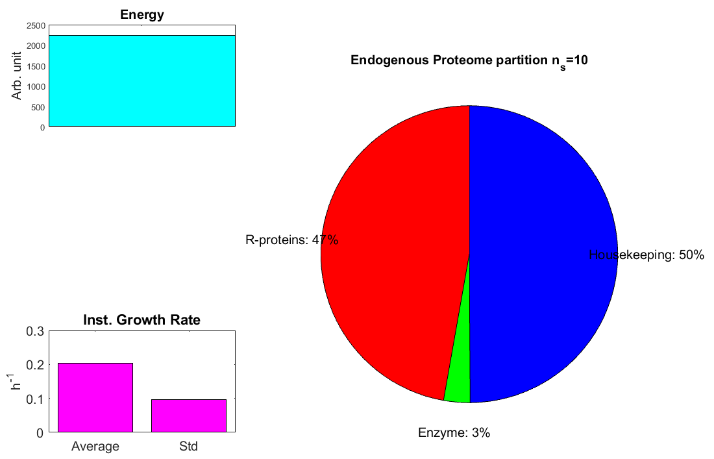
Proteome partition as a function of ns

Slide 12
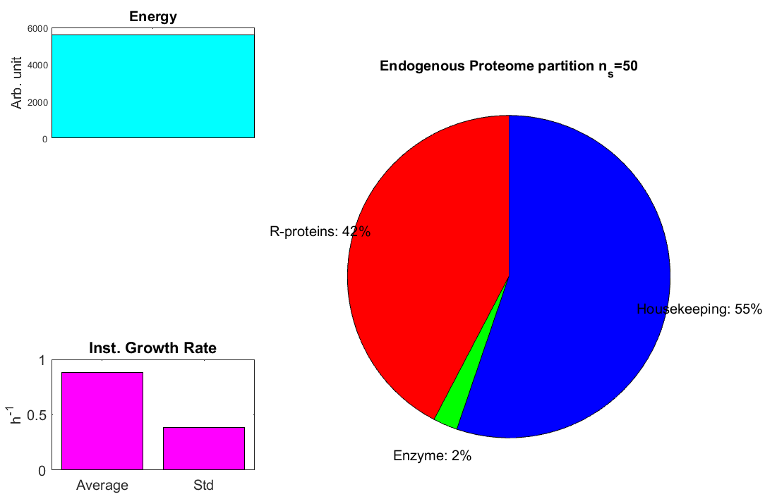
Proteome partition as a function of ns

Slide 13
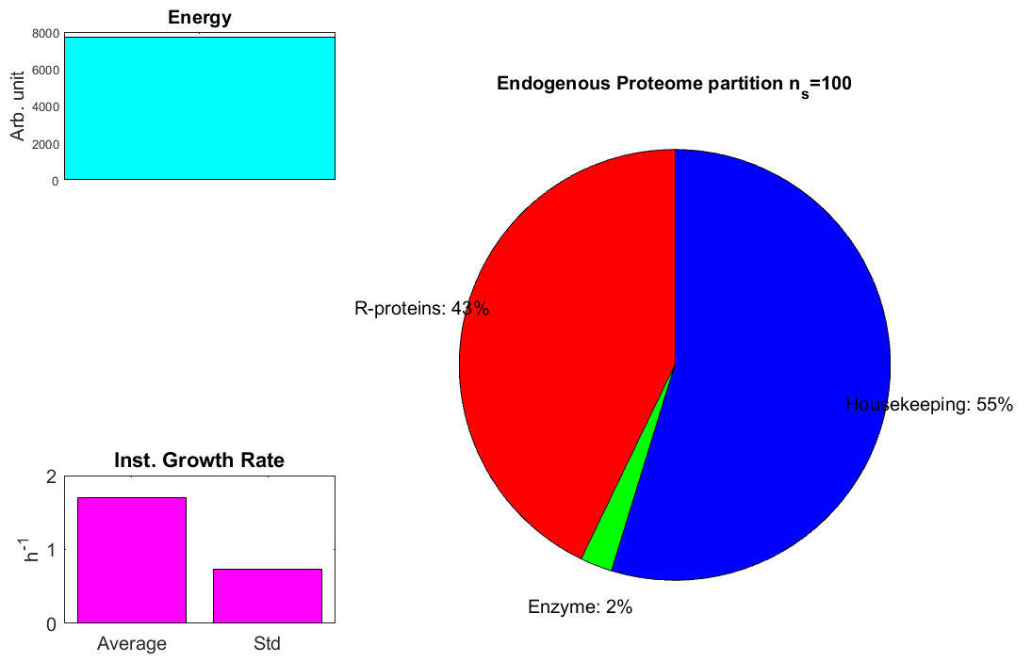
Proteome partition as a function of ns

Slide 14
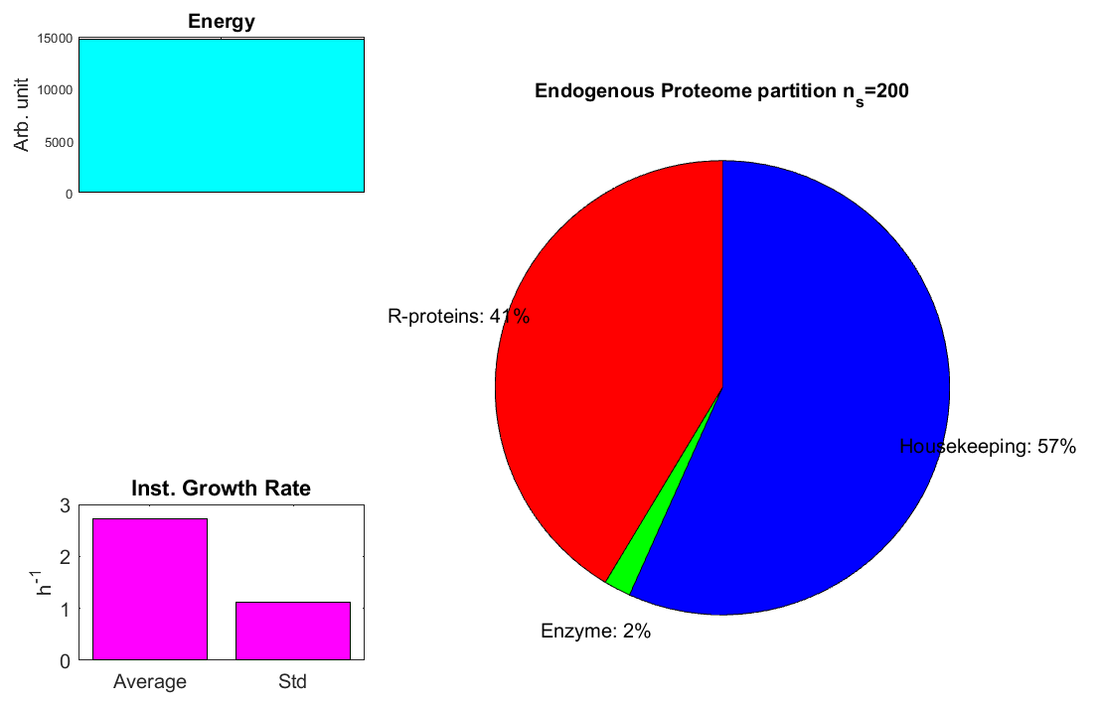
Proteome partition as a function of ns

Slide 15

Proteome partition as a function of ns

Slide 16
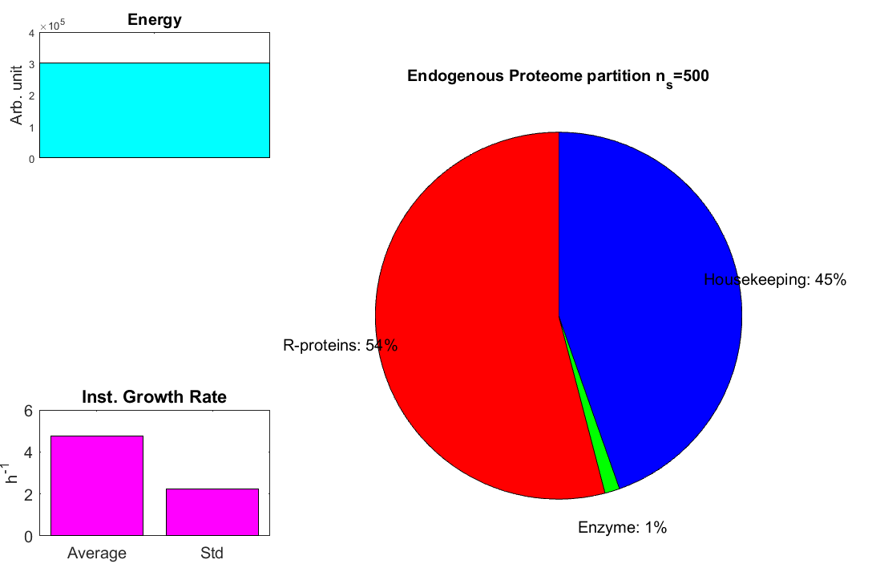
Proteome partition as a function of ns

Slide 17
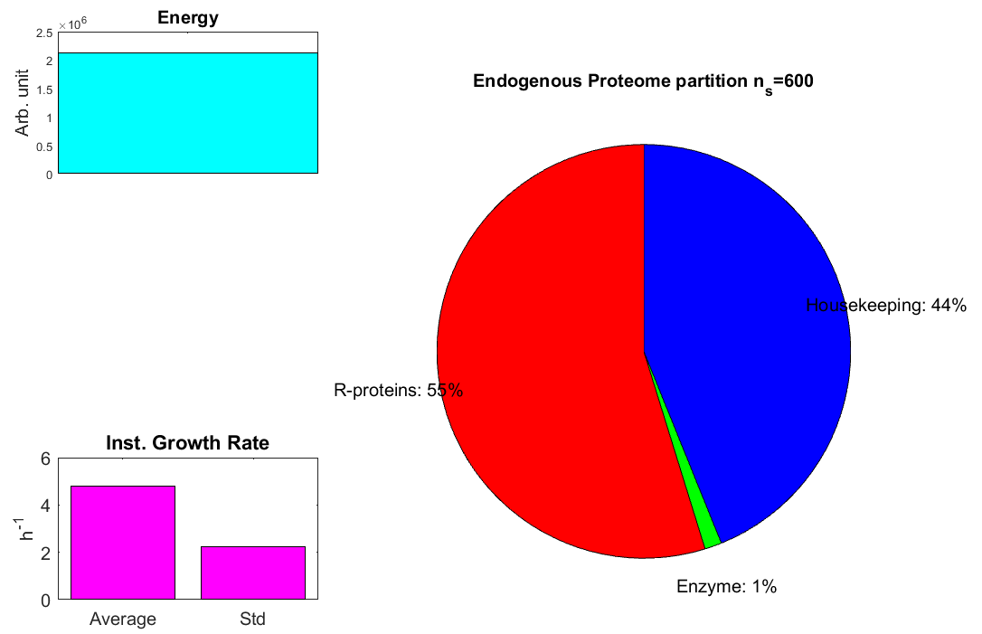
Proteome partition as a function of ns

Slide 18
Observations - changing nutrient quality
With nutrient quality proteome fraction of enzymes go down
At the baseline (ns = 10) ribosomal protein fraction (47%) is quite in balance with housekeeping fraction (50%)
Then as nutrient quality increases housekeeping becomes more dominant (57% vs. 41%) up to ns = 200; this is because even though the percentage increase is smaller on the Hill curve for housekeeping (closer to half-saturating constant), the maximum rate of transcription for housekeeping (850) is much bigger than the maximum rate for ribosomal proteins (27)
But the Hill curve for housekeeping starts saturating earlier, so at large ns, R-protein fraction increases and takes over housekeeping protein fraction (55% vs. 44%)

Slide 19
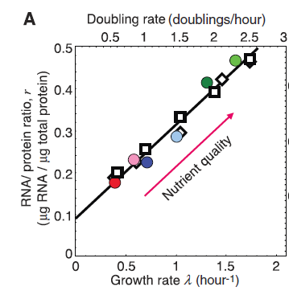
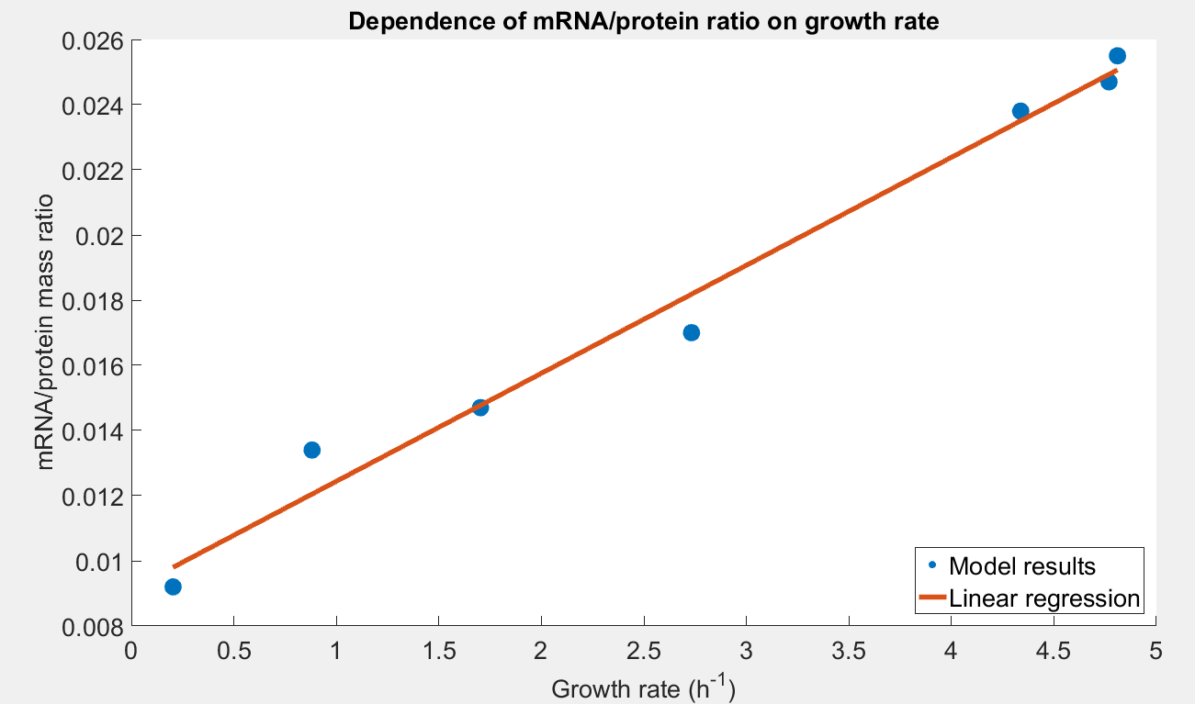
So wait..where is the linear relationship?
Scott et al. (Science, 2010) showed that RNA/protein ratio increases roughly linearly with growth rate (left, adopted from Scott et al.)
We reproduce this result with our model! (right)
Notes:
The ratio is actually ten times bigger in Scott et al. However, Lynch et al. says that protein numbers are three orders of magnitude higher than transcript numbers. Hence our two orders of magnitude seems reasonable.
Note that Scott et al. makes and argument that linear relationship of mRNA/protein ratio with growth rate implies linear relationship of R-protein fraction with growth rate. This does not seem true in our model.

Slide 20
Introduction of heterologous proteins
In general: higher the heterologous protein production rate, the lower growth rate is, since translational resources are taken away from endogenous proteins. This is referred to as burden!
We ran simulations with changing the maximal transcription rate (parameter a from 0.1 to 10) and the initiation rate constant (parameter b from 0.1 to 10) for the heterologous protein
We did this for three cases:
No slow codons
10th ribosome site has slow codons (out of 30)
21st ribosome site has slow codons (out of 30)
With two relative slow codon rates: 0.03 and 0.005

Slide 21
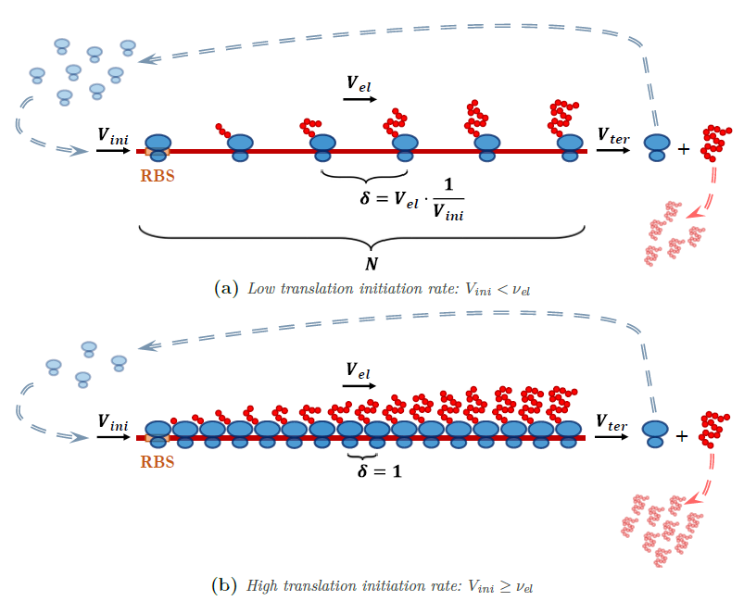
Introduction of heterologous protein with slow codon (graph from thesis of Joaquin)

Slide 22
Slow codon limiting translation phenomenon
The higher the initiation rate compared to the limiting elongation rate, the more likely it is that queues form
Queues are very inefficient: Without gaining bigger production rate for heterologous proteins, growth rate is decreases since ribosomes in the queues are not actively translating
Hence better practice to make promoter of heterologous transcript stronger if higher heterologous production rate is required
It is worse to have slow codons at the 3’ end than at the 5’ end because it allows for longer queue formation
All these rules above are reflected in the simulation results!

Slide 23
StoCellAtor gives insight into the cell
Not only do the results correspond clearly to the expectations, StoCellAtor gives insight into transient and stationary proteome partition, internal energy and growth rate of the cell
It also outputs other state variables of the cell, for example
Number of internalized nutrients
Transcript levels
Which ribosome sites are occupied by the ribosomes
Let’s watch how the cell changes when a heterologous transcript with 10th slow ribosome site (0.005 rel. elongation rate) is introduced (a=1 and b=1): https://www.youtube.com/watch?v=EPMutCumilk&feature=youtu.be

Slide 24
Video observations
Growth rate decreases
Energy increases: we simulated a case with slow codon limiting translation phenomenon: ribosomes are queuing, they cannot translate, energy usage is reduced -> energy grows
Innate proteome is “squeezed” by the heterologous protein in the pie chart
Sanity check: Simulation clearly converges

Slide 25


Summary of model justification
Reproduces Monod’s growth law
Reproduces linear relationship discovered by Scott el al.
Gives experimentally valid growth rate without parameter tuning
(doubling time = 20 mins corresponding to 2.4 h⁻¹ growth rate); makes sense, since we used values from bionumbers and some arbitrary values for less important and biologically unknown parameters -> robust model
Effects of burden are clearly visible in the results
Effects of ribosome queues are clearly observed in the heterologous case with slow codons

