Slide 1

MLOPS (GROUP 12)
AIRLINE PASSENGER SATISFACTION PREDICTION
AN END-TO-END MACHINE LEARNING PROJECT WITH MLFLOW, DOCKER, AND STREAMLIT
GitHub Link - https://github.com/sarvarthp/mlopsProject
Presented By:
24030242002 - Abhinav Dandale
24030242024 - Ishita
24030242042 - Sarvarth Patil
24030242064 - Shouvik Kapat

Slide 2
Problem Statement:
Airlines want to analyze passenger feedback (comfort, service, delays, etc.).
Goal: Predict passenger satisfaction ("Satisfied" vs "Neutral/Dissatisfied").
Helps airlines improve customer service, optimize resources, and enhance loyalty.
Dataset Overview:
Source: Kaggle – Airline Passenger Satisfaction
Rows: ~129k passengers
Features: 23 (numeric + categorical)
Target: satisfaction → Binary (1 = Satisfied, 0 = Not satisfied)
Example columns:
Demographics: Gender, Customer Type
Travel details: Class, Type of Travel, Flight Distance
Service ratings: Food, Seat Comfort, In-flight service
Delay info: Departure/Arrival Delay

Slide 3
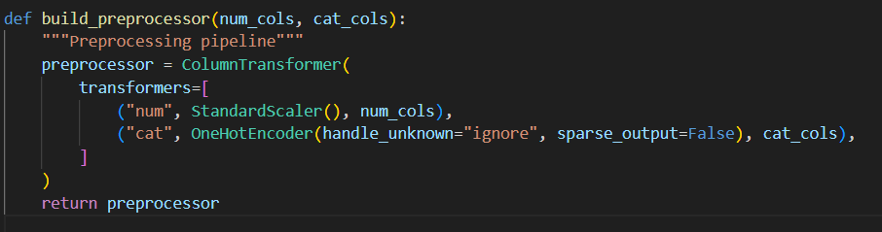
DATA PREPROCESSING:
Dropped unnecessary columns (id, Unnamed: 0)
Mapped satisfaction → binary target
Handled missing values:
Numeric → Median imputation
Categorical → Mode imputation
Encoded categorical variables (One-Hot Encoding)
Standardized numeric columns (scaling)
Training & Testing Setup:
Training Data: train.csv (provided dataset for model training)
Testing Data: test.csv (separate dataset for model evaluation)
Ensures strict separation of training and evaluation data
Maintains realistic assessment of model performance (avoids data leakage)

Slide 4
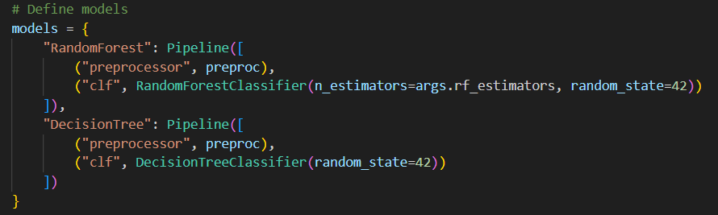
MODELS IMPLEMENTED:
Decision Tree Classifier
Simple, interpretable model
Useful as a baseline
Visualizes decision rules
Random Forest Classifier
Ensemble of Decision Trees
Reduces overfitting
Generally more accurate and stable
Pipeline & Preprocessor:
Preprocessor:
Numeric → Imputer + Scaler
Categorical → Imputer + One-Hot Encoder
Classifier (Decision Tree / Random Forest) added at the end
Ensures no data leakage

Slide 5
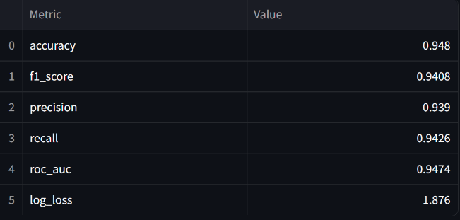
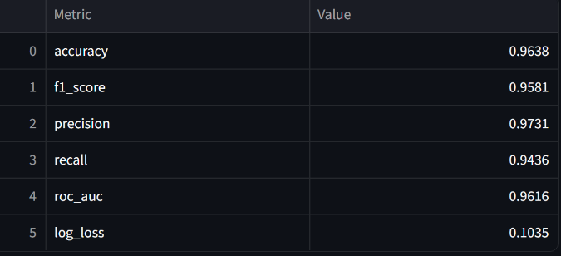
RESULTS:
Decision Tree
Accuracy: ~92–94%
Pros:
Simple, interpretable
Fast training
Cons:
Overfits on training data
Less generalization
Random Forest
Accuracy: ~95–96%
Pros:
Handles large dataset well
Better generalization
More robust to noise
Cons:
More complex, harder to interpret

Slide 6
MLFLOW INTEGRATION:
USed MLflow for tracking experiments
Logged:
Hyperparameters (e.g., n_estimators)
Metrics (Accuracy, Precision, Recall, F1, ROC-AUC, LogLoss)
Artifacts (saved models, confusion matrix plots)
Benefits:
Centralized experiment tracking
Model comparison made easy
Reproducibility & version control

Slide 7
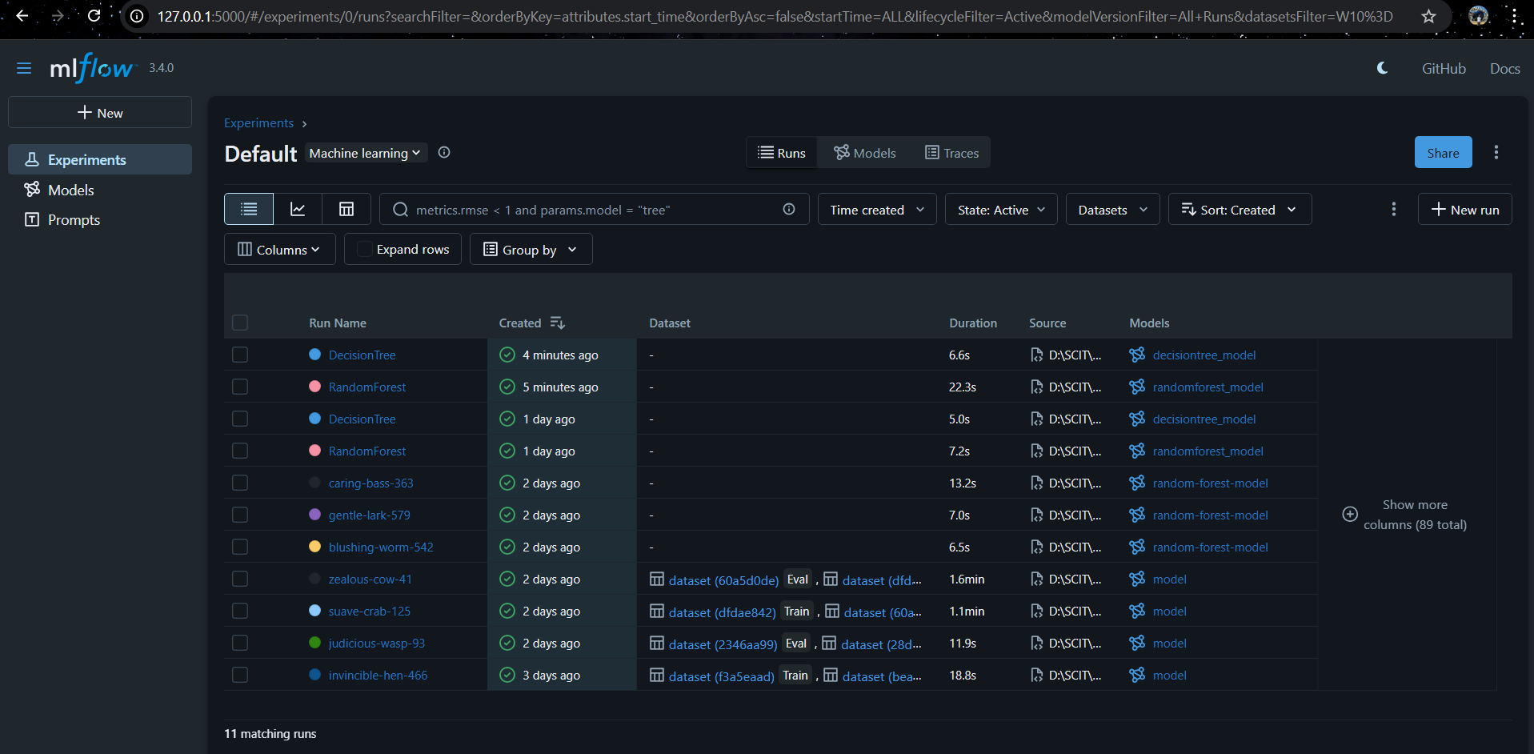
ML FLOW SCREENSHOTS
http://127.0.0.1:5000/#/experiments

Slide 8
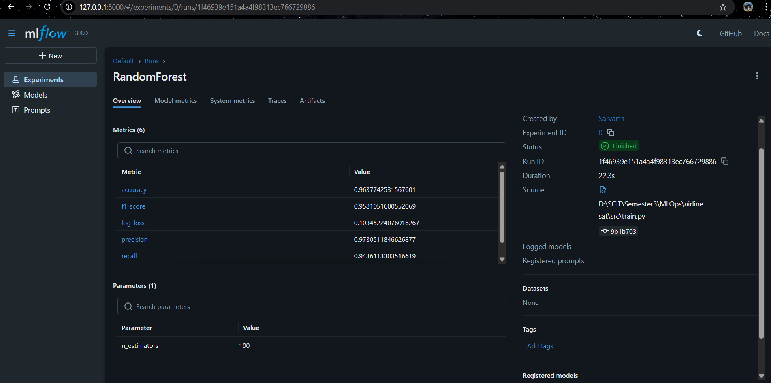
ML FLOW SCREENSHOTS

Slide 9
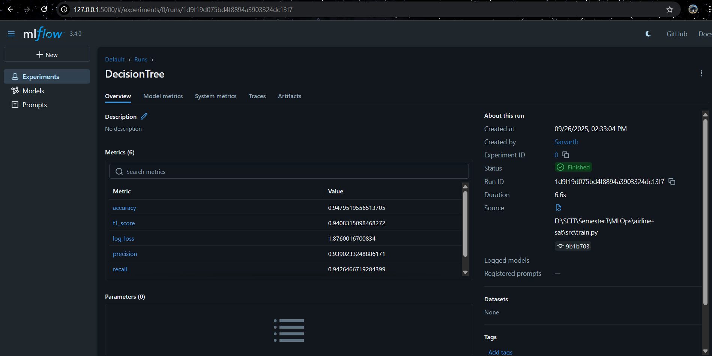
ML FLOW SCREENSHOTS

Slide 10
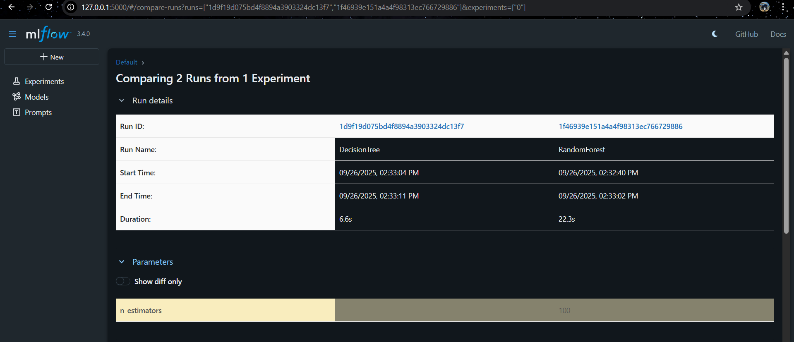
ML FLOW SCREENSHOTS

Slide 11
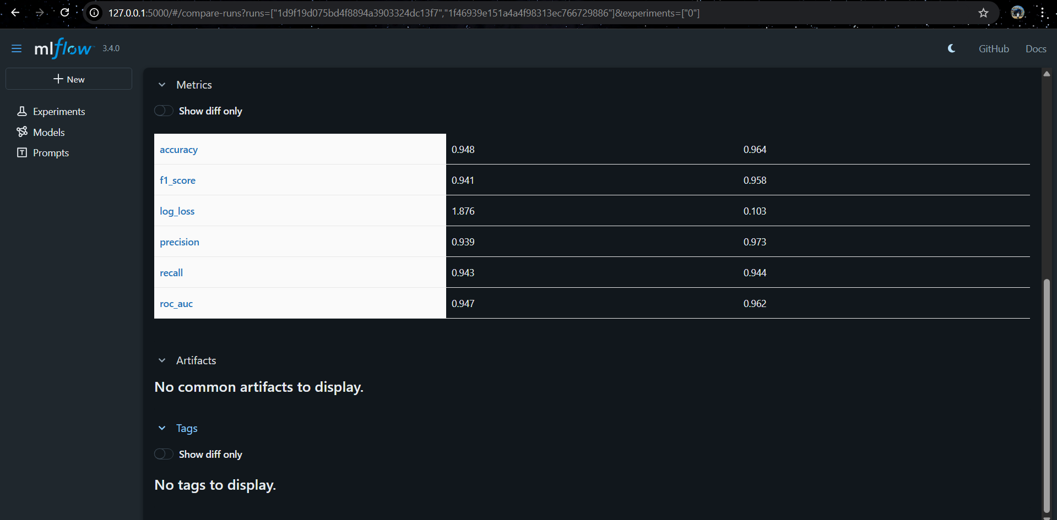
ML FLOW SCREENSHOTS

Slide 12
DOCKERIZATION:
DOCKERFILE SETUP:
BASE IMAGE: PYTHON 3.9 SLIM (LIGHTWEIGHT AND EFFICIENT).
SYSTEM DEPENDENCIES: INSTALLED BUILD TOOLS FOR PANDAS/NUMPY/SKLEARN.
REQUIREMENTS: INSTALLED PYTHON LIBRARIES FROM REQUIREMENTS.TXT.
PROJECT FILES: COPIED APPLICATION CODE (SRC/, APP/, MODELS/) INTO CONTAINER.
EXPOSED PORT: 8501 FOR STREAMLIT WEB APP.
STARTUP COMMAND: RUNS STREAMLIT_APP.PY AUTOMATICALLY.
HOW IT WORKS:
BUILD IMAGE → DOCKER BUILD -T AIRLINE-APP .
CREATES A REUSABLE IMAGE OF THE PROJECT.
RUN CONTAINER → DOCKER RUN -P 8501:8501 AIRLINE-APP
LAUNCHES ISOLATED ENVIRONMENT WITH MODEL + STREAMLIT APP.
ACCESS WEB APP → HTTP://LOCALHOST:8501.

Slide 13
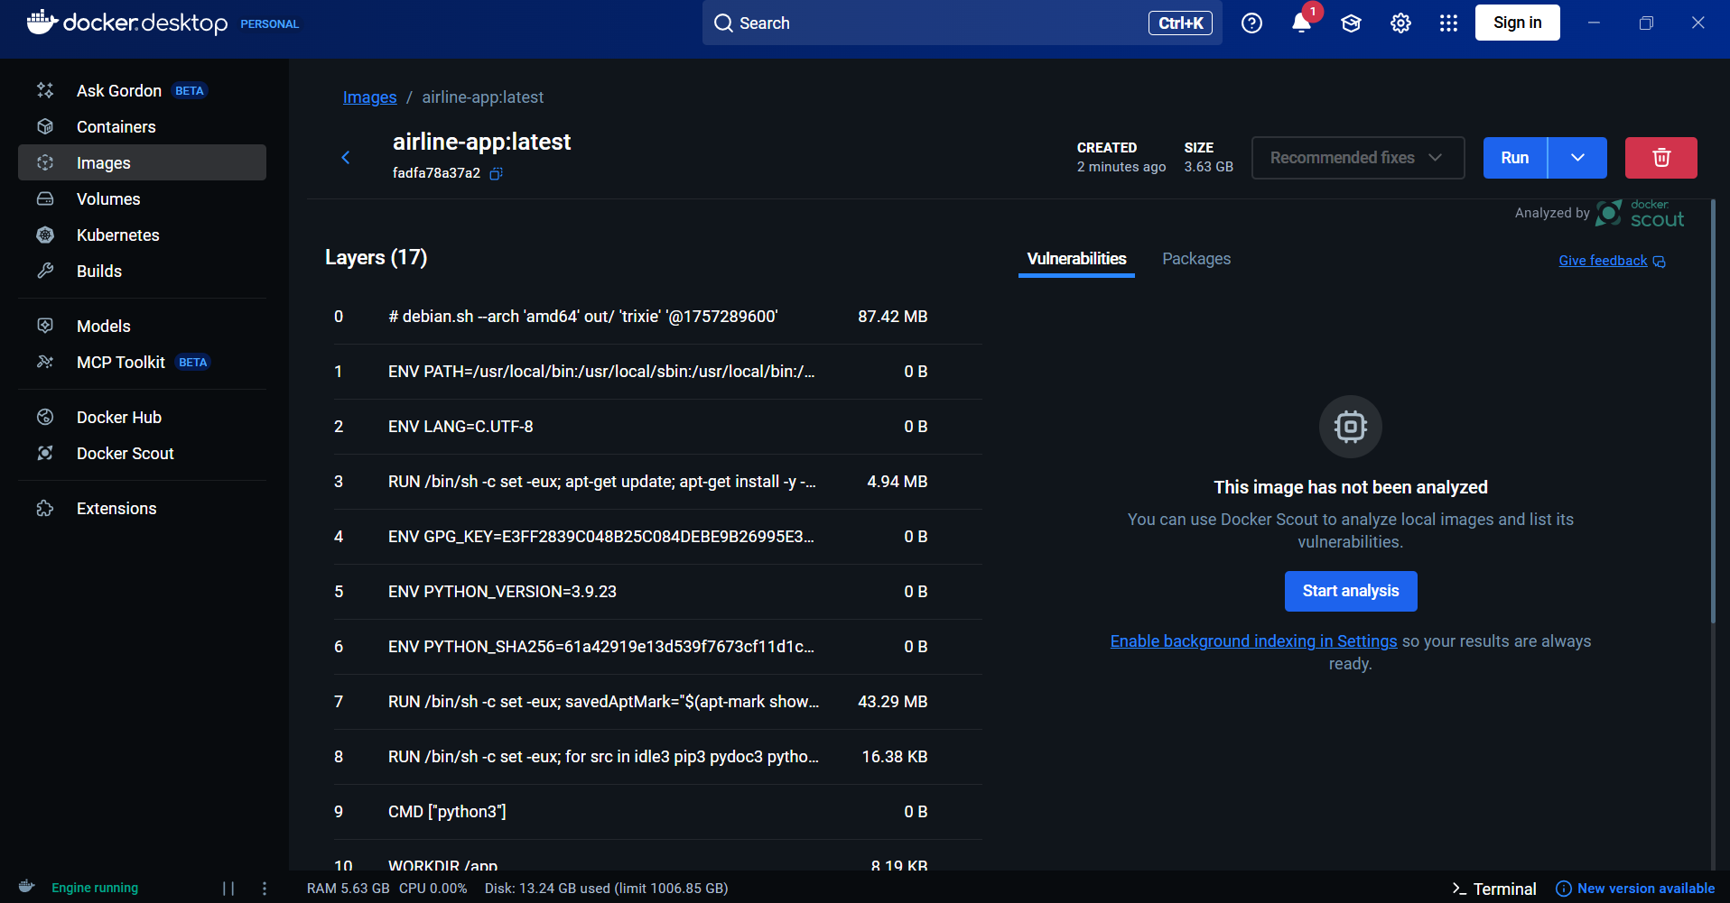
DOCKER SCREENSHOTS

Slide 14
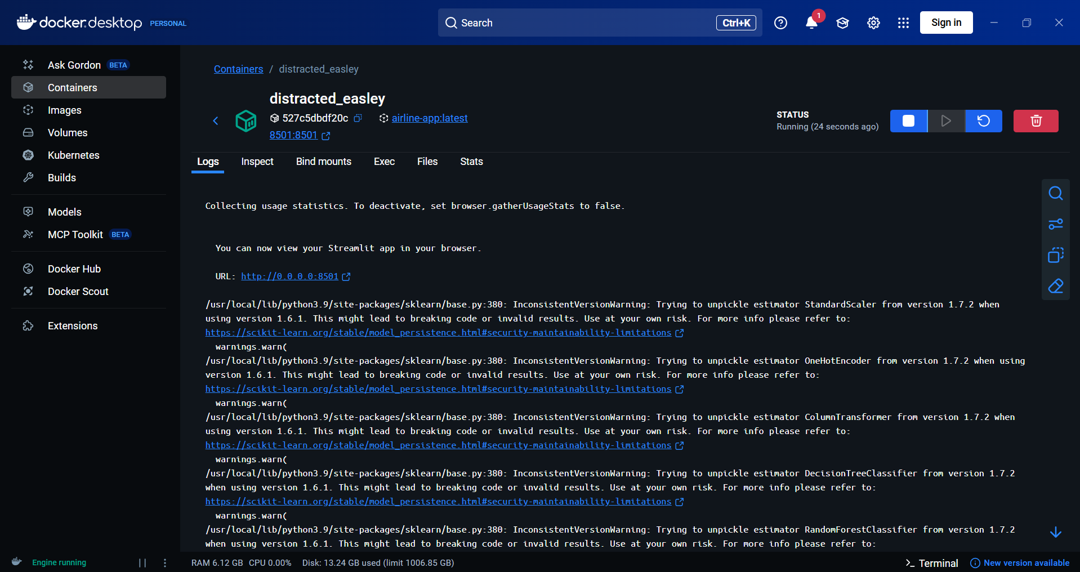
DOCKER SCREENSHOTS

Slide 15
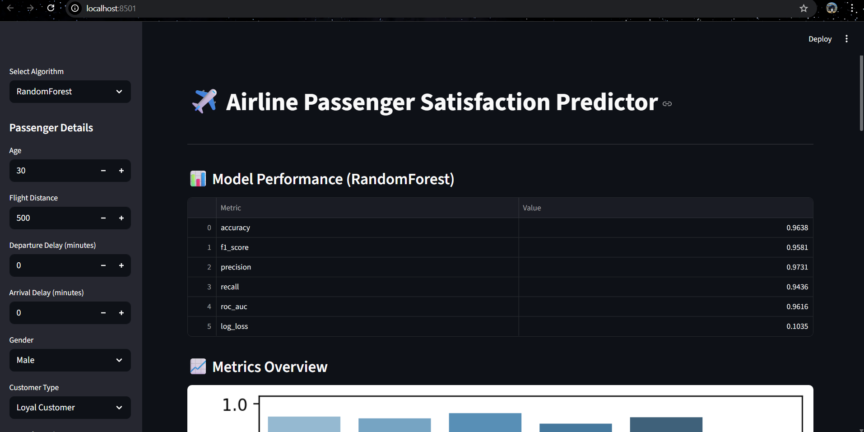
DOCKER SCREENSHOTS
http://localhost:8501/

Slide 16
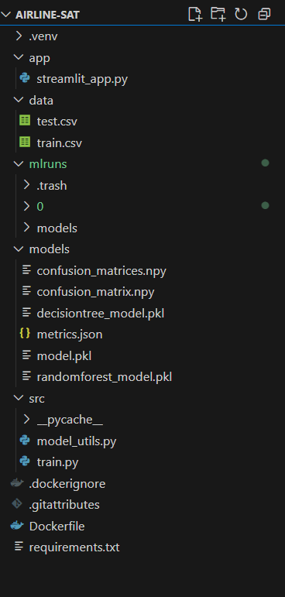
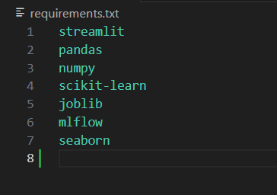
PROJECT FOLDER STRUCTURE

Slide 17
Commands
Command to create virtual environment:
python3 -m venv .venv
Command to activate the virtual environment:
.\.venv\Scripts\activate
Command to train the models:
python -m src.train --train data/train.csv --test data/test.csv --out-dir models --rf-estimators 100
Command to view Mlflow ui:
mlflow ui
Command to run Streamlit locally:
streamlit run app/streamlit_app.py
Command to create docker image:
docker build -t airline-app .
Command to run docker image:
docker run -p 8501:8501 airline-app
Command to commit to GIT for 1st time:
git init
git lfs install
git lfs track "*.pkl"
git add .
git commit -m "Initial commit with Git LFS for model files"
git remote add origin https://github.com/yourusername/mlopsProject.git
git branch -M main
git push -u origin main
Command to push changes to GIT:
git status
git add .
git commit -m "Describe your changes here"
git push origin main

Slide 18
STREAMLIT CLOUD DEPLOYMENT:
CODEBASE PUshed to GitHub
Project organized with src/, app/, models/, and requirements.txt
Version-controlled for collaboration and CI/CD readiness
Deployment on Streamlit Cloud
Connected GitHub repo to Streamlit Cloud
Configured streamlit_app.py as the entry point
Dependencies automatically installed from requirements.txt
Live Application Features
Interactive form for passenger input (gender, class, service ratings, delays, etc.)
Real-time model prediction (Satisfied vs. Dissatisfied)
Dashboard includes charts: Accuracy metrics, Confusion Matrix
Outcome
Working, shareable ML dashboard accessible from any device/browser
Demonstrates complete end-to-end ML pipeline to deployment

Slide 19
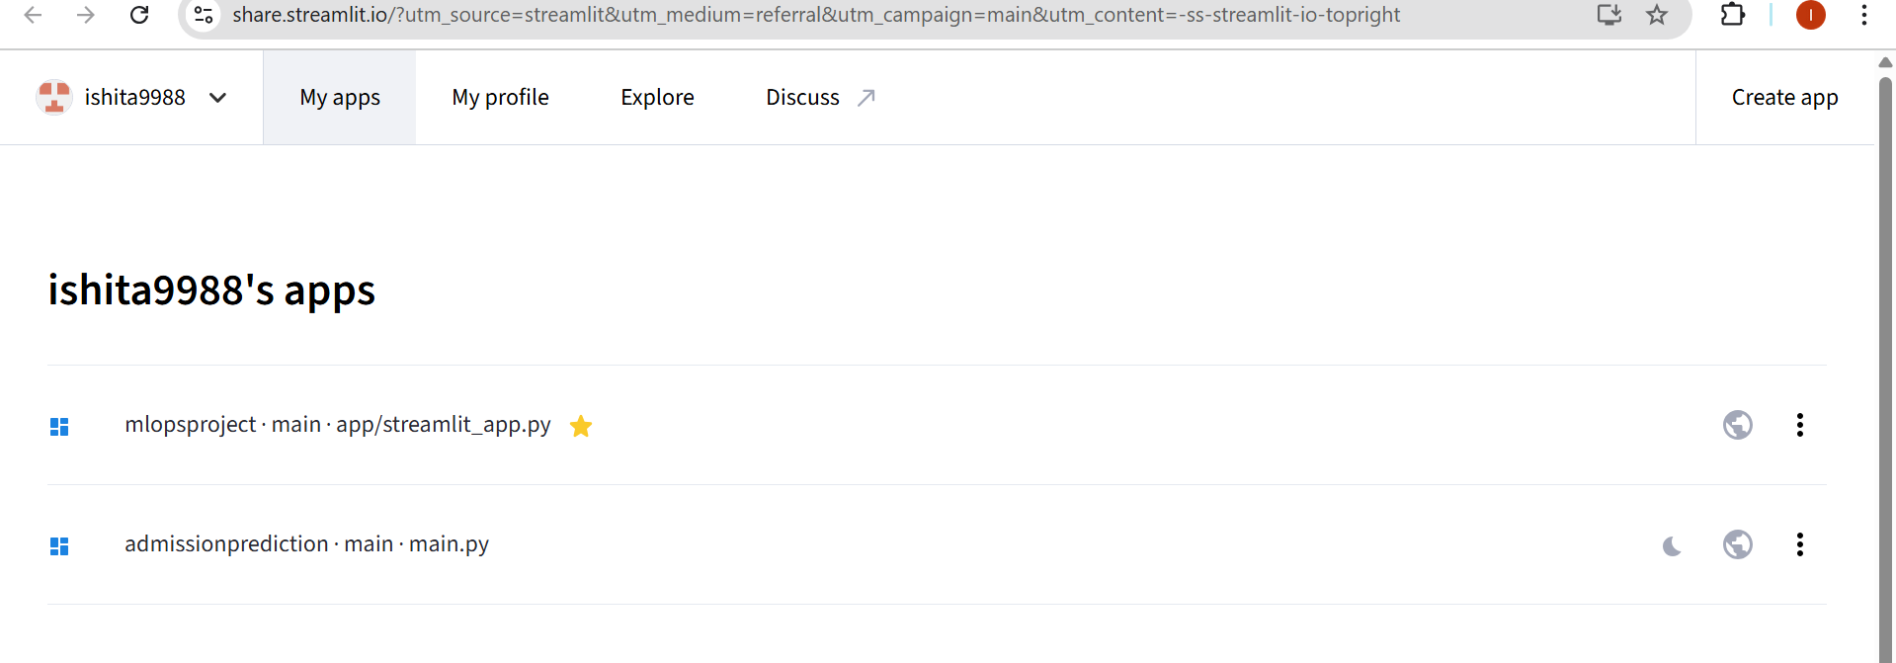
STREAMLIT SCREENSHOTS
https://mlopsproject-demoishi.streamlit.app/

Slide 20
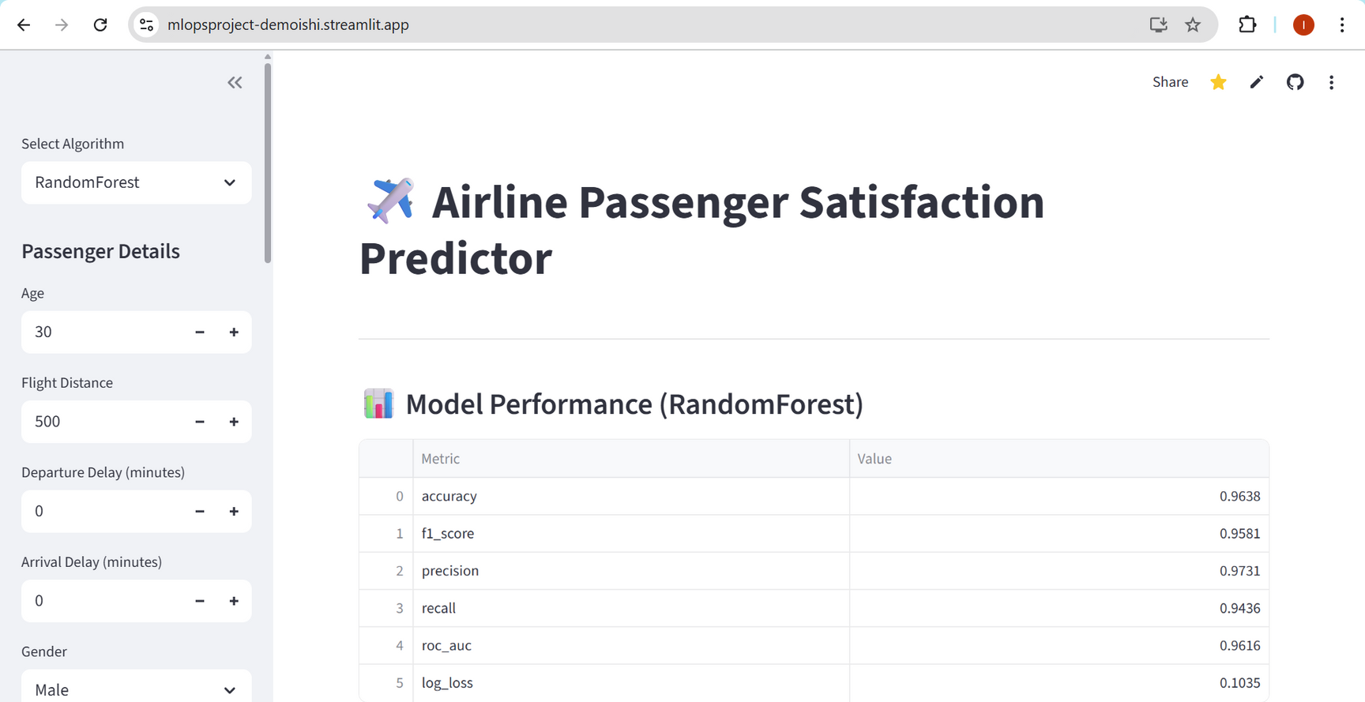
STREAMLIT SCREENSHOTS

Slide 21
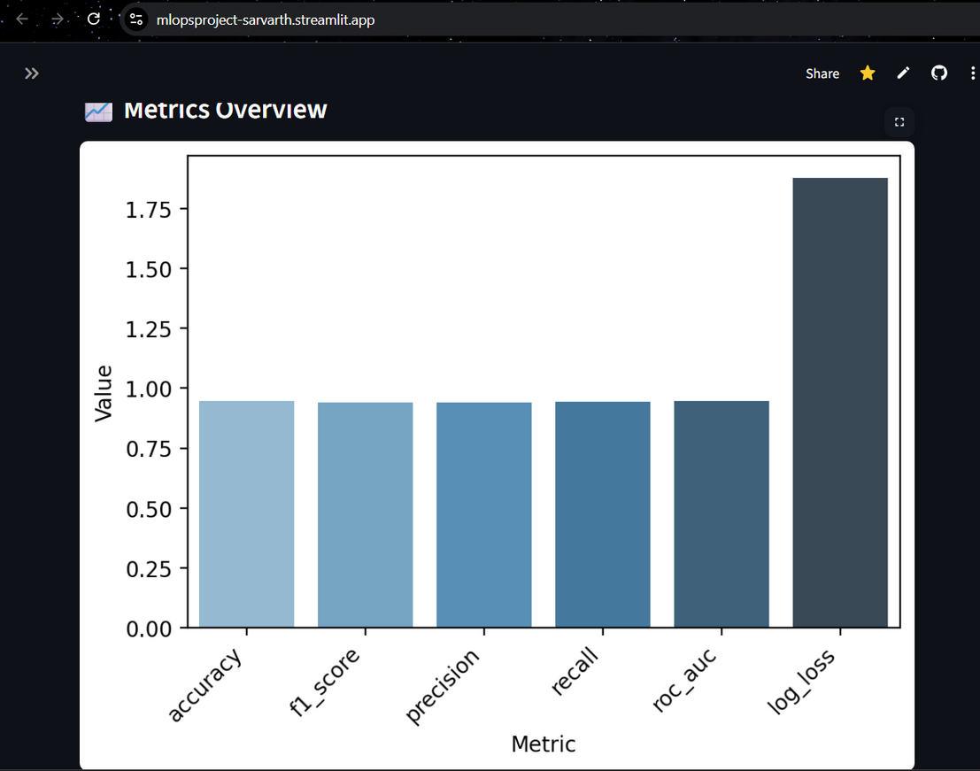
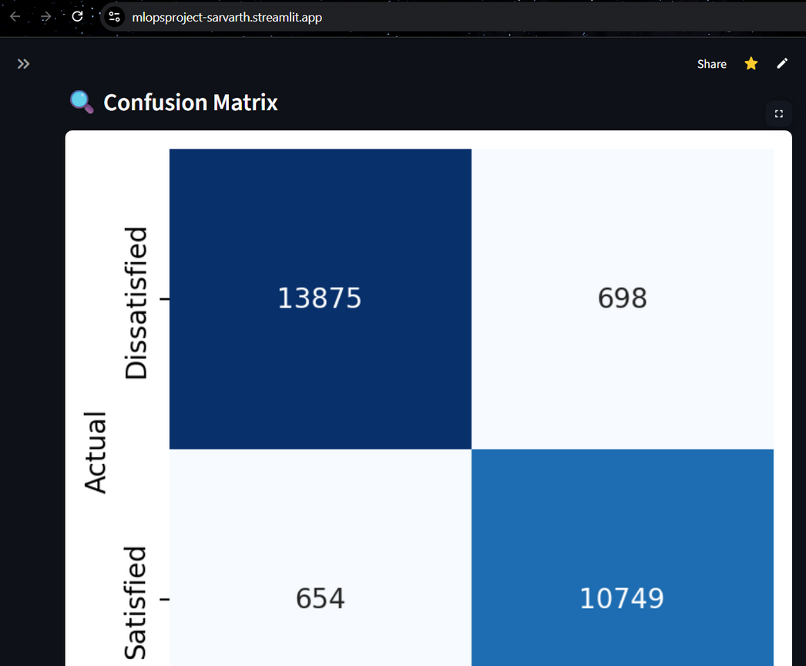
STREAMLIT SCREENSHOTS

Slide 22
LEARNINGS:
BUilding reproducible ML pipelines
Model comparison with MLflow
Benefits of Docker for ML projects
Streamlit for quick deployment
Conclusion:
Implemented Decision Tree & Random Forest for passenger satisfaction prediction
Compared models with MLflow → Random Forest chosen
Achieved 96% accuracy
Deployed working dashboard with Streamlit + Docker + Cloud

Slide 23
THANK YOU

