Slide 1
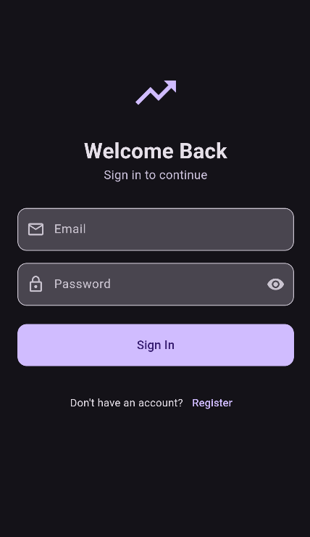
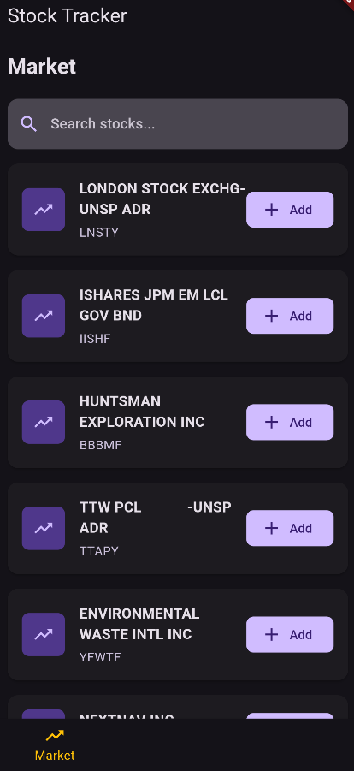
December 15, 2024
Stock Tracker App
Creative Market Devs Team Name: FlutterPros
Team Members: Chris Baez & Sar Vashisht

Slide 2
Problem Statement
In an increasingly volatile and fast-paced stock market, individuals struggle to efficiently track real-time market data, manage personalized stock watchlists, and stay informed with relevant financial news tailored to their interests. Existing solutions often lack a seamless, synchronized user experience, robust authentication, and the ability to integrate diverse functionalities such as portfolio management and news prioritization. This leaves users overwhelmed, uninformed, and unable to make timely and informed investment decisions on the go.

Slide 3
Requirements
App Features Need to Include:
A market to watch stocks, see the opinions of insiders, and to keep an eye out for stocks.
Store user specific watchlists and be able to add and remove stocks to and from the watchlist.
Provide relevant news to the user regarding the stock market and general financial market news.

Slide 4
Input/Output
Input
Output
Login information
Add Stocks to watchlist
Stock Market and Search by icon
Relevant News
Watchlist

Slide 5
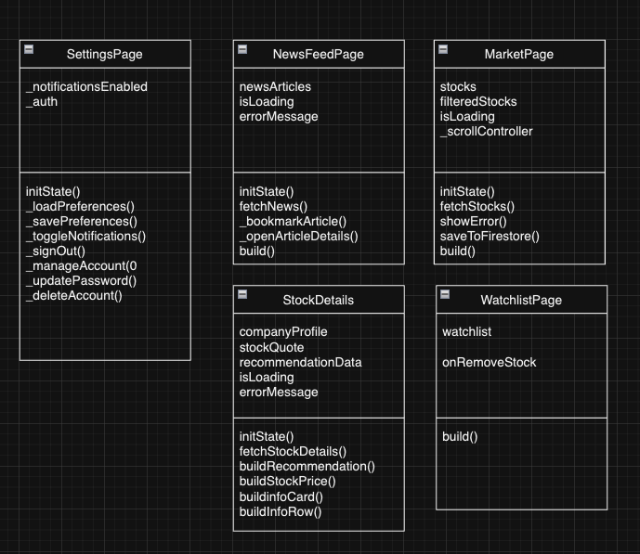
UML

Slide 6
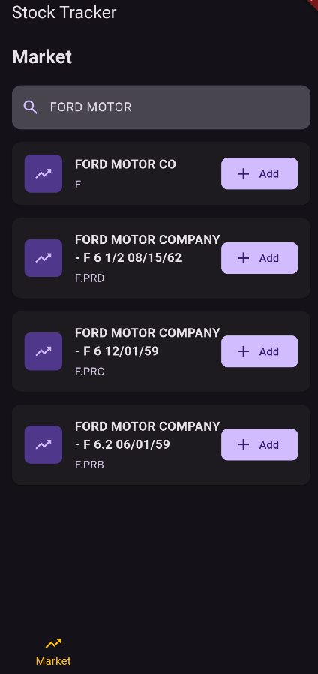
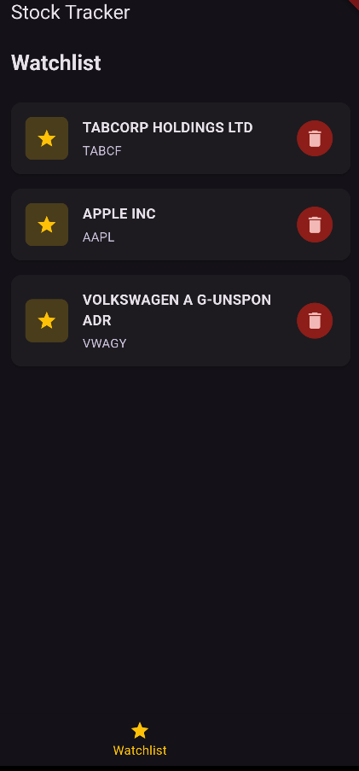
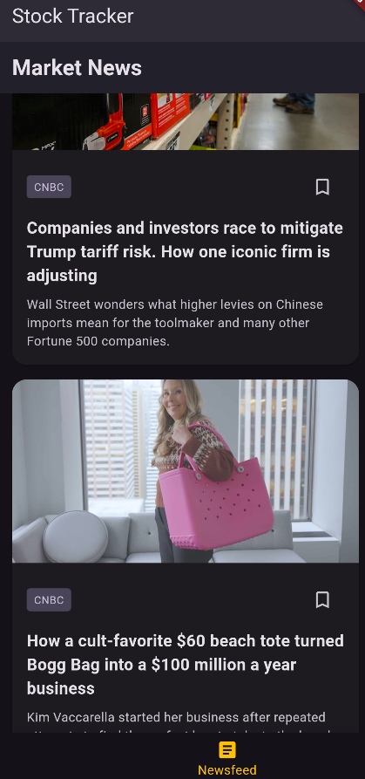
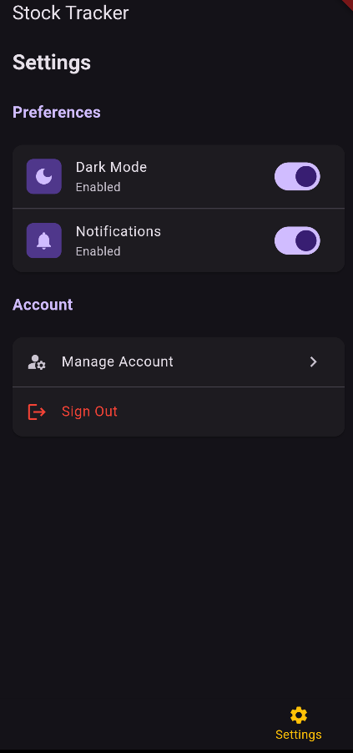
DESIGN OVERVIEW

Slide 7
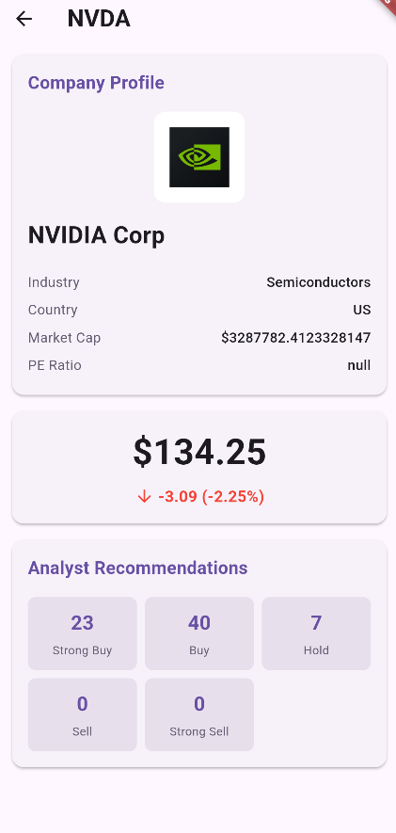
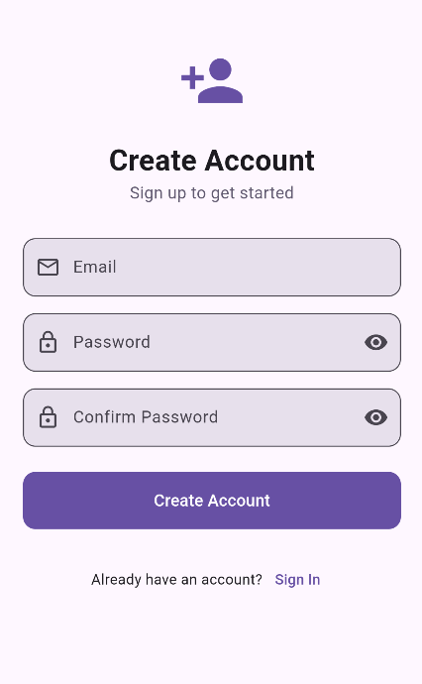
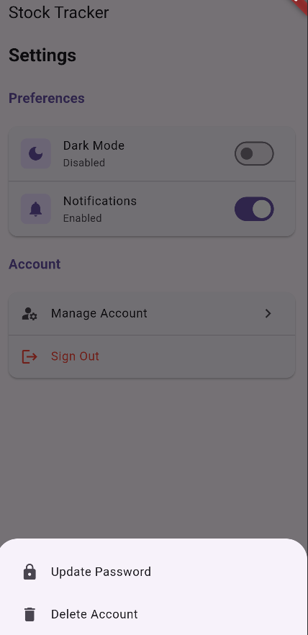
DESIGN OVERVIEW

Slide 8
Testing
The Testing Scenarios were pretty straightforward, making sure everything works, Implementing a lot of debug prints throughout the code and making sure everything is saved to the firebase console. Implementing different accounts and passwords and testing the upper limits in order to stress test the app and so on.

Slide 9
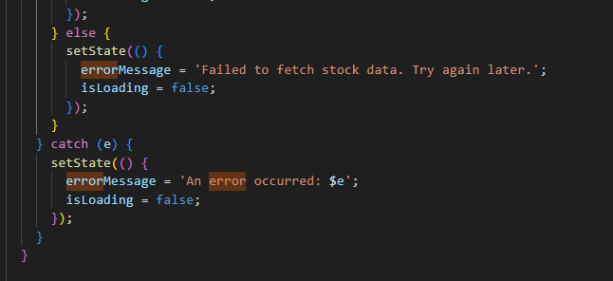
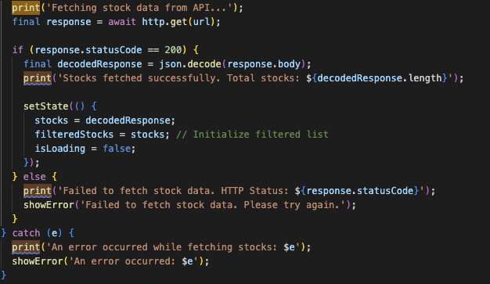
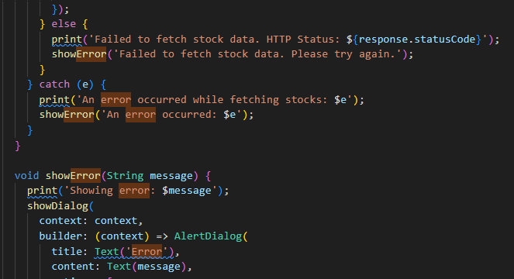
Testing

Slide 10
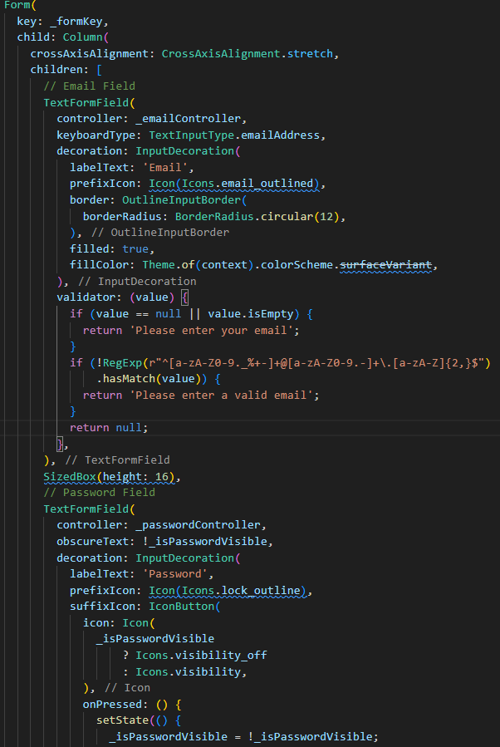
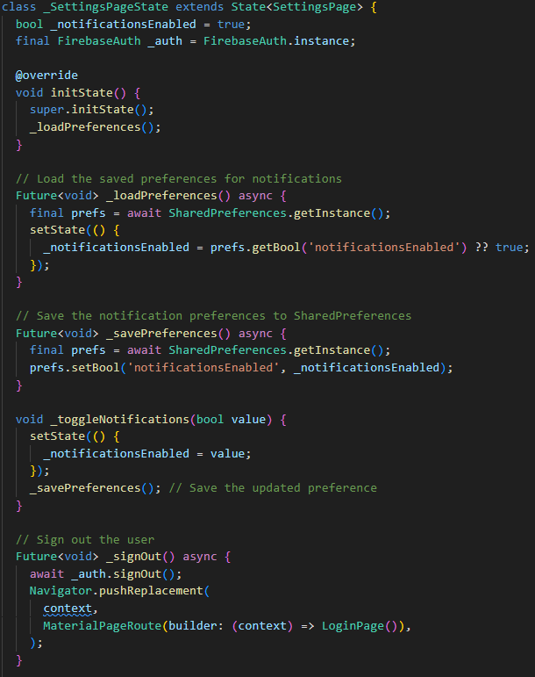
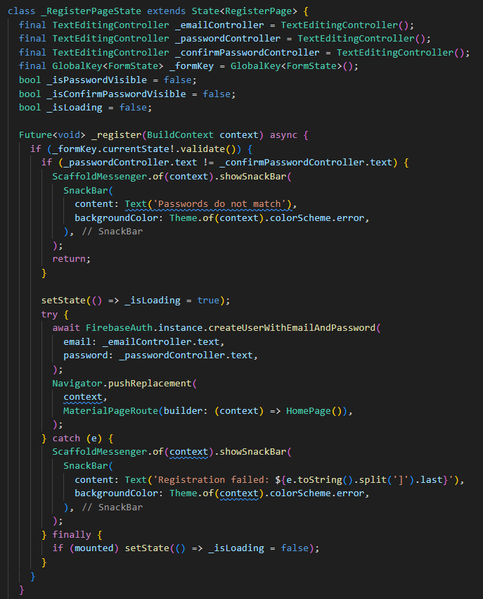
Registration Logic
Login Logic
Settings Page
Has error handling for bad inputs.
The login logic for the email and password and making sure password meets requirements
Saves preferences of the user upon logout, whether dark or light mode and allows account management

Slide 11
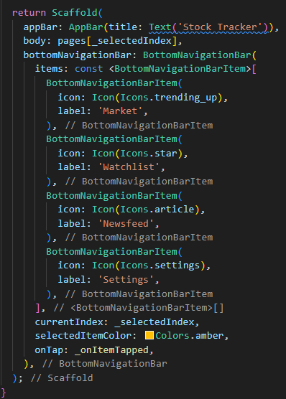
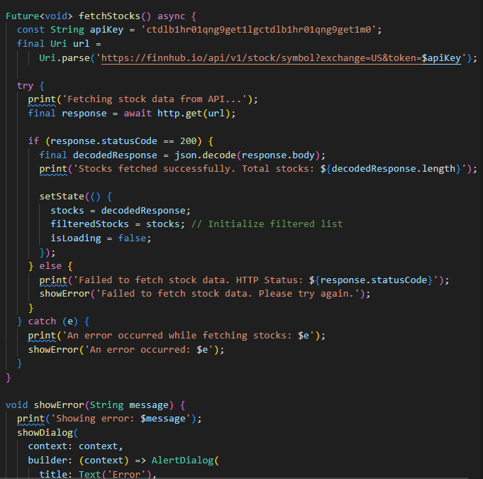
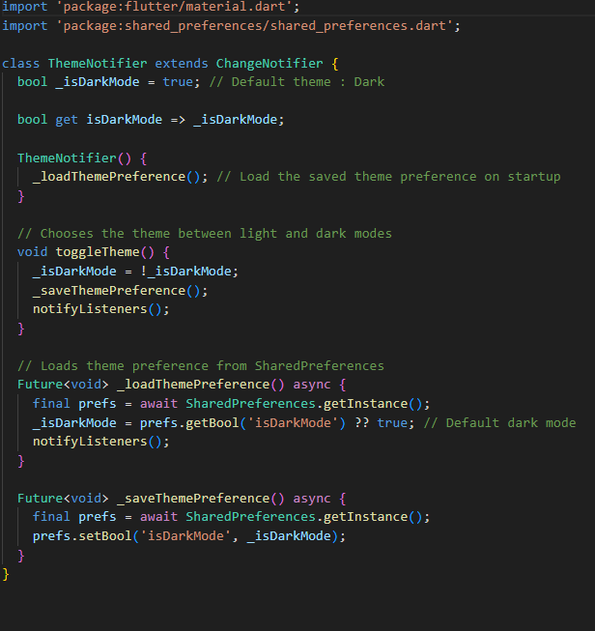
Dark Mode and Light Mode
NavBar Implementation
Stock Fetching Along with Error Handling
App starts default in light mode, allows user to switch between and saves it for the user on logout
We wanted to make the NavBar look minimalistic and modern with this app having a dark and light mode
Implementation of the Finnhub API and handling of the errors fetching that we ran into along the way

Slide 12
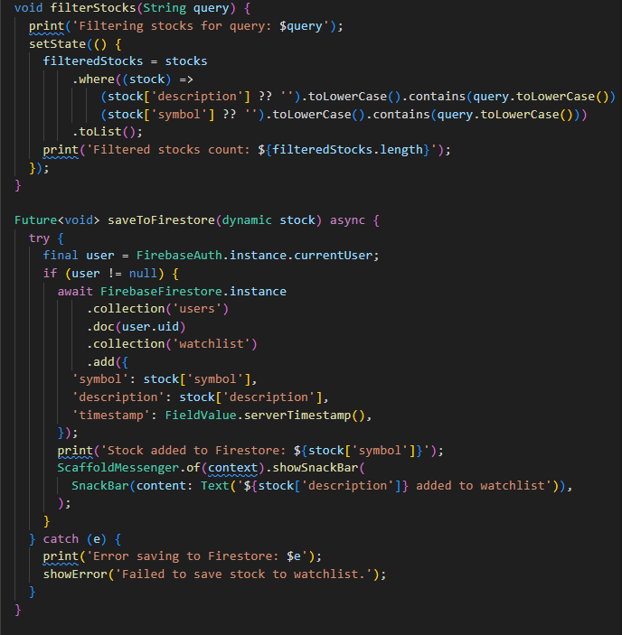
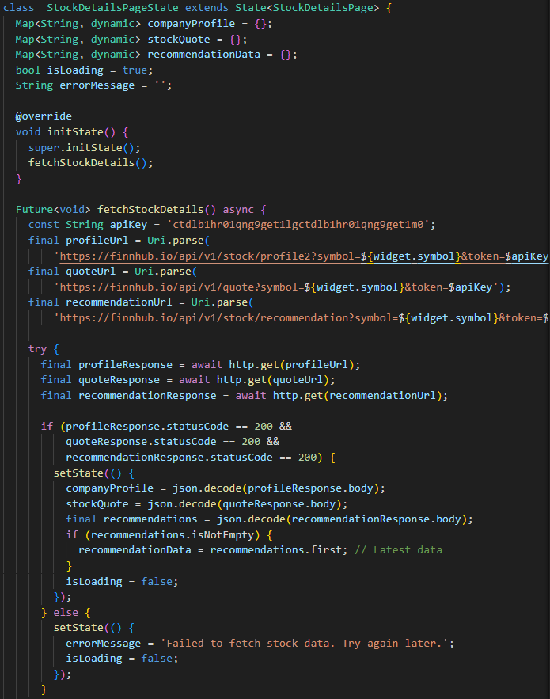
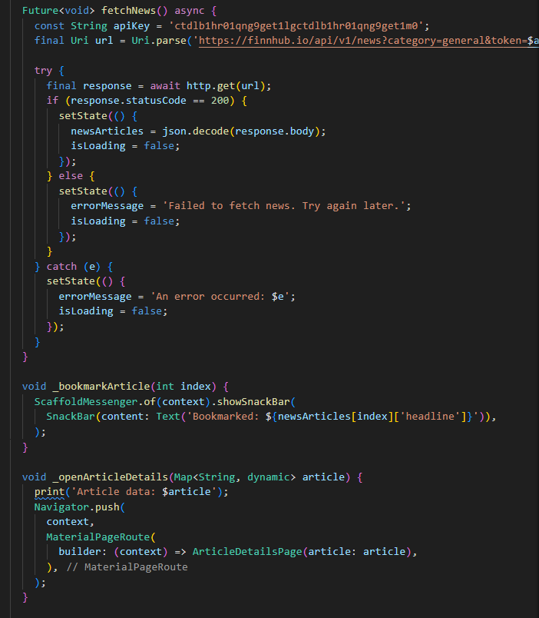
Newsfeed Logic
Market Page
Stock Details
Fetches and displays news using FinnHub API
For filtering stocks and adding them to the database on firebase for the watchlist to display them.q
Using Finnhub API to fetch as much information as we can to populate the stock details page.

Slide 13
Issues We Ran Into
API Data Syncing Delays: Stock data from the Finnhub API was slow to load, leading to delays in displaying real-time prices. Solution: Implemented caching and optimized API requests to improve speed.
Firebase Authentication Errors: Users faced login failures with correct credentials due to network instability. Solution: Improved error handling and added retry mechanisms for network-related issues.
Watchlist Sync Issues: The watchlist did not sync properly across devices. Solution: Fixed Firebase real-time database rules to ensure proper synchronization.
Stock Search Failures: The search bar returned incorrect or no results for certain stocks. Solution: Refined the search logic to handle matches better and validate queries.
Dark Mode Inconsistencies: Dark mode wasn’t applied uniformly across all screens. Solution: Ensured global application of dark mode settings across the entire app.

Slide 14
Future Implementation
Using FinnHub API’s premium features to integrate graphs into the app, our main goal was to use graphs to populate the app but finding an API to fetch dynamic graphs that was free was an issue.
Adding more features to the app such as pattern recognition, separate watchlists and being able to separate by indicators.
AI implementation for recommended stocks
Separated Crypto Implementation.

Slide 15
Helpful Sources
Class Content for Firebase Use
Stack Overflow
Existing Reddit Threads
Github Open Source.
Youtube

Slide 16
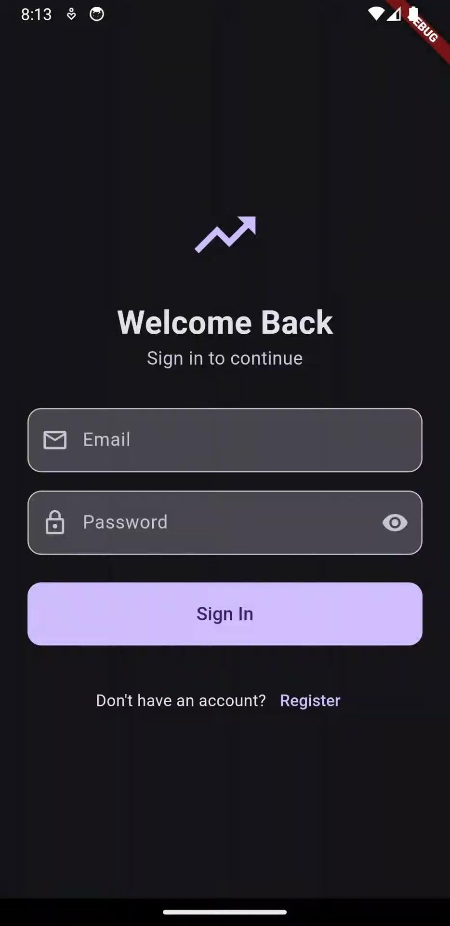
LIVE DEMO

