Slide 1

Music Store Management System

Slide 2

About Us :-
1. B. Vamsi :
Completed The Bachelors of Computer Applications (2026)
Linked in :- Vamsi Bodigadla | LinkedIn
2. S. Sai Kiran : - Completed B.Tech in (CSE)
Linked in :- sankara saikiran | LinkedIn
3. P. Suresh :- Completed B.Tech in (Civil)
Linked in :- POREDDY SURESH REDDY | LinkedIn

Slide 3
Agenda
Objective of the Project
Key analysis questions (use cases)
Conclusion (Key finding overall)
Q&A Slide
Your Experience/Challenges working

Slide 4
Objective of the Project:
The objective of this project is to analyse the Music Store database and gain valuable insights into customer purchasing behaviour and sales performance.
The project aims to identify top customers, popular music genres, and high-performing artists based on purchase data.
It helps analyse customer preferences across different countries and cities to understand market trends and revenue distribution.
By using SQL queries, the project extracts meaningful information from raw transactional data through joins, aggregations, and data analysis techniques.
The insights generated can support data-driven decision-making, improve customer engagement, and help optimize business strategies.
Overall, the goal is to uncover trends, patterns, and business opportunities within the Music Store dataset using SQL-based analysis.

Slide 5
Key Analysis Questions:
Who is the most senior employee in the organization?
Which countries generate the highest number of invoices?
What are the highest invoice values recorded?
Which city generates the highest revenue for the music store?
Who is the most valuable customer based on total spending?
Which customers are interested in Rock music?
Which artists have produced the highest number of Rock tracks?
Which tracks are longer than the average song length?
How much does each customer spend on different artists?
What is the most popular music genre in each country?
Which customer spends the most money in each country?

Slide 6
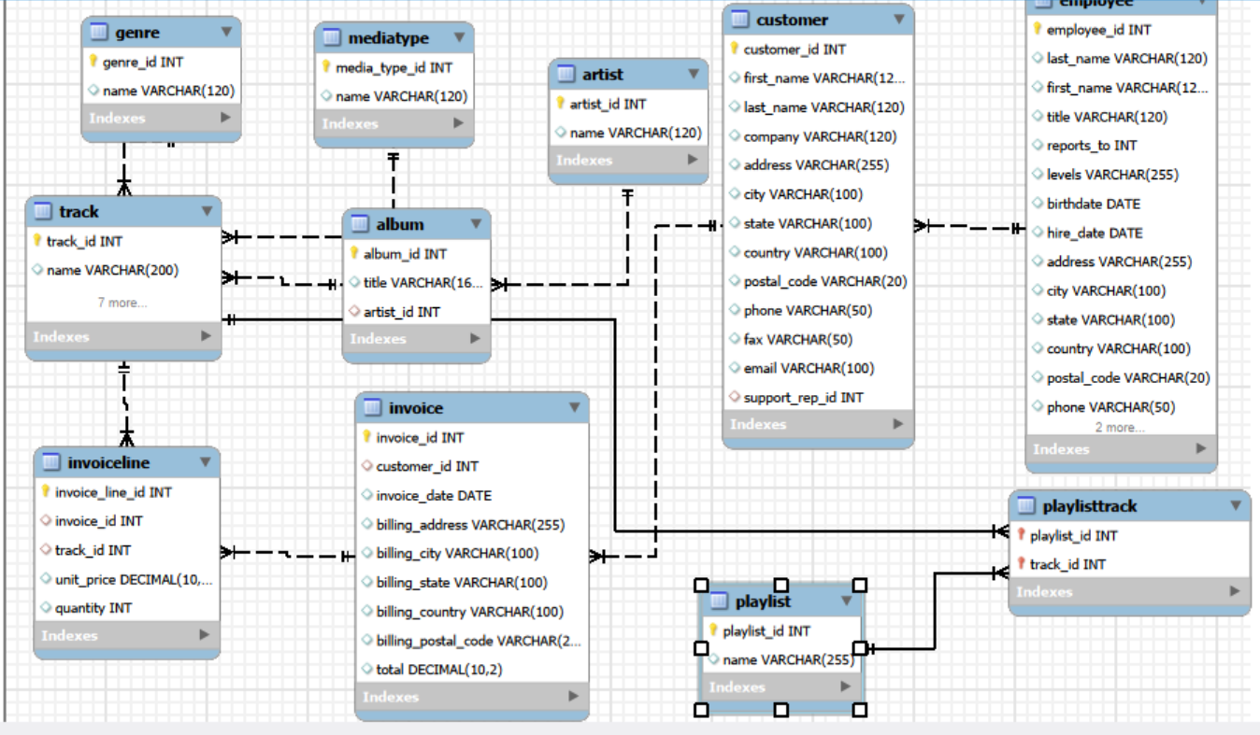
Schema Diagram :

Slide 7
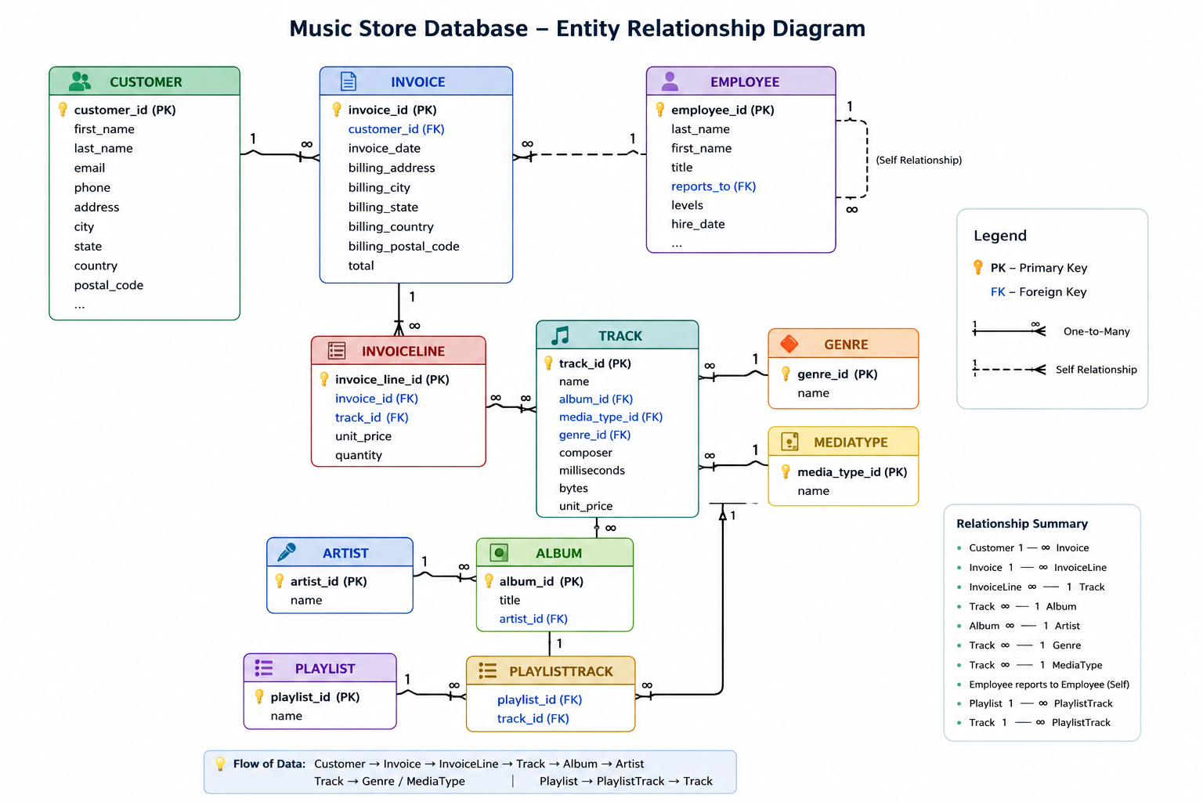

Slide 8
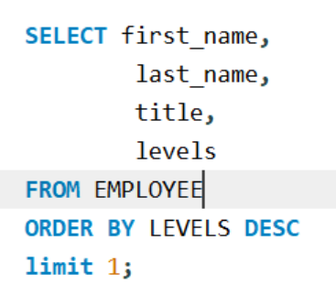

1. Who is the senior most employee based on job title?
Query :
Output :
Key Insight :-
Andrew Adams is the senior-most employee in the company, holding the position of General Manager (L6), which is the highest level in the organization.

Slide 9
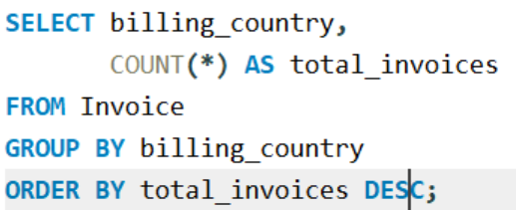
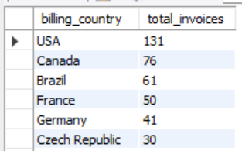
2. Which countries have the most Invoices?
Query :
Output :
Key Insight :-
The USA has the highest number of invoices (131), followed by Canada (76) and Brazil (61). This indicates that customers from these countries contribute the most transactions, making them the strongest markets for the music store.

Slide 10
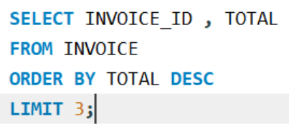
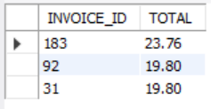
3. What are the top 3 values of total invoice?
Query :
Output :
Key Insight :-
The highest invoice value recorded is 23.76, followed by 19.80. This shows that a few customers made larger purchases compared to the average transaction, contributing more revenue to the music store.

Slide 11
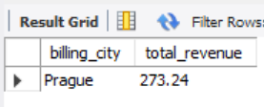
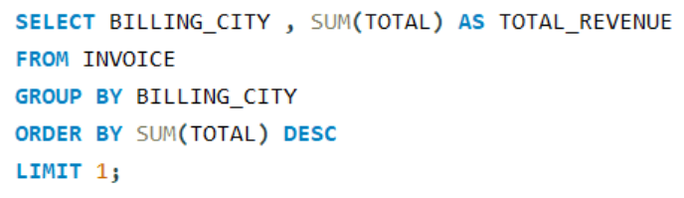
4. Which city has the best customers? - We would like to throw a promotional Music Festival in the city we made the most money. Write a query that returns one city that has the highest sum of invoice totals. Return both the city name & sum of all invoice totals
Query :
Output :
Key Insight :-
Prague generated the highest revenue with a total invoice value of 273.24. This indicates that customers in Prague contributed the most to the store's sales, making it a suitable location for promotional events such as a music festival.

Slide 12
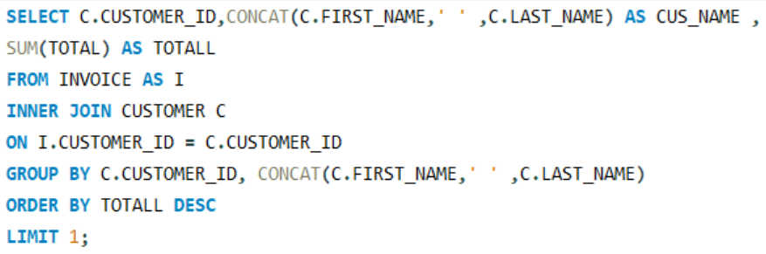

5. Who is the best customer? - The customer who has spent the most money will be declared the best customer. Write a query that returns the person who has spent the most money
Query :
Output :
Key Insight :-
František Wichterlová is the highest-spending customer, with a total purchase amount of 144.54. This indicates strong customer loyalty and a high level of engagement with the music store's products.

Slide 13
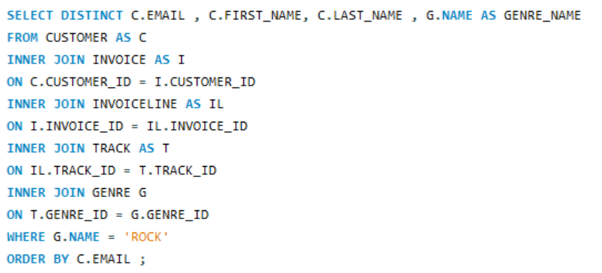
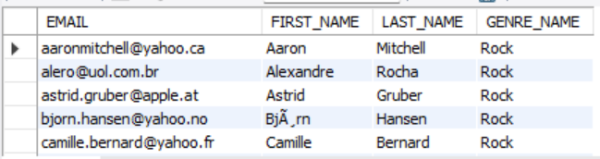
6. Write a query to return the email, first name, last name, & Genre of all Rock Music listeners. Return your list ordered alphabetically by email starting with A
Query :
Output :
Key Insight :-
The results show that customers from different countries have purchased Rock music, making Rock one of the most popular genres in the music store. This indicates a broad and diverse audience for Rock music across the customer base

Slide 14
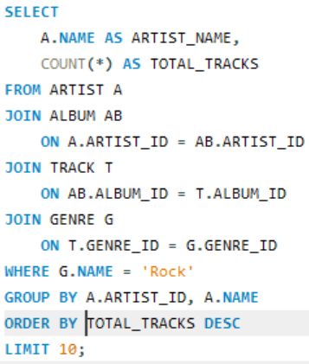
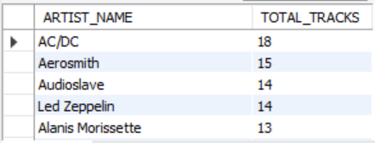
7. Let's invite the artists who have written the most rock music in our dataset. Write a query that returns the Artist name and total track count of the top 10 rock bands
Query :
Output :
Key Insight :-
AC/DC has the highest number of Rock tracks (18), followed by Aerosmith (15) and Audioslave and Led Zeppelin (14 each). This shows that these artists have a strong presence in the Rock genre and are among the most significant contributors to the music store's Rock music collection.

Slide 15
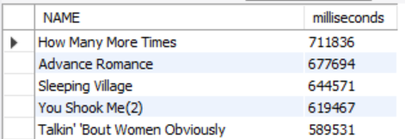
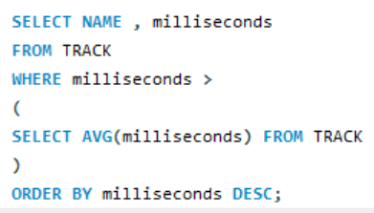
8. Return all the track names that have a song length longer than the average song length.- Return the Name and Milliseconds for each track. Order by the song length, with the longest songs listed first
Query :
Output :
Key Insight :-
Several tracks in the music store are significantly longer than the average song length. The longest track is "How Many More Times" with a duration of 711,836 milliseconds, indicating that the collection includes extended versions and long-form musical compositions preferred by certain listeners.

Slide 16
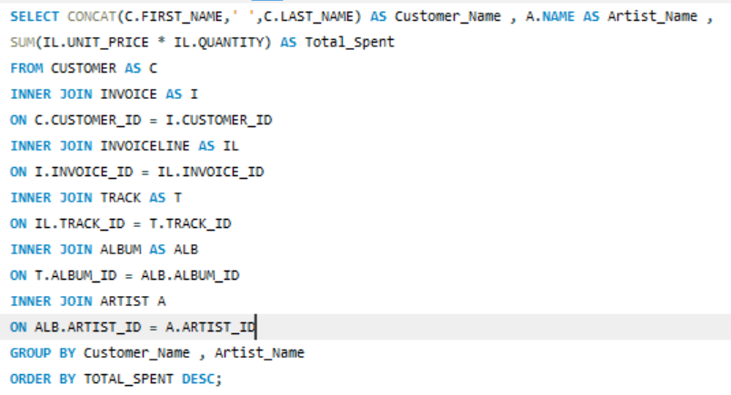
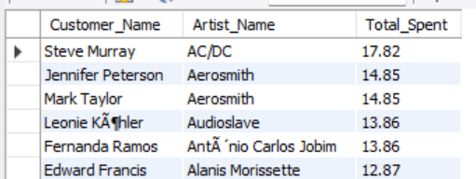
9. Find how much amount is spent by each customer on artists? Write a query to return customer name, artist name and total spent
Query :
Output :
Key Insight :-
The analysis shows that some customers have strong preferences for specific artists. Steve Murray spent the highest amount (17.82) on AC/DC, while several other customers also spent significantly on artists such as Aerosmith, Audioslave, and Alanis Morissette. This helps identify artist popularity and customer listening preferences

Slide 17
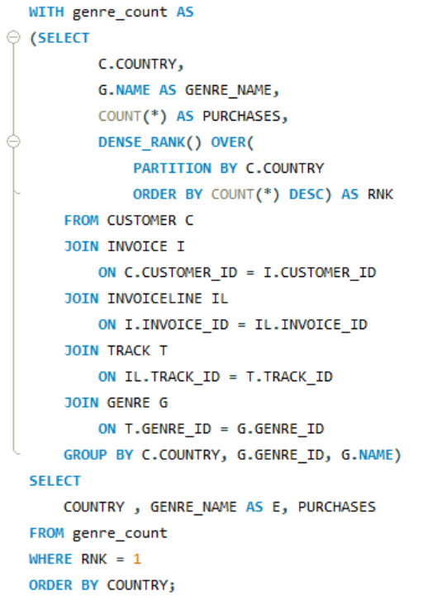
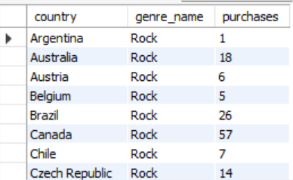
10. We want to find out the most popular music Genre for each country. We determine the most popular genre as the genre with the highest amount of purchases. Write a query that returns each country along with the top Genre. For countries where the maximum number of purchases is shared, return all Genres
Query :
Output :
Key Insight :-
The analysis shows that Rock is the most purchased genre in the majority of countries. Understanding genre preferences by country helps the company design region-specific marketing campaigns and improve customer engagement.

Slide 18
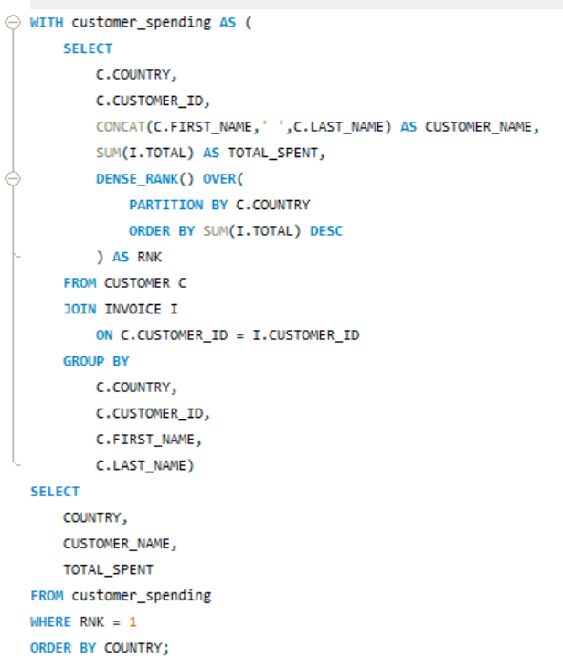
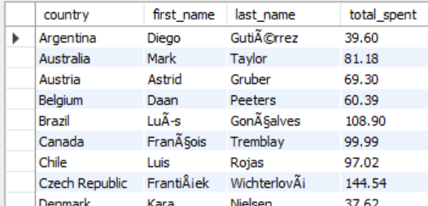
11. Write a query that determines the customer that has spent the most on music for each country. Write a query that returns the country along with the top customer and how much they spent. For countries where the top amount spent is shared, provide all customers who spent this amount
Query :
Output :
Key Insight :-
The analysis identified the highest-spending customer in each country. Among the results, František Wichterlová from the Czech Republic spent the most overall (144.54), while customers from countries such as Brazil, Canada, and Australia also contributed significantly to sales. This helps identify valuable customers across different regions.

Slide 19
Conclusion:-
The analysis shows that sales are concentrated in a few key countries and cities, with the USA leading in invoice count and Prague generating the highest revenue.
Rock is the most popular music genre across most countries, indicating a strong customer preference for this category.
A small group of customers contributes a significant portion of the overall revenue, highlighting the importance of loyal customers.
Customer purchasing patterns are influenced by their preferred artists and music genres.
SQL analysis helps transform raw transactional data into meaningful insights that can support better business decisions and future growth.

Slide 20
Our Experience / Challenges Working
Understanding the database structure and relationships between tables was initially challenging.
Working with multiple JOIN operations required careful analysis to retrieve accurate results.
Applying aggregate functions, subqueries, and grouping techniques helped improve query-writing skills.
Some queries involved advanced concepts such as CTEs and Window Functions, which required additional practice and debugging.
Overall, this project enhanced practical SQL knowledge and provided hands-on experience in solving real-world data analysis problems.

Slide 21

THANK YOU

