Slide 1
Cluster 7 Metal Pusher Analysis
Aug-13

Slide 2
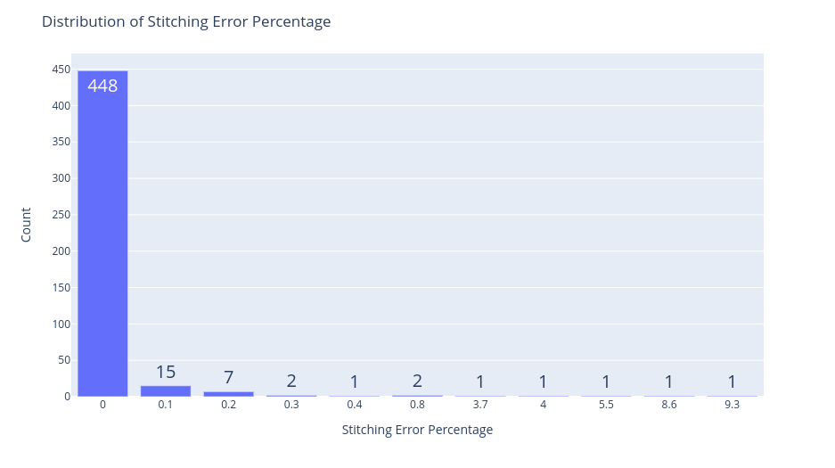
AIM : To find any effect of pusher material change from delrin to metal.
A pusher is used to lock our slide in the slot. (Optional) Data used : 480 Slides One complete cycle's Data from all scanners. Stitching Error Distribution : Looking at the data from 480 slides. 473 slides had Stitching Error Percentage to be less than 0.5%.
Slides with more than 0.5% are from Unstained slides.

Slide 3
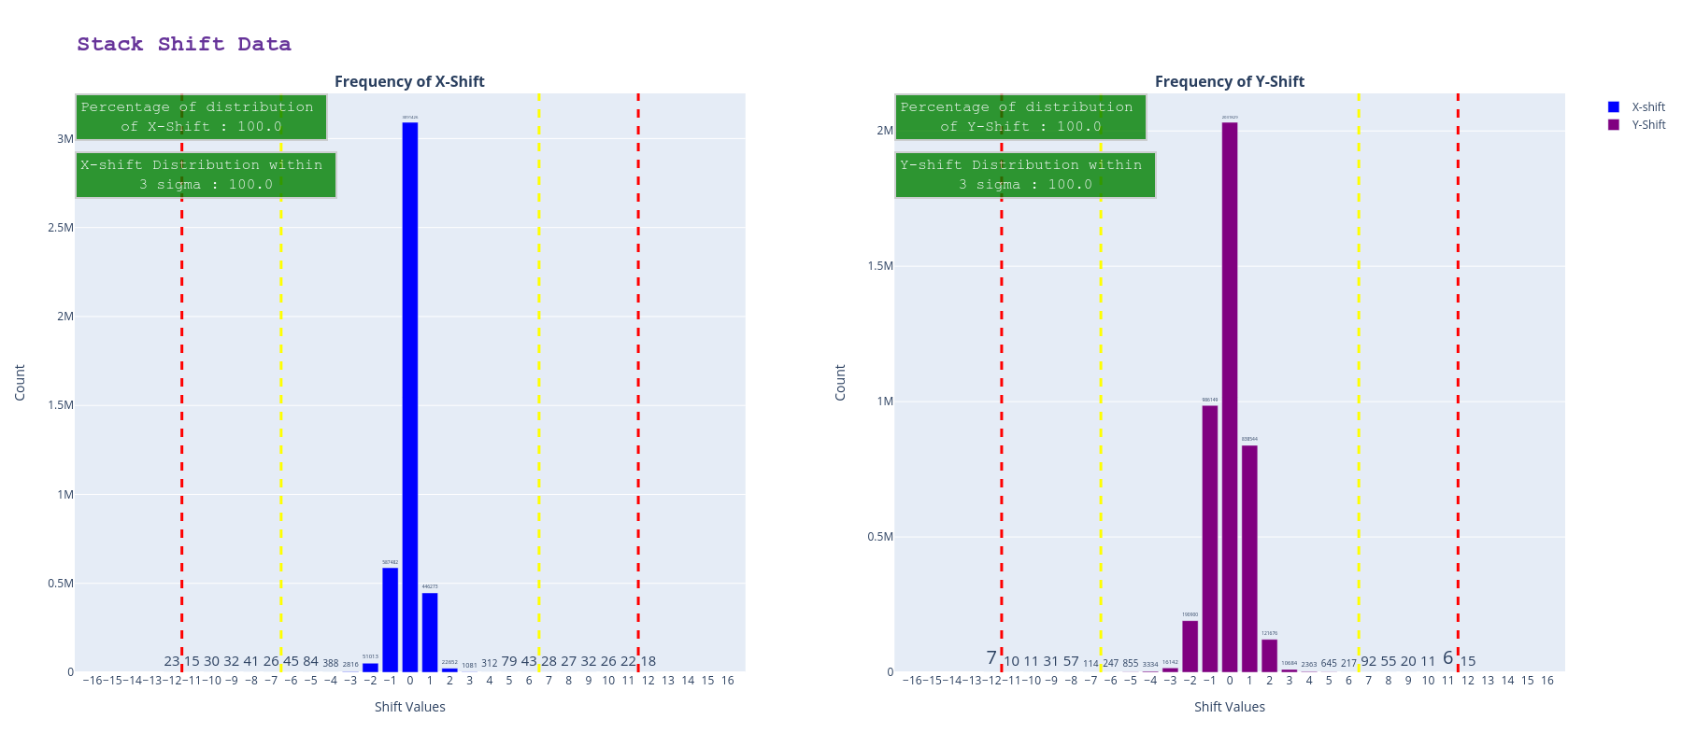
Looking at the stack shift data, A consolidated view of all 480 slides in one single view shows that there is not much deviation with respect to stack shift.
100% of the shift falls within 3 sigma limit which is less than ±7 pixels.

