Slide 1
Update on Displacement Issue
Aug-10

Slide 2
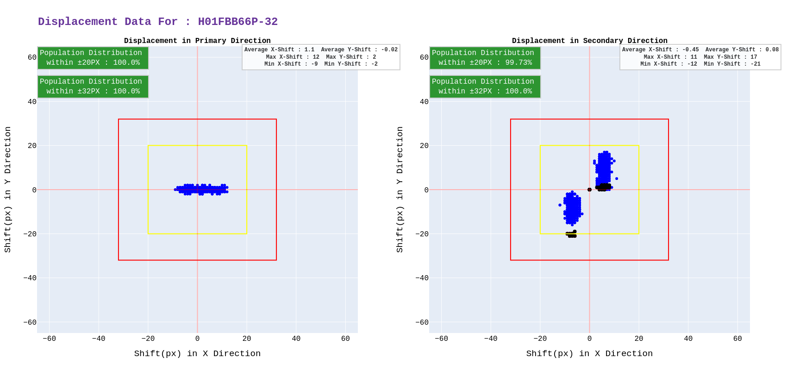
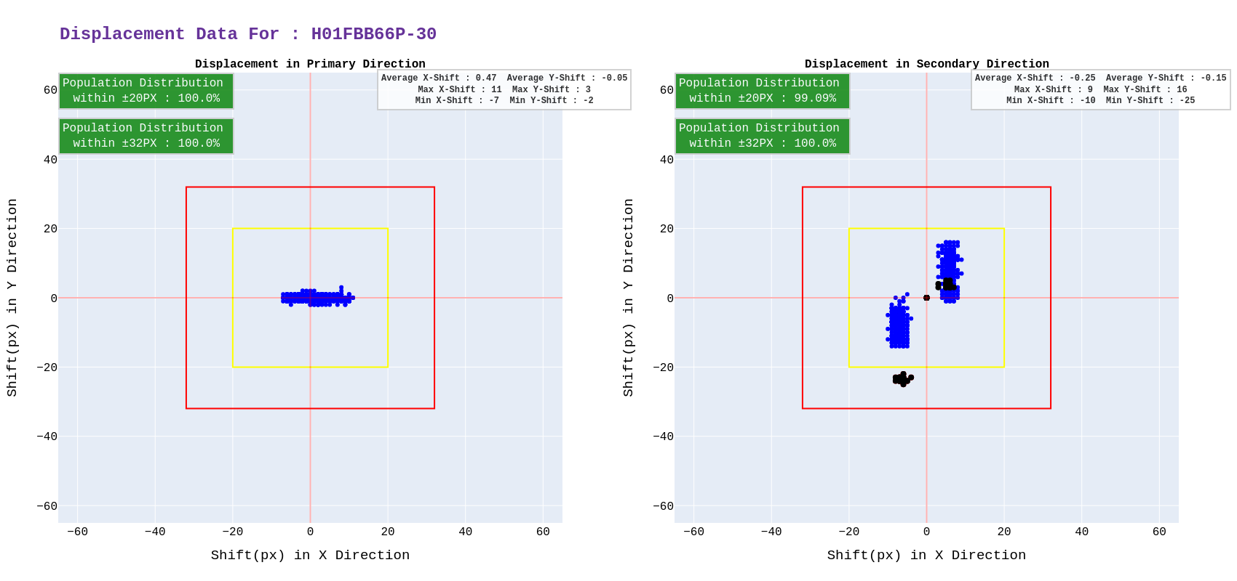
Issue observed with Displacement, While performing validation AOI's from the best row were showing more deviation from
rest of the AOI's.
Example of the issue black points are the AOI's
from the best row.
Normal flow of acquisition is, If we find some offset/deviation after re-acquring
best row. We add that offset and start acquring top side of the best row( BR - 1 ). After looking at the data, Whenever we are adding this offset, We are see a pattern where AOI's from the best row are forming seperate clusters. So, for an experiment. We disabled this offset/deviation correction and acquire same slides again.

Slide 3
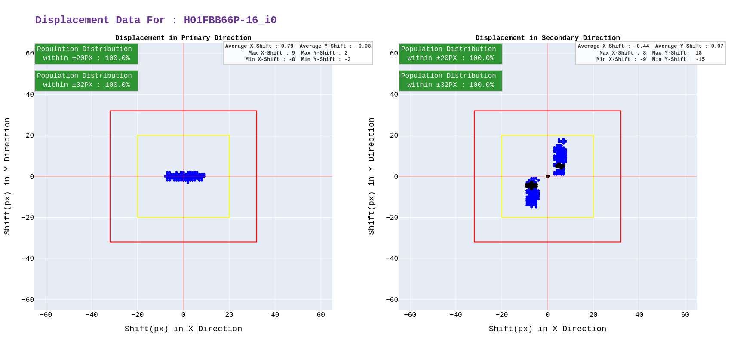

Data after disabling offset/deviation correction after best row re-acquisition.
After disabling, We observe an ideal behaviour where AOI's from best row are not forming a seperate cluster. We are still investigating why this is behaviour occuring.
For now, We will be moving scanners to the cluster and keep monitoring them. Even though, We did not observe any stitching error in both the scenarios.
Concerns right now are a large deviation would definately result in stitching error.

