Slide 1
Shift Analysis Utility
Feb-15

Slide 2
Shift Analysis Utility:
This code provides way to validate for shifts in a scanner by only using DB file. We will be looking at 2 thing here,
1) Slide level detalis
2) AOI level details
Input : Slide folder as an argument.
Output : Folder named stack_analysis inside Slide Folder.
We are using DB file as, while acquisition we are computing shifts across stack of images for stack fusion.
Link for the code

Slide 3
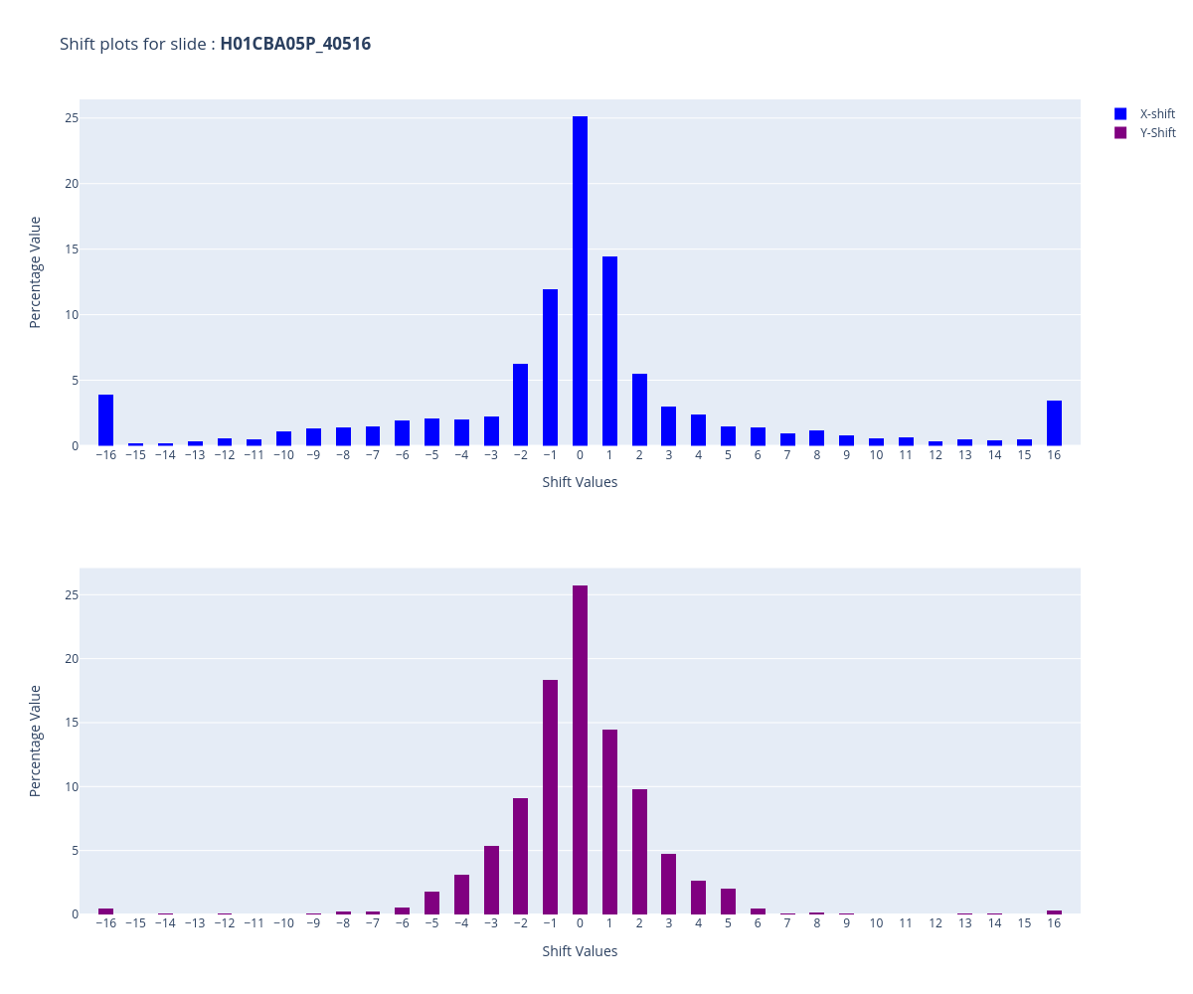
Output Files : i) Shift Distribution overall Slide
Interpretation :
This plot shows the distribution
of each shift value, against % of
time they have been repeated.
Ideal Case: All shifts should within 12px of
range.

Slide 4
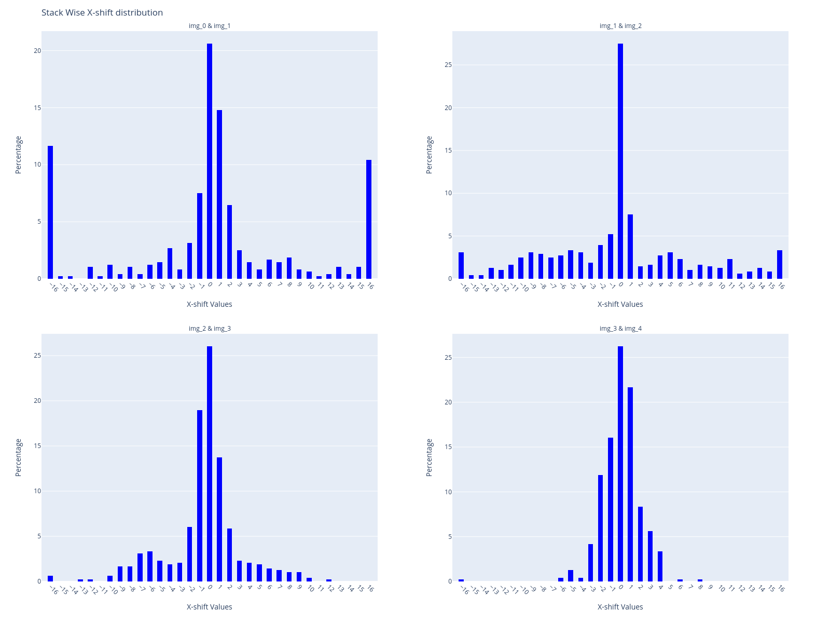
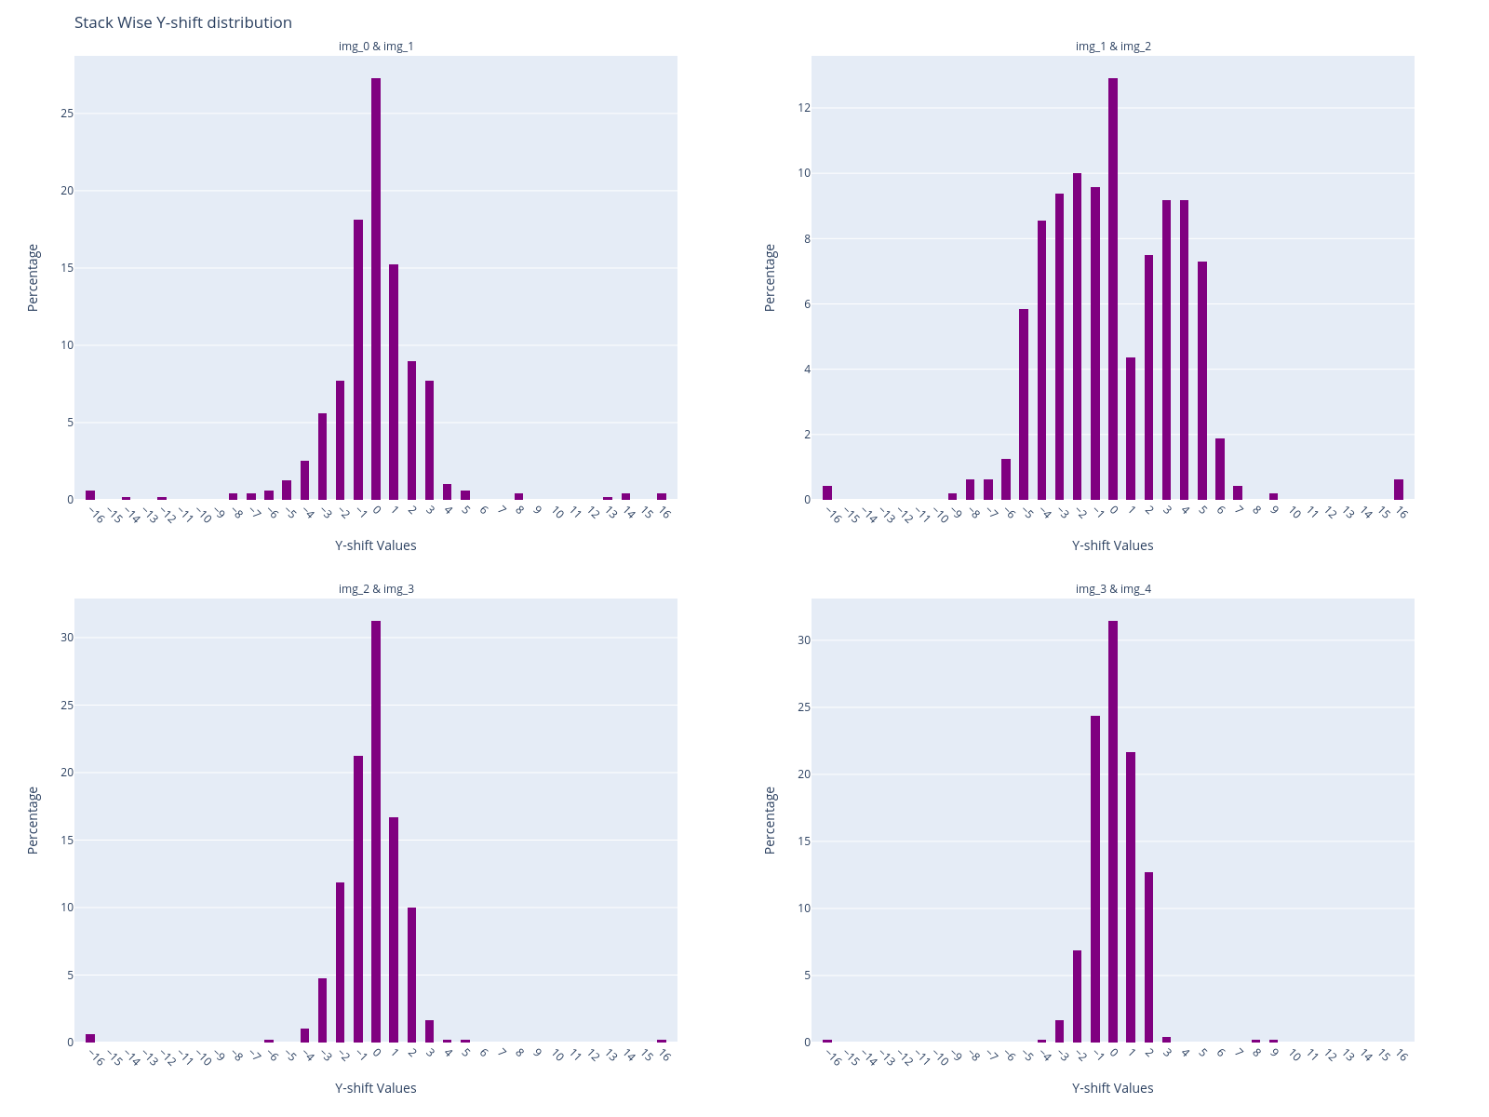
Output Files : ii) X-Shift Distribution across Stack
Output Files : iii) Y-Shift Distribution across Stack
Interpretation :
This plot shows the distribution
of each shift value across/
between 2 images of a stack
Ideal Case: Spread of the distribution at higher stack(img3&img4) should be less compared to other images.

Slide 5
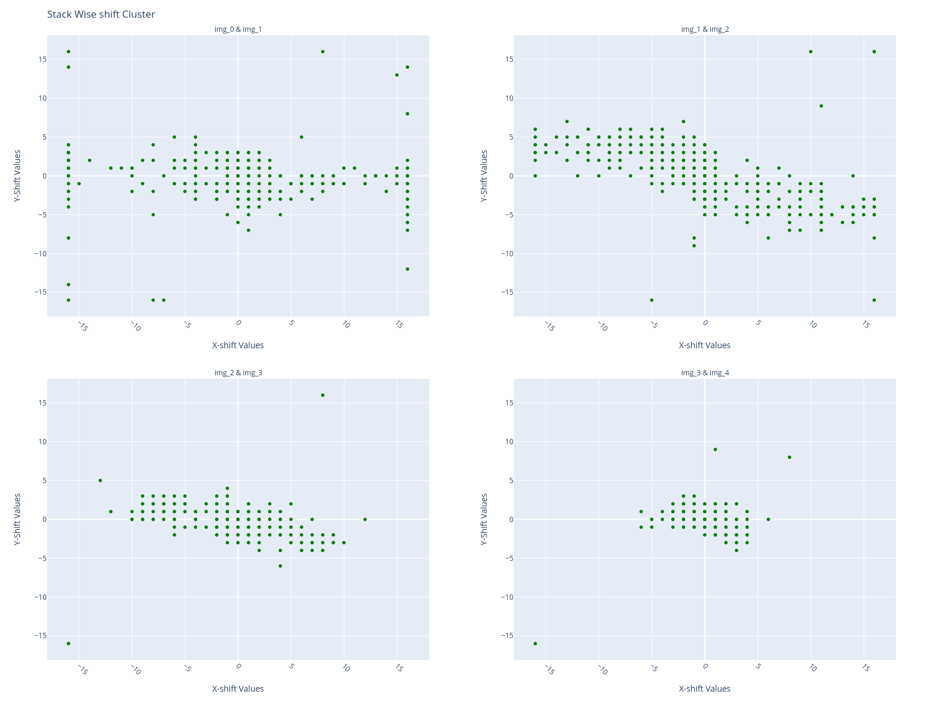
Output Files : iv) Shift Distribution overall Slide
Interpretation :
This plot shows distribution of
both X and Y shifts.
Ideal Case: Stack shift should concentrated
at higher stack(img3&img4).

Slide 6
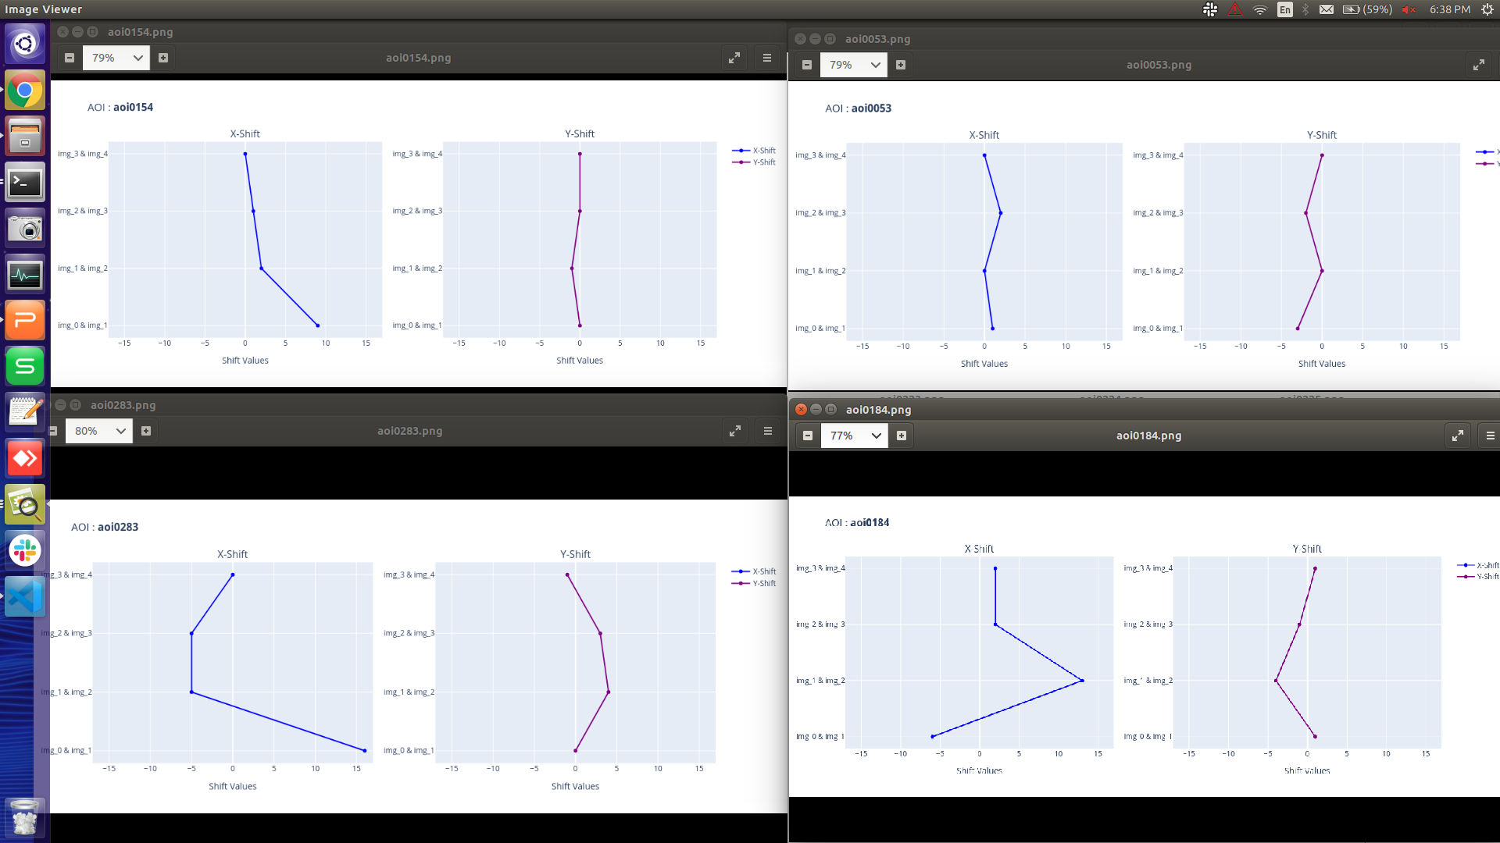
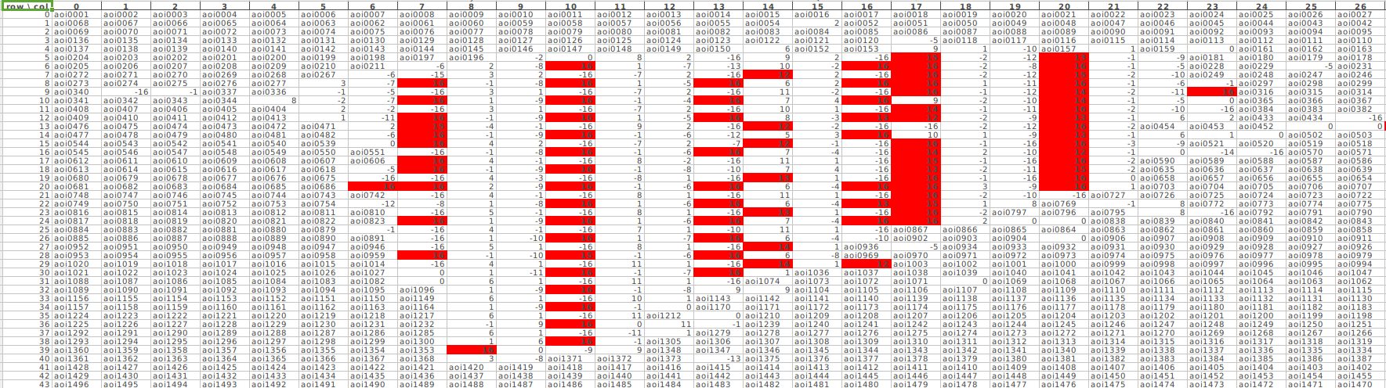
Output Files : v) Shift across stack for Independant AOI
Output Files : v) Excel File
Interpretation :
AOI names will be replaced by their respective maximum shift values and the is highlighted if shift is greater 12.
Ideal case:
All shift values should within 12px of range.
Interpretation :
Each AOI will have a shifts side by side across Stack.
Ideal case:
All shift values should within 12px of range.

