Slide 1
Slide Thickness Experiment

Slide 2
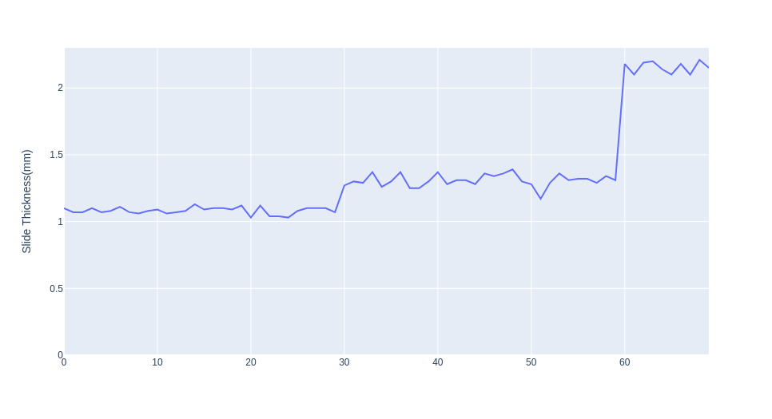
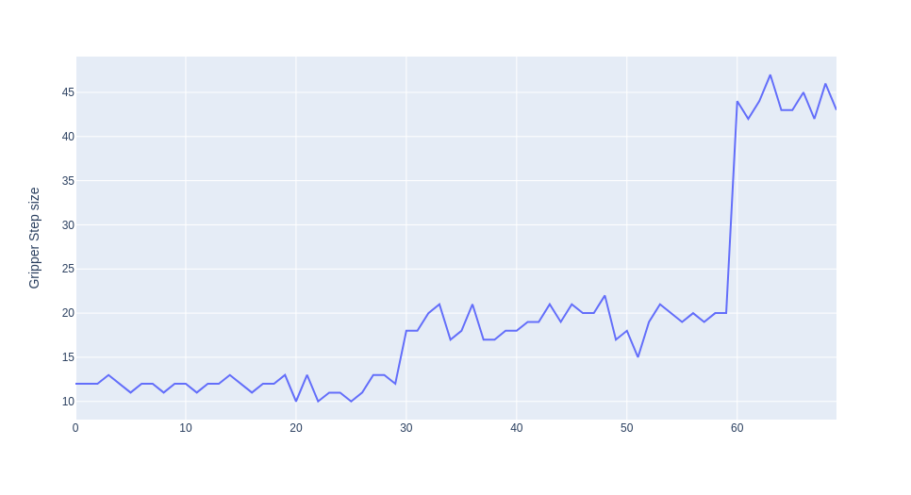
Aim: To achieve Optimal mm Conversion Factor
For this Experiment, 70 Blank slides were used with manual recorded thickness ranging from 1 mm to 2.3mm.
Manually Recorded Slide Thickness Observed Step size for Thickness

Slide 3
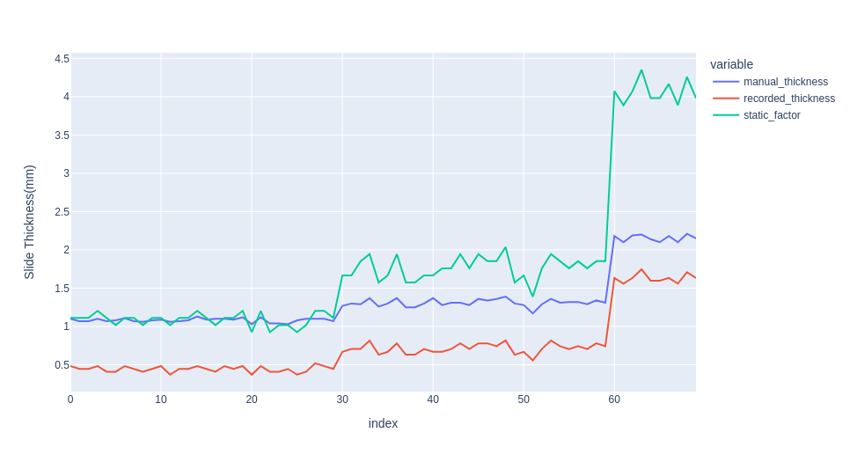
It was observed that with old conversion factor, Values for Recorded Thickness was half of the Actual Thickness Values.
After, finding a static conversion factor, it observed that, whenever we have higher step size having a static conversion factor wont help.
Factor: 10.8
Manual
Factor: 26.9
Old conversion Factor Values observed were half of the Actul Thickness Values.
After looking at this behaviour, it was certain that static conversin factor wont help at all.

Slide 4

Approach, after looking at the data, It obvious that a linear line fit wouldn't work, but a curve fitting would
work.
Simple regression with a single predictor , where Y is the target, x is the predictor,
θ0 is the bias, and θ1 is the weight in the regression equation.
Polynomial Regression , θ0 is the bias,
θ1, θ2, …, θn are the weights in the equation of the polynomial regression and n is the degree
of the polynomial.
Steps | MM
0 | 0
1.08 | 11.758
1.3 | 18.952

