Slide 1

DEPARTMENT OF ARTIFICIAL INTELLIGENCE AND MACHINE LEARNING
AGI1242 – MACHINE LEARNING TECHNIQUES
BATCH - 13
Presented by :
saravanan.S
sarveshwaran.R
shiny teressa.S
shivashankar.S
Guided by :
Mr. A. Joshua Issac M.E.,(Ph.D)
ASSISTANT PROFESSOR / AI
1

Slide 2
Predicting loan approval based on
customer financial information.

Slide 3
OVERVIEW:
Research Objective
Problem Statement
Abstract
Literature Survey
Proposed System
Methodologies
Implementation
Result
Conculsion

Slide 4
RESEARCH OBJECTIVE
The main objective of this project is to develop a Deep Learning-based Loan Approval Prediction System that can predict whether a customer's loan application should be approved or rejected based on their financial and personal information.
Specific Objectives
To collect and preprocess historical loan application and customer financial data.

Slide 5
PROBLEM STATEMENT
Loan approval is an important decision made by banks and financial institutions. Traditionally, loan applications are evaluated using customer financial information such as income, credit history, loan amount, employment status, and other personal details. Manual evaluation can be time-consuming and may result in inconsistent decisions.
Therefore, there is a need for an automated and reliable loan approval prediction system. This project proposes a Deep Learning-based model that learns patterns from historical loan application data and predicts whether a new loan application is likely to be approved or rejected.

Slide 6
ABSTRACT
The Loan Approval Prediction Using Deep Learning project aims to develop an automated system for predicting whether a customer's loan application will be approved or rejected based on financial and personal information. The system uses historical loan application data containing features such as applicant income, loan amount, credit history, employment status, loan term, education, and other relevant factors.
The collected data is preprocessed by handling missing values, encoding categorical features, and scaling numerical feature.

Slide 7
LITERATURE SURVEY
S.No | Paper Name | Year | Algorithm Used | Key Finding
1 | Deep Learning for Credit Risk Prediction: | 2026 | Reviewed modern DL techniques including MLP, CNN, RNN, LSTM, Transformers and GNNs for credit-risk prediction. | It highlights that deep learning can capture complex nonlinear relationships in borrower data, while interpretability, fairness and robustness remain important challenges.
2 | Machine Learning-Based Loan Approval Automation | 2026 | Developed an automated loan-eligibility system and compared models such as Random Forest, XGBoost, stacking and voting ensembles. | SMOTE was used to address class imbalance, with accuracy, precision, recall, F1-score and AUC used for evaluation.
3 | Enhanced Credit Risk Prediction Using Deep Learning | 2025 | Investigated CNN, LSTM, GRU and GNN models. | SHAP was also used to improve model interpretability.
4 | Loan Approval in Financial Sector | 2025 | Compared ensemble methods with Logistic Regression, Neural Networks, Decision Trees, Naive Bayes and SVM. | The study reported strong performance from ensemble approaches and emphasized multiple evaluation measures such as ROC, AUC, accuracy and Brier score.

Slide 8
PROPOSED SYSTEMS
1. Customer Financial Data
2.Data Collection& Data Preprocessing
3. Missing value Handling&Categorical Encoding
4. Feature scaling&DNN Model
5. Model Evaluation
6.Approved/Rejected
Final Output: Accurate loan-status classification to support faster identification of financial data.

Slide 9
METHODOLOGIES
The proposed Loan Approval Prediction Using Deep Learning system follows a systematic methodology to predict whether a loan application will be approved or rejected.
1. Data Collection
Historical loan application data is collected containing customer financial and personal information such as:
Applicant income
Co-applicant income
Loan amount
Loan term
Employment status
Education
Property area
Loan approval status

Slide 10
DATA COLLECTION & PREPROCESSING
2. Data Preprocessing
The collected dataset is cleaned before training:
Missing values are handled.
Duplicate records are removed.
Categorical variables are converted into numerical values.
Numerical features are scaled or normalized.
3. Feature Selection
Important features that influence loan approval are selected. Irrelevant or redundant features are removed to improve model efficiency.

Slide 11
FEATURE SELECTION & DATA SPLITTING
4. Dataset Splitting
The dataset is divided into:
Training data – used to train the DNN.
Testing data – used to evaluate the trained model.
For example, an 80:20 ratio can be used for training and testing.
5. Deep Learning Model Development
A Deep Neural Network (DNN) is developed using TensorFlow/Keras.
Model Optimization
The Adam optimizer is used to update the model weights and minimize the prediction error. Binary Cross-Entropy is used as the loss function because loan approval is a binary classification problem.

Slide 12
PREDICTION
6. Model Training
The DNN is trained using the training dataset for multiple epochs. During training, the model learns the relationship between customer financial information and loan approval outcomes.
7. Prediction
After training, new customer information is provided to the model. The model generates a probability and classifies the application as:
Approved or Rejected.
8. Performance Evaluation
The model is evaluated using:
Accuracy
Precision
Confusion Matrix

Slide 13
IMPLEMENTATION
The Loan Approval Prediction Using Deep Learning system is implemented using Python, Pandas, NumPy, Scikit-learn, and TensorFlow/Keras. The implementation consists of data preprocessing, DNN model development, training, and prediction.
1.Input Data – Take customer income, loan amount, and credit score.
2.Preprocessing – Convert the values into numerical/normalized form.
3.Hidden Layer – Calculate the weighted input and bias.
4.Activation – Apply the Sigmoid function.
5.Output Layer – Calculate the loan approval probability.
6.Decision – If probability ≥ 0.5, predict Loan Approved; otherwise Loan Rejected.

Slide 14
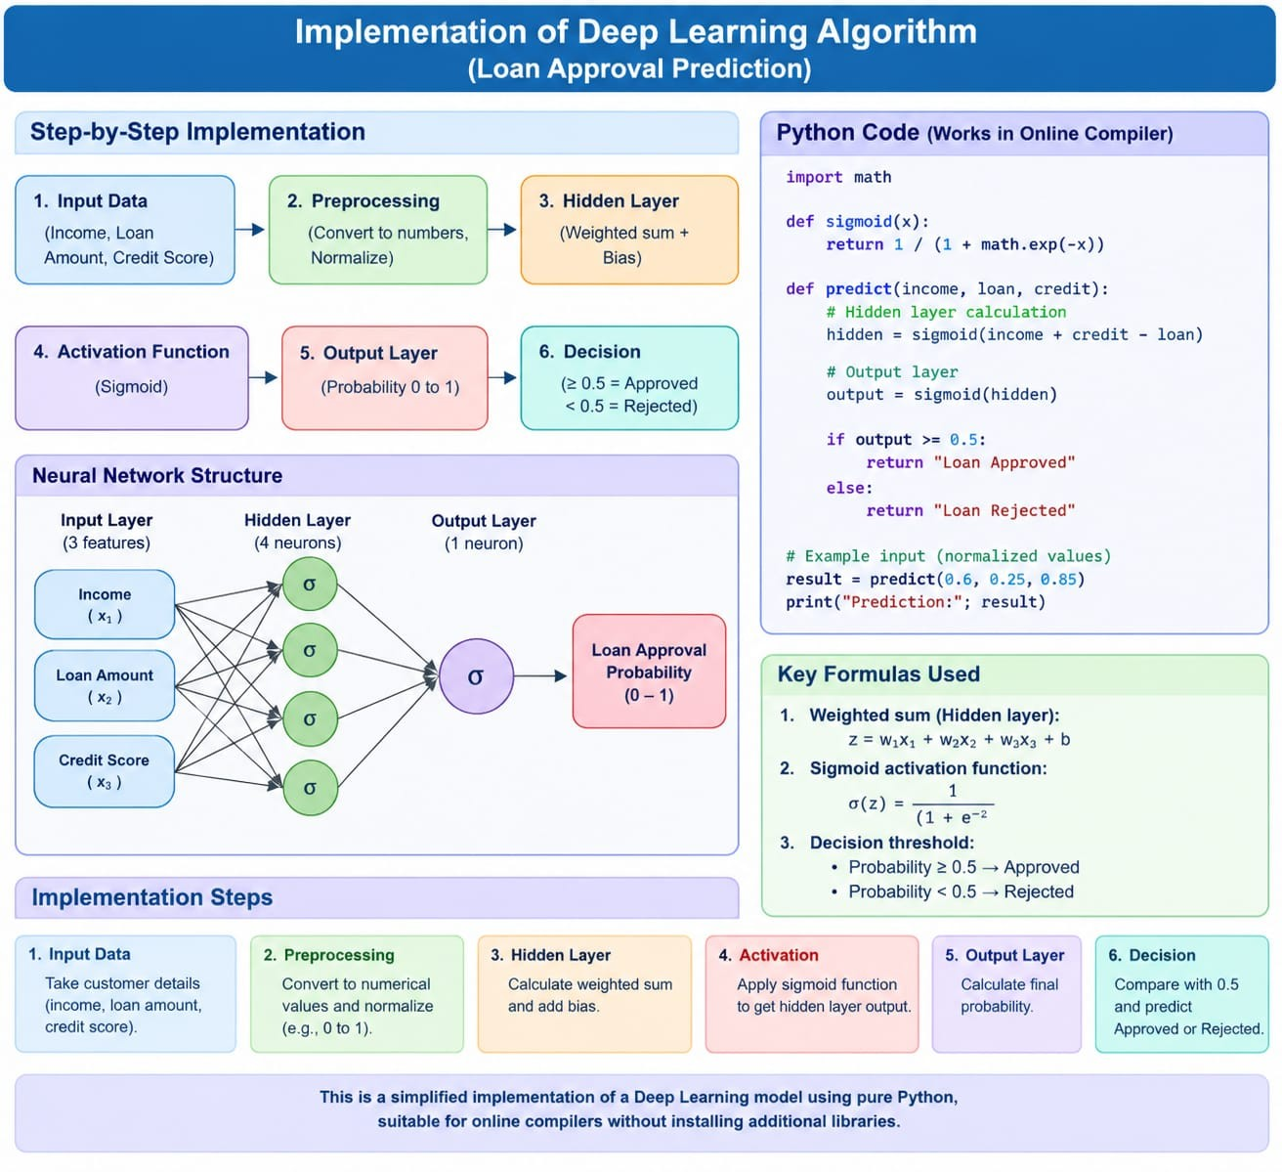

Slide 15
RESULT AND OUTPUT
The proposed Loan Approval Prediction Using Deep Learning system was successfully implemented using a Deep Neural Network (DNN). The model was trained using customer financial information such as income, loan amount, loan term, credit history, and employment status.
After training, the model was tested with unseen loan applications and successfully predicted whether the applications were Approved or Rejected. The performance was evaluated using Accuracy, Precision, Recall, F1-score, and Confusion Matrix.
The use of the Adam optimizer helped the DNN effectively minimize the training loss and improve the learning process. The Sigmoid activation function provided the probability of loan approval.

Slide 16
CONCLUSION AND FUTURE SCOPE
The Loan Approval Prediction Using Deep Learning project successfully develops an automated system for predicting loan approval based on customer financial and personal information. A Deep Neural Network (DNN) is used to learn patterns from historical loan data and classify applications as Approved or Rejected.
Data preprocessing, feature scaling, ReLU and Sigmoid activation functions, and the Adam optimization algorithm are incorporated to improve the learning process. The model is evaluated using accuracy, precision, recall, F1-score, and confusion matrix.
The proposed system can help financial institutions reduce manual processing time, improve consistency, and support data-driven loan decisions. In the future, the system can be improved using larger datasets, advanced deep learning models, explainable AI techniques, and real-time financial data.

Slide 17
Thank You

