Slide 1

Swiggy outlets data analysis

Slide 2
OBJECTIVE
To make a dashboard for the business team to derive insights about the interests of customers and hence make wise business decisions.
To create a customer-friendly dashboard to help them make wise food choices.

Slide 3
Problem Statement
Food industry is one of the continuously booming ones in the last couple of years. Swiggy is one of the leading app-based food delivery company. Its database on food outlets is very useful in driving business decisions.
Prepare dashboards from which a customer can easily understand the availability of restaurants around various regions in Bangalore and explores into the influence of region, cost of food and cuisine on the customers’ rating.

Slide 4
Benefits
Better understanding about the ratings given by customers
Better understanding about the relationship between cost of food and rating.
Hassle free exploration of restaurants according to favourite cuisines.
Simpler identification of restaurants with a combination of good rating and affordable cost.

Slide 5
Data Sharing Agreement
File name: Swiggy Bangalore Outlet Detsils.xlsx
Column names: Shop_Name, Cuisine, Location,Sub-district, Rating, Cost_for_two.
Column data type: Text, Text, Text,Text, Whole number, Whole number.

Slide 6
Data description
Swiggy delivery outlet data contains ratings of restaurants which fall under the category such as name of the restaurant, cuisine ,location, cost for two, customer rating.Shop_name: Name of the restaurants
Cuisine: Different varieties of cuisines available in the restaurants.
Location: Address where the shop is located.
Sub-district: The shop is located in this region of Bangalore.
Cost_for_two: The average cost of food for two people at the restaurant.
Rating: The average rating given by the customers based on their experience.

Slide 7
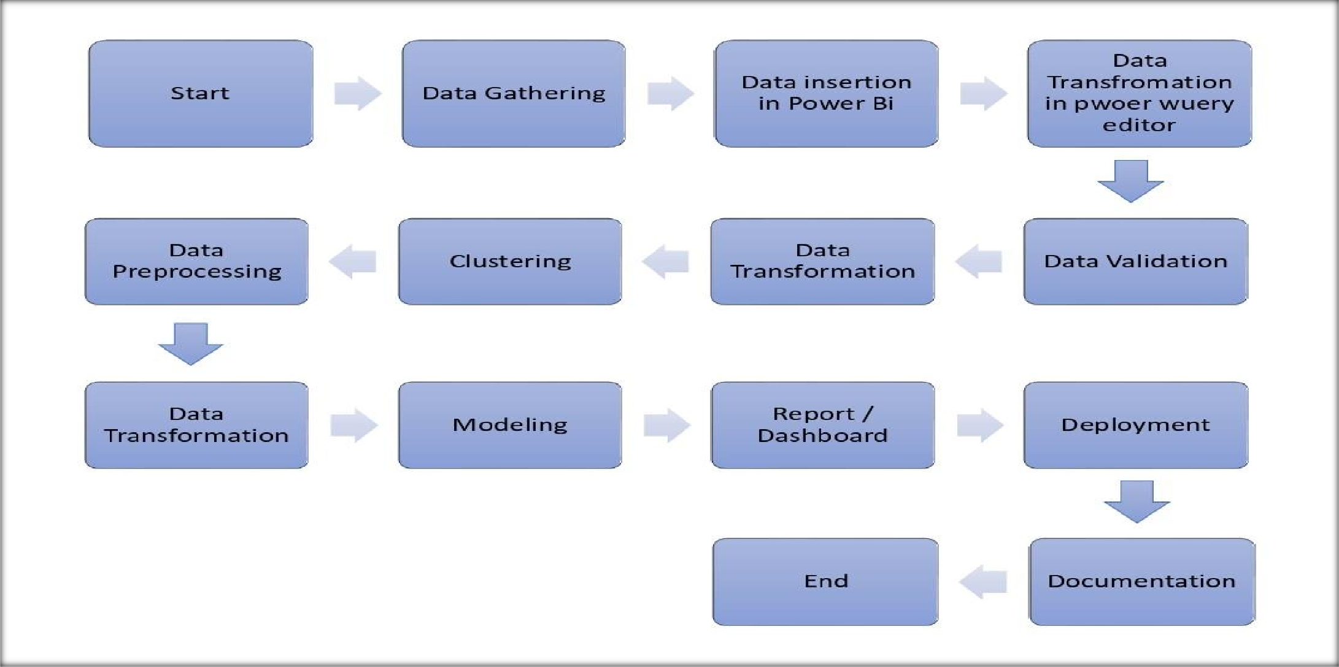
ARCHITECTURE

Slide 8
Data Insertion in Microsoft Power BI
The database file was in .csv format. So, after opening the Microsoft Power Bi, I have imported the file into Microsoft Power Bi.
Data was unstructured so I have transferred the data in Power Query Editor for the further process.

Slide 9
DATA VALIDATION AND TRANSFORMATION
First I have done some basic transformation of the data such as- removing error, removing null values, getting first row as header if required in the Power Query Editor.
The data was messy so I have extracted the important data from the files and transformed it according to the requirement.
In the transformation process I have done different transformation such as- pivoting and unpivoting columns, removing error, removing null values, creation of new tables.
Validation of date column:- I have validated the columns data type the most unstructured columns was date type data.

Slide 10
Cost Vs Rating→ The correlation of cost of food and rating was done to understand the relation.
Average rating Vs Cuisine→ Cuisine is plotted against the average rating. It shows the most preferred cuisine of people
Cost Vs Rating→ The correlation of cost of food and rating was done to understand the relation.
Count of hotels Vs Average Rating→ It gives an idea about the number of shops with a particular rating.
Region wise display of restaurants→ Average rating and average cost of food for the four different regions or sub-districts. When the cursor is brought near the values, a table pops up showing the details of shops in the particular region.
Cost of food Vs count across various ratings→ It shows the distribution of number of shops across various average cost and rating. It helps the customer in choosing the best restaurant.

Slide 11
DEPLOYMENT
After making the Report and dashboards I have published it on the Microsoft Power Bi Service from Microsoft Power Bi Desktop.

Slide 12
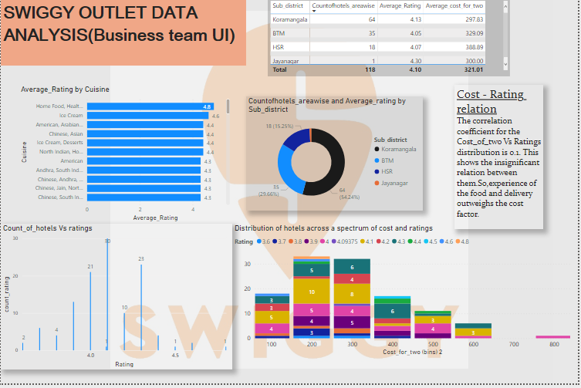
INSIGHTS
I have designed 2 complete dashboards. One is meant for the business team and the other for the customer.
1

Slide 13
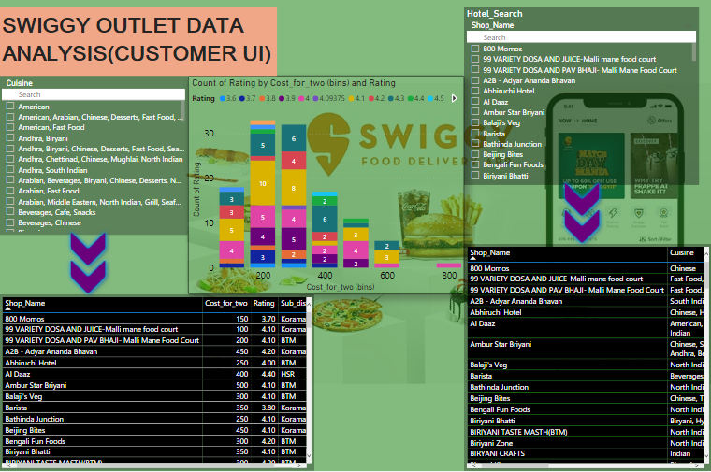
2

Slide 14
Business team UI dashboard
This dashboard is meant for the business team to generate insights and hence optimal business decisions.

Slide 15
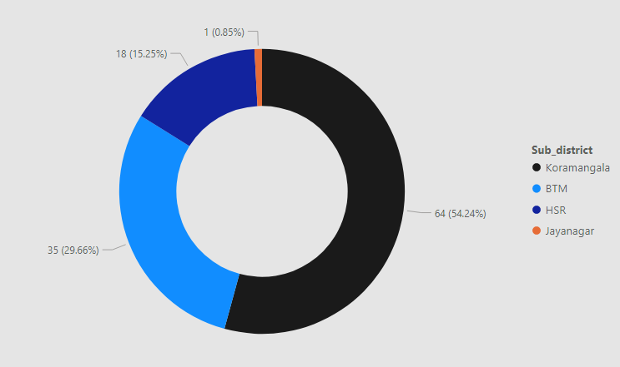
The chart shows the distribution of number of hotels across different regions.
1.Koramangala region has the highest number of restaurants.
2.Jayanagar region has the least number with just on restaurant.
The chart also has a tooltip containing the average rating. When the cursor is skimmed through, it displays the average rating for each region(or)sub-district.

Slide 16
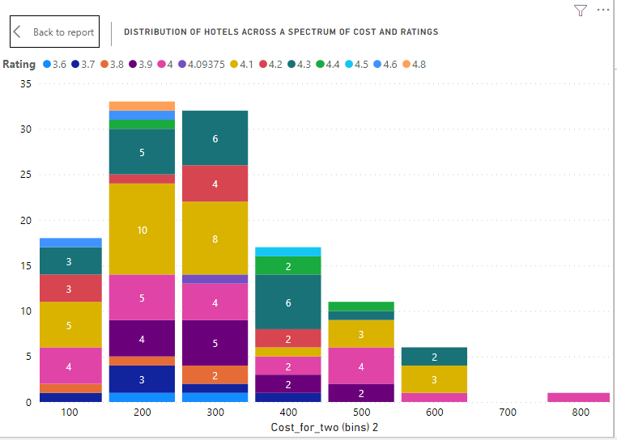
X axis:Cost for two
Y axis:Count of restaurants
Legend: Rating
This shows the number of restaurants under a set of values of cost and rating.
The colours represent various values of ratings.
A tooltip containing details of the respective restaurants would be displayed when skimmed through the particular coloured block.
For example: The arrow pointed orange coloured block has the shop with the most affordable food(Rs.100) and also the highest rating(4.8).

Slide 17
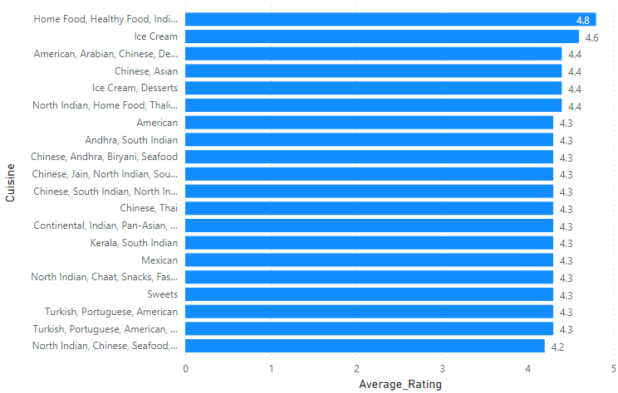
This chart shows the average likeability of the people in Bangalore.
Home food ,Healthy food, Indian is the most preferred and the satisfying cuisine for the customers.

Slide 18
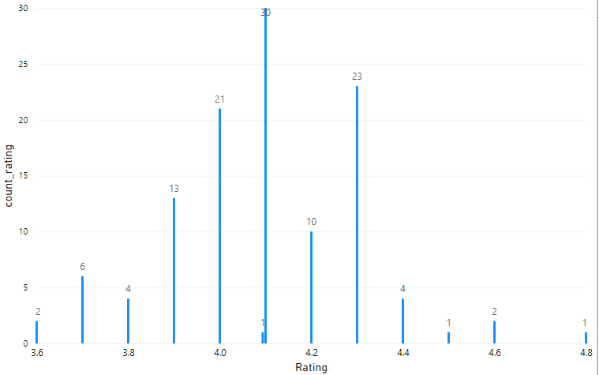
This graph shows the number of restaurants under a particular value of rating.
The single largest group, consisting of 30 restaurants has a rating of 4.1 .
The smallest group, with only 1 restaurant each comes under the rating of 4.8 ,4.5 and 4.1.

Slide 19
Customer UI
This is a customer friendly dashboard meant exclusively for customers, for an awesome food ordering experience.

Slide 20
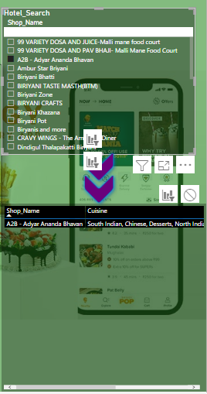
Hotel name search slicer
This menu allows you to search the hotel name and hence you get the details of the restaurant.

Slide 21
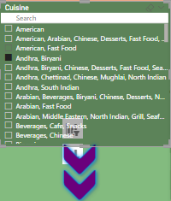

Cuisine search menu
When the cuisine is selected, the table displays the details of all the restaurants offering the cuisine.

Slide 22
X axis: Cost for two
Y axis: Count of restaurants
Legend: Rating
This shows the number of restaurants under a set of values of cost and rating.
The colours represent various values of ratings.
A tooltip containing details of the respective restaurants would be displayed when skimmed through the particular coloured block.
For example: If a customer prefers the cheapest restaurant (Rs.100) and also which has the highest rating(4.8), he/she has to choose the arrow pointed orange coloured block.

Slide 23
Q&A
Q1) What’s the source of data?
The data for training is provided by the client in multiple batches and each batch contain multiple files
Q 2) What was the type of data?
The data was the combination of numerical and Categorical values.
Q 3) What’s the complete flow you followed in this Project?
Refer slide 5th for better Understanding
Q 4) After the File validation what you do with incompatible file or files which didn’t pass the validation?
Files like these are moved to the Achieve Folder and a list of these files has been
shared with the client and we removed the bad data folder.

Slide 24
Q 5) How logs are managed?
We are using different logs as per the steps that we follow in validation and
modelling like File validation log , Data Insertion , prediction log, etc.
Q 6) What techniques were you using for data pre-processing?
Removing unwanted attributes
Visualizing relation of independent variables with each other and output variables
Checking and changing Distribution of continuous values
Removing outliers
Cleaning data and imputing if null values are present.
Converting categorical data into numeric values.
Scaling the data

Slide 25
What are the different stages of deployment?
The deployment has been done using Power BI.

Slide 26
THANK YOU

