Slide 1




Semester: IV OS Presentation CA 2
Title of the Project:
Resilience Techniques in Operating Systems
Domain:
Applications of IOT
Mentor Name:
Mrs Kajal Joseph
Group Members:
Member 1 : Member 2: Member 3: Member 4:
Vaibhav Gupta - 35 Shlok Hemnani - 36
Sarvesh Dabhade -22
Jayesh Deshmukh - 28

Slide 2

2
Introduction
Definition of Resilience in OS – The ability to withstand failures while maintaining system functionality.
Why It Matters?
Prevents downtime and system crashes.
Ensures availability and reliability of computing resources.
Key Techniques:
Redundancy: Hardware, Software, Network.
Fault Tolerance: Proactive, Reactive, Resilient Approaches.

Slide 3
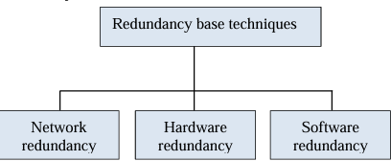
3
Redundancy-Based Techniques
Definition of Redundancy
Redundancy refers to the duplication of critical components to prevent failures and ensure continuous operation.
Types of Redundancy:
1. Hardware Redundancy
Uses duplicate physical components to prevent failures.
Examples: RAID storage, Dual power supplies.
2. Network Redundancy
Ensures uninterrupted data flow using backup paths.
Examples: Multiple ISPs, Load-balanced routers.
3. Software Redundancy
Replicates software instances to maintain uptime.
Example: Cloud microservices with automatic scaling.

Slide 4
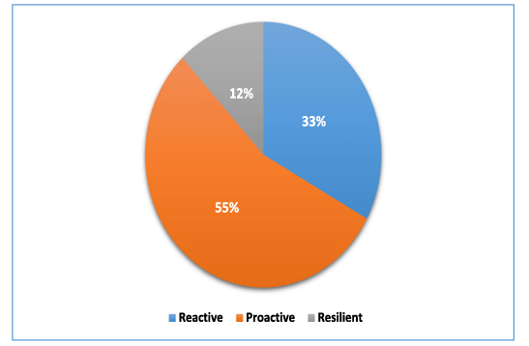
Fault Tolerance Approaches
Definition of Fault Tolerance
Fault Tolerance allows a system to continue functioning correctly even when failures occur.
Types of Fault Tolerance:
Reactive Fault Tolerance (Triggered after a failure occurs)
Techniques: Checkpointing – Saves system state periodically.
Replication – Duplicates processes for backup.
Job Migration – Transfers tasks to healthy nodes.
Example: If a server crashes, data is restored from the last saved state.
Proactive Fault Tolerance (Prevents failures before they happen)
Techniques: Predictive Analysis – AI-driven monitoring for anomaly detection.
Software Rejuvenation – Periodic system restarts to clear errors.

Slide 5
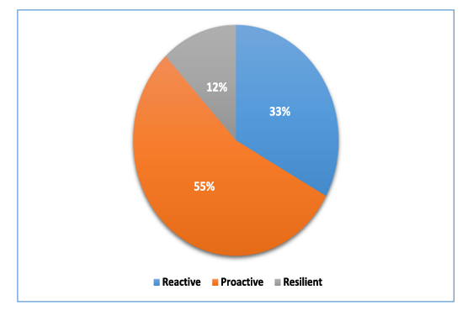
Resilient Fault Tolerance (Combines proactive & reactive approaches dynamically)
Uses AI-based monitoring for real-time failure detection and self-healing.
Adaptive failure handling minimizes system disruption.
Purpose: Ensures systems remain operational despite failures, reducing downtime.

Slide 6
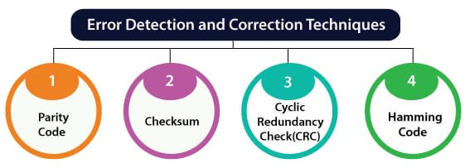
Error Detection & Correction
Error Correction Code (ECC): Detects and fixes bit errors in memory.
Checksums & Parity Bits: Ensures data integrity in network communications.

Slide 7
Recovery Mechanisms
Rollback Recovery
Reverts system to the last stable state.
Used in databases and mission-critical applications.
Failover Systems
Automatically switches to a backup system.
Example: High-availability servers in cloud computing.

Slide 8
Case Study & Real-World Applications
Cloud Computing: AWS auto-scaling & failover.
Mission-Critical Systems: NASA spacecraft redundancy.
Banking Systems: Data replication in financial transactions.

Slide 9
Future Trends in Fault Tolerance
AI-driven Fault Prediction & Self-healing Systems – Automates issue detection and resolution.
Blockchain-based Redundant Storage for Decentralization – Secure, distributed fault-tolerant storage.
Quantum Computing for Higher Fault Tolerance – Error-resistant quantum systems.

Slide 10
Conclusion
Key Takeaways:
Redundancy ensures high availability.
Fault Tolerance minimizes failures.
Combining proactive and reactive techniques improves resilience.
Final Thought: “A robust OS is one that never truly fails.”

Slide 11
References
[1] Shadi Attarha et al., “Virtualization Management Concept for Flexible and Fault-Tolerant Smart Grid Service Provision,” Energies, vol. 13, no. 9, pp. 1-16, 2020. [CrossRef] [Google Scholar] [Publisher Link]
[2] Han Bao, Tate Shorthill, and Hongbin Zhang, “Hazard Analysis for Identifying Common Cause Failures of Digital Safety Systems Using a Redundancy-Guided Systems-Theoretic Approach,” Annals of Nuclear Energy, vol. 148, pp. 1-22, 2020. [CrossRef] [Google Scholar] [Publisher Link]
[3] Tobias Distler, “Byzantine Fault-Tolerant State-Machine Replication from a Systems Perspective,” ACM Computing Surveys, vol. 54, no. 1, pp. 1-38, 2021. [CrossRef] [Google Scholar] [Publisher Link]

