Slide 1


BRACT’S
Vishwakarma Institute Of Information Technology
(An Autonomous Institute affiliated to Savitribai Phule Pune University)
MediScribe – A real time Doctor and patient Consultation Summarizer
Presented by Group 07
Group- 07, Department Of Computer Science Engineering (Artificial Intelligence), VIIT, Pune-48

Slide 2
ROADMAP
METHODOLOGY
Future scope
OBJECTIVE
Explanation of detailed work base
The future use and scopes of the project
Understanding the basic objective
1
3
5
2
4
LITERATURE SURVEY
RESULTS
Existing technology and researches
Obtained results after following proposed methodology
Group-07, Department Of Computer Science Engineering (Artificial Intelligence), VIIT, Pune-48

Slide 3

GROUP INFORMATION
Group No. :- Group07
Group Members
Sr No. | Name | Roll No. | PRN No.
1 | Rudra Swant | 382071 | 22420151
2 | Sarvesh Warule | 382074 | 22420229
3 | Tanmay Tambe | 382072 | 22420169
4 | Ayush Munot | 382053 | 22311649
Guided by : Dr.Anuradha Yenkikar and Prof. Pranjal Pandit
3
Group-07, Department Of Computer Science Engineering (Artificial Intelligence), VIIT, Pune-48

Slide 4
The simplicity of producing fake content and its realism have both increased significantly due to exponential advancements in deep learning. Using neural network components like auto encoders and GANs (Generative Adversarial Networks), the technique known as "deep fake" simulates human images by superimposing target pictures onto source videos. The result is a realistic-looking deepfake video that may increase terrorism, political unrest, and extortion. We developed a deep learning-based model that effectively distinguishes real videos from artificially created ones. The proposed method makes use of a Res-Next Convolution neural network to retrieve frame-level characteristics. An LSTM-based Recurrent Neural Network (RNN) is then trained using these attributes to identify the videos according to whether they have been altered or not .
INTRODUCTION
This project focuses on building an AI-powered medical transcription system that automatically converts doctor–patient conversations into structured, role-aware transcripts. The pipeline integrates speech-to-text transcription (Whisper), speaker diarization (Pyannote), and a fine-tuned Bio_ClinicalBERT model to classify each utterance as either doctor or patient. Finally, it leverages Google Gemini to generate concise, patient-friendly summaries of the consultation, which can also be securely emailed. The solution improves clinical documentation efficiency, reduces administrative burden, and ensures that both doctors and patients have clear, accessible records of medical interactions.
OBJECTIVE
Automate Medical Transcription – Convert raw doctor–patient conversations into accurate text using Whisper.
Identify Speakers & Roles – Apply diarization and fine-tuned BioBERT to distinguish between doctor and patient speech.
Generate Structured Summaries – Use Gemini to create concise, role-aware medical summaries for easy reference.
Enable Multi-Input Audio Handling – Support both uploaded audio files and live in-app recording with auto conversion to .wav.
Facilitate Information Sharing – Provide an option to securely send consultation summaries to patients via email.
Improve Clinical Efficiency – Reduce manual documentation workload, ensuring doctors spend more time with patients.
Group-07, Department Of Computer Science Engineering (Artificial Intelligence), VIIT, Pune-48

Slide 5
LITERATURE SURVEY
Title | Methodology | Gaps | Results
Dr. Summarize: Global Summarization of Medical Dialogue by Exploiting Local Structures | Dr. Summarizer is a tool that creates short summaries of conversations between doctors and patients. It starts with written (text) conversations that are already typed or transcribed. It first cleans the text and separates what the doctor and patient said. Then, it uses NLP (Natural Language Processing) to find important details like symptoms, medicines, and advice. After that, it uses AI models (like BERT or T5) to turn this information into a short, easy-to-read summary that highlights the main points of the conversation. | The "Dr. Summarizer" system has several limitations, including its reliance solely on pre-written textual dialogues without support for real-time or audio-based inputs. It lacks integration with speech-to-text capabilities, does not perform medical term extraction or intent classification, and generates only generic summaries without structured output | The results of the "Dr. Summarizer“ system demonstrated that it could generate concise summaries from predefined textual doctor-patient conversations using transformer-based models. The summaries preserved key information and improved readability for clinical documentation. However, the effectiveness was constrained by the quality and format of input text, and the system showed limitations in handling diverse conversational styles or unstructured dialogue formats typically found in real-world settings
Group-07, Department Of Computer Science Engineering (Artificial Intelligence), VIIT, Pune-48

Slide 6
LITERATURE SURVEY
Title | Methodology | Gaps | Results
A Benchmark for Automatic Medical Consultation System: Frameworks, Tasks and Datasets | The project uses real doctor-patient dialogues to build an AI medical assistant. It extracts medical terms, classifies each part of the conversation, identifies confirmed symptoms, learns how to ask relevant follow-up questions, and generates a final medical report. Deep learning models like BERT and T5 help in understanding and generating accurate outputs. | The project faces several key challenges. It struggles to accurately identify all symptoms, especially those not clearly stated (implicit symptoms), with a low accuracy of about 37%. It also finds it harder to detect symptoms that are negative or uncertain. The system’s ability to carry out proper diagnosis conversations is still limited, with current models not performing well in detecting hidden symptoms. The patient simulator used is basic and only works with structured data, not natural conversations, which limits realism. Lastly, while the system generates medical reports with good text scores, it still lacks medical accuracy and reasoning ability. These gaps show that more work is needed to improve understanding, diagnosis, and natural conversation handling. | The project tested AI models on medical consultation tasks using the IMCS-21 dataset. While models performed well in identifying terms and classifying dialogue, they struggled with symptom inference and reasoning-heavy tasks. Report generation and diagnosis saw moderate success, but there's still room for improvement in understanding complex medical information.
Group-07, Department Of Computer Science Engineering (Artificial Intelligence), VIIT, Pune-48

Slide 7
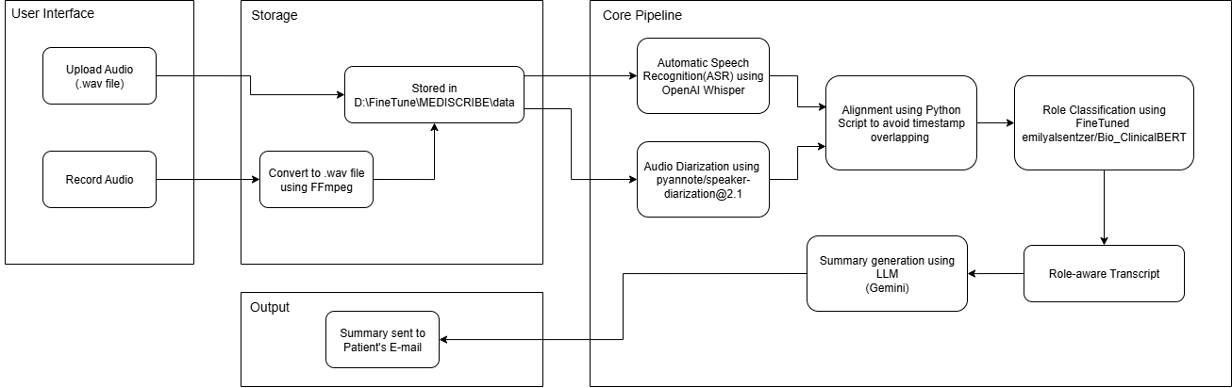
PROJECT ARCHITECTURE
Fig 1. System Architecture
Group-07, Department Of Computer Science Engineering (Artificial Intelligence), VIIT, Pune-48

Slide 8

TECHNOLOGIES USED
Bio- Clinical BERT
BioClinicalBERT is a transformer model fine-tuned on clinical text, used here for role classification.It analyzes each transcribed sentence and predicts whether it was spoken by the doctor or the patient.This ensures the transcript is structured with accurate speaker roles for better understanding
Pyannote
Whisper
Whisper
PyAnnote is used in our system for speaker diarization, which means detecting “who spoke when” in an audio recording.It segments the conversation into time-stamped parts and assigns temporary speaker IDs
Whisper is an advanced speech recognition model used for transcribing audio into text.It takes the raw audio input and generates highly accurate, time-stamped text segments.
Gemini API, Ffmpeg, Torch Audio
Helping Technologies
Group-07, Department Of Computer Science Engineering (Artificial Intelligence), VIIT, Pune-48

Slide 9
METHODOLOGY
Audio Acquisition- Users can either upload audio files or record live
conversations within the application.
Ffmpeg ensures all audio is standardized into WAV format.
Speaker Diarization- Pyannote detects speaker change points and segments the audio into speaker-specific chunks.
Speech Transcription- Whisper model converts segmented audio into text
transcripts with timestamps.
Alignment & Role Classification-Transcripts are aligned with diarization
output.
Fine-tuned BioClinicalBERT classifies each segment as Doctor or Patient.
Summarization- Gemini LLM generates a concise medical summary of the
conversation.
Result Delivery- Users can view the role-classified transcript and summary in the GUI.Option to send summary via email to patients/doctors.
9
Group-07 , Department Of Computer Science Engineering (Artificial Intelligence), VIIT, Pune-48
15-09-2025
9

Slide 10
USP
1) Multimodal Integration
2) Voice-based Interaction
3) Real-time Summary Generation
4) Time-Saving for Healthcare Professionals
5) Personalized Output
10
Group-07, Department Of Computer Science Engineering (Artificial Intelligence), VIIT, Pune-48
15-09-2025
10

Slide 11
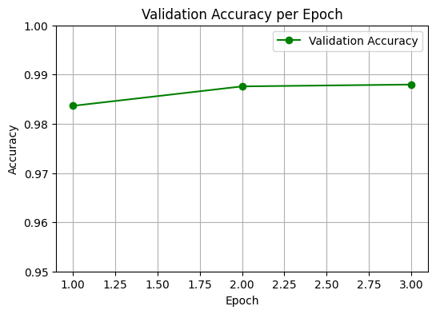
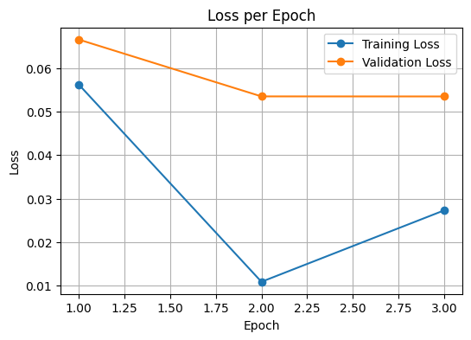
Fig 2. Model Evaluation
Group-07, Department Of Computer Science Engineering (Artificial Intelligence), VIIT, Pune-48

Slide 12
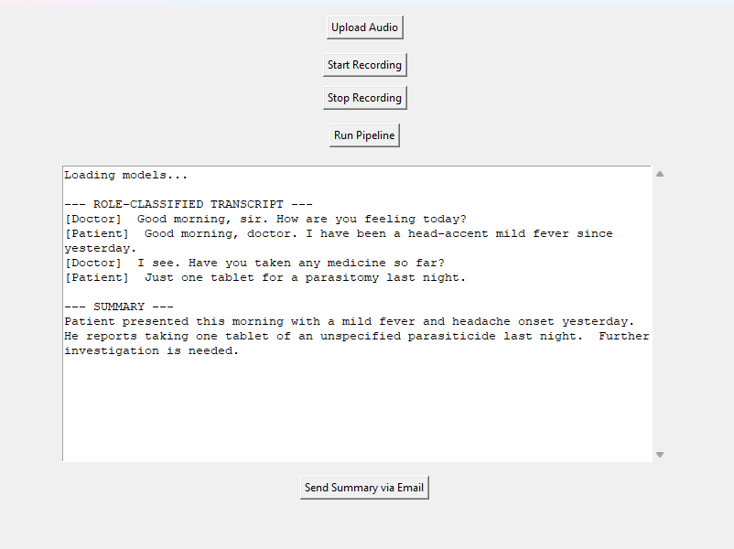
RESULTS
Group-07, Department Of Computer Science Engineering (Artificial Intelligence), VIIT, Pune-48

Slide 13

FUTURE SCOPE
1) Multi-Language Support
2) Dynamic Doctor and Patient Dashboards
3) Patient History & Database Management
4) 24×7 Virtual Support
5) Doctor Community Integration
Group-07, Department Of Computer Science Engineering (Artificial Intelligence), VIIT, Pune-48

Slide 14

Group-07, Department Of Computer Science Engineering (Artificial Intelligence), VIIT, Pune-48

Slide 15
Thank You!!
15
Group-07, Department Of Computer Science Engineering (Artificial Intelligence), VIIT, Pune-48

