Slide 1
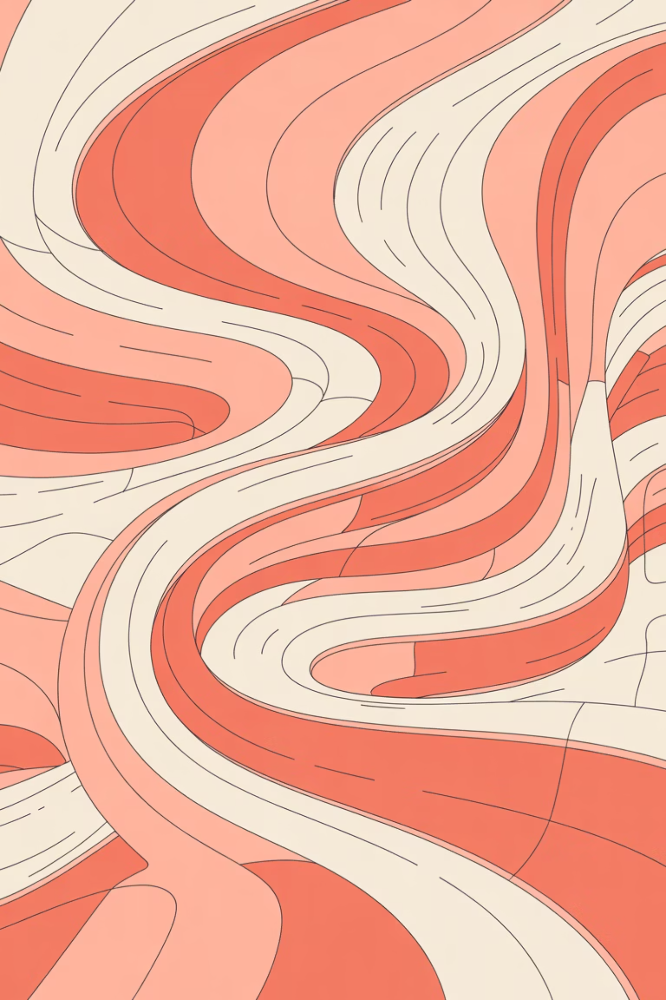
Stable Diffusion: A Deep Dive into Latent Text-to-Image Generation
An exploration of the architecture, efficiency, and practical advantages of Stable Diffusion for developers and ML engineers

Slide 2

What is Stable Diffusion?
prompt = "A fantasy girl holding a glowing crystal orb, magical forest, butterflies, ultra detailed, cinematic lighting"
Stable Diffusion is a latent text-to-image diffusion model that generates photorealistic images through iterative denoising guided by natural language prompts.
Unlike traditional pixel-based approaches, it operates in compressed latent space, dramatically reducing memory requirements and computational overhead whilst maintaining exceptional image quality.
The model is open-source and highly customisable, making it accessible for both research and production deployments.

Slide 3




Core Architecture Components
CLIP Text Encoder
VAE Encoder
Transforms natural language prompts into rich semantic embeddings that guide the generation process
Compresses high-resolution images into efficient latent representations for processing
U-Net Denoiser
Scheduler
Predicts and removes noise iteratively through attention mechanisms and skip connections
Controls the denoising timeline, determining step count and noise reduction scale

Slide 4
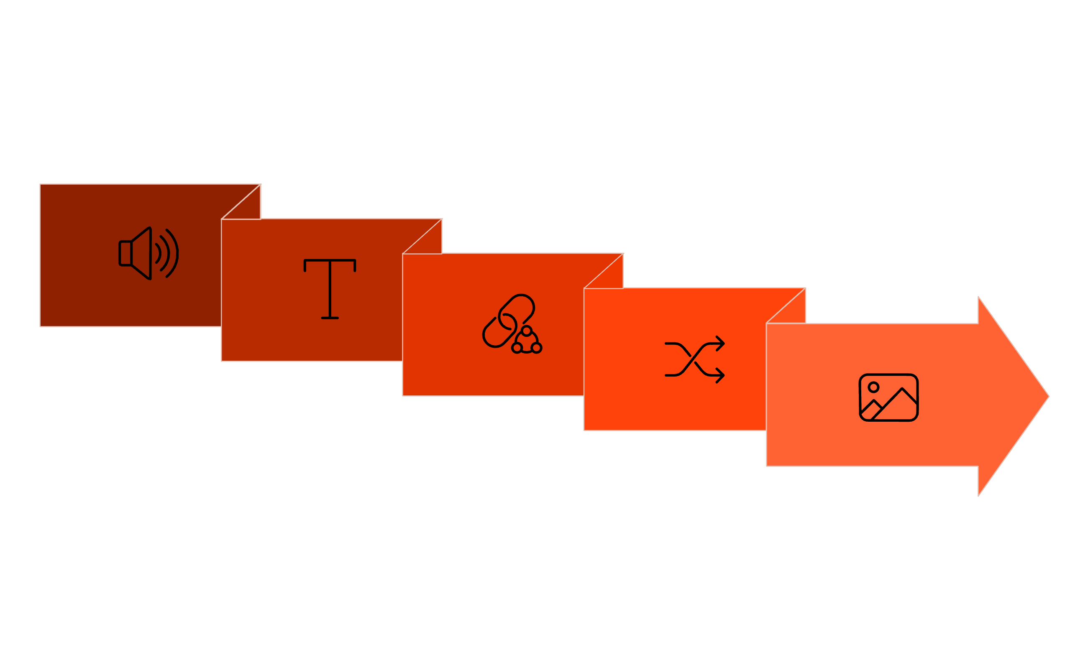





The Generation Process: From Noise to Image
Random Noise
U-Net Denoise
VAE Decode
CLIP Encode
Scheduler Refine
The generation begins with pure random noise and progressively refines it through guided denoising. The CLIP encoder provides semantic direction, whilst the U-Net iteratively predicts and removes noise patterns. The scheduler determines the pace and intensity of denoising, and finally, the VAE decoder transforms the latent representation back into a high-quality image.

Slide 5

Stable Diffusion vs GANs: Key Distinctions
No Mode Collapse
Superior Text Control
Training Stability
Diffusion models avoid the generator-discriminator instability that plagues GAN training, producing more consistent and diverse outputs
Cross-attention mechanisms between text embeddings and image features enable precise prompt-guided generation
Progressive denoising provides a stable training signal without adversarial dynamics, making convergence more reliable

Slide 6



Stable Diffusion vs DALL·E: The Open Alternative
Open-Source Advantage
Local Execution
Fine-Tuning Support
Full model weights, architecture details, and training code available for inspection, modification, and commercial use
Run entirely on your infrastructure without API dependencies, rate limits, or privacy concerns
Customise the model on domain-specific datasets using techniques like LoRA, DreamBooth, and textual inversion

Slide 7
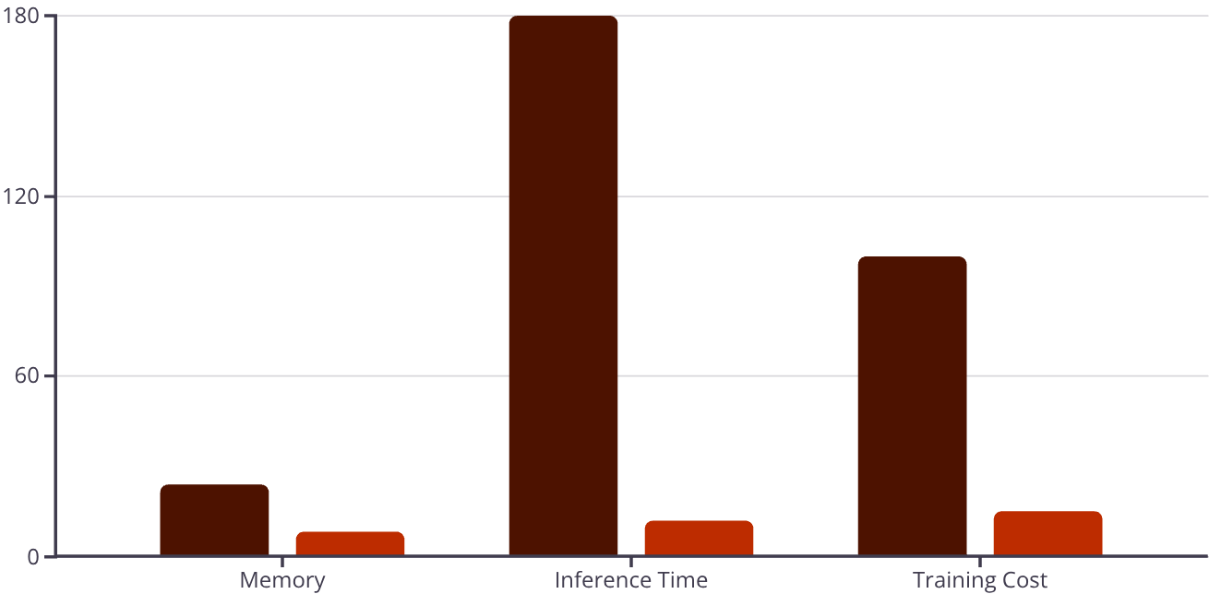
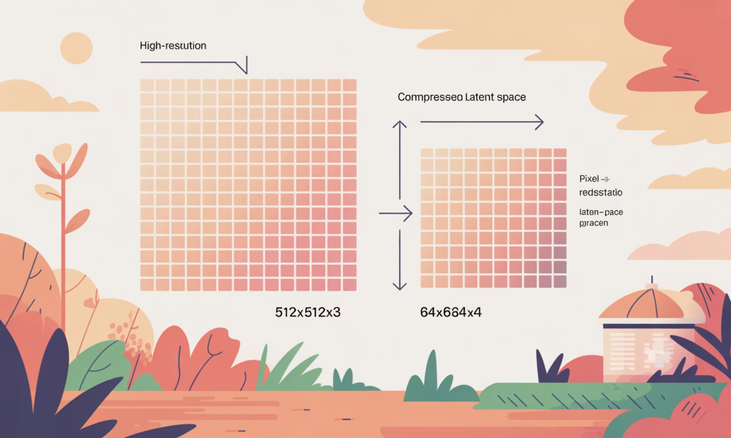
Computational Efficiency Metrics
Pixel Space
Latent Space
Performance Gains
Latent diffusion delivers dramatic improvements across all key metrics:
Memory: 8GB vs 24GB VRAM required
Speed: 12s vs 180s per image
Cost: 85% reduction in training expenses
These improvements make Stable Diffusion practical for production deployments and rapid prototyping.

Slide 8
Technical Advantages at a Glance
Memory Efficient
Fast Inference
High Quality
Customisable
Runs on consumer GPUs with 8GB+ VRAM
Generates 512px images in 10-15 seconds
Maintains photorealistic detail despite compression
Fine-tune on domain-specific datasets
Open Source
Production Ready
No API fees or usage restrictions
Battle-tested in real-world applications

