Slide 1




Goldman Sachs
India Hackathon
2026 | QUANTITATIVE TRACK
Sarvesh Joshi
IIT Guwahati
Computer Science and Engineering

Slide 2

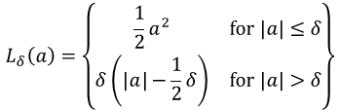
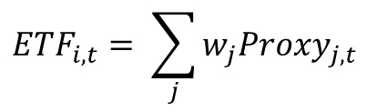
ETF Proxy Models
Regime Navigator
Bermudan Swaption Pricing
01 The problem
02 NAV and Risk Estimation
03 The Hedge
$$ETF_{i,t}= \sum_{j}{w_{j}{Proxy}_{j,t}}$$
Overfitting on noisy returns
→ Ridge regression
$$L_{δ}\left(a\right)=\left\{\begin{matrix}\frac{1}{2}a^{2} & \text{for} \left|a\right|≤δ \\ δ\left(\left|a\right|−\frac{1}{2}δ\right) & \text{for} \left|a\right|>δ\end{matrix}\right\}$$
Huber Loss :
Tiny weights → transaction costs may exceed profit
→ Lasso (sparse weights)
Proxy instruments include Proxy ETFs, Bonds, Futures, CDX.
We ignore Proxy ETFs for risk estimation
Elastic-Net selector + Huber Regressor
Unclean data — extreme outliers
→ Winsorization
NAV weights
Hedge
Fit on target y = −Portfolio PnL
→ chosen to maximize HER
Another step to ensure outliers do not distort the model
→ Huber regressor
Risk weights
Two ways to fit – with and without intercept. The fundamental difference is a drifting portfolio .
Linear Regression?
Avoid Ridge’s tiny-weight problem again
→ Elastic Net as selector
Improvements
The Hedge -
NAV and Risk Model -
No transaction cost penalty — incorporate into the objective function of an optimizer or scale data by 1/(transaction_cost).
The instrument selector is blind to transaction costs. Dropping it and incorporating transaction cost into an optimizer would be better.
Account for the DV01 metric – longer duration bonds show more DV01 than shorter durations.
Regime detection – improve upon the plan for high volatility regimes

Slide 3
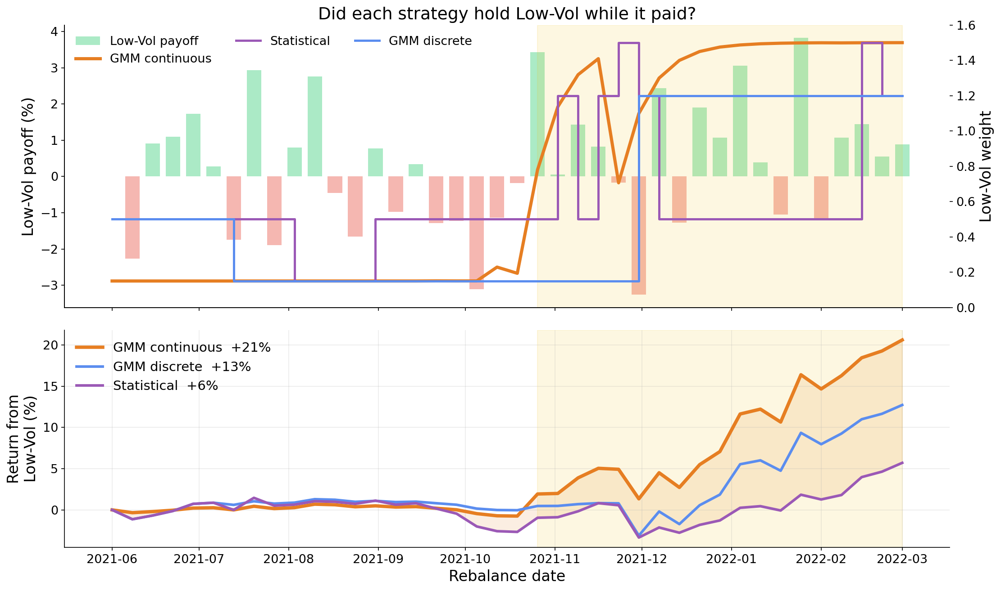
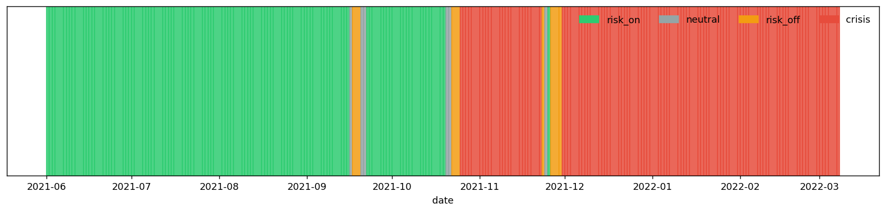


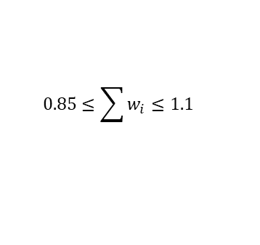
Regime Navigator
Bermudan Swaption Pricing
01 The problem
02 The architecture
Momentum
Indicators
Scaling
GMM(unsupervised learning)
Feature engg.
Features
Volatility
Given 100 securities –
Build a regime prediction framework
Build a regime-adaptive portfolio
Quality
risk_aversion
Some constraints -
alpha_scale
Objective parameters
Regime
Feature parameters
a_mom
$$0.85≤\sum{w_{i}}≤1.1$$
turn_penalty
a_vol
Net exposure :
smooth_lam
a_qual
Max single position :
$$\left|w_{i}\right|≤0.1$$
Objective function
SLSQP Optimizer!
Alpha
Short exposure :
$$>= −0.3$$
03 Continuous Regime Prediction
Find probability of belonging to stress regime by using GMM.
Interpolate all parameters based on a continuous regime spectrum.
Regime Whipsawing!

Slide 4
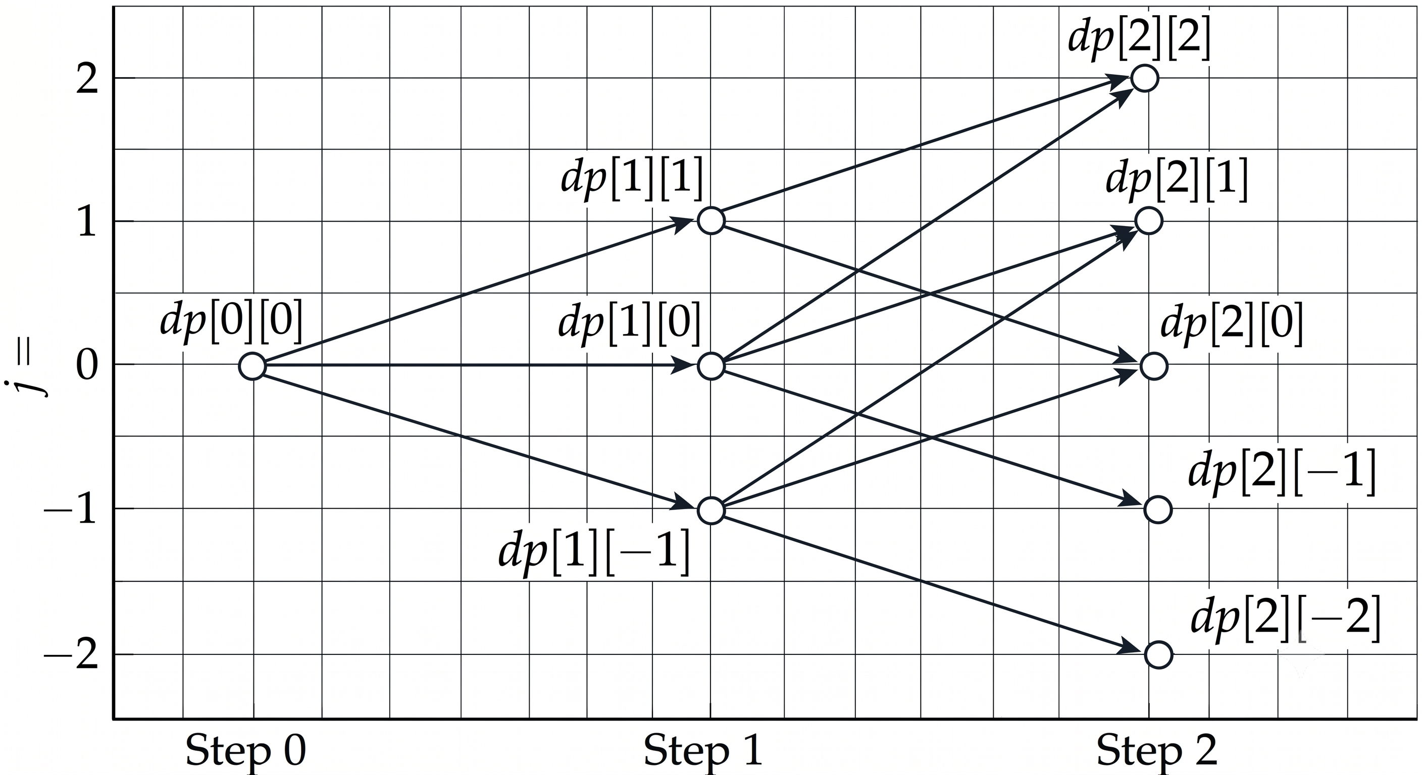








Bermudan Swaption Pricing
01 The problem
02 The Hull-White model
$$dr_{t}=\left(θ\left(t\right)−ar_{t}\right)dt+σdW_{t}$$
a – reversion constant
$σ$ – volatility
$θ\left(t\right)−$ drift
$dW_{t}$ -- N(0,dt)
Interest Swap
Convert from a fixed to a floating interest rate or vice-versa.
Given European Swaptions
Bachelier formula
Premiums
Jamshidian Decomposition
Calibration via optimizer
Option
Floating rate = Benchmark(Eg- RBI Repo Rate) + Spread
03 Pricing the Bermudan Swaption
Swaption
$$dp_{\text{cont}}\left[i\right]\left[j\right]=e^{−r_{i,j}Δt}\left(p_{u}⋅dp\left[i+1\right]\left[j+1\right]+p_{m}⋅dp\left[i+1\right]\left[j\right]+p_{d}⋅dp\left[i+1\right]\left[j−1\right]\right)$$
$$dp\left[i\right]\left[j\right]=\max\left({\text{IV}}_{i,j}, dp_{\text{cont}}\left[i\right]\left[j\right]\right)$$
Trinomial Tree
European – Single exercise date
American – Continuous exercise period
Bermudan – Discrete exercise dates
${\text{IV}}_{i,j} is computed by Hull−White$
Payer Swaption – Reserves the right to pay fixed rate and receive floating rate
Transition probabilities are computed by using the reversion constant.
Yield Curve
Increase number of transitions. (pentanomial)
Discount Factor
$$P\left(0,T\right)=\exp\left(−r\left(T\right)⋅T\right)$$
04 Vega/Delta
Forward Rate
$$f\left(0,T_{i}\right)=−\frac{\ln{P\left(0,T_{i+1}\right)}−\ln{P\left(0,T_{i}\right)}}{T_{i+1}−T_{i}}$$
Vega – Bump each vol by +1 bp , recalibrate, reprice and compute the difference
Delta – Bump each zero rate by +1 bp , recalibrate, reprice and compute the difference

