Slide 1


CS224 – Hardware Lab Project
Group 22
Shivansh,Sarvesh,Abhigyan,Manthan

Slide 2

Project Overview
Implementing a 5-stage pipeline which supports RV32IMA integrated with dedicated L1 instruction and data caches, complemented by dynamic branch prediction
THE GOAL :
Commitment
Convert the existing 3-stage pipeline into a 5-stage pipeline with support for RV32M
A multi-core processor supporting RV32A ISA (atomic operations) enabling functioning of multi-threaded algorithms.
Goal System
Dynamic Branch Prediction: Integrate per-core branch target minimizing stalls during branching operations.
Integrated L1 Cache Hierarchy: Incorporate dedicated L1 instruction and data caches for each core
Stretch Goals
Hardware Performance Monitoring: Implement the Zicsr extension, accessing the Control and Status Registers, to monitor critical hardware-level profiling metrics

Slide 3
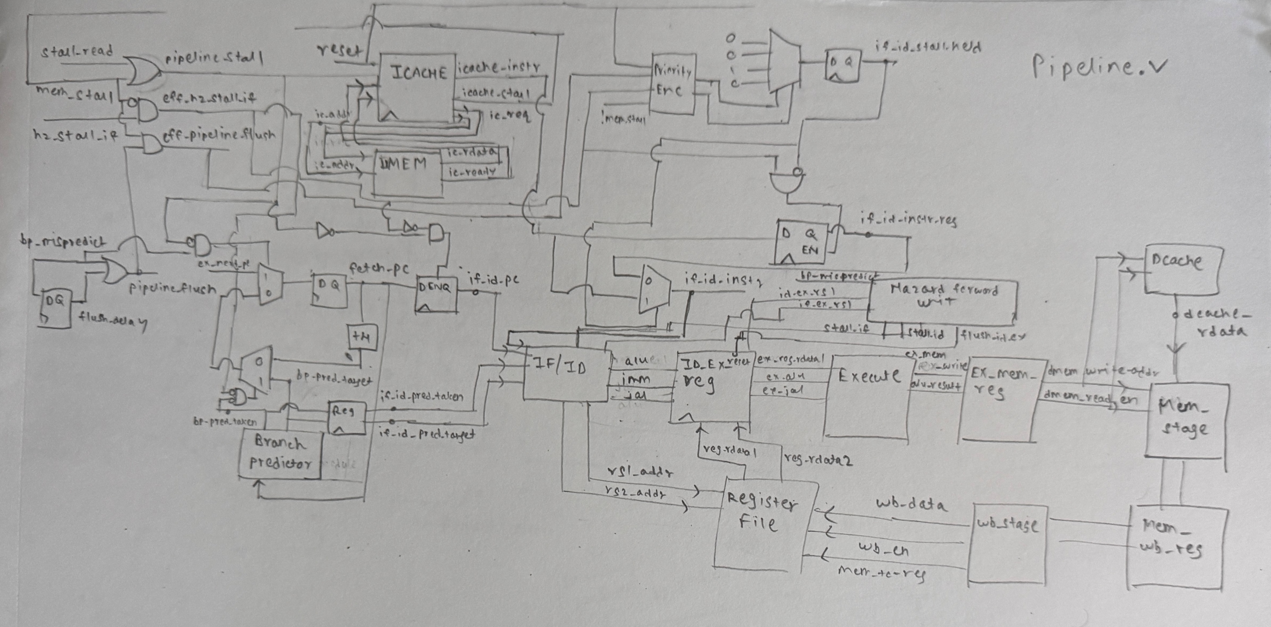
System Architecture(Block Diagrams)

Slide 4
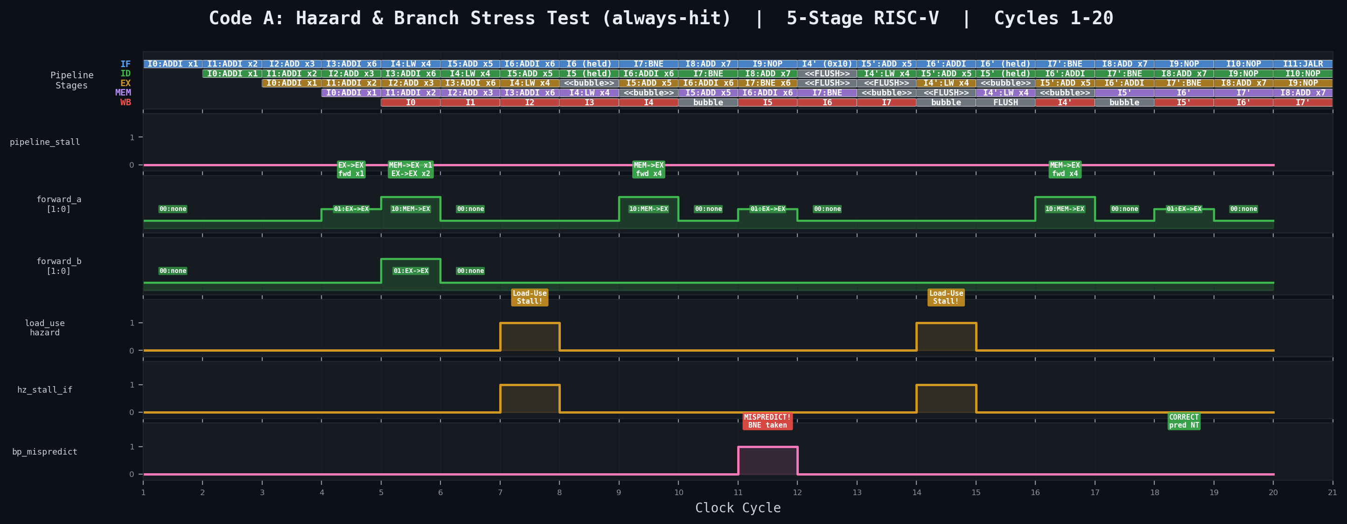
Timing Diagram
PC | Icache Line | Instruction
0x00 | 0 | ADDI x1, x0, 10
0x04 | 0 | 0x04: ADDI x2, x1, 5
0x08 | 0 | ADD x3, x1, x2
0x0c | 0 | ADDI x6, x0, 2
0x10 | 1 | LW x4, 0x100(x0)
0x14 | 1 | ADD x5, x4, x1
0x18 | 1 | ADDI x6, x6, -1
0x1c | 1 | BNE x6, x0, -12
0x20 | 2 | ADD x7, x3, x5
0x24 | 2 | NOP
0x28 | 2 | NOP

Slide 5
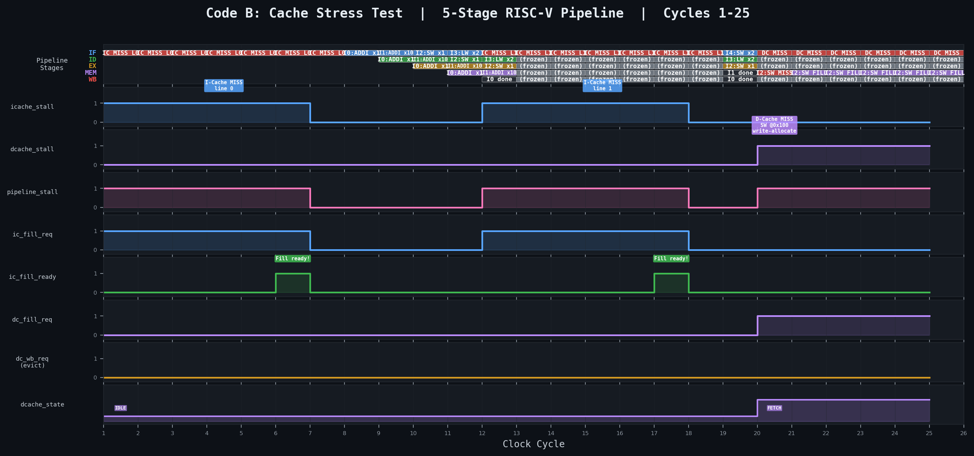
Timing Diagram

Slide 6

Design + Verification Plan
Convert existing code to a 5-stage pipeline with RV32M. Test on simple assembly codes via a testbench.
Incorporate Branch Prediction(BTB) and L1 data and instruction caches. Test functioning via a testbench as well as run bitstream on FPGA.
Incorporate atomic operations (RV32A) within the pipeline ensuring proper data locking. Test functioning via testbench
Instantiate two processor modules (dual-core) and handle common resource sharing via a separate bus arbiter. Testing via a testbench
Generate bitstream and final project demo on FPGA. May need to manage utilized resources like LUTs.
Testing will have emphasis on :
Multi-core resource sharing
Coverage of RV32IMA ISA
Functioning of cache and BTB

Slide 7
Timeline
Convert existing code to a 5-stage pipeline with RV32M. Test on simple assembly codes via a testbench.
Incorporate Branch Prediction(BTB) and L1 data and instruction caches. Test functioning via a testbench as well as run bitstream on FPGA.
Incorporate atomic operations (RV32A) within the pipeline ensuring proper data locking. Test functioning via testbench
Instantiate two processor modules (dual-core) and handle common resource sharing via a separate bus arbiter. Testing via a testbench
Generate bitstream and final project demo on FPGA. May need to manage utilized resources like LUTs.
10 April
Testing will have emphasis on :
Multi-core resource sharing
Coverage of RV32IMA ISA
Functioning of cache and BTB
15 April
19 April

Slide 8
Team Responsibilities
Team Member | Responsibility
Shivansh | Base 5-stage pipeline modules, bus arbiter for multi-core
Sarvesh | Branch prediction, Hazarding unit, top module (including dual core)
Abhigyan | I-cache,D-cache, multiply-divide of execute, RV32A instruction support
Manthan | Simulation artifacts including multithreaded C++ programs, testbenches of checkpoints, UART demo

Slide 9
Demo Plan
Challenges
maintaining cache coherency across multiple cores during parallel execution
ensuring integrity of inter-core atomic locks
. Integrating the RV32M multi-cycle sequential multiplier and divider increases clock cycle time period
sub-cycle race conditions where the same data is accessed by multiple cores
Show full functioning of multithreaded programs written in C++ with concurrent execution on our dual-core processor visible via a UART connection on our PC.

