Slide 1

PolicyLens
Multi-Agent RAG System Architecture
15 pluggable agents • Hybrid retrieval • LLM auto-failover • Zero-cost deployment
Sarvesh Mokal | 2026

Slide 2





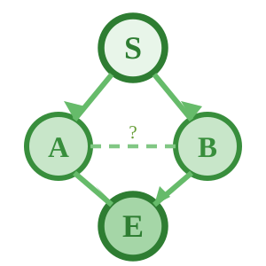
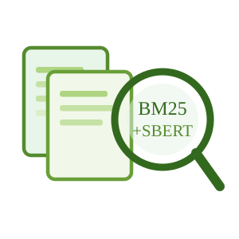
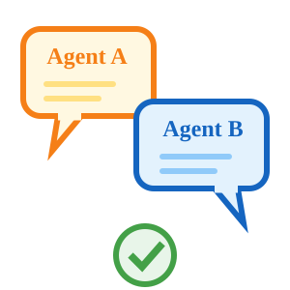


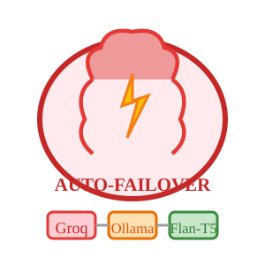
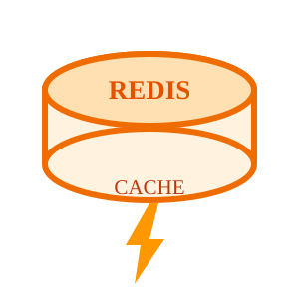
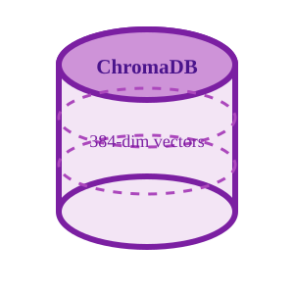
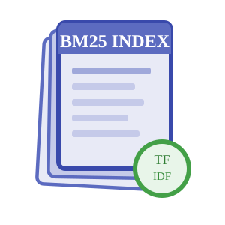
Presentation UI & API Gateway
Dashboard
FastAPI Gateway
Document Upload
EXTERNAL INPUT
SOURCES
user uploads
Metrics, agent status,
trace logs & analytics
REST + WebSocket
endpoints for all services
Drag & drop PDFs
into ingestion pipeline
OUTPUT
DESTINATIONS
Cited answers,
dashboard views
Core
Processing
Layer
(LangGraph +
15 Pluggable
Agents)
LangGraph Engine
Hybrid Retrieval
Synthesis & Debate
Verifier + NLI
State machine with
conditional routing
& decision nodes
BM25 sparse +
SBERT dense search
α-weighted fusion
LLM answer generation
DebateA/B adversarial
stress-testing
BART-MNLI checks
entailment ≥ 0.8
or re-retrieve
Agent Registry
LLM Provider Chain
Plugin architecture — toggle any agent via YAML config
Auto-Failover
Ingestion (4)
Analysis (4)
1. Groq (Free Tier)
DocProcessor, Preprocessor,
Embedding, TopicModel
Planner, Retriever,
Reranker, Synthesizer
Cloud, ~200 tok/s
2. Ollama (Mistral-7B)
Verification (4)
Support (3)
Local, no API needed
DebateA/B, Verifier, NLI
Evaluator, MultiLingual,
Guardrails
3. Flan-T5 (CPU)
Always available
Async Task Queue — streams via WebSocket
Caching Layer
Redis Cache — Query result caching & session management
Database
Layer
documents
chunks
query_logs
doc_id (PK)
chunk_id (PK)
query_id (PK)
title
doc_id (FK → documents)
question
ChromaDB
(Dense Vectors)
BM25 Index
(Sparse Tokens)
source_org
text_content
answer
page_count
embedding (384-dim)
confidence_score

Slide 3
Agent Pipeline — BaseAgent Interface
Every agent implements process(), health_check(), and declares its I/O schema — plug in or out without breaking the pipeline
BaseAgent Interface
Ingestion
Ingestion
Ingestion
Ingestion
DocProcessor
Preprocessor
Embedding
TopicModel
process(input)
Core processing logic
PDF parsing & extraction
Cleaning, normalization
SBERT vectorization
LDA topic extraction
health_check()
Returns agent status
Analysis
Analysis
Analysis
Analysis
input_schema
Planner
Retriever
Reranker
Synthesizer
Pydantic model for input
Query decomposition
Hybrid BM25 + dense
Cross-encoder scoring
Answer generation
output_schema
Pydantic model for output
Verification
Verification
Verification
Verification
name: str
DebateAgent A
DebateAgent B
Verifier
NLI Agent
Unique agent identifier
Advocate position
Challenge position
Fact-check claims
Entailment scoring
enabled: bool
Toggle via config
Quality
Support
Support
Support
version: str
Evaluator
MultiLingual
Guardrails
Memory
Semantic versioning
Response quality metrics
Language detect/translate
Safety & content filter
Conversation persistence

Slide 4
Data Flow — Ingestion & Query Pipelines
Two parallel pipelines share the same vector store: documents flow in from the left, queries resolve on the right
INGESTION PIPELINE
QUERY PIPELINE
1
Raw PDF Upload
1
User Question
11 pre-loaded demo documents + real-time user uploads via Dashboard
Natural language query via Chat UI or API endpoint
▼
▼
2
DocumentProcessor Agent
2
PlannerAgent
PyMuPDF extraction → text, tables, metadata, page numbers
Decomposes complex queries into sub-questions + routing
▼
Shared
Vector
Store
▼
3
Preprocessor Agent
3
RetrieverAgent (Hybrid)
Cleaning, normalization, language detection, section tagging
BM25 sparse + SBERT dense → α-weighted fusion scoring
▼
▼
4
Semantic Chunking
4
RerankerAgent
Sentence-boundary aware chunking with sliding window overlap
ms-marco-MiniLM cross-encoder re-scores top-k passages
▼
▼
5
EmbeddingAgent (SBERT)
5
SynthesizerAgent + Debate
all-MiniLM-L6-v2 → 384-dim dense vectors per chunk
LLM generates answer → DebateA/B stress-test → consensus
▼
▼
6
Dual Index Storage
6
VerifierAgent (NLI)
ChromaDB (dense vectors) + BM25 (sparse token index)
BART-large-MNLI checks entailment ≥ 0.8 — fail → re-retrieve
▼
▼
7
TopicModelAgent (LDA)
7
Final Output
Classical NLP: topic distribution per document for dashboard
Cited answer with page numbers, confidence score, trace log

Slide 5
LLM Provider Chain — Auto-Failover
Provider-agnostic abstraction layer: if one provider fails or hits rate limits, the system automatically falls to the next
Primary
~200 tok/s
Secondary
~30 tok/s
Tertiary
~5 tok/s
Fallback
Instant
Groq API
Ollama (Mistral-7B)
Flan-T5 (HuggingFace)
Graceful Degradation
Cloud inference via free tier
Fastest available option
Rate limited (30 RPM)
→
Local model on user machine
No API dependency
Requires GPU for speed
→
CPU-only fallback
Always available, zero cost
Smaller but reliable
→
Informative error message
Suggests retry or alternative
Logs for monitoring
failover
failover
failover
How It Works
1. Application sends request to the LLM abstraction layer with model-agnostic prompt format
2. Provider chain attempts Groq first — if rate-limited or unavailable, catches the error and tries Ollama
3. If Ollama is not running, falls to Flan-T5 which runs on CPU — always available, no external dependency
4. If all providers fail, returns a graceful error with diagnostics — never crashes, always logs the chain

