Slide 1



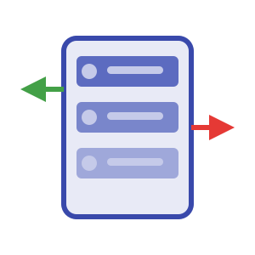

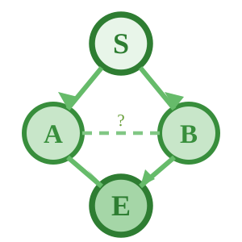

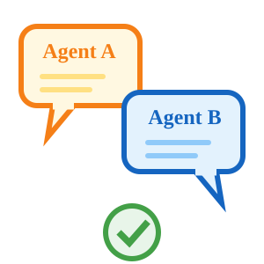
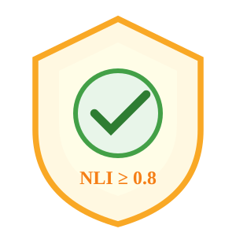

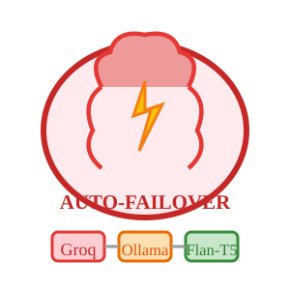
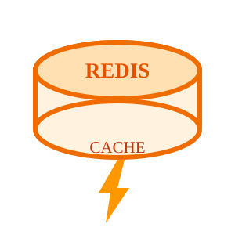
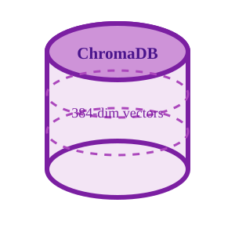
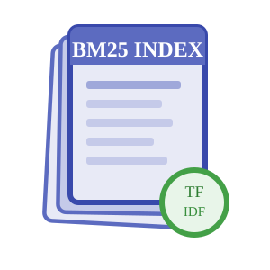
Presentation UI & API Gateway
Dashboard
FastAPI Gateway
Document Upload
Metrics, agent status,
trace logs & analytics
REST + WebSocket
endpoints for all services
Drag & drop PDFs
into ingestion pipeline
EXTERNAL INPUT
SOURCES
11 demo PDFs +
user uploads
OUTPUT
DESTINATIONS
Cited answers,
dashboard views
Core
Processing
Layer
(LangGraph +
15 Pluggable
Agents)
LangGraph Engine
Hybrid Retrieval
Synthesis & Debate
Verifier + NLI
State machine with
conditional routing
& decision nodes
BM25 sparse +
SBERT dense search
α-weighted fusion
LLM answer generation
DebateA/B adversarial
stress-testing
BART-MNLI checks
entailment ≥ 0.8
or re-retrieve
Agent Registry
LLM Provider Chain
Plugin architecture — toggle any agent via YAML config
Auto-Failover
Ingestion (4)
Analysis (4)
1. Groq (Free Tier)
DocProcessor, Preprocessor,
Embedding, TopicModel
Planner, Retriever,
Reranker, Synthesizer
Cloud, ~200 tok/s
2. Ollama (Mistral-7B)
Verification (4)
Support (3)
Local, no API needed
3. Flan-T5 (CPU)
DebateA/B, Verifier, NLI
Evaluator, MultiLingual,
Guardrails
Async Task Queue — streams via WebSocket
Always available
Caching Layer
Redis Cache — Query result caching & session management
Database
Layer
documents
chunks
query_logs
doc_id (PK)
chunk_id (PK)
query_id (PK)
title
doc_id (FK → documents)
question
ChromaDB
(Dense Vectors)
BM25 Index
(Sparse Tokens)
source_org
text_content
answer
page_count
embedding (384-dim)
confidence_score

