Slide 1
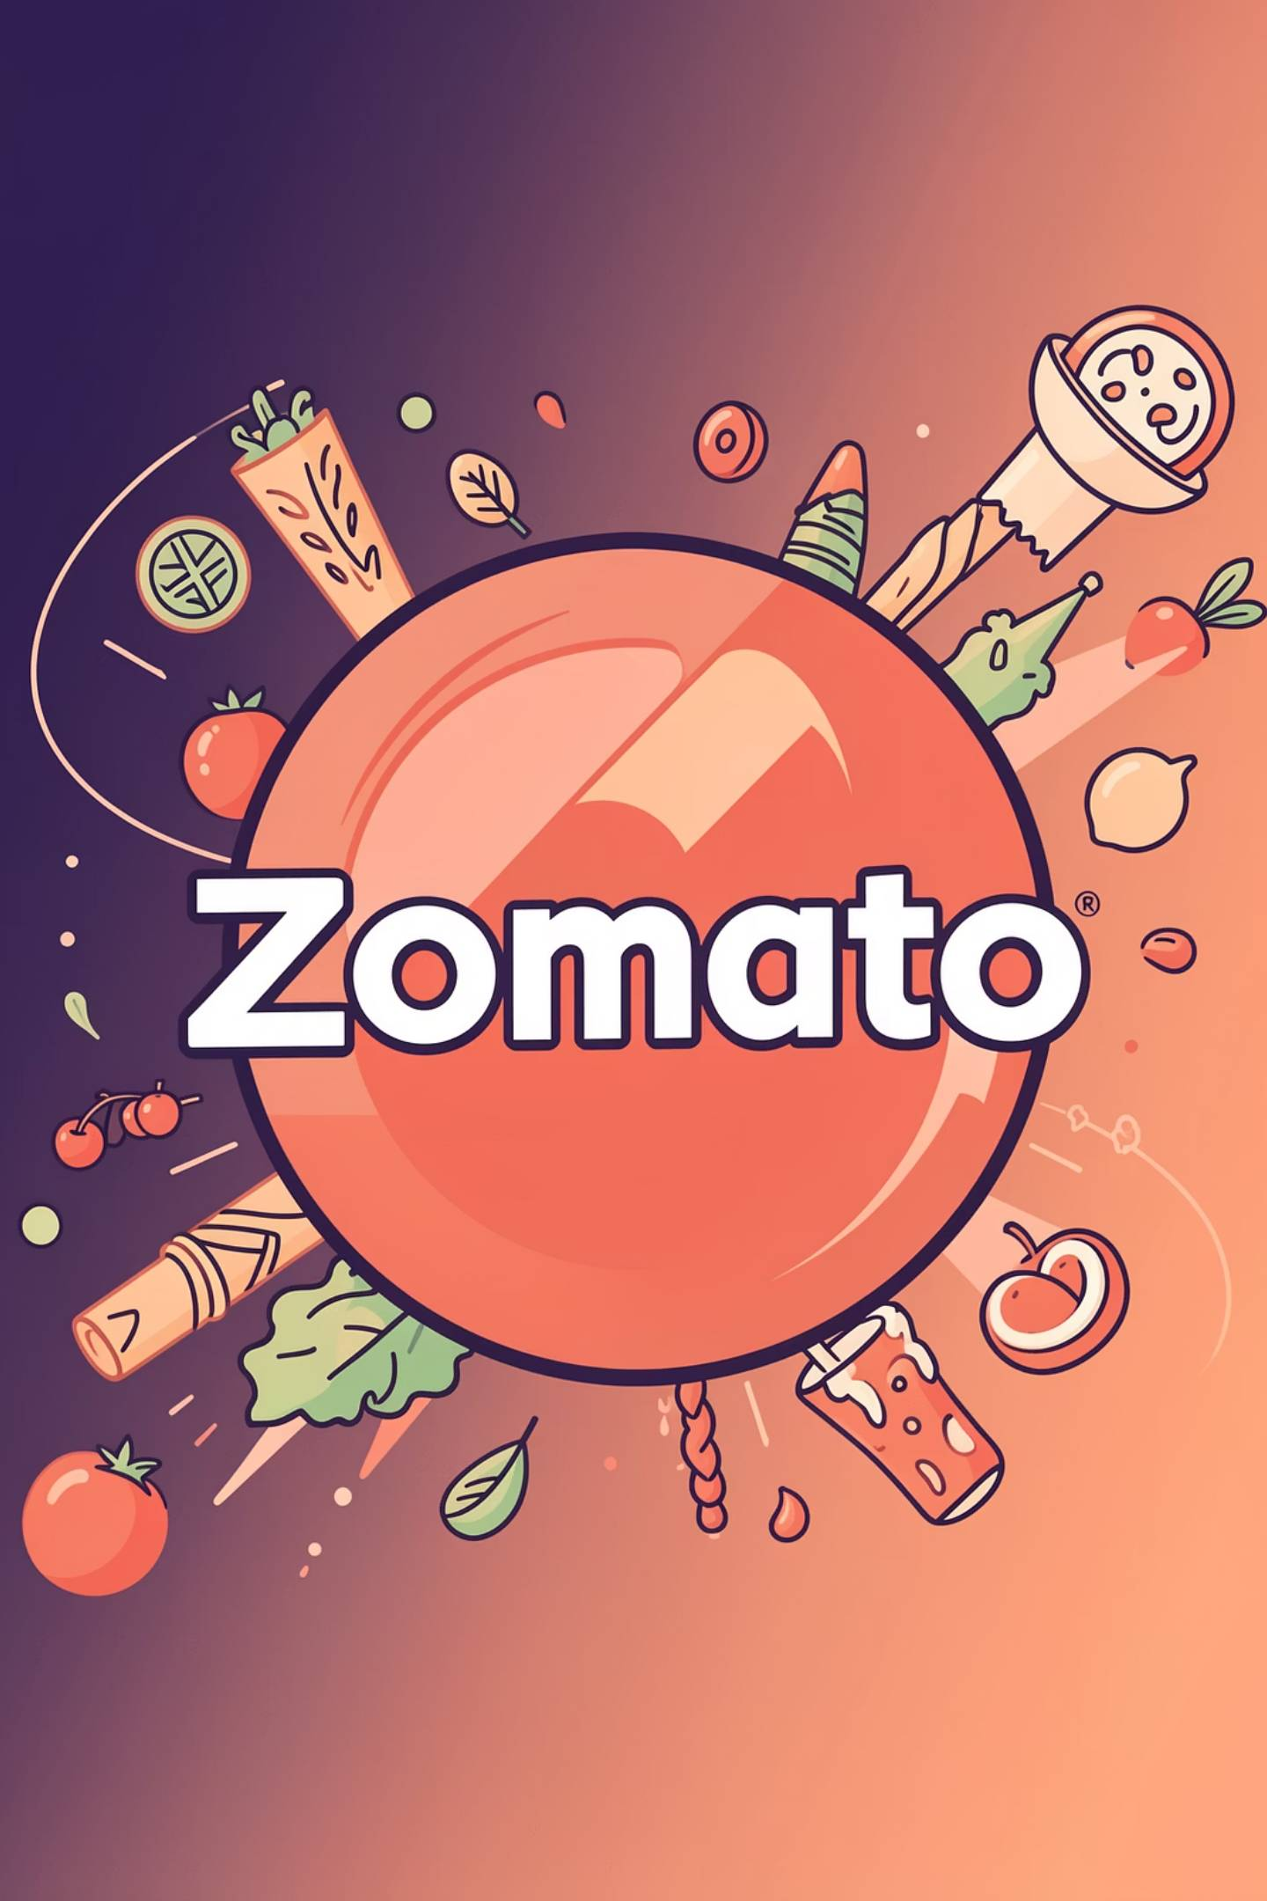
Zomato Profitability Case FY 2025: Strategic Insights & Financial Performance
An in-depth analysis of Zomato's remarkable journey towards sustained profitability and its strategic outlook for the future.

Slide 2
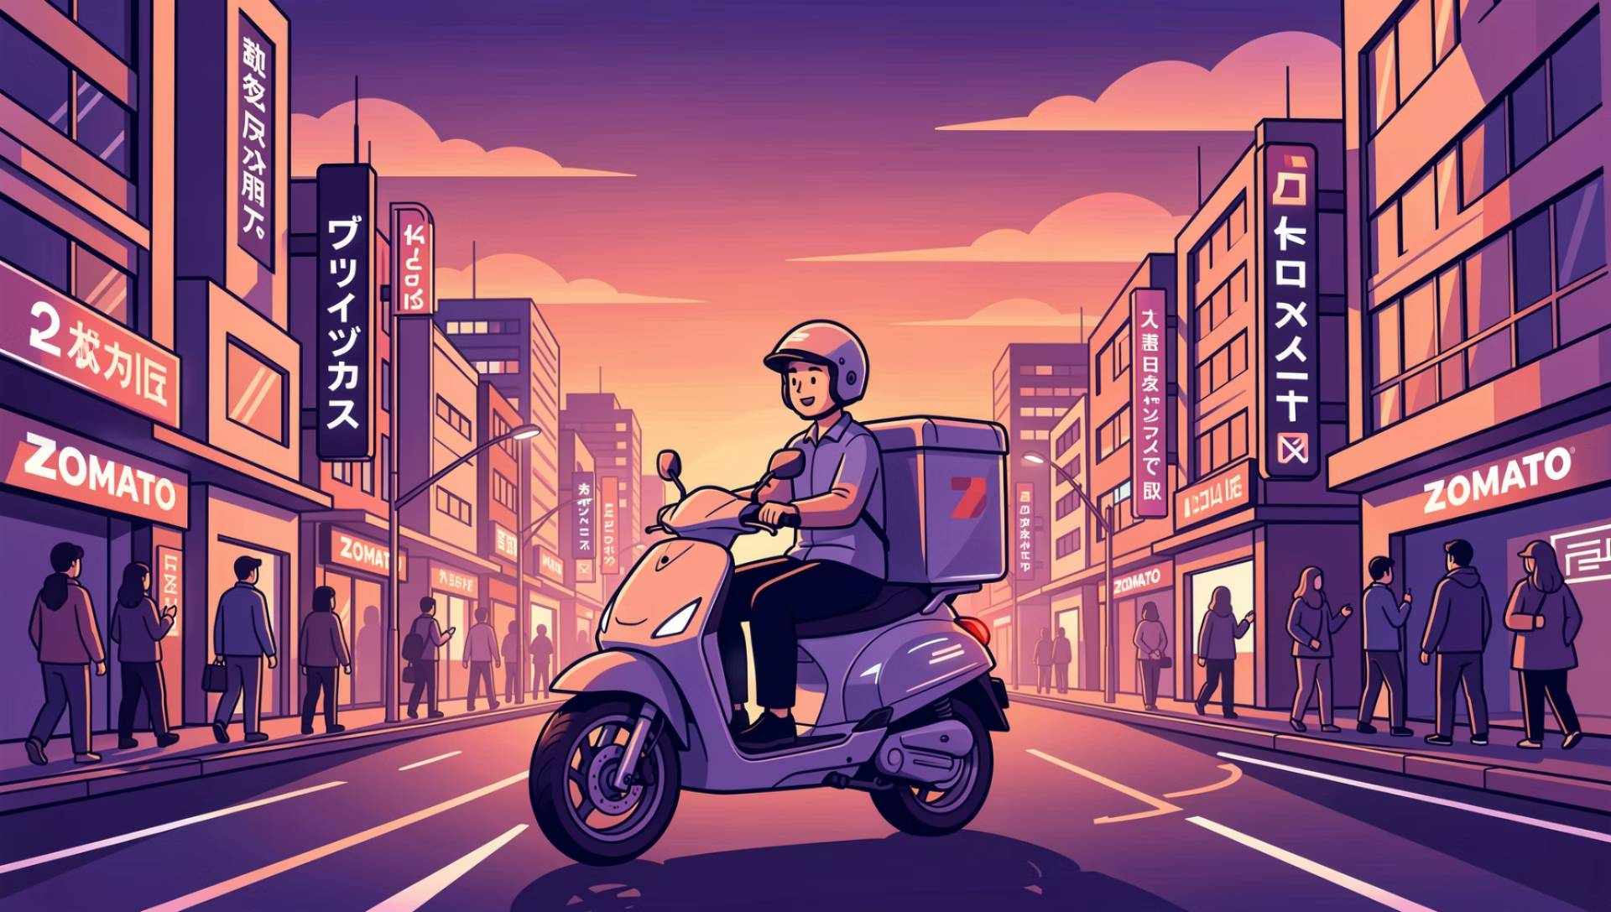
CHAPTER 1
Executive Summary
Zomato is scaling rapidly across Food Delivery, Blinkit, and Hyperpure, crossing ~Rs 20,500 Cr in FY25 revenue, but profitability remains fragile due to expansion-heavy economics.
Blinkit and Hyperpure are driving top-line growth, while per-order margins in core food delivery remain thin at ~4–8% after variable costs.
Unit economics are positive but highly sensitive to discounts, delivery costs, and customer retention.
Clear levers exist in discounts, batching, subscription monetisation, and segment focus to move from “growth at all costs” to “profitable growth.”

Slide 3

CHAPTER 2
Financials FY 2025
₹20,243Cr
₹527Cr
₹1,079Cr
Consolidated Revenue
Profit After Tax (PAT)
Adjusted EBITDA
A remarkable 56% YoY growth.
Sharp turnaround from previous losses.
Reflecting strong operational leverage.
₹18,824Cr
Cash Balance
Significantly strengthening financial stability.
Zomato’s financial performance in FY 2025 demonstrates a significant leap towards fiscal health, driven by strategic execution and market leadership.

Slide 4
Problem Statement
Business Problem
Zomato’s revenue is growing strongly, but profits are volatile and under pressure.
The client is concerned about whether current growth is sustainable and value-accretive.
Key Questions
Where is Zomato making money vs. losing money?
Are unit economics structurally attractive?
What levers can be pulled to improve profitability without stalling growth?

Slide 5
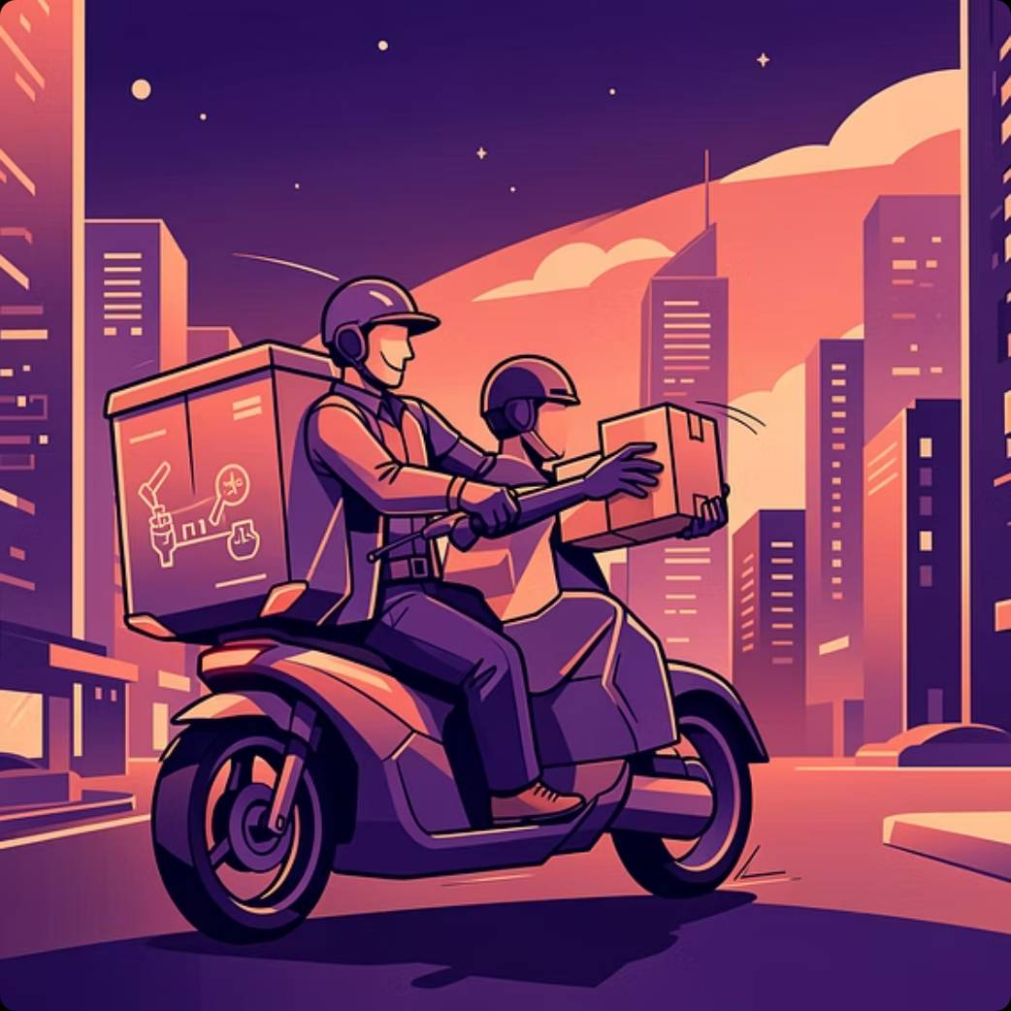
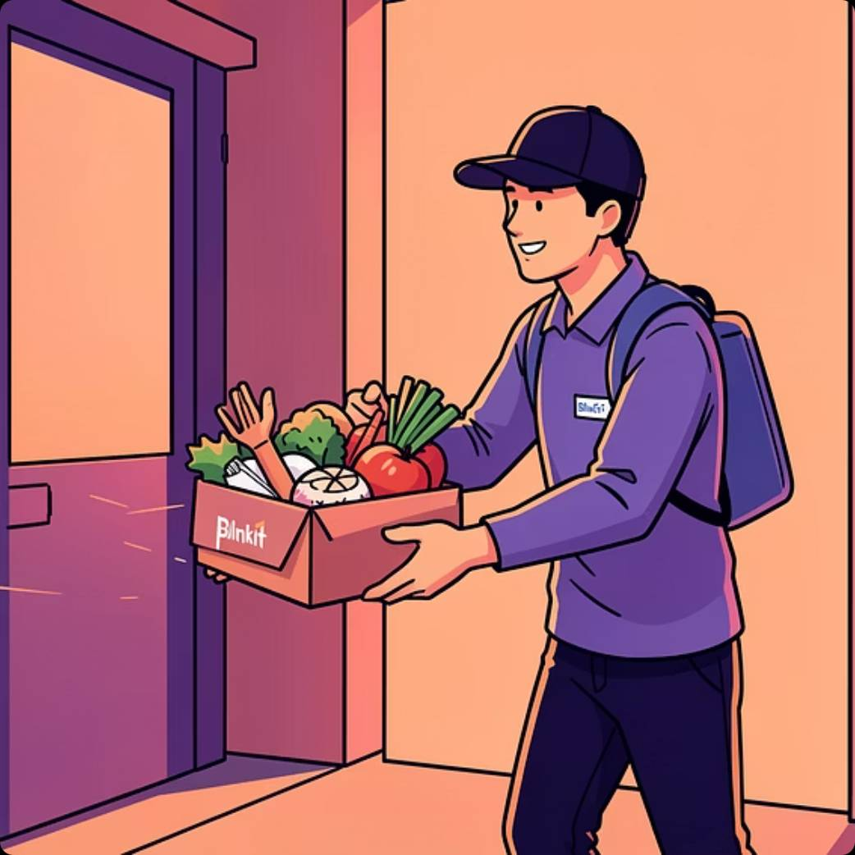

CHAPTER 3
Business Segments Driving Growth & Profitability
Food Delivery
Quick Commerce (Blinkit)
Going-Out & B2B Supplies
Achieved ₹38,646 crore GOV, contributing 48% of B2C business with 21 million monthly customers. Continues to be a robust revenue stream.
Generated ₹7,796 crore GOV and rapidly expanded to 1,301 stores, carving out a 10% share of the B2C segment.
Growing verticals like "Going-Out Experiences" and "Hyperpure" (B2B supplies) are diversifying Zomato's portfolio and contributing to overall resilience.
Strong revenue growth but profit contraction due to cost escalation.
Expense growth fully keeps pace with revenue, constraining margin expansion.

Slide 6
Segment Revenue Breakdown (FY25)
Quarter
Food Delivery
Blinkit
Hyperpure
Others
Total Revenue
Q1 FY25
~1,800 Cr
~800 Cr
~1,200 Cr
~200 Cr
4,520 Cr
Q2 FY25
1,900 Cr
1,156 Cr
1,473 Cr
~270 Cr
4,799 Cr
Q3 FY25
2,072 Cr
1,399 Cr
1,671 Cr
~263 Cr
5,405 Cr
Q4 FY25
~2,300 Cr
~1,500 Cr
~1,800 Cr
~233 Cr
5,833 Cr
Callouts:
Blinkit: ~2x revenue in a year; key growth engine.
Hyperpure: ~30% revenue share, building B2B moat.
Food Delivery: Core, slower but stable growth.

Slide 7
Major Profitability Challenges
Drivers
Impact
Blinkit expansion (368 new stores; ~Rs 370 Cr capex)
High upfront costs, depreciation drag.
High variable costs (delivery payouts, discounts, ads)
Thin per-order contribution margins.
Competitive intensity from Swiggy, Zepto, others
Discount pressure and marketing spend
Fixed cost base (tech, support, corporate)
Slows conversion of contribution margin to net profit.

Slide 8




CHAPTER 5
Operational Challenges & Ecosystem Frictions
Platform Tensions
Blinkit's Expansion Costs
Competitive Intensity
Restaurant partners protested commission opacity, and delivery agents resisted wage cuts under the "Select to Go" model.
Accelerated store expansion led to increased losses (₹178 crore in Q4FY25), impacting near-term profitability.
Rising competition in Q-commerce and food delivery pressured take rates and increased marketing expenditures.
Navigating these operational challenges and maintaining a balanced ecosystem remains crucial for sustained success.

Slide 9
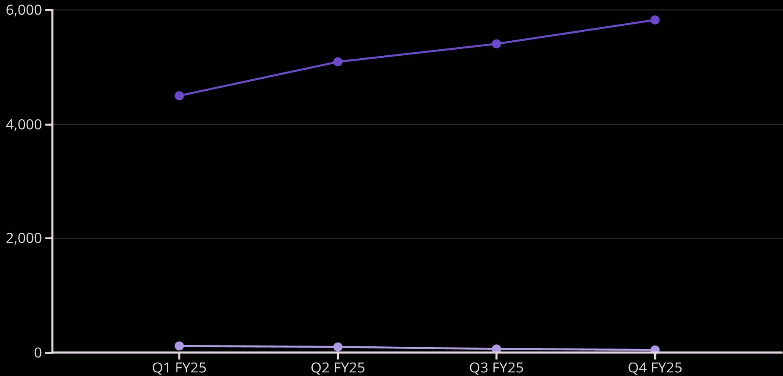
CHAPTER 6
Financial Performance Deep Dive: Q4 FY25 Snapshot
Q4 FY25 revenue reached ₹5,833 crore, a robust 64% YoY growth, yet only an 8% QoQ increase, indicating potential saturation in certain areas.
Operating profit stood at ₹72 crore with a 1.2% margin, experiencing a QoQ dip primarily due to significant expansion costs in new ventures.
Net profit declined 34% QoQ to ₹39 crore, influenced by heightened marketing efforts and increased operational expenditures. Management remains cautiously optimistic for long-term growth and margin recovery.
Revenue (Cr)
Net Profit (Cr)

Slide 10

CHAPTER 7
Market & Competitive Landscape
Duopoly in Food, Crowded in Q-Commerce
Competitor
Food Delivery Share
Quick Commerce Position
Recent Highlights
Zomato / Blinkit
55–58%
Leader (>50%)
FY25 rev ~Rs 20K Cr, strong cash
Swiggy / Instamart
42–45%
#3 (~20%)
Bolt 10-min, IPO momentum
Zepto
Small in food
25–30%
Aggressive dark store build-out
Flipkart Minutes
N/A
Emerging
Bengaluru pilot, ONDC focus
Zomato is well-positioned but cannot rely on market structure alone for profitability.

Slide 11
A Large and Fast-Growing Market
Year
Market Size (US$ Bn)
CAGR Projection
Key Drivers
2025
55.6
22% to 2034
Smartphones, urban workforce
2026
65.0
28.8% to 2029
Tier-2/3 expansion, ready-to-eat
2030
~200+
24–33%
Q-commerce integration
Food delivery + quick commerce is already >Rs 4.6 lakh Cr.
Quick commerce GMV: US$ 6–7 Bn (2024), ~40% CAGR expected.

Slide 12
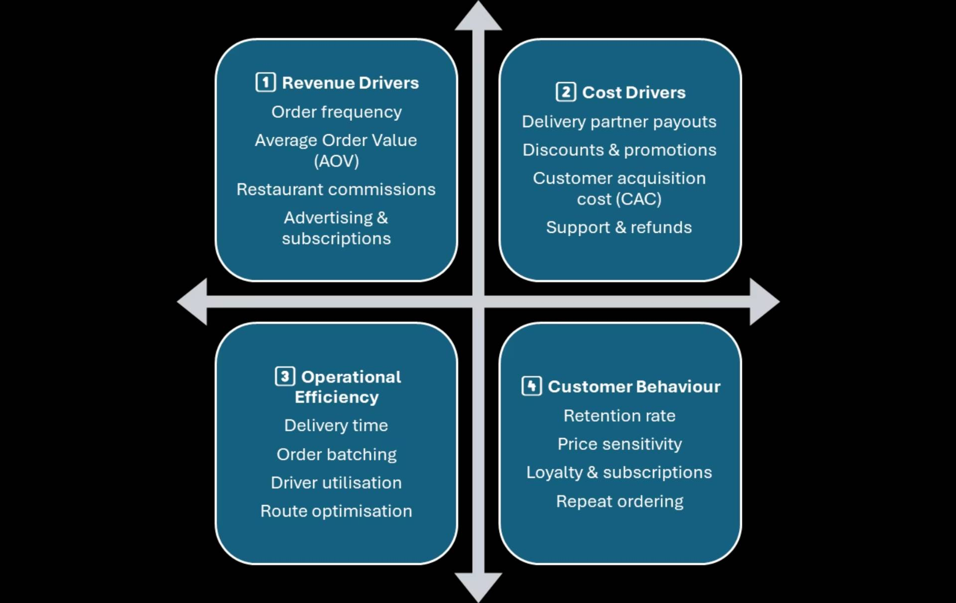
Four-Bucket Profitability Framework

Slide 13
CHAPTER 8
Unit Economics Summary: The Rs 500 Order
Analyzing a typical Rs 500 order reveals the tight margins and critical balance between revenue generation and variable costs.
Component
Amount (Rs)
% of Gross AOV
Gross order value
500
100%
Total revenue (commissions, fees, subs)
175
35%
Variable costs (delivery, discounts etc.)
-175
-35%
Net contribution margin (before fixed)
~0
0%
Estimated profit per order (post-optim.)
20–40
4–8%
Profit drivers: Higher AOV (e.g., Blinkit Rs 669), better batching, subscription usage.
Risk factors: Over-discounting, poor delivery performance, and high CAC.

Slide 14
How Zomato Earns on a Rs 500 Order
Driver
Per Order Value (Rs)
Insight
Restaurant commission (20–25%)
100–125
Core monetisation, tier-based rates
Delivery fee (to customer)
30–50
Mostly retained after payout
Platform/ads fees
10–20
Sponsored listings, visibility boosts
Subscription allocation (Gold)
5–10
Recurring revenue, higher frequency
Total revenue capture ≈ Rs 145–205 (~30–40% of gross order value).

Slide 15
Where the Money Leaks Out
Cost Driver
Per Order Cost (Rs)
Insight
Delivery partner payout
80–100
40–50% of delivery fee + distance-based component
Discounts & offers
50–75
10–15% of AOV; critical for demand stimulation
CAC allocation
10–15
Marketing and reactivation cost spread over orders
Support & refunds
5–10
Cancellations, service recovery
“After variable costs, contribution margin per order is only Rs 20–40 (4–8%).”

Slide 16
Delivery Time, Batching, and Driver Utilisation
Phase
Time (min)
Std Dev
Optimisation Focus
Prep
17.3
6.8
Restaurant SLAs, incentives
Pickup
3.8
2.1
GPS, queue management
Transit
11.6
4.2
Routing, zone design
Order batching via AI (clustering + routing) → 20–30% multi-order trips; ~15–20% cost reduction.
Driver earnings ~Rs 102/hour; utilisation ~70–80% at peak; incentives tied to peaks and batching.
Delays >35–45 minutes significantly hurt ratings and raise refunds.

Slide 17




CHAPTER 8
Deep-Dive Diagnosis by Bucket
Revenue
Cost
Average order frequency ≈ 2–2.5 orders/user/month – moderate, indicating room for improvement.
Delivery costs ~20% of order value – acceptable but highly sensitive to driver incentives and fuel price fluctuations.
Discounts support volume but can cap overall monetisation potential.
Discounts represent the largest controllable leakage point in the cost structure.
Operations
Customer
Delivery time averages ~34 minutes, competitive but requires ongoing optimisation, especially in dense urban markets.
Approximately 50% retention at Day 30; loyalty is strong among Gold users but comparatively weaker for non-subscribers.
Order batching is implemented, but significant scope remains to increase its share and efficiency.
High price sensitivity means a shift to value perception rather than relying purely on discounts is crucial for sustained growth.

Slide 18
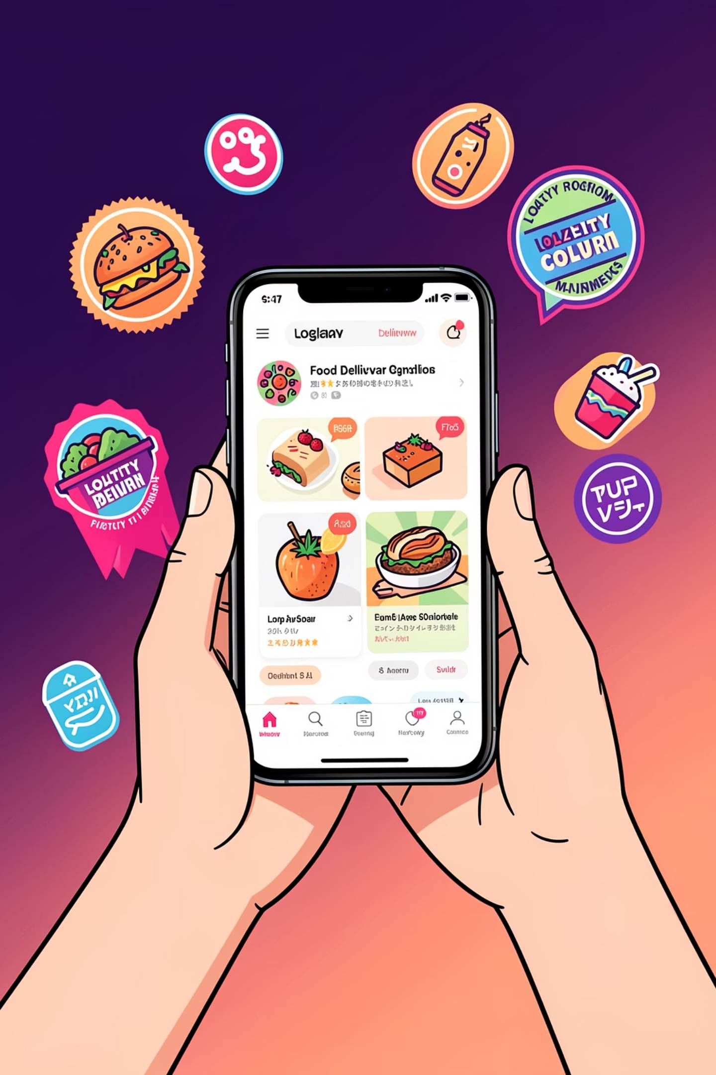
CHAPTER 8
Understanding Customer Behavior
Loyalty & Retention
Zomato Gold subscribers show significantly higher order frequency and average order value, boosting lifetime customer value.
Retention rate ~ 40-50%
Price Elasticity : 10–15% AOV driven by discounts
Customers are highly responsive to promotions and free delivery, making discounts a double-edged sword for acquisition and margins.
Delivery Experience
Timeliness and order accuracy are critical; delays over 35 minutes directly correlate with negative ratings and increased support costs.
Cross-Platform Usage
A growing segment of users leverages both Zomato (food) and Blinkit (quick commerce), indicating strong ecosystem stickiness.
“The economics depend heavily on retaining high-frequency, subscription users while reducing ‘discount-only’ customers.”

Slide 19




CHAPTER 8
Short-Term: Protect Margins While Preserving Growth
Targeted Discounts
Optimize Delivery Logistics
Transition from blanket promotions to specific, data-driven offers to improve profitability without sacrificing growth.
Implement advanced AI for order batching and dynamic zoning to significantly reduce per-order delivery costs.
Enhance Average Order Value (AOV)
Strategic Restaurant Commissions
Introduce strategic bundles, compelling add-ons, and seamless in-app upsell features to boost customer spend.
Explore incremental commission adjustments with top-tier restaurant partners, guided by performance data.
Focus on these levers will stabilize unit economics in the immediate future, laying groundwork for sustained profitability.

Slide 20




CHAPTER 8
Medium to Long Term: Build Profitable Scale
Scale Zomato Gold
Expand Dark Kitchens & Private Labels
Leverage personalised benefits to deepen customer loyalty and increase order frequency, maximizing lifetime value.
Strategically grow proprietary dark kitchens and private-label brands in high-demand micro-markets to capture higher margins.
Implement Dynamic Pricing
Invest in Automation & AI
Utilize time-of-day and demand-based pricing models to efficiently manage order load and optimize profit margins.
Develop advanced AI for routing and supply-demand forecasting to ensure cost per order remains flat as transaction volumes grow.
These long-term strategies focus on creating sustainable competitive advantages and unlocking new avenues for revenue and efficiency.

Slide 21
CHAPTER 8
Phased Execution and Success Metrics
Phase 1 (0–6 months)
Phase 2 (6–24 months)
Actions:
Actions:
Discount clean-up initiative.
Batching optimisation efforts.
AOV-focused experiments.
Aggressive Zomato Gold user acquisition and retention.
Scaling of dark kitchens and private labels.
Advanced routing and dynamic pricing implementation.
KPIs:
KPIs:
Contribution margin per order.
Discount % of Average Order Value (AOV).
On-time delivery %.
Batch share of orders.
Orders per user per month.
Gold subscription penetration rate.
Blinkit & Hyperpure margin trajectory.
Overall EBITDA margin.
“By systematically addressing each bucket – revenue, cost, operations, and customer – Zomato can move from high growth with fragile profits to a structurally profitable, multi-vertical food-tech leader.”

Slide 22

CHAPTER 8
Future Outlook & Strategic Priorities
Mature Blinkit
Customer Experience
Scale quick commerce capabilities and profitability
Enhance service, speed, and satisfaction
Inventory Ownership
20% GOV Growth
Drive gross order value through market expansion
Control stock to boost availability and margins
Zomato is poised to build on its profitability by strategically enhancing its quick commerce segment, optimizing operations, and expanding its market reach through innovative solutions.

Slide 23

What should Zomato do ?
Reduce blanket discounting
Increase batching efficiency
Implement strategic restaurant commissions
Focus on high margin segments

Slide 24

CONCLUSION
Zomato’s Path to Sustainable Profitability
The FY25 profitability milestone validates Zomato's strategic pivot from "growth at all costs" to a balanced economic model. This achievement underscores the effectiveness of their diversified portfolio and operational discipline.
While significant challenges remain, including competitive pressures, margin management, and ecosystem alignment, Zomato is well-positioned for long-term value creation.
Call to Action: Leverage these insights to advise on strategic investments and partnership opportunities with Zomato, fostering mutual growth and market leadership.

