Slide 1
CAPSTONE PROJECT 4
ACTIRA
Agentic Cybersecurity Threat Intelligence
& Incident Response Advisor
Human-gated AI IR advisor · Hybrid RAG · Investigation workspace · Offline golden eval
Advanced Certification Programme in Agentic and Generative AI
TalentSprint / IISc track · 26 July 2026 · Enterprise Pilot Ready (78/100)
ACTIRA · Capstone Project 4 · Confidential for evaluation
1 / 20

Slide 2
The problem
SOC alert overload without grounded IR
1
Alert overload
2
Manual IR steps
SIEM / EDR / cloud sensors outpace manual triage
IoC extract → TI → ATT&CK → playbook is slow & inconsistent
3
Chatbot risk
4
Cost of delay
Generic LLMs lack citations, audit trail, and formal human gates
Inconsistent response quality under fatigue and time pressure
ACTIRA · Capstone Project 4 · Confidential for evaluation
2 / 20

Slide 3
Objectives & non-goals
Clear scope for evaluators
OBJECTIVES
NON-GOALS
▸ Automate parse → IoC → TI → ATT&CK → RAG playbook
▸ Not a Sentinel / Splunk / Falcon replacement
▸ Human-in-the-loop for critical / low-grounding cases
▸ Not multi-tenant SaaS isolation (v1)
▸ Investigation workspace as case system of record
▸ Not unsupervised SOAR execution
▸ Offline golden IR evaluation (CI gates)
▸ Not formal ISO/SOC2 certification
▸ RBAC, vault, audit integrity, compliance alignment
▸ Not 500-user scale certification
ACTIRA · Capstone Project 4 · Confidential for evaluation
3 / 20

Slide 4
Solution overview
Human-gated AI IR advisor
Upload logs → parse → IoC → TI → ATT&CK → hybrid RAG → playbook → HiTL → workspace → audit
01
02
03
04
05
Ingest
Enrich
Map
Advise
Govern
Multi-format
ZIP + jobs
IoC + TI
live/mock
ATT&CK
heuristics
RAG
playbooks
HiTL +
audit
Personas: Analyst · Senior Reviewer · Admin · Executive (demo)
Positioning: complements SIEM dual-run — does not replace the platform of record.
ACTIRA · Capstone Project 4 · Confidential for evaluation
4 / 20

Slide 5
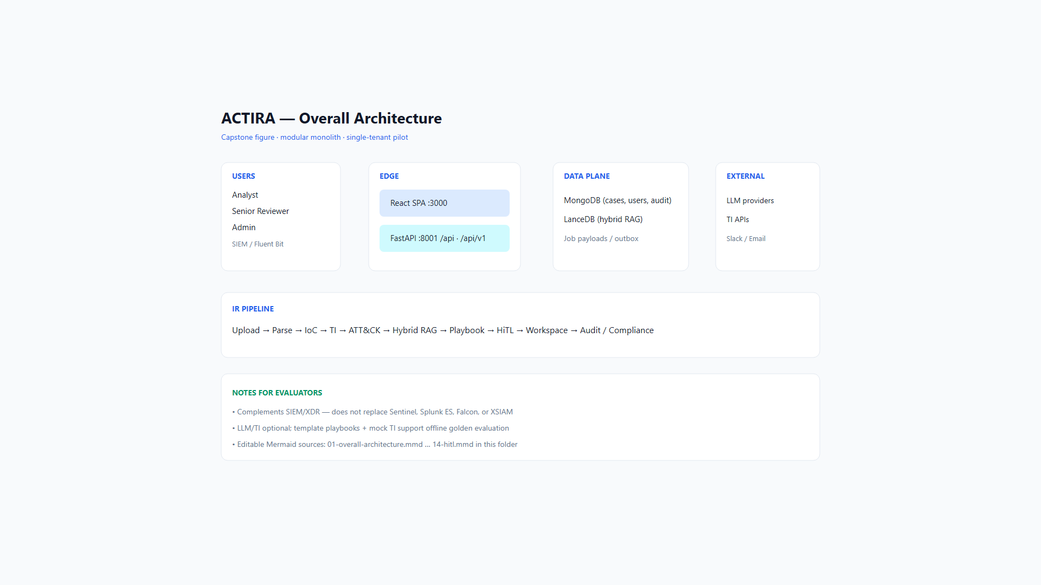
Architecture
Modular monolith · dual API · light enterprise UI
ACTIRA · Capstone Project 4 · Confidential for evaluation
5 / 20

Slide 6
Architecture layers
React · FastAPI · MongoDB · LanceDB
React SPA
SOC console · Workspace · Settings · Compliance
FastAPI (/api + /api/v1)
Auth · Jobs · Pipeline · Review · Hunt · LLM · Audit
MongoDB + LanceDB
Cases / users / audit · Hybrid BM25 + vectors (RRF)
External (optional)
LLM providers · AbuseIPDB / VT / TI · Slack
ACTIRA · Capstone Project 4 · Confidential for evaluation
6 / 20

Slide 7
AI & RAG design
Grounded playbooks with measurable offline gates
Hybrid retrieval
Citation grounding
BM25 + LanceDB dense vectors fused with RRF; optional re-rank
Playbook citation_ids ⊆ KB allow-list; grounding score 0–1
Structured JSON
Multi-provider LLM
NIST-style phases; resilient parse_llm_json for noisy LLM output
Free/paid catalog; cross-provider fallback; template last resort
HiTL gates
Honest framing
Critical severity or low grounding → pending_review
Modular agentic pipeline stages — not a full LangGraph swarm product
ACTIRA · Capstone Project 4 · Confidential for evaluation
7 / 20

Slide 8
Threat intelligence & ATT&CK
Enrichment + technique mapping
IoC & TI
MITRE ATT&CK
● Extract IP / domain / URL / hash
● Heuristic keyword / pattern mapping
● Filter private IPs from public enrich
● Technique filters on incident list
● Live: AbuseIPDB, VT, GreyNoise, …
● Dashboard heatmap of prevalence
● Mock default without keys (demo-safe)
● Timeline + RCA for kill-chain narrative
● FORCE_MOCK_TI for deterministic tests
● Not full STIX/TAXII enterprise sync
ACTIRA · Capstone Project 4 · Confidential for evaluation
8 / 20

Slide 9
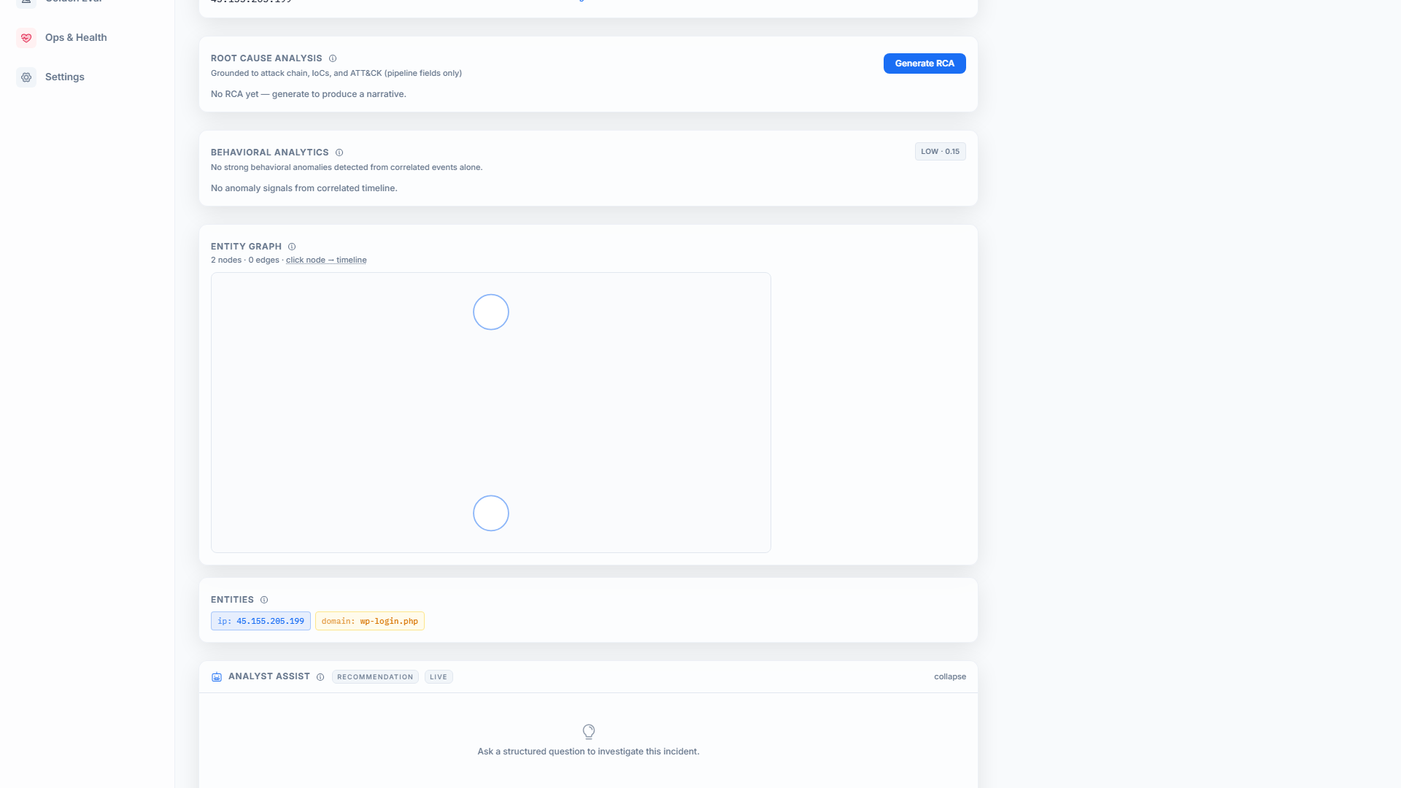
Investigation workspace
System of record for a single case
Workspace tabs
▸ Case
▸ Evidence
▸ Timeline
▸ Graph
▸ TI
▸ MITRE
▸ Notes
▸ Playbooks
▸ RCA
▸ AI
ACTIRA · Capstone Project 4 · Confidential for evaluation
9 / 20

Slide 10
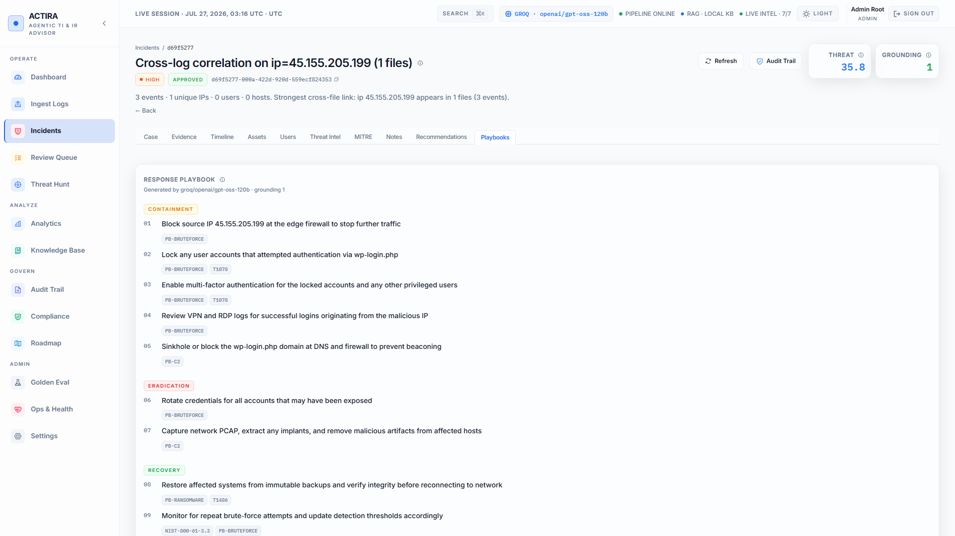
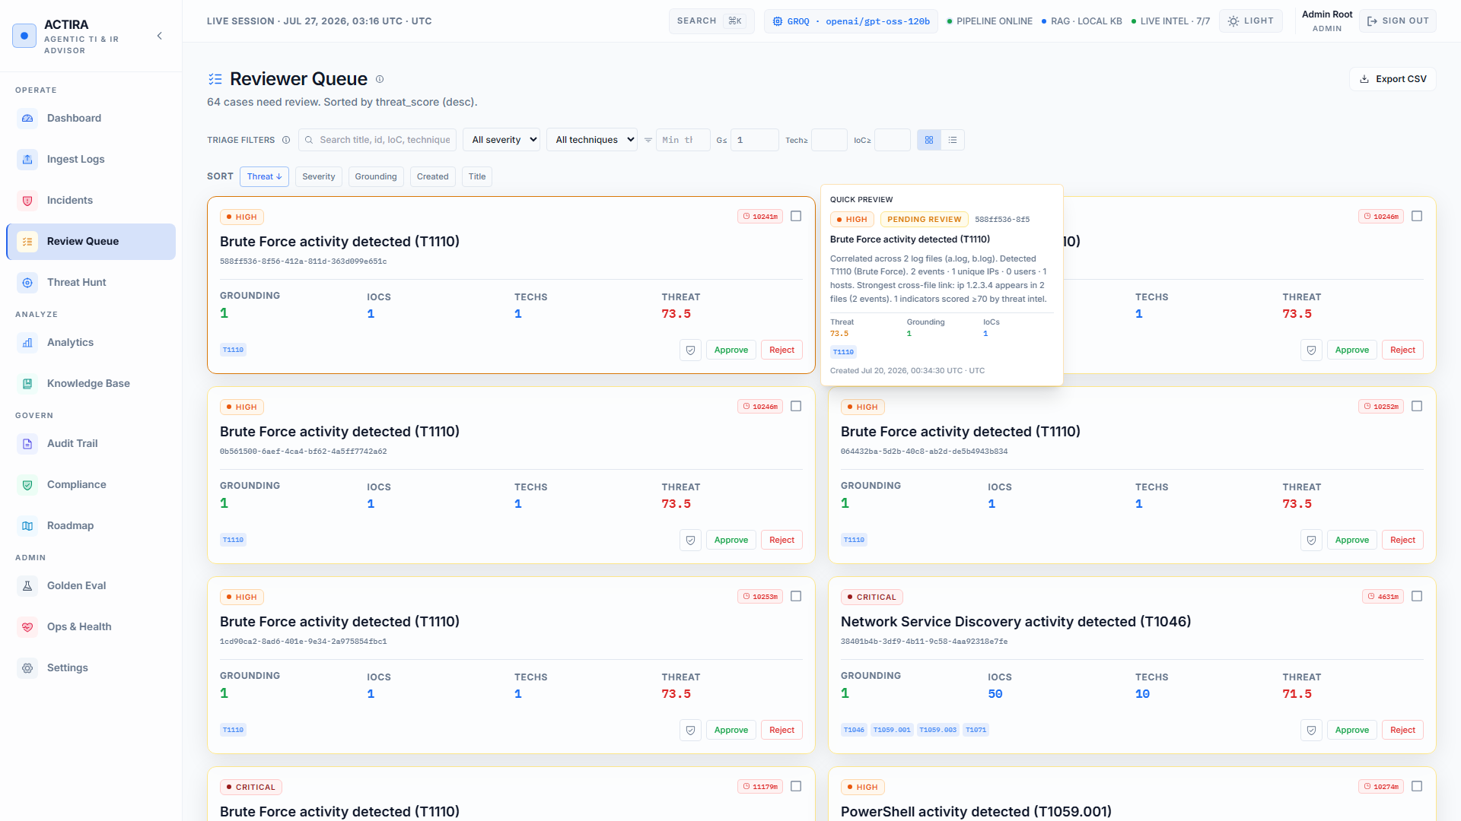
Playbook & Human-in-the-Loop
Citations, grounding, formal review
ACTIRA · Capstone Project 4 · Confidential for evaluation
10 / 20

Slide 11
Security & governance
Pilot controls with honest compliance language
RBAC
Sessions
Vault
analyst · senior_reviewer · admin matrix on mutate paths
Cookie JWT · lockout after failures · weak secret refused outside lab
API keys encrypt-at-rest; never returned raw from Settings
Audit chain
Compliance
Ingest safety
SHA-256 integrity · summary & export for executives
Alignment score + gaps + evidence — not certification
ZIP bomb limits · pipeline isolation on bad files
ACTIRA · Capstone Project 4 · Confidential for evaluation
11 / 20

Slide 12
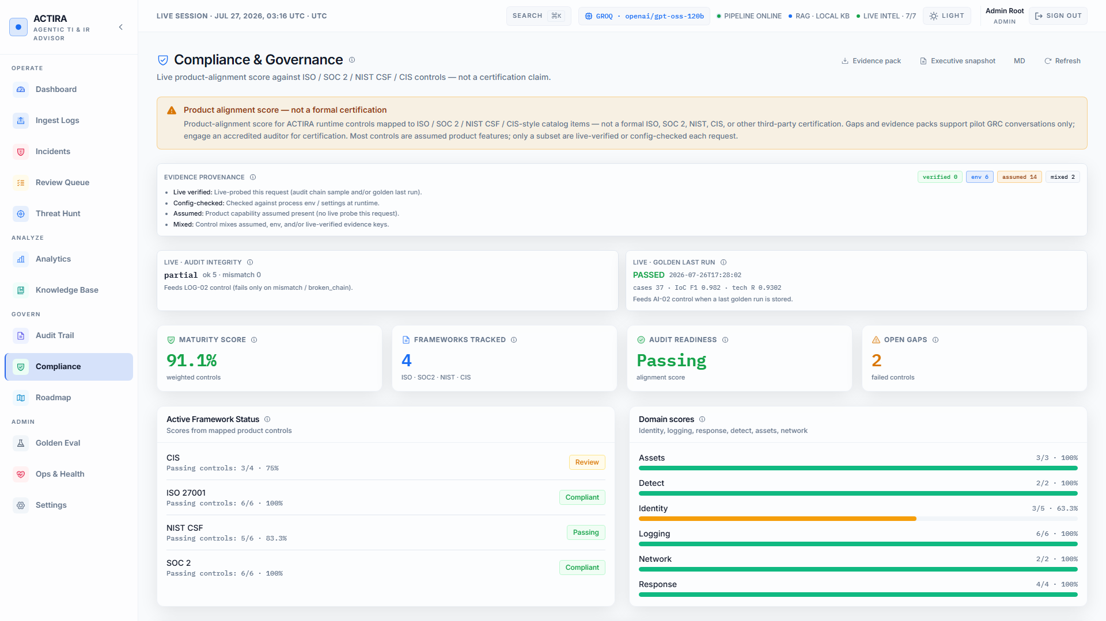
Compliance alignment
Product readiness score — not formal certification
ACTIRA · Capstone Project 4 · Confidential for evaluation
12 / 20

Slide 13
Testing & evaluation
Golden offline IR suite — 26 July 2026
Metric | Threshold | Result | Status
Golden cases | ≥ 30 | 37 | PASS
Mean IoC F1 | ≥ 0.85 | 0.982 | PASS
Mean technique recall | ≥ 0.80 | 0.930 | PASS
Mean grounding | ≥ 0.50 | 1.000 | PASS
Full phase coverage | 100% | 100% | PASS
Mean latency (offline) | ≤ 7 s | < 0.01 s | PASS
Case errors / gate failures | 0 | 0 / [] | PASS
Also: unit · RBAC · pipeline isolation · Playwright smoke · Live LLM quality not gated offline (honest limit)
ACTIRA · Capstone Project 4 · Confidential for evaluation
13 / 20

Slide 14
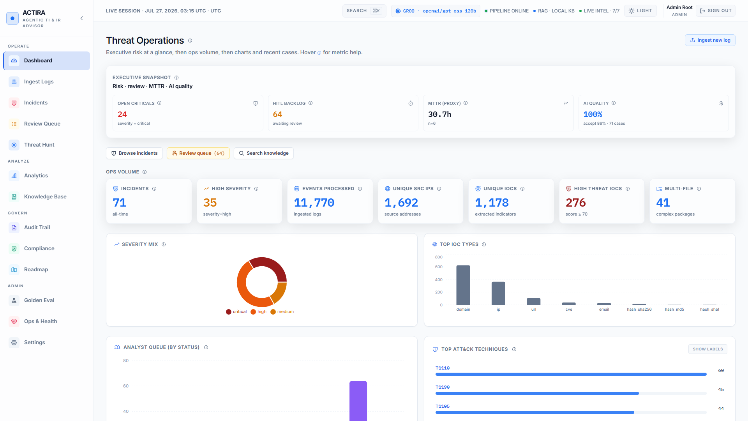
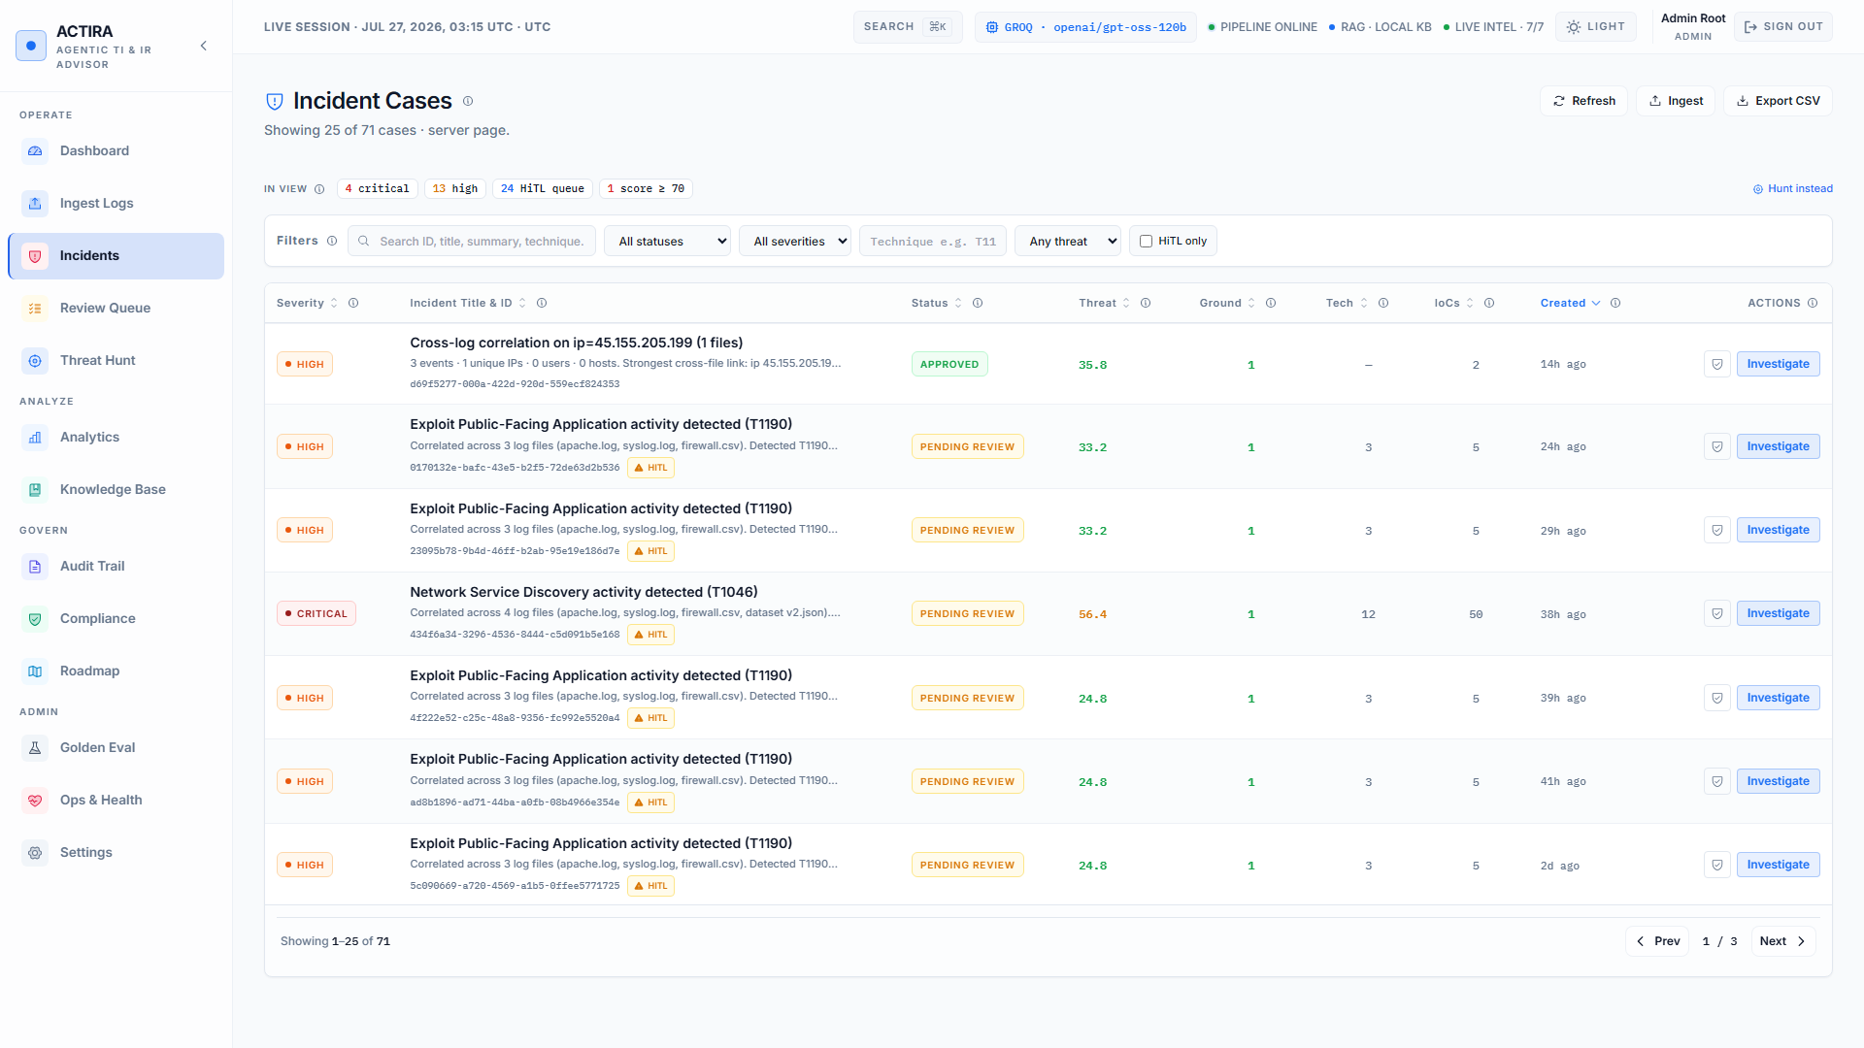
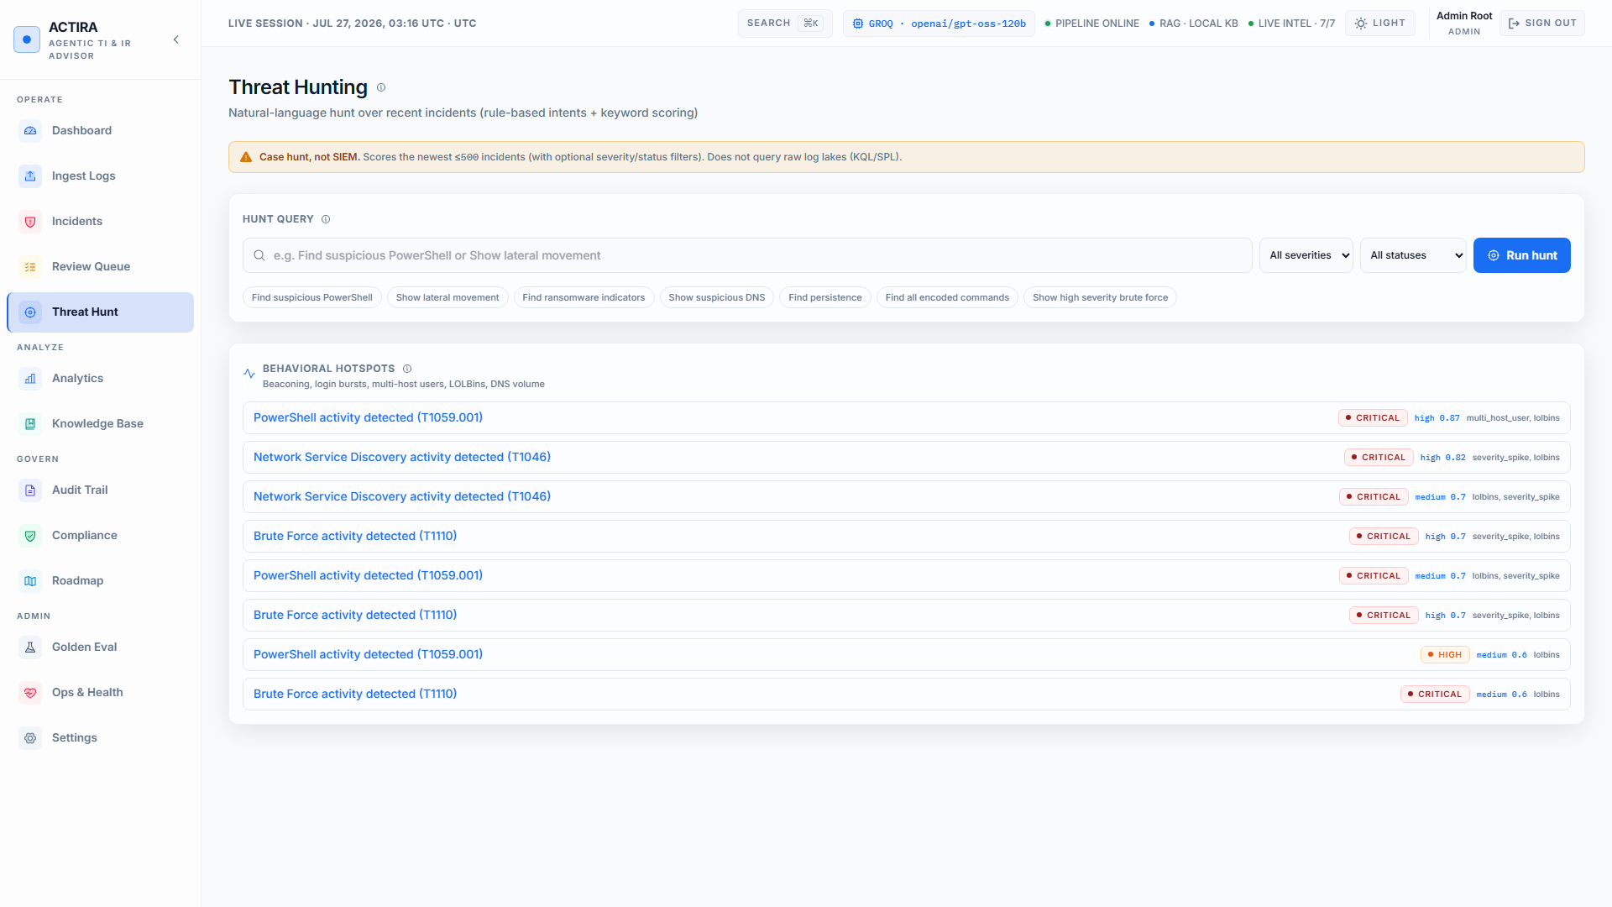
5-minute demo path
Live path — see DEMO_SCRIPT.md
1
2
3
4
5
6
7
Login
Ingest
Incident
Evidence
Playbook
HiTL
Govern
Roles
Sample logs
Workspace
Timeline
Grounding
Approve
Audit
ACTIRA · Capstone Project 4 · Confidential for evaluation
14 / 20

Slide 15
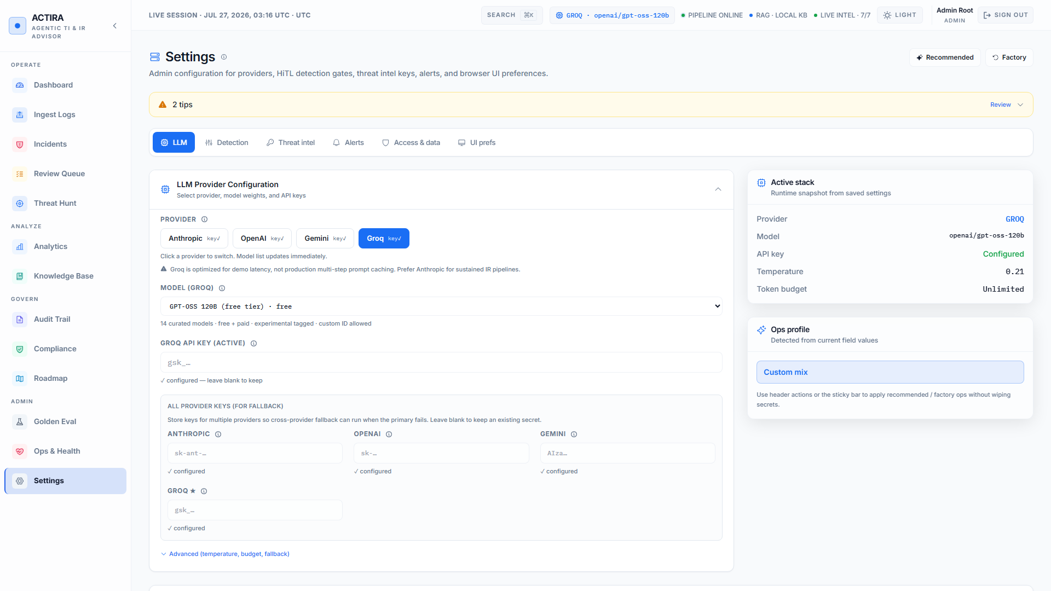
Product UI (light theme)
Dashboard KPIs · multi-provider LLM settings
ACTIRA · Capstone Project 4 · Confidential for evaluation
15 / 20

Slide 16
Results & impact
Capstone fit + pilot readiness
78
0.98
0.93
37
/100
F1
R
cases
Enterprise board score
Pilot Ready
Mean IoC F1
golden offline
Technique recall
golden offline
Golden dataset
CI gated
Impact narrative
Faster time-to-first playbook vs pure manual IR · Traceable citations · Reproducible offline eval · React workspace exceeds Gradio baseline · Wave C compliance + audit export for executives
ACTIRA · Capstone Project 4 · Confidential for evaluation
16 / 20

Slide 17
Challenges & mitigations
Mapped to Project 4 challenge list
Challenge | Mitigation
Log volume | Jobs + ZIP limits (not real-time SIEM)
Correlation accuracy | Heuristic ATT&CK + HiTL + timeline
False positives | Grounding score + review queue
TI cost / keys | Mock default + multi-vendor vault
Hallucination risk | Citations allow-list + templates
HiTL coordination | Queue · claim · audit trail
ACTIRA · Capstone Project 4 · Confidential for evaluation
17 / 20

Slide 18
Future work
From pilot to production path
Next sprint
Next release
v2.0
v3.0
▸ Demo video polish
▸ SSO JWKS hardening
▸ Multi-tenant design
▸ Gated SOAR actions
▸ Analytics error polish
▸ API rate limits
▸ SIEM connectors
▸ Forensics agent
▸ E2E expansion
▸ Connector pilots
▸ Commercial pilot
▸ RAGAS board metrics
ACTIRA · Capstone Project 4 · Confidential for evaluation
18 / 20

Slide 19
Conclusion
Project 4 objectives met — and exceeded
1. End-to-end AI IR advisor: ingest → enrich → ATT&CK → grounded playbook → HiTL → workspace
2. Exceeds Gradio baseline with React SOC UI, compliance alignment, audit integrity, golden CI
3. Strong offline metrics (IoC F1 0.98, technique recall 0.93) with honest evaluation limits
4. Enterprise Pilot Ready at 78/100 — not multi-tenant SIEM/XDR replacement
5. Ethical stance: advisory AI with human accountability for high-risk actions
ACTIRA · Capstone Project 4 · Confidential for evaluation
19 / 20

Slide 20
Thank you
Questions & discussion
Pack: docs/capstone/ · Report PDF: PROJECT_REPORT.pdf · Appendices: appendices/
PPT: presentation/ · Board: board/CAPSTONE_BOARD_REVIEW_AND_SUBMISSION.md
Screenshots: light-theme live captures (capture_screenshots.py)
ACTIRA · Capstone Project 4 · Confidential for evaluation
20 / 20

